Slide 1
GLOBAL ECONOMIC IMPACT
Impact of changes in culture, politics, cross-border trade and
Investment on United States of America.
ALETHIA SPENCER
PART 2
Notes:
Hello, welcome to my presentation. I will be presenting on impact of changes in culture, politics, cross-border trade and
Investment on United States of America.

Slide 2
Introduction and purpose.
Globalization has contributed to an increase in international trade and, therefore, more income from foreign exchange.
Economic agreements between nations have provided more opportunities for the united states as a foreign market is available for export goods and services.
This PowerPoint presentation discusses the impact of the changes in culture, and globalization on the united states economy.
The presentation will also include the country's economic conditions and how the opportunities in the world market for economic expansion.
Notes:
Globalization is the main trend in the world economy and has contributed to major global market changes. It has facilitated international trade, and therefore united states can get more income from foreign exchange. This PowerPoint presentation will explain the shifts in the global market's culture and politics and their impact on the economy of the united states. The presentation will also analyze the economic conditions and future opportunities for growth and expansion.

Slide 3
characteristics of the early economy in U.S.
Plantation farming was the main economic activity.
Slaves were the main source of labour in the plantations.
British colonizers controlled the economy, production and trade Barrett, et al (2019).
The settler economy was the major component of the early economy.
Notes:
the U.S. economy has had the highest growth rate since the pre-colonial period, from a subsistence economy to a global economic giant. Farming was the main economic activity in the early times, which was done in plantations and controlled by the British. The slaves were the main source of labour in the large plantations. The British controlled production of goods and trade outside their colonies. Settler economy dominated the economy.

Slide 4
The economy of the united states.
The economy has undergone different phases since its independence from Britain. It has continued to expand to become a leading economy.
The economy is the fastest-growing in the world, with the highest GDP of $65,112.
It is a mixed economy with different sectors that work harmoniously for the greater good of the economy (Shahbaz, M et al 2019).
The economy's main source of income is the export of goods and services from the country's industries.
Notes:
Speaker notes. The economy of the united has experienced different phases of growth since its independence from Britain in 1776. Efforts to promote economic growth faced different challenges throughout with economic depression hitting it hard also. Currently, it is the country with the biggest economy, with a GDP of $65,112. With export being the leading source of income in the united states, international trade has been the priority. Globalization has provided many opportunities for the growth and expansion of the economy.

Slide 5
Economic challenges in the united states.
High level of unemployment, especially among the youths.
Competition from fast-growing economies such as China.
Economic depression due to the Covid-19 pandemic (Steiner-Khamsi et al, 2018).
Widening gap between the rich and poor in the country.
Notes:
the U.S. is one of the leading economies in the world and has dominated the global market. However, it continues to face some challenges, just like any other growing economy. There is an increase in unemployment among the young people which lowers standards of living and consumption levels in the country. There is stiff competition from fast-growing economies which are taking over the market formerly dominated by U.S. currently there is economic depression and recession due to health crisis which has strongly hit the country. High level of unemployment which increases the gap between rich and poor.

Slide 6
Demography and the economy of the U.S.
High population growth rate in the U.S. has created local market and labour.
High population of the young provides an energetic population for labour and consumption.
The population is comprised of different cultures, race and religion, and therefore there is a wide business opportunity.
The country is densely populated, and this enables the localization of industries.
Notes:
the composition of the population in terms of age and gender is a resource to the industries in the countries. The high population provides both labour and market for the goods produced from the industries. High number of young people ensures that the population is productive. Composition of the population is different races, cultures, and this creates opportunities for the business.

Slide 7
environment and economic growth.
Industrialization may cause environmental pollution and hence climate change.
Social responsibilities are geared towards the promotion of sustainable economic growth.
Environmental degradation affects the economic development of a country.
A safe environment guarantees quality life to the citizens.
Notes:
The environment is an important aspect of development because it regulates human life. Economic growth should be sensitive to the environment as a safe environment is important as economic growth. Industries that cause pollution should be closed down or put up measures to conserve the environment. Business and other organizations are responsible for environment safety through co-corporate responsibilities. A quality life is dependent on the environment.

Slide 8
Trade and investment.
United states engage in trade with countries from all parts of the world. This provides a market for the locally produced goods increasing industrial growth.
Industrialization in the united states has increased at a high rate and hence high rates of production of different goods (Asaad, C. T. 2016).
Economic agreements have been signed between the united states and other developing, providing opportunities for investment and trade to the united states.
Trade and investment opportunities worldwide have accelerated the economic growth of the united states by broadening their sources of income.
Notes:
Trade activities to the United States have increased due to the trade agreement between the US and other developing companies, which guarantee the US as the priority exporter to these countries in exchange for investment in those countries. It is, therefore, a win for the economy from both ends. Export of goods and promotes industrialization as more products will be demanded in the market; hence economic development takes place in the source country.

Slide 9
impact of cultural practices to the economy.
Cultural values influence consumption and investment decisions.
Religious teachings prohibit the consumption of some types of food or animals affecting the economy.
Division of labour and gender roles inhibits the economic empowerment of women Asaad, (2016).
Some cultural practices and beliefs influence economic preferences.
Notes:
: culture and economy are two issues that go hand in hand influencing each other. The united culture has enjoyed a culture that is positive to the economy hence high growth rate. There are cultural values that define do's and don'ts, even in economic activities such as consumption and investment choices. Some religious teachings or principles are against the consumption of some goods and therefore influences the economy. Division of labour and some gender beliefs are influencing economic choices for women.

Slide 10
World politics impact on the economy.
The United States is a powerful nation that shapes political opinion on international issues and has used the position to place itself for economic development strategically.
Peace and security in the world promote trade and investment, as there is the confidence to invest when investors are guaranteed safety and security in the regions (Steiner-Khamsi, G et al 2018).
International relations between countries changes over time and may either positively or negatively affect their economic co-operation and hence economic growth.
International organizations of trade formulate policies that encourage and facilitate trade between countries from different parts of the world.
Notes:
Speaker notes. The United States-based on its economic power and therefore uses its political ability to influence the global market and economy for the benefit of its economy. Because each country prefers a trade agreement with a powerful nation, the US is the best choice for developing countries. International peace and security provide an easy opportunity for participating in investment and trade in different parts of the world. Terrorism disrupts trade and investment; hence it's a global threat. The economic partnership is based on the bilateral relations between nations, and any shift in the right or wrong direction has a great impact on the economy.

Slide 11
Impact of technology on the economy of the united states.
Trade has been promoted through online platforms that are used for e-commerce purposes. This has provided opportunities for more income and economic growth.
The United States has exported innovation and inventions in technology, which has been exported to other countries and became another source of income.
Technological innovations have promoted industrialization in the United States by introducing modern methods of production, which are effective and more efficient.
The United States has applied technology in different sectors of the economy, which has boosted its performance.
Notes:
Technology has been an important part of the economy to boost its performance and income generated from the sectors. Different inventions made in the US have been imported to other countries, becoming a source of revenue. Digital business in foreign exchange and other startups has been facilitated for expansion and establishment, which has greatly boosted the economy. Modern forms of production have been incorporated in industries making production efficient.

Slide 12
Government’s policies and impact on the economy.
The government has invested in small and medium enterprises by funding startups with grants and loans; they create employment and are sources of revenue for the state.
The government has created policies that create an enabling environment for business and entrepreneurship to thrive.
The government facilitates the establishment of industries by providing incentives and subsidies to new industries.
The government participates in negotiations for foreign investment and trade on behalf of citizens.
Notes:
Every government of the country since its independence has made efforts to facilitate economic development. Therefore, the policies established are aimed at creating an enabling environment for business and investments to thrive. Grants have been availed for startups and small enterprises to facilitate their operations. The government also initiates and negotiates trade pact with other countries on behalf of private investors.

Slide 13
Global trading agreements.
The U.S. has entered into a various regional and global trading and investments agreements.
Private investors are negotiated through such trade agreements.
Trading agreements promote free trade and the movement of labour (Yan, 2019).
Regional trade agreements promote co-operation between countries.
Notes:
trade agreements between are key components towards trade and globalization. They are either signed regionally between neighbours or globally by countries in other countries. They provide for foreign and local investments by private partnerships. With regional trade, there is a co-operation between nations, even in matters non-economic.

Slide 14
impact of economic growth in U.S.
Improves the living standards of the citizens.
The government can provide basic and other essential services to the citizens.
High economic growth rate increases foreign investment.
Some causes climate change due to a high level of population.
Notes:
the United enjoys one of the fastest-growing economies in the world, and this benefits even the common American in various ways. The living standards of the citizens have improved as income per capita is high. Due to high GDP, the government can provide access to basic and other essential services to citizens. Fast-growing economy attracts foreign investment creating employment opportunities. Other forms of economic growth cause pollution to the environment and hence climate change.

Slide 15
future of the U.S. economy 20th Century and beyond.
Penetration and globalization take over.
Promotion of environmentally sustainable economic growth.
Expansion of the services sector in the country.
Technical export.
Notes:
the economy of the united states at the current growth rate is expected to have undergone a lot of changes. With an increase in globalization, the economy is expected to take another direction in foreign investments and exchange of economic ideas. The economy is also expected to make a policy framework to ensure economic growth is sustainable by the environment to prevent climate change. The services sector is also expected to improve and expand. Technology and skills development in the country will promote the export of technical skills.

Slide 16
Global political development and effects on the economy.
The U.S. only trades with countries allied to its capitalism economic model.
Politics have threatened trade agreements and treaties among multilateral countries.
Former trading partners of the U.S. have turned to Asian countries due to better trading deals (Shahbaz et al, 2019).
African countries and the middle east have accused the U.S. of interfering with their internal matters in the name of trade.
Notes:
the political mood in the globe dictates economic growth of all countries, not just U.S. foreign trade is dictated by the common political and social ideals shared by two nations. Agreements that promoted trade have been threatened by col political climates between china and U.S. a large number of trading partners shift their allegiance to Asia and hence affect the economy of America. Some countries in Africa have stopped trading with U.s due to its interference with local affairs in the name of trade.

Slide 17
social impact of globalization.
Exchange of cultures between citizens of different nations.
The flow of ideas promotes entrepreneurial activities.
Globalization may promote the acquisition of negative cultures.
Globalization promotes cohesiveness between individuals of different cultures and race.
Notes:
globalization has both positive and negative impact, and therefore decided to apply it should be made considering its impacts. Cultures exchange between different nations where some are assimilated into the majority cultures. Ideas for entrepreneurial activities may be exchanged and therefore escalate investment opportunities. Some negative cultures may be acquired, and therefore it should be regulated.

Slide 18
Advantages and opportunities for the economy of the United States.
Globalization has enabled the country to penetrate and transfer investment into different countries in the world.
With modern technology, the united states can export such technologies to other parts of the world and earn foreign revenue.
The United States high skilled population provides labor supply to the industries in producing goods for exports.
Barrett, C. B et al 2019 argues that economic growth and expansion create employment for citizens in the US.
Notes:
Globalization has eased movements of goods and services across different countries in the world. Therefore the US has an opportunity to trade with more nations and promote investment. The country is a hub for technological innovation, which can be exported to different countries and get revenue. The population of the US gets employment the economic growth in the country.

Slide 19
Advantages and opportunities for the economy of the United States contd.
Economic development reduces government borrowing.
It promotes expenditure on the provision of basic services to the citizens.
Unemployment levels are low and, therefore, high standards of living in the US.
Economic growth increases consumption in the country, and therefore there is economic balance.
Notes:
The United States stands to benefit, especially from the opportunities available in the world market. More taxes are raised and paid to the government from the increased business activities, and therefore, the government has enough to fund the country's expenditure plans. It also facilitates the provision of basic services to the citizens. It improves citizens' living standards and, therefore, high consumption in the country, fighting poverty levels.

Slide 20
conclusion.
Shifts in the culture, politics, and international trade provides opportunities for countries to expand their economy.
Governments should establish policies and measures that encourage investment and entrepreneurship in the country to facilitate economic growth.
Policies formulated by governments should create an enabling environment for local and foreign investment.
According to Yan, J. (2019) technology should be embraced as it can be used to create efficient trading activities that earn foreign exchange.
Notes:
The economic development of a nation depends on the country's cultural and political situations and globally. The government has a critical role in promoting economic growth by creating an enabling environment for investment. Technology is important for globalization to be efficient in improving the economy of a country.

Slide 21
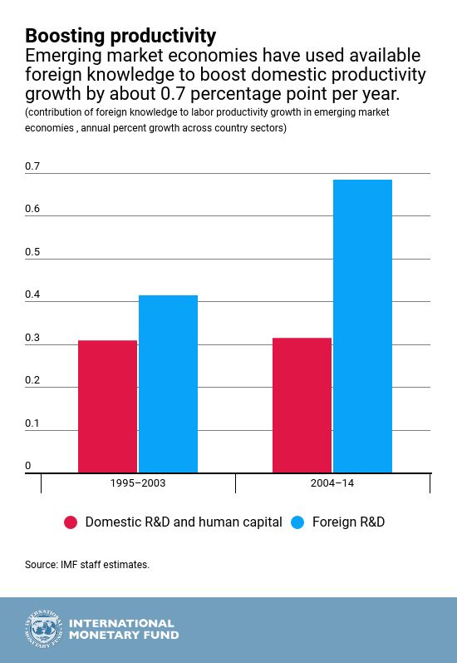
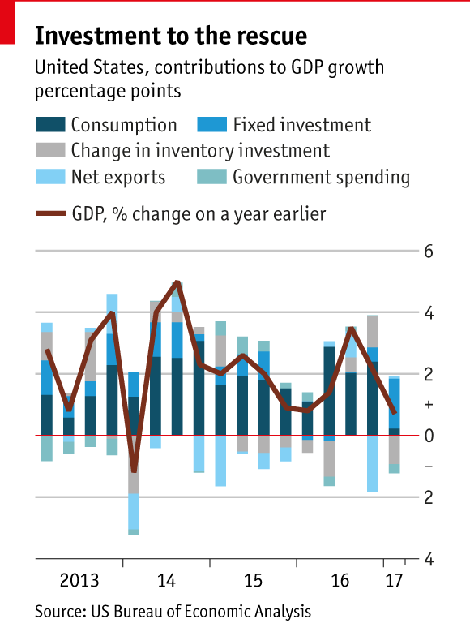
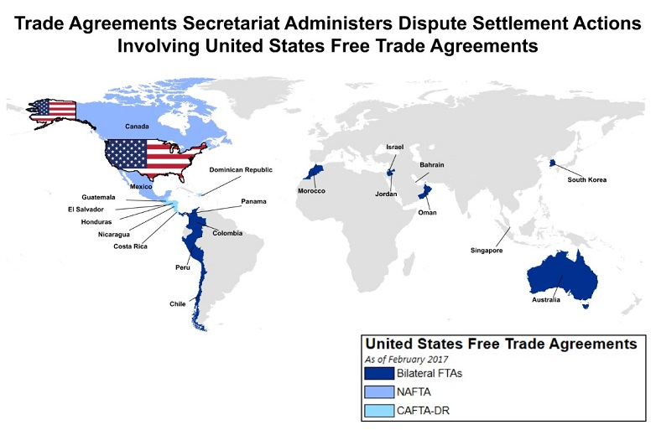
Visuals.

Slide 22
REFERENCES.
Asaad, C. T. (2016). Educational entertainment: Integrating business ethics with out-of-the-classroom financial documentaries. Journal of Financial Education, 42(1-2), 56-80.
Barrett, C. B., Carter, M., Chavas, J. P., & Carter, M. R. (Eds.). (2019). The economics of poverty traps. University of Chicago Press.
https://data.worldbank.org/indicator/NY.GDP.MKTP.CD?locations=US
Shahbaz, M., Ahmed, K., Tiwari, A. K., & Jiao, Z. (2019). Resource curse hypothesis and role of oil prices in USA. Resources Policy, 64, 101514.
Steiner-Khamsi, G., Appleton, M., & Vellani, S. (2018). Understanding business interests in international large-scale student assessments: a media analysis of The Economist, Financial Times, and Wall Street Journal. Oxford Review of Education, 44(2), 190-203.
Yan, J. (2019). Globalization Has Double Sides on Developing Countries: The Benefits and the Harm. Journal of Business and Economic Development, 4(1), 11-14.
https://blogs.imf.org/wp-content/uploads/2018/04/eng-april-3-weoch4-2-4.jpg
Notes:
Thank you.

