Slide 1
GENETICALLY MODIFIED ANIMALS
Source of Food

Slide 2
WHAT ARE GMO ANIMALS?
A genetically modified animal can be defined as an animal whose genetic composition has been altered
The alteration can be in the form of addition, changing, or removal of certain DNA Sequences from the animal
The process is undertaken by introduction of new trait in the animal such as resistance to disease
Notes:
Genetically modified animals tend to be more production compared to other animals. People are now turning to these animals because of the high level of production. Unlike the normal animals, these ones tend to increase their production depending on what they are given to consumer. Cows are a common example of animals that have been modified in the recent past to meet the needs of the owners.

Slide 3
BACKGROUND OF GMO ANIMAL FOR FOOD
Commercial sale of GMO animals food dates began in 2015
The AquAdvantage salmon became the first animal to be approved for commercial purposes as GMO animal
During that period only plants were being sold as GMO foods and not plants
The Food and Drugs Administration has continued to accept more animals for food production process
Notes:
Plants are more popular in the production of GMO Food compared to animals. GMO animals have only gained popularity in the 2015 after Salmon became the first animal to be approved for the same

Slide 4
EXAMPLES OF ANIMALS THAT HAVE BEEN SUCCESSFULLY MODIFIED
                Not all animals have been genetically modified to produce more food. The common examples of GMO animals are
                Pigs
                Salmon
                Chicken
                Cattle
Notes:
Researchers from all the world have embarked on the modification of animals to ensure that there is an increase in the level of production. The modified animals tend to produce more meat, milk and other components. The modification takes different forms depending on the methods used along the way.

Slide 5
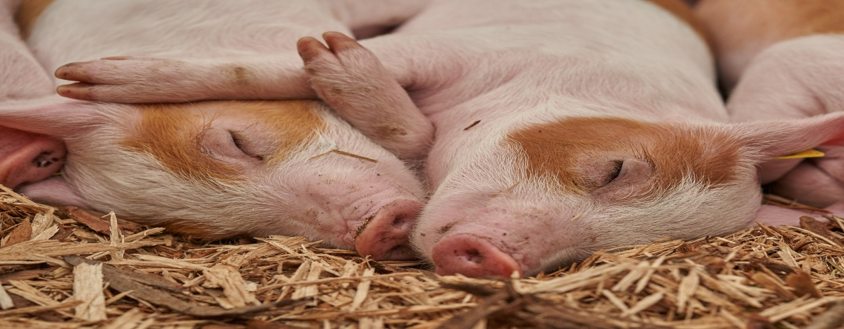
GMO PIGS FOR FOOD
GMO Pigs are preferred for pork
These pigs feed on different items including leftovers
Their level of consumption is quite high compared to the normal pigs
They also produce large quantities of pork
Notes:
Genetically Modified Pork is considered as a solution to the problems of food shortage in the world. These pigs will transform the lives of people by providing them with food. It is also worth noting that these pigs can be raised under different conditions.

Slide 6
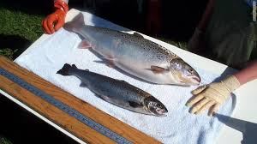
GMO SALMON FOR FOOD
Salmon is nutritious and delicious
Salmon was the first animal to be confirmed as edible after genetic modification
Salmon are sold all the world in the genetic form
GMO Salmons, however, have raised concerns in the health sector over their composition
Notes:
Salmon is among the common GMO foods on the market. The popularity of the sale of Salmon has become high because of the large production on the market. Restaraunts are among the leading buyers of Salmon on the market.

Slide 7
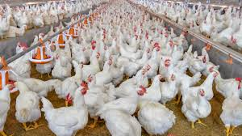
GMO CHICKEN FOR FOOD
GMO chickens are now readily available on the market
The chicken are consumed in different parts of the world
GMO chicken tend to mature fast compared to the normal chicken
The chicken also lay eggs faster compared to the normal ones on the market
The chicken can also feed on GMO feed depending on the preference of the owners of the same
Notes:
GMO chicken have grown in popularity. These chicken are used in different parts of the world. The chicken are common in the hospitality industry where they are sold in hotels and restaraunts

Slide 8
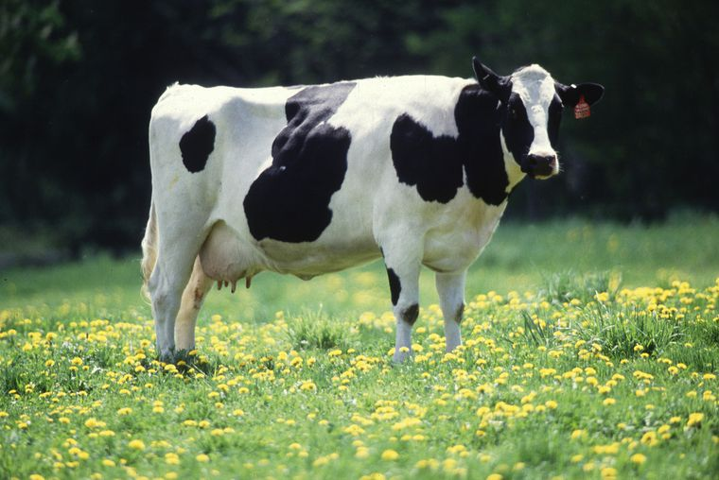
GMO CATTLES FOR FOOD
Technology has contributed to the livestock sector in different ways
GMO cattle have become the next big thing in the industry
The cattle are sold for commercial purpose
Most of the people prefer these cattle because of their size
The cows also thrive in different areas because they are resistant to different forms of diseases

Slide 9
BENEFITS OF ANIMAL GMOS
Production of pharmaceuticals that can be used for other animals and humans.
Improve dietary nutrient utilization hence saving on wastage of resources
Increased resistance to diseases
Production of high value materials
Effective in the production of food and other things
Notes:
Genetically modified animals stand out from the normal animals because of their unique composition. These animals tend to produce more food compared to the normal animals. They also utilize energy in a better way as compared to the other animals out there hence they are preferred in most cases.

Slide 10
WHY GMO ANIMALS ARE POPULAR
They produce more food compared to normal animals
They can be reared under different climatic conditions
They are highly resistance to diseases
They conserve resources such that they do not waste food and other items within their reach

Slide 11
RISKS OF GMO ANIMALS FOR FOODS
Genetic contamination
Competition with natural species can lead to decline in their number
Increase pressure on the target organisms
Impossibility of follow-up hence increases chances of distinction of the animals
Loss of management control measures within the environment
Notes:
Once a GMO Animal has been introduced into the planet then problems start to arise from one side to another. The increase in the pressure on the natural animals is among the first effect witnessed when a GMO is introduced into the equation. It is also worth noting that competition with other species also becomes rife along the way. There is also increase on the pressure on the target animals at the end of the day.

Slide 12
HOW GMO AFFECTS ANIMALS
The firm intends to introduce competitive prices
The price will reflect that one of other products on the market
We intend to sell the product from as low as $ 25
The product will be sold in Brampton.
We target both men and women
The population can comprise of students and employed persons (IBIS World, 2019)
Notes:
We will interview different groups to get their opinions on the product before it is launched to the market.

Slide 13
IS MODIFICATION DETECTABLE IN THE PRODUCTS OF THE ANIMALS
GMO products are different from the natural ones
For instance, meat and eggs from GMO is not the same as that from the natural animals
The differences can be in terms of taste and size
However, both products from the normal and GMOs can be digested in a favorable manner within the body
Notes:
The Genetically engineered components cannot be detected in meat and milk. The contents can be digested into the body in a normal way as the others.. Feeds can also be GMO modified and they do not have an impact on the end products from the process

Slide 14
REFERENCE
Lievens, A., Petrillo, M., Querci, M., & Patak, A. (2015). Genetically modified animals: Options and issues for traceability and enforcement. Trends in Food Science & Technology Volume 44, Issue 2 , Pgs 159–176.
Maghari, B. M., & Ardekani, A. M. (2011). Genetically Modified Foods and Social Concerns. Avicenna Journal of Medical Biotechnology 3(3) , 109–117.
Ormandy, E. H., Dale, J., & Griffin, G. (2011). Genetic engineering of animals: Ethical issues, including welfare concerns. Can Vet J. 52(5) , 544–550.

