Slide 1
Introduction to Global Business
Chapter 5
The Cultural Environment

Slide 2
After studying this chapter, you should be able to:
Define culture and identify the four characteristics of culture that companies doing business abroad need to recognize.
Name several elements of culture.
Name and distinguish among the cultural dimensions proposed by Hofstede and Trompenaars.
Identify the primary and secondary sources that can be used to learn about foreign countries’ cultures.

Slide 3
After studying this chapter, you should be able to:
Describe the cultural aspects of doing business in various countries, including East Asian countries, Arab countries, and Latin America.
Explain why culture is important in global management and marketing.

Slide 4
Defining Culture and Its Characteristics
Culture is learned behavior; a way of life for one group of people living in a single, related, and independent community
Characteristics of culture
  Culture is not inherited.
  It is nearly impossible to change an entire country’s culture.
  A global firm must ascertain the level of importance of various aspects of culture in the foreign markets it serves and recognize these aspects when doing business overseas.
  Companies’ operations need to recognize and adjust to the cultural environment in the countries the global company serves.

Slide 5
Elements of Culture: Language
Verbal communication
  A message’s actual contents intended to be conveyed to the receiver (i.e., what the message says)
Nonverbal communication
  Tone of voice, gestures, eye contact, body positions, facial grimaces, and other body language that accompanies verbal communication
Backward translation
  Translating a message from English into a foreign language, then translating it back into English to check for accuracy

Slide 6
EXHIBIT 5.1 THE IMPORTANCE OF LANGUAGE IN FOREIGN COUNTRIES’ CULTURES
“Chuck” had been sent by the president of Parker Pen Company to visit the firm’s trading company in Buenos Aires, Argentina. This was the first time he had been outside the United States, and he did not know how to speak Spanish. Upon arriving after a 14-hour flight from Chicago, Chuck went to a bank of telephones to call the trading company and arrange for transportation. Because he could not read the instructions for use, he prevailed upon a good-natured passerby for help. Then, he had to figure out the Argentinean money system to decide which coins to insert. While talking with the trading company, he was asked to take a taxi to the office as they were tied up with important customers. Upon finding the taxi pickup area, Chuck was dismayed to find that all of the licensed taxi drivers were on strike; he was hoping that the “regular” drivers would know enough English to compensate for his lack of Spanish skills. After an extended length of time, he was able to convey to the driver where he needed to go. After an hour of working with the people at the trading company, he was invited to accompany them to lunch. Because the menu was in Spanish, he was in a quandary about what to order. He thought that the word “bistec” might mean beef steak, so he ordered it. He was right. The waiter proudly presented Chuck with a two-pound steak. Chuck found out later that Argentina is justifiably proud of its world famous, Pampas beef cattle. Chuck and his colleagues worked another four hours at the headquarters of the trading company. About six o’clock, he was invited to accompany a group of customers to dinner. Although it was a different restaurant, it was the same problem: The entire menu was in Spanish. Fortunately, or unfortunately, there was one item that Chuck could read: “bistec.” Chuck ate his second 32 ounces of prized Argentinean steak. Around eleven o’clock, Chuck had returned to his hotel where he was greeted in the lobby by Parker Pen’s president who said: “Chuck, I just arrived. The food on the flight was terrible. Let’s go get something to eat.” Chuck ate his third two-pound steak with his boss.

Slide 7
Elements of Culture:
Religion, Values, and Attitudes
Religion’s effects
  Business operations
  Manufacturing and marketing of products
  Observance of holidays
  Working days and working hours
Values
  Basic beliefs or philosophies that are pervasive in a society
Attitudes
  Feelings or opinions

Slide 8
Elements of Culture: Manners and Customs,
Material Elements, and Aesthetics
Manners and customs
  The usual way a society does things
Material culture
  A direct result of technology; best demonstrated by economic, social, financial, and marketing infrastructures of a society
Aesthetics
  Color, form, and music are the major components of aesthetics─what is perceived as taste and beauty by a society.

Slide 9
Elements of Culture: Education
The level of education of people in foreign countries is a major factor in explaining economic growth.
Level of education must be such that host-country personnel can work or be trained for a variety of jobs.
Some countries emphasize different educational specialties:
  South Korea and Japan stress education in sciences and engineering.
  Russia is strong in mathematics and computer programming.
  India emphasizes engineering and software development.
Some countries have tiered system of higher education with prestigious colleges and universities.

Slide 10
Elements of Culture: Social Institutions
Social institutions
  The way people in a society relate to one another within group settings
Reference groups
  Groups that are important to individuals
Social stratification
  The extent to which groups at the top of the social pyramid exert control over others at lower levels of the pyramid

Slide 11
Clustering Countries and Regions by Culture
Hofstede
Trompenaars
individualism vs. collectivism
universalism vs. particularism
power distance
neutral vs. emotional
masculine vs. feminine
specific vs. diffuse
uncertainty avoidance
achievement vs. ascription
time orientation

Slide 12
EXHIBIT 5.2 GLOBE CONSTRUCTS AND CORRESPONDING QUESTIONNAIRE ITEMS

Slide 13
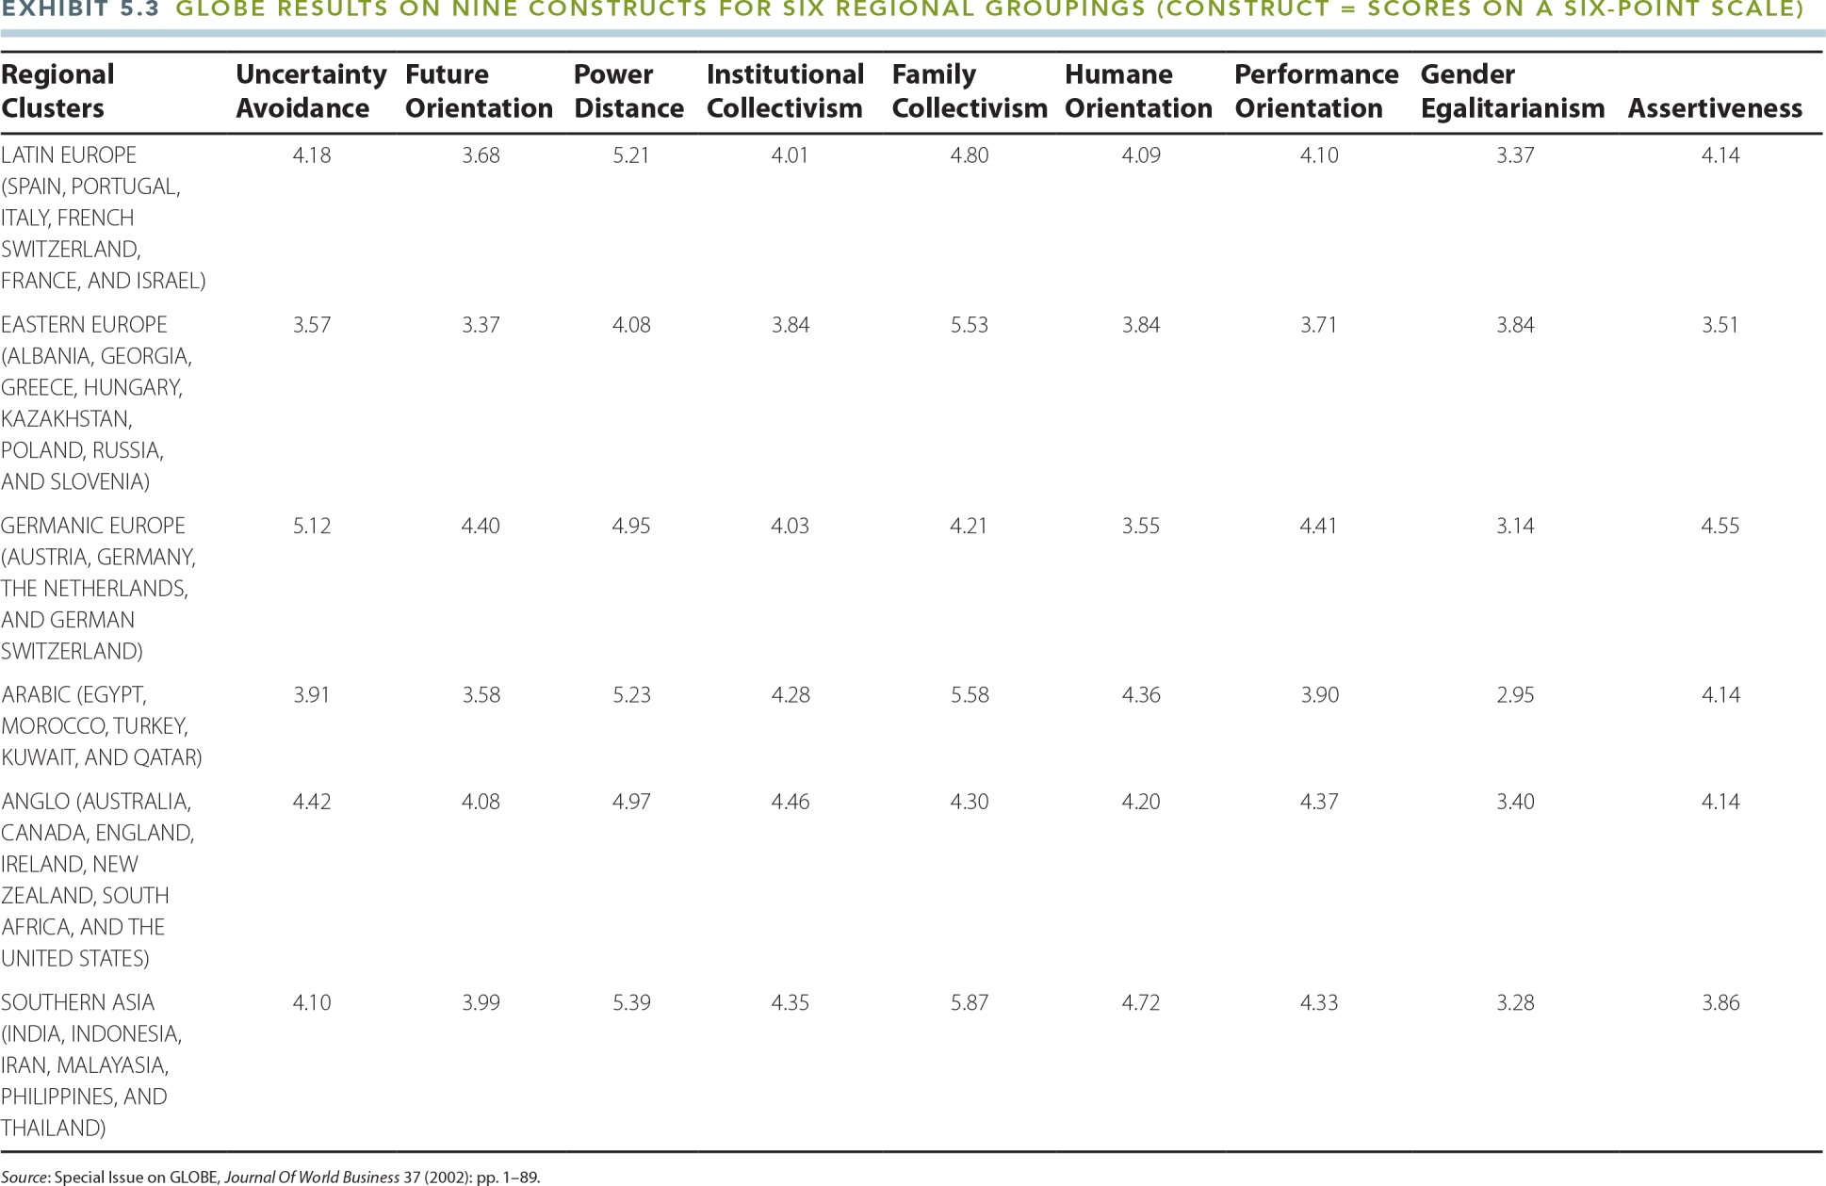
EXHIBIT 5.3 GLOBE RESULTS ON NINE CONSTRUCTS FOR SIX REGIONAL GROUPINGS

Slide 14
Gannon’s Cultural Metaphors
Gauge a specific culture by using an image (“metaphor”) that depicts how people in a specific culture think and behave:
  French wine—Purity; classification; composition; compatibility; maturation
  German symphony—Orchestra; conductors; performance; society; education and politics
  British house—Laying the foundation; building the brick house; living in the brick house

Slide 15
Sources of Cultural Information
The U.S. Department of Commerce Country Commercial Guide provides cultural information for 133 countries.
The Economist’s Intelligence Unit contains the same type of information on 180 countries in its Country Reports.
Culture Grams, from Brigham Young University’s Center for International and Area Studies, describes customs existing in 174 countries.
Craigshead’s International Business, Travel, and Relocation Guide to 84 Countries gives cultural information for these nations.
Price Waterhouse Coopers Doing Business in 118 Countries contains information about 118 countries.

Slide 16
Cultural Dimensions of Doing Business in Japan
Upon meeting a Japanese executive, a slight bow and handshake are appropriate.
Business card etiquette is important.
  Information should be in English on one side of the card.
  The other side should have the same information in Japanese.
It is not appropriate to look directly into the eyes of your Japanese hosts.
It is important for your Japanese hosts to know your title and rank.

Slide 17
Cultural Dimensions of Doing Business in Japan (continued)
Japanese business has a group orientation, rather than an individualistic one.
Japanese executives expect foreign business representatives to arrive prepared and to have decision-making authority.
New potential business partners must have been referred to Japanese business representatives through a third party.

Slide 18
Cultural Dimensions of Doing Business in Korea
Elders are respected for their knowledge and wisdom.
“Yangban” refers to the noble class’s culture of honor, reputation, and dignity (similar to the concept of gravitas in Western cultures).
“Inwa” involves harmony among unequals: loyalty is owed to parents and authority figures, yet superiors are responsible for the well-being of their subordinates.
A personal relationship needs to occur before business matters can be discussed with foreigners.

Slide 19
Cultural Dimensions of Doing Business in China
Guanxi
  A philosophy denoting friendships among unequals (as between subordinates and superiors) and the unlimited exchanges of favors; it is utilitarian and not based on sentiment, emotions, or a group orientation
  Exchanges are often uneven, an advantage for weaker member in the guanxi relationship.
  Persons of low rank may be powerful and influential due to guanxi relationships with superiors.
  Foreigners who want to conduct business in China may need to seek out lower-level persons and obtain their favor in order to gain access to more powerful superiors who are decision makers.

Slide 20
Cultural Dimensions of Doing Business in Arab Countries
Avoid sitting so that the sole of one’s shoe is shown.
The left hand is viewed as “unclean.”
Good posture is imperative.
Foreign business representatives should not inquire about the wives of Arab business representatives.
Do not overly praise the possessions of Arab hosts, as this could create a perception that you expect your hosts to give them to you.

Slide 21
Cultural Dimensions of Doing Business in Arab Countries (continued)
Arab business representatives will probably be reluctant to do business with women.
If a woman is accepted, modest dress is appropriate.
Arab business representatives may frequently divert from the topic initially discussed, then return to it.

Slide 22
Cultural Dimensions of Doing Business in Latin America
Potential customers will want to develop a personal relationship before doing business with foreign executives.
Latin Americans are more flexible about time than are North Americans.
Latin Americans are not as immersed in their work as the business people in the United States.

Slide 23
The Importance of Culture for Managing and Marketing in Overseas Markets
A country’s culture affects its attitudes toward work.
Management styles can give rise to challenges or lead to success.
When developing new products, management styles must be considered along with many other aspects of marketing.
Advertising campaigns must be carefully tailored to local cultures.
Culture has an impact on communication styles.

Slide 24
EXHIBIT 5.4 U.S.-BASED BUSINESS JARGON THAT WOULD NOT BE UNDERSTOOD BY FOREIGN BUSINESS REPRESENTATIVES
“Flying by the seat of my pants.”
“On the same wave length.”
“Shotgun approach.”
“Run it up the flag pole.”
“100 k.”
“Belly up.”
“Overview.”
“If it ain’t broke, don’t fix it.”
“Let’s throw it on the wall and see if it sticks.”
“Let’s see how it plays out.”
“It ain’t over until the fat lady sings.”
“Reinvent the wheel.”

Slide 25
Key Terms
culture
acculturation
verbal communication
nonverbal communication
backward translation
values
attitudes
manners and customs
material culture
aesthetics
social institutions
reference groups
social stratification
individualism vs. collectivism
power distance
masculine vs. feminine
uncertainty avoidance
time orientation
universalism vs. particularism
neutral vs. emotional
specific vs. diffuse
achievement vs. ascription
inwa
guanxi

