Slide 1

Stadium Promotions
By: Avondre Murphy & Taylor Masse

Slide 2
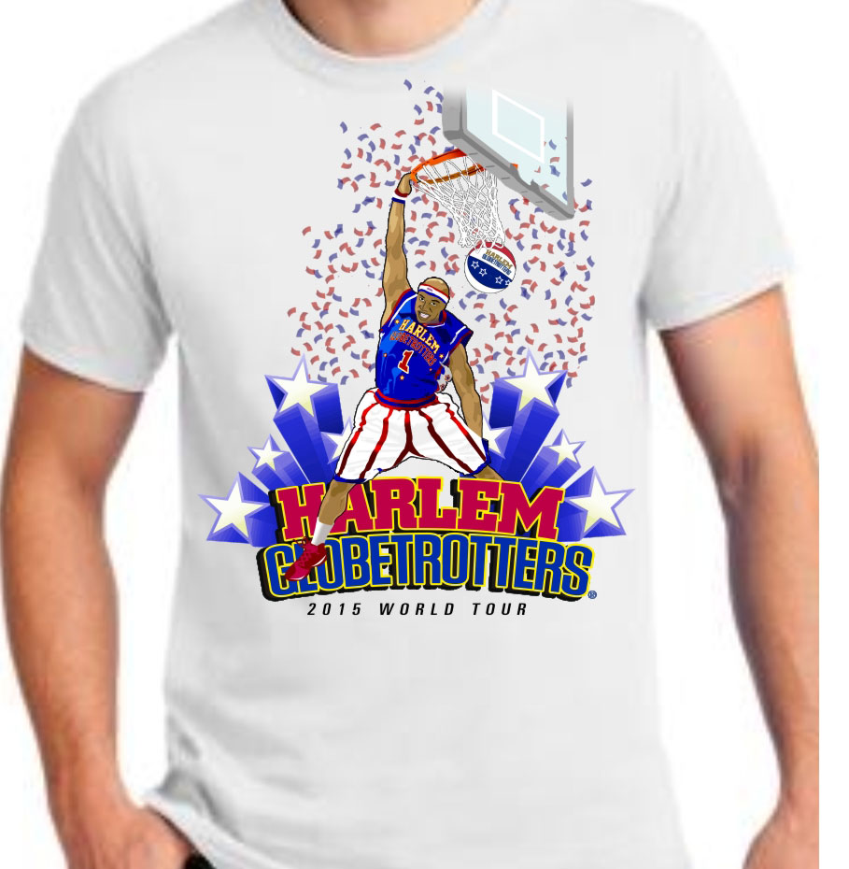
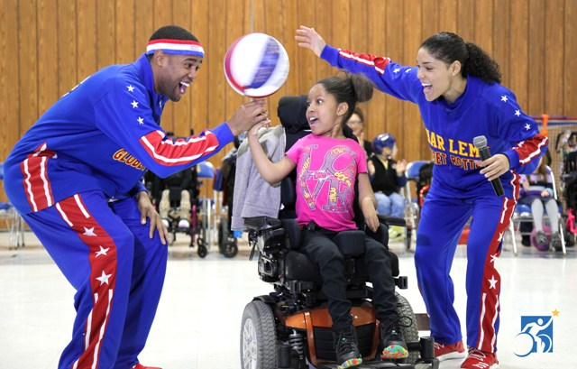
Elementary School
Upper Bowl End Seating - $15.00 ( $4 off of classes with 15 or more kids)
Free t-shirt and raffle ticket to have a Globetrotter come to their school and speak to them

Slide 3
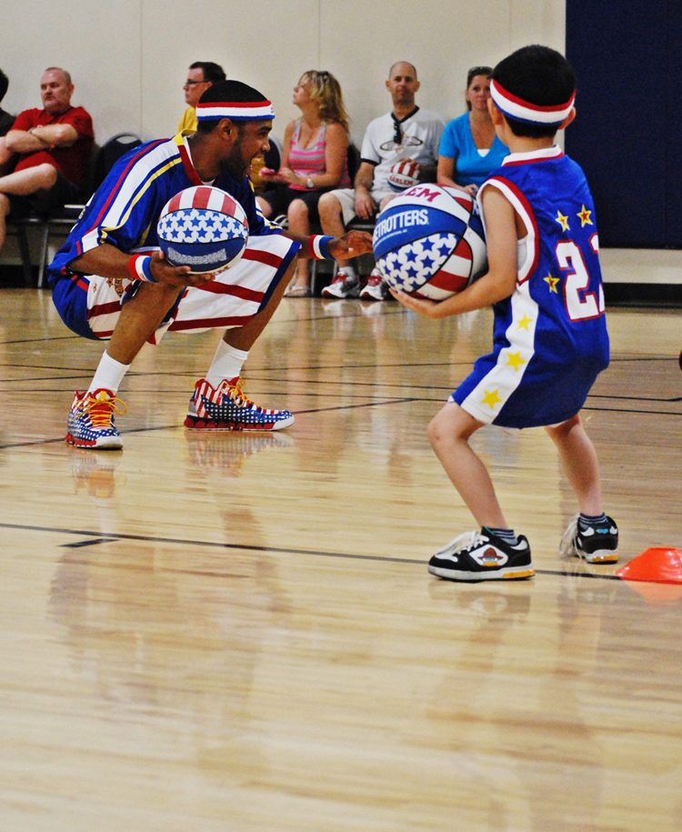
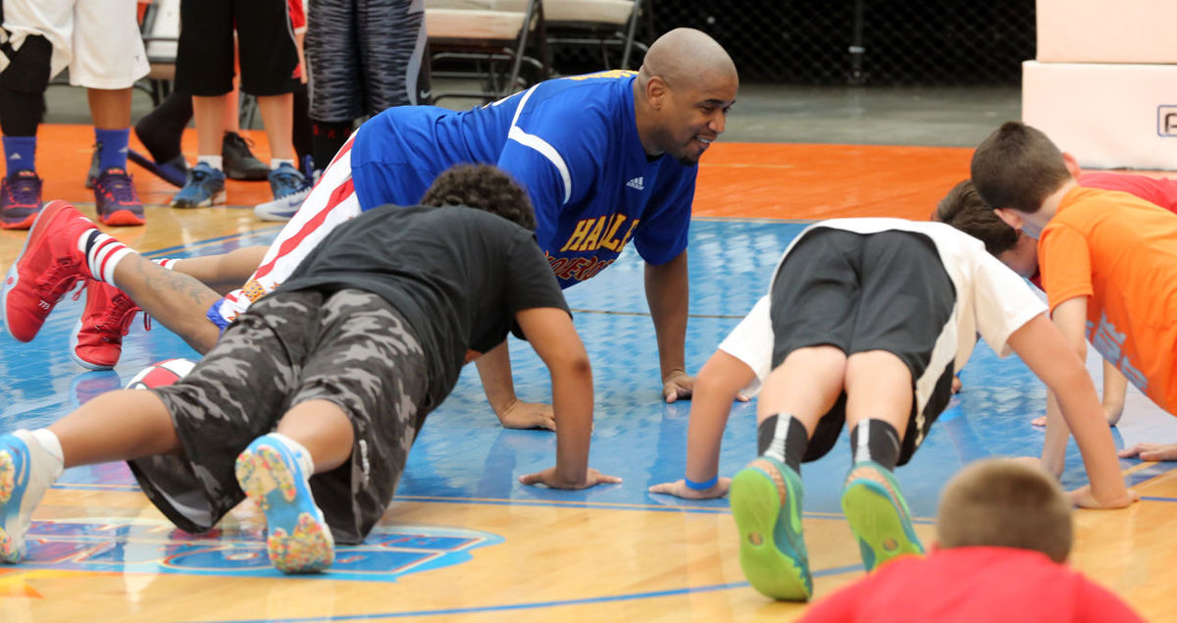
Sports Association – Youth basketball
Lower Section Center Seating - $80.00 ( 25% discount to every youth Basketball organization )
3 teams will be chosen at random to attend a 1 hour skills clinic before the game with one or two of the Globetrotters with the opportunity to run out the tunnel with them.

Slide 4
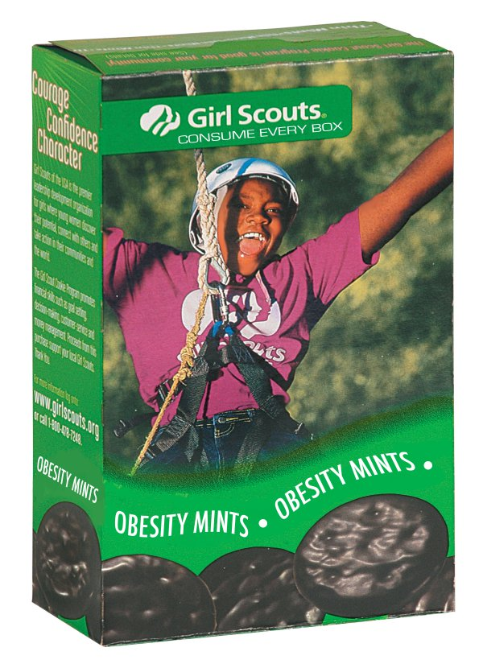
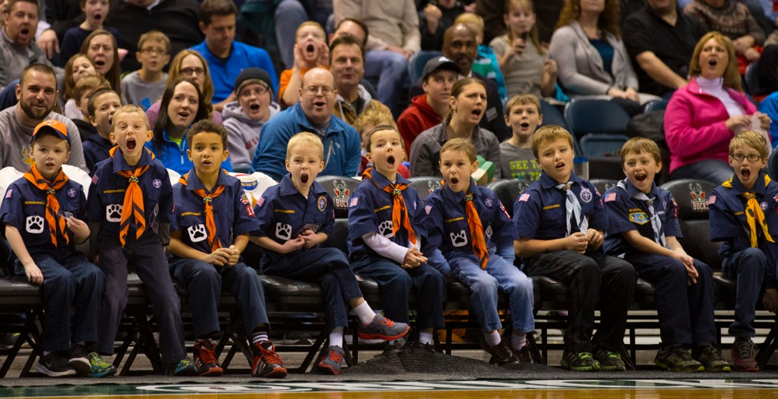
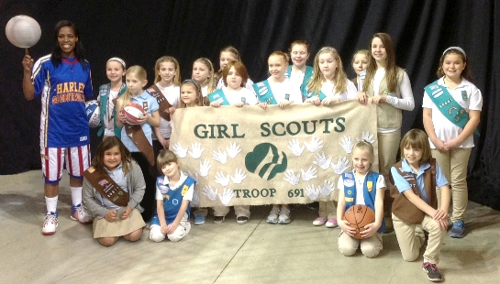
Scouts
Upper Bowl Side & Corner Seating - $25.0000 ( 20 % off the overall price of the tickets with the purchase of 10 or more )
At halftime they roam the stadium selling their scout cookies whoever sells the most gets an autograph basketball

