Slide 1

By: Jason & Kyle

Slide 2



Groups
NOTE:
To change images on this slide, select a picture and delete it. Then click the Insert Picture icon
in the placeholder to insert your own image.
Armed Forces
Local YMCA
Youth Night

Slide 3
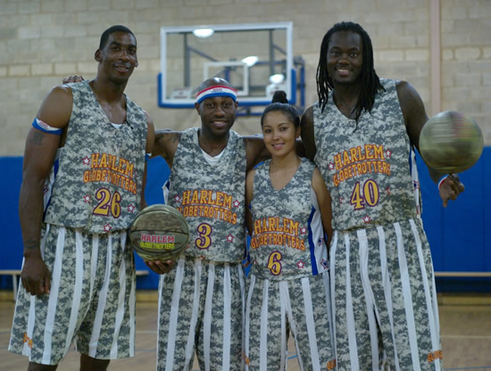
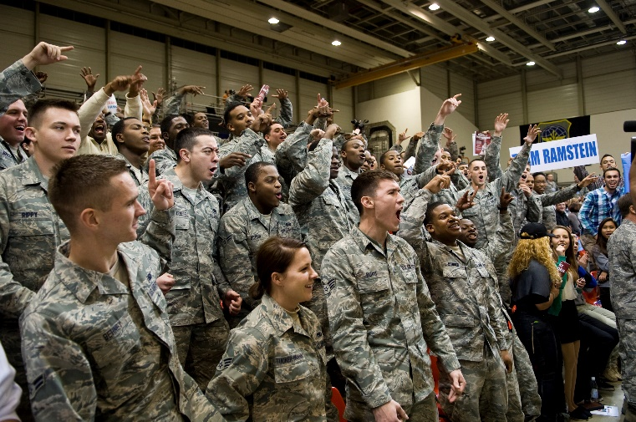
Armed Forces
10% off Each Ticket
Standing Ovation
Fan Cam
Free Team Cup/ Food Voucher
Thursday and Friday
@ 7 pm
Group Sales
  Specific Groups 10+ ppl
    Navy
    Veteran
    Air Force
    Army
    Marines
    Coast Guard
    National Guard
Class | Normal | Group
VIP Floor | $100 | $90
Lower (Center) | $80 | $72
Lower (Side/End) | $55 | $49.50
Upper Bowl (Side/Center) | $25 | $22.50
Upper Bowl (End) | $15 | $13.50

Slide 4
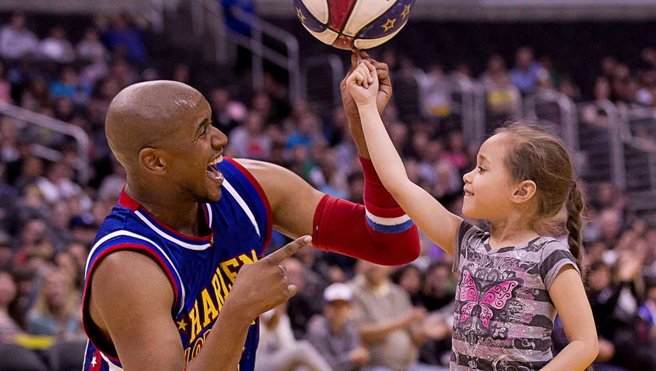
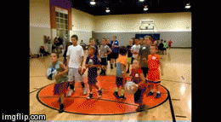
YMCA
Class | Normal | Group
VIP Floor | $100 | $85
Lower (Center) | $80 | $68
Lower (Side/End) | $55 | $46.75
Go On To Court
15%
Free Throw Competition
  Proceeds go to local YMCA
Fan Cam
Flash Mob
Sunday @ 3 & 7
Local Branch of YMCA
  Sells Most Tickets
  Gets proceeds from competition
Upper Bowl (Side/Center) | $25 | $21.25
Upper Bowl (End) | $15 | $12.75

Slide 5
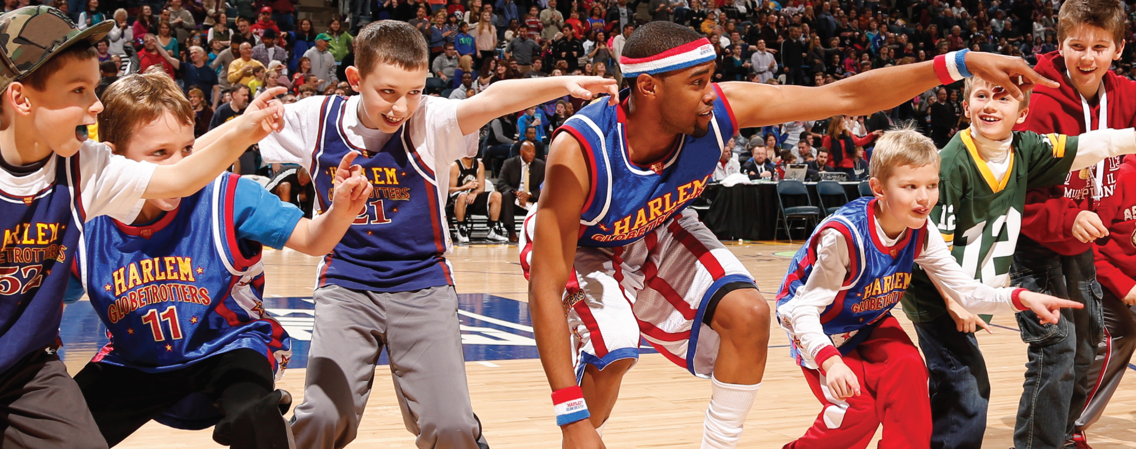
Youth Sports Night
Class | Normal | Group (20 + ppl)
VIP Floor | $100 | $90
Lower (Center) | $80 | $72
Lower (Side/End) | $55 | $49.50
10% off Each Ticket
  (20 + Tickets)
Fan Cam/ PA Announcement
Free Globetrotters T-Shirt
Saturday @ 3pm &7pm
Upper Bowl (Side/Center) | $25 | $22.50
Upper Bowl (End) | $15 | $13.50

