Slide 1
Grignard Reagent (RMgBr) Name Course Date

Slide 2
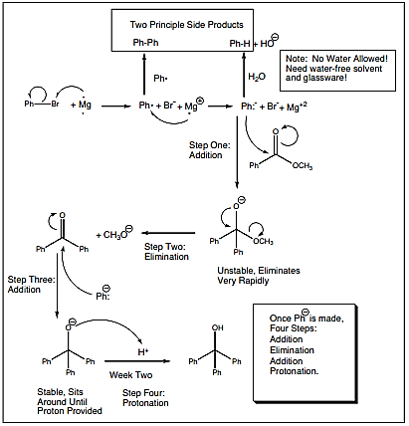
Grignard reagent RMgBr - Overall mechanism
Initial substituted bromobenzene mass: 5.973 g
Substituted benzoic acid mass (after ﬁltration): 4.722 g
Substituted benzoic acid mass (after desiccation): 3.866 g
Grignard reagent RMgBr
Notes:
Electron transfer from magnesium metal produces the carbanion. An anionic intermediate is formed when the reactive carbanion attacks electrophilic carbonyl. A methoxide anion is quickly removed by this unstable intermediate. The ketone that results is targeted once more (step three). The resulting anion eagerly awaits the next laboratory cycle, when acid will be applied to protonate it.

Slide 3
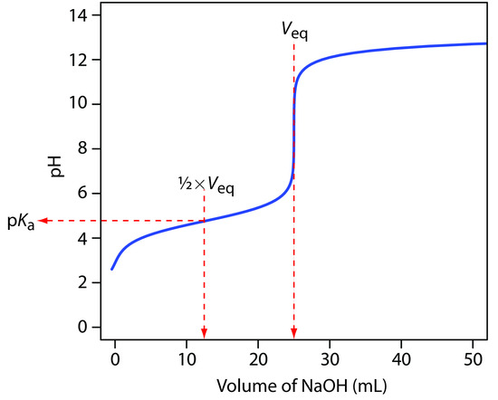
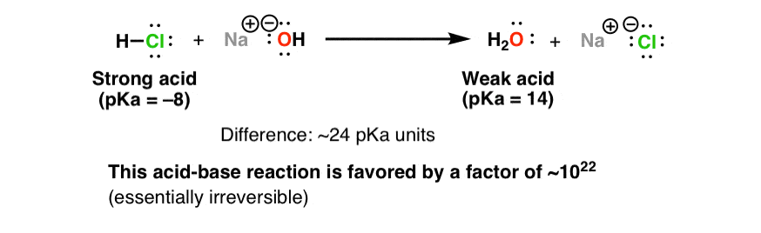
Volume reading and pH values
Acid | pKa
2-Methylbenzoic acid
2-Methoxybenzoic acid | 5.2
Benzoic acid | 5.2
4-Methylbenzoic acid
4-Methoxybenzoic acid | 5.3
2-Hydroxybenzoic acid | 3.6
Concentration of sodium hydroxide (M) | 0.100 M
Prepared benzoic acid derivative | 2-Methylbenzoic acid
Assigned benzoic acid derivative | 4-Methylbenzoic acid
Notes:
HCl and NaOH react to give water and NaCl . The pKa of HCl is -8. Sodium hydroxide is the conjugate base of H2O (pKa 15.7).

Slide 4
Results sheet
Group Results
 | A | B | C | D | E | F | G | H
1 | Volume reading (mL) | Titration volume (mL) | pH | ΔV | ΔpH | ΔpH/ΔV | V(average) | Δ(ΔpH)/ΔV2)
2 | From results sheet | 0 | From results sheet | =B3-B2 | =C3-C2 | =E2/D2 | =(B3+B2)/2 | =(F3-F2)/(G3- G2)
3 | From results sheet | =A3-A$2 | From results sheet | =B4-B3 | =C4-C3 | =E3/D3 | =(B4+B3)/2 | =(F4-F3)/(G4- G3)
Acid | pKa
2-Methylbenzoic acid
2-Methoxybenzoic acid | 5.2
Benzoic acid | 5.2
4-Methylbenzoic acid
4-Methoxybenzoic acid | 5.3
2-Hydroxybenzoic acid | 3.6
Notes:
Byproducts
The first by product is biphenyl, or Ph-Ph, which is produced when the Grignard reagent PhMgBr is used. After obtaining an electron, the phenyl radical Ph• may accept another electron to shape the required carbanion or combine with another phenyl radical to form biphenyl. The carbanion protonation produces the second side product, benzene (Ph-H). Since the carbanion is very basic, it would be protonated whether there is some water in the solvent even glassware, or if moist air is able to join the reaction mixture. As a result, extreme caution is necessary to maintain “dry” and water-free environments. The third issue is for the magnesium to actually move electrons! Pure magnesium is a very active metal, so much so that any magnesium subjected to air can produce a crust of magnesium oxide on the top. This oxide film prevents bromobenzene from meeting active magnesium, preventing the necessary electron transfer. New active magnesium must be exposed for a Grignard reaction to take place. Otherwise, there will be no electron transfer from magnesium to bromobenzene, no carbanion will develop, and the reaction will not continue. The fourth concern is that the unreacted starting substance may be Ph-Br, Mg, or an ester.

Slide 5
Summary and conclusions
RMgBr reacts as a strong base with water or alcohols
RMgBr reacts as a strong nucleophile with carbonyl groups ketones, aldehydes, and esters
By products:
Biphenyl (Ph-Ph)
Benzene (Ph-H)

