Slide 1

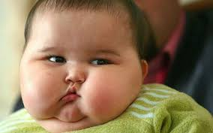
Investigation of the Contribution of Breastfeeding and Birth Weight on the Reduction of the Early Childhood Obesity
A UAE Study
via
Retrospective Cohort Study
Group E
Rahma Ahmed and Sakeena Mohamed Ali
Kyunghee Hong and Sehjeong Kim
Public Health, College of Medicine, UAEU
Sept. 09, 2017

Slide 2

Introduction
Comment from Dr. Luai: We need to recruit government kindergartens randomly and adjust our result regarding SES

Slide 3
Background
Overweight and obesity under 5yr children rose by 47.1% between 1980 and 2013 worldwide (Ng, 2014)
Breast feeding contributed 35% of reduction of obesity of kindergarten children in Germany (Ruddiger, 1999)
12 County study: High birth weight increased odds of obesity in children aged 9-11 (Qiao, 2015)
Some conflicting study: Birthweight is not a predictor of early childhood weight gain (McCarthy, 2007)

Slide 4
(WHO, 2014) http://www.who.int/end-childhood-obesity/facts/en/

Slide 5
Prevalence of Early Childhood Obesity
in Various Countries
Country | Sample Size | Age Group | Study Period | Results
Singapore | 3009 (Chinese children) | 24-72 month | 2006-2008 | 8.1% overweight 7.1% obese (CDC)
Brazil | 2635 | 24-59month | 2006 | 7.8%
US | 4362 (Alabama) | 2-5 year | 2009-2010 | 12.1%
UAE | 27,078 (Emiratis only) | 3-6 year | 2014-2015 | 14% (CDC)
KSA | 15,516 | 0-5 year (2005 data) | 2012 | 15% overweight 6% obese (WHO-Z score)

Slide 6
Risk Factors
Physical inactivity
Increase in caloric and fat intake
Increasingly eat heavily processed foods
Parents work longer hours
Genetic
Cultural aspect

Slide 7
Public Health Issues
Many comorbid condition like metabolic, cardiovascular, orthopedic, neurological, hepatic, pulmonary, and renal disorder are also seen in association with childhood obesity (Bhadoria, 2015)
Poor academic performance and lower quality of life, low self esteem experienced by the child
Childhood obesity can persist into adulthood

Slide 8
Purpose of Study
To investigate the impact of breastfeeding and birth weight on the obesity of national kindergarten children in the UAE
Study Justification
WHO recommends 6 month exclusive breastfeeding for baby immunity and protection against later year diseases
B. Children adiposity is an increasing public health issue
worldwide
C. No similar research conducted in the UAE in the past

Slide 9
Target Audiences
Baby friendly association
Public health policy maker
Breast feeding supporter
Public health care professionals
The research finding can be a reference for the public health policy maker to improve childhood health statues

Slide 10

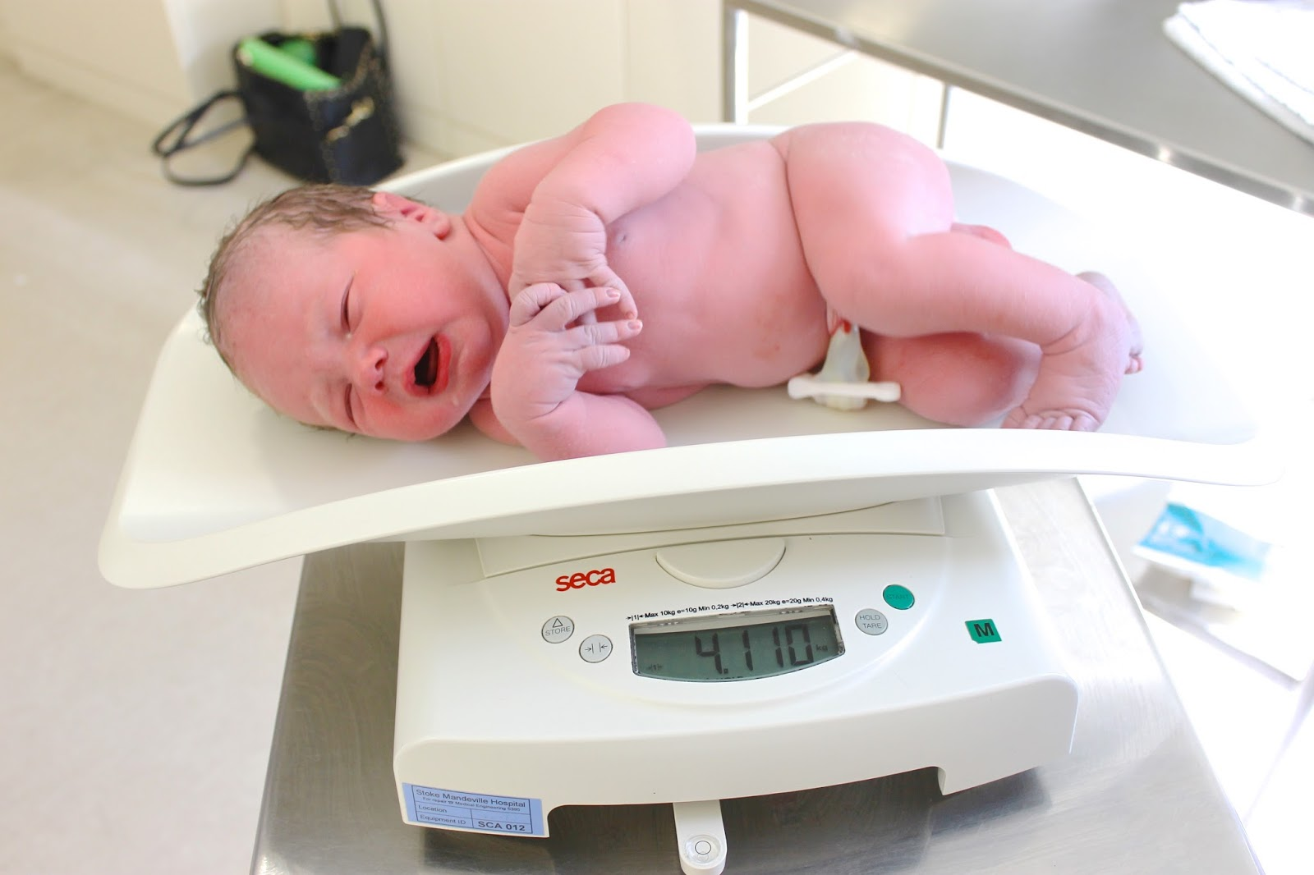
Research Questions
RQ 1. Will exclusive 6 month
breastfeeding and normal birth
weight be protective factors against
early childhood obesity ?
RQ 2. Will there be the association
between breastfeeding durations
and early childhood obesity?

Slide 11
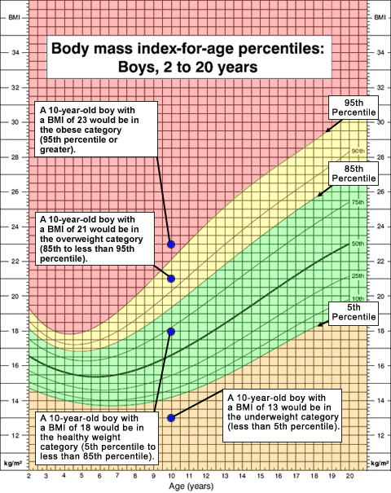
CDC Cutoffs
Weight Status | Range
Underweight | Less than the 5th percentile
Normal or Healthy Weight | 5th percentile to less than the 85th percentile
Overweight | 85th to less than the 95th percentile
Obese | Equal to or greater than the 95th percentile
Status | Birth Weight Range
Low | Less than 2.5kg
Normal | Between 2.5kg and 3.5 kg
High | More than 3.5kg

Slide 12

Procedures and
Methods

Slide 13
Study design
A. Identify the association between
- Early childhood obesity
- Exclusive 6 month breastfeeding and Birth weight
Association between the duration of breastfeeding and early
childhood obesity
Respective Cohort Study
Normal weight | BMI for age between 5th and 85th percentiles
Overweight/obese/extreme obese | BMI for age >= 85th percentiles
Exclusive 6 month breastfeeding | Continuous feeding with only breast milk for 6 months
EBF: Exclusively breastfed | NEBF: NOT exclusively breastfed
NBW: Normal birth weight | HBW: High birth weight

Slide 14
Study Population
4-5 year old national kindergarten school children in Al Ain in 2017
Government school having a school nurse
Children enrolled in city center kindergartens and nearby areas
Case Definitions
4-5 year old national kindergarten school children in Al Ain in 2017
Weight classified as normal and overweight & above by
BMI for age >=85th percentile according to the CDC cutoffs

Slide 15
4 Exposure groups at birth and 6 months after
A | (Exclusively breastfed, normal birth weight)
B | (Exclusively breastfed, high birth weight)
C | (Not exclusively breastfed, normal birth weight)
D | (Not exclusively breastfed, high birth weight)
Observe
How many developed obesity in each group by the time they reached 4-5 year old?

Slide 16
Exposure
Study Pop
4-5y preschoolers
EBF, NBW
Overweight &
Obese Preschooler
EBF, HBW
NEBF, NBW
Normal weight
Preschooler
NEBF, HBW
Study time
Exposure time
Past
Present

Slide 17
Participant Inclusion and Exclusion Criteria
Inclusion
1000 national kindergarten children aged 4-5 years old
from 12 government schools in Al Ain
Both sexes
Their mothers
Exclusion
A child with preexisting medical conditions
A child below 4 or above 5 years old
A child born before the 37th week (wHO standard)
A child born underweight below 2.5kg
Non national kindergarten children

Slide 18
Justification of Exclusion
Any child born underweight below 2.5kg
- Conflict of interest
- Controversial issue about later year weight gain
Any child born before the 37th week
- Most preterm baby is underweight
All non national kindergarten children
- For a follow-up study in the future, sustainability and
availability of the same study subjects
- No guarantee of official birth records in the UAE
- Controlling SES confounding effect

Slide 19
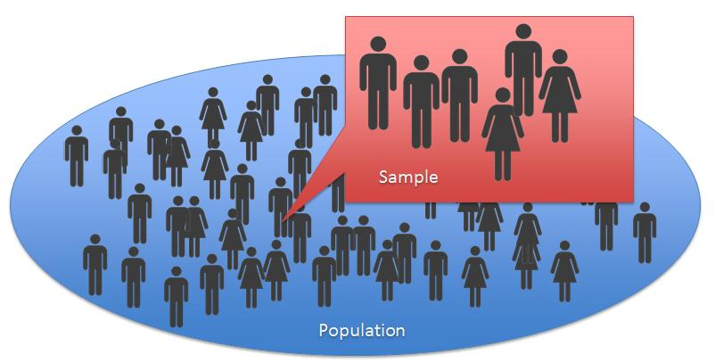
Estimated Number of Participants
1000 national kindergarten students aged 4-5 years are the estimated number of participants in this study
Therefore 3 times more than designed sample size will receive the written informed consent form and questionnaire

Slide 20
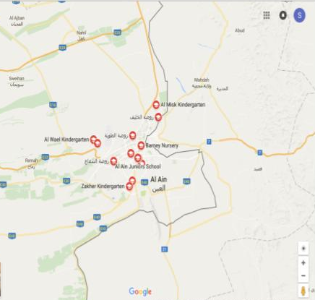
Sampling
There are 32 government KGs in Al Ain city, but we will select 12 schools that are manly located in the city town center and nearby area, to avoid SES variation.
All KG1 and KG2 students in selected schools will receive an envelope that contains consent form and questionnaire.

Slide 21


Enrollment
The envelopes will be distributed and obtained by class teachers and then collected and kept with the school nurse.
We will enroll in the study all the students with completed consent forms and questionnaires and who doesn’t have any of the previously mentioned exclusion criteria.
All recruited students BMI will be measures and recorded

Slide 22

Outcome Variables and Analysis
Variables to be collected
Study instruments
(1) Student sex, age, weight and height at the recruitment
(2) Number of breastfeeding months
(3) Birth weight of a child in the study population
(4) Mother’s education level, gestational age, GDM history
(5) Mother’s working status
(6) Number of siblings
Questionnaire to Mothers | Items requiring all numeric or clear categorical answers
School health record | Available in each school in Al Ain
Birth registry | Available in Al Ain

Slide 23
Analysis 1 – RQ1
Analysis 2-RQ2
4 Groups to compare
(EBF, NBW, Outcome)
(EBF, HBW, Outcome)
(NEBF, NBW, Outcome)
(NEBF, HBW, Outcome)
Outcome:
Normal weight/overweight
RRs from A and B, A and C and A and D
Multiple logistic regression
Association between
# of breastfeeding months
Early childhood obesity
RRs
Dose-Response Analysis
Multiple logistic regression
EBF: Exclusively breastfed | NBW: Normal birth weight
NEBF: NOT exclusively breastfed | HBW: High birth weight

Slide 24

Bias in Data Collection
Measurement bias
Any calibration error will effect in faulty BMI measures
Response Bias
Child's birth weight is reported by the child's mother and
this information might be inaccurate comparing to child’s
birth registry
Social desirability bias
local Muslim mothers might report inaccurately breastfeeding
status in order to present themselves in the best most
favorable behavior (SDR)

Slide 25

Potential Study Limitations
Limited in Al Ain, not nationally representative
Private kindergartens are not included
Various SES status are not considered
Possible gender imbalance in the study sample

Slide 26
References
WHO | Facts and figures on childhood obesity. Who.int. 2014. Available from: http://www.who.int/end-childhood-obesity/facts/en/
Ng M, Fleming T, Robinson M, Thomson B, Graetz N, Margono C et al. Global, regional, and national prevalence of overweight and obesity in children and adults during 1980-2013: a systematic analysis for the Global Burden of Disease Study 2013. Lancet 2014; 384: 766–781.
von Kries R, B. Koletzko, T. Sauerwald, E. von Mutius, D. Barnert, V. Grunert et al. Breast feeding and obesity: cross sectional study BMJ 1999; 319 :147
Qiao Y, Ma J, Wang Y, Li W, Katzmarzyk P, Chaput J et al. Birth weight and childhood obesity: a 12-country study. International Journal of Obesity Supplements. 2015;5:S74–S79.
McCarthy A, Hughes R, Tilling K, Davies D, Smith G, Ben-Shlomo Y. Birth weight; postnatal, infant, and childhood growth; and obesity in young adulthood: evidence from the Barry Caerphilly Growth Study. Am J Clin Nutr. 2007;86(Am J Clin Nutr.):907–913.
Pwint M, Lee Y, Wong T, Saw S. Prevalence of overweight and obesity in Chinese preschoolers in Singapore. Ann Acad Med Singapore. 2013;42:66-72.
Silveira J, Colugnati F, Cocetti M, Taddei J. Secular trends and factors associated with overweight among Brazilian preschool children: PNSN-1989, PNDS-1996, and 2006/07. Jornal de Pediatria. 2014;90(3):258-266.

Slide 27
AlBlooshi A, Shaban S, AlTunaiji M, Fares N, AlShehhi L, AlShehhi H et al. Increasing obesity rates in school children in United Arab Emirates. Obesity Science & Practice. 2016;2(2):196-202.
Al Shehri A, Al Alwan I, Al Fattani A. Obesity among Saudi children. Saudi Journal of
Obesity. 2013;1(1):3.
Bhadoria A, Sahoo K, Sahoo B, Choudhury A, Sufi N, Kumar R. Childhood obesity: Causes
and consequences. Journal of Family Medicine and Primary Care. 2015;4(2):187.

Slide 28


Contact
Early Childhood Obesity Study Group
Int. of Public Health, UAEU
Sehjung.kim@uaeu.ac.ae
201470270@uaeu.ac.ae
sokaina.alhashemy@gmail.com
rahma.dafaalla@gmail.com

