Slide 1
Measuring Corporate Performance
Textbook: Chapter 4
ISBN 978-1-259-91895-7

Slide 2
Topics Covered
Value and Value Added
Measuring Profitability
Measuring Efficiency
Analyzing the Return on Assets: The Du Pont System
Measuring Leverage
Measuring Liquidity
Calculating Sustainable Growth
Interpreting Financial Ratios
The Role of Financial Ratios–and a Final Note on Transparency
Notes:
3
2
2
2
2
2

Slide 3
Value and Value Added
Market Capitalization
  Total market value of equity, equal to share price times number of shares outstanding.
Market Value Added
  Market capitalization minus book value of equity.

Slide 4
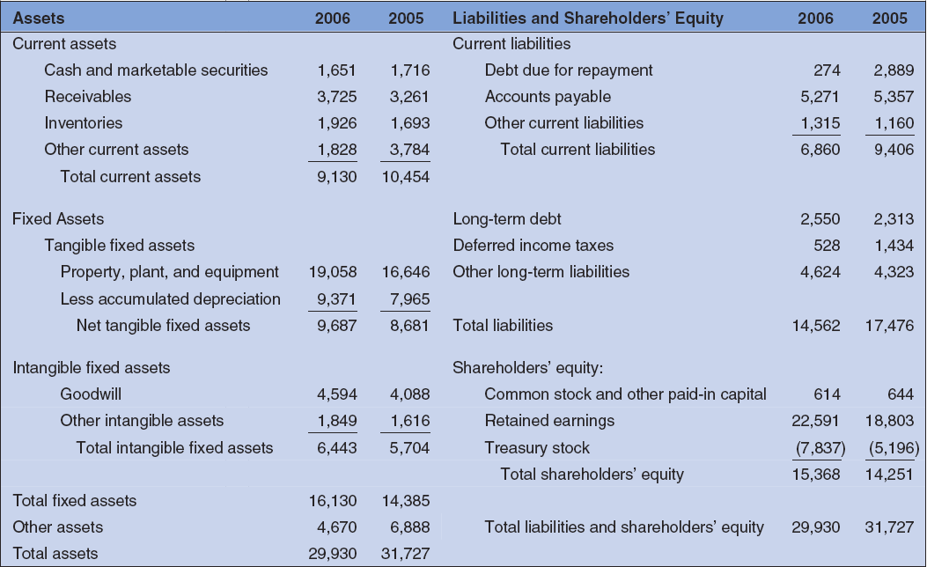
Value and Value Added
PepsiCo Balance Sheet (December 31, 2006) $Millions

Slide 5

Value and Value Added
Pepsico Income Statement (year end 2006)
Net Sales 35,753
COGS 15,762
Selling, G&A expenses 11,530
Depreciation expense 1,406
EBIT 7,055
Net interest expense 66
Taxable Income 6,989
Income Taxes 1,347
Net Income 5,642
Notes:
13

Slide 6
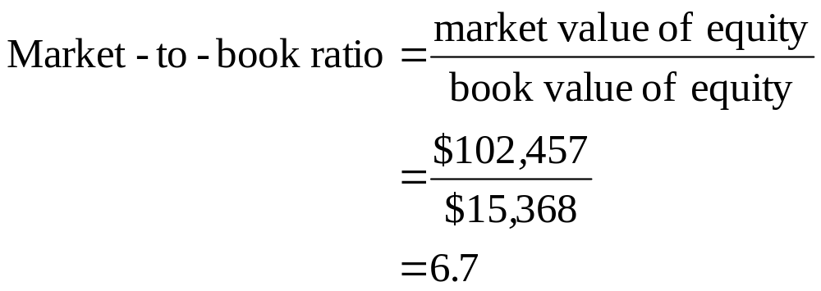
Value and Value Added
Market-to-Book Ratio
  Ratio of market value of equity to book value of equity.

Slide 7
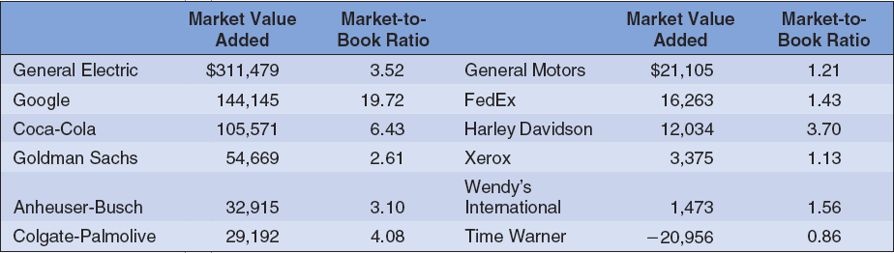
Value and Value Added
Stock market measures of company performance, 2006. Companies are ranked by market value added. (dollar values in millions)

Slide 8
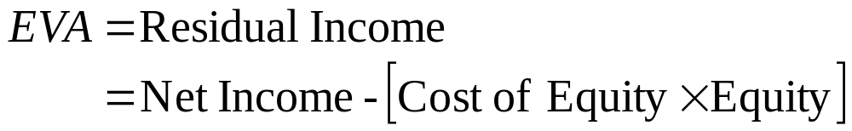
Measuring Profitability
Economic Value Added (EVA)
  Net income minus a charge for the cost of capital employed. Also called residual income.
Residual Income
  Net Dollar return after deducting the cost of capital

Slide 9
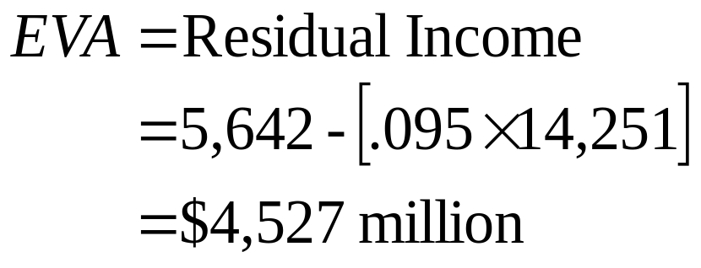
Measuring Profitability
Economic Value Added (EVA) of PepsiCo

Slide 10
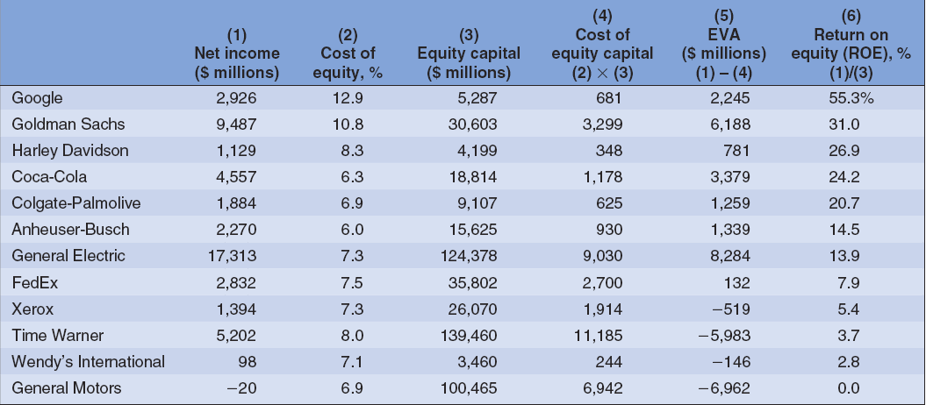
Measuring Profitability
Accounting measures of company performance, 2006. Companies are ranked by return on equity.

Slide 11
Measuring Profitability
Return on Equity (ROE)
  Net income as a percentage of shareholders’ equity
Return on Capital (ROC)
  Net income plus Interest as a percentage of long-term capital.
Return on Assets (ROA)
  Net income plus interest as a percentage of total assets

Slide 12
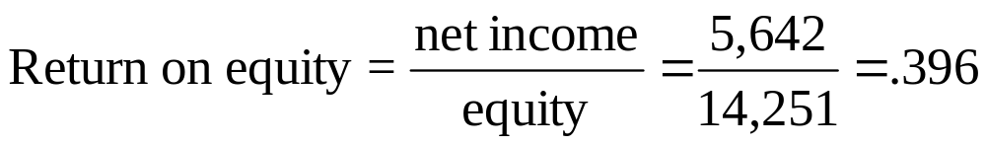
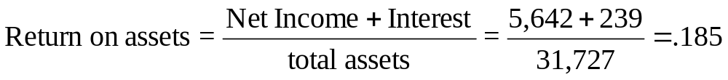
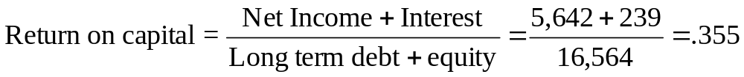
Measuring Profitability - PepsiCo

Slide 13
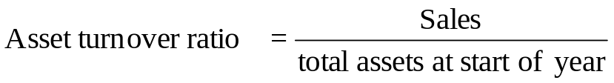

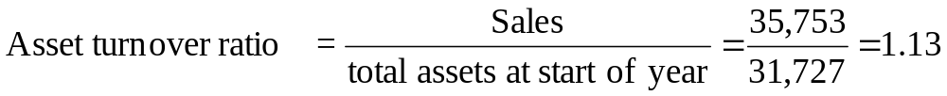
Measuring Efficiency
OR
For PepsiCo
OR
Notes:
7

Slide 14
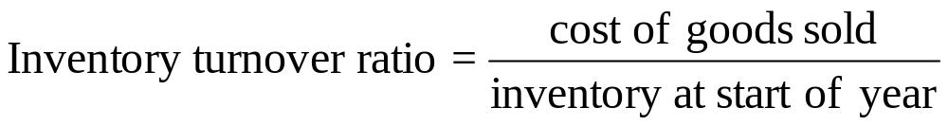
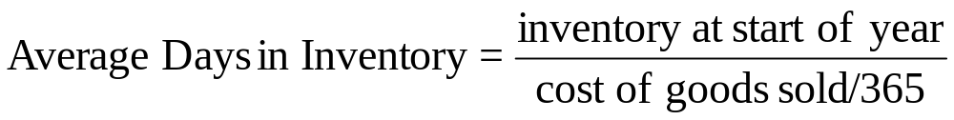
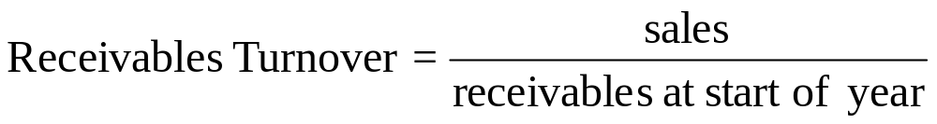
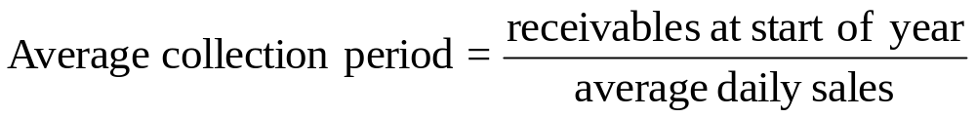
Measuring Efficiency
Notes:
8

Slide 15
Efficiency Ratios
Inventory, receivables and turnover ratios measure how efficiently we utilize different asset classes with reference to some standard, e.g., sales.
One goal is to produce sales. The Total Asset Turnover Ratio measures the relationship between sales and a dollar spend on total assets.
  For example: if the ratio were 5 times, that would mean that, on average, $1.00 in assets were needed to generate $5.00 in sales.

Slide 16
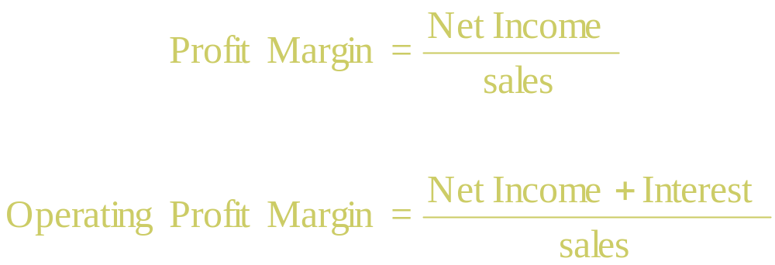
The DuPont System
A breakdown of ROE and ROA into component ratios
Notes:
13

Slide 17


The DuPont System
asset
turnover
Operating profit
margin
Notes:
15

Slide 18
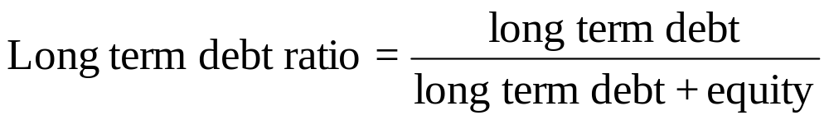
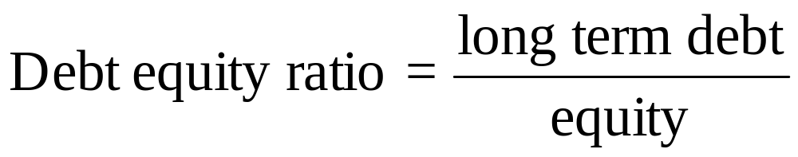
Measuring Leverage
Notes:
3

Slide 19



Measuring Leverage
Notes:
4

Slide 20
Measuring Leverage
leverage
ratio
asset
turnover
Operating
profit
margin
debt
burden
Notes:
17

Slide 21
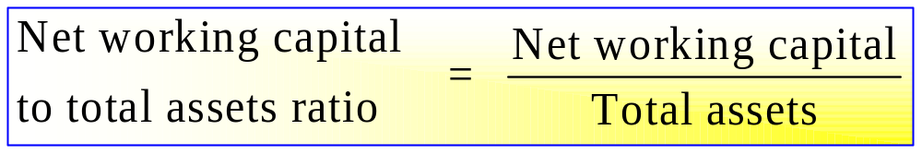

Measuring Liquidity
Notes:
5

Slide 22
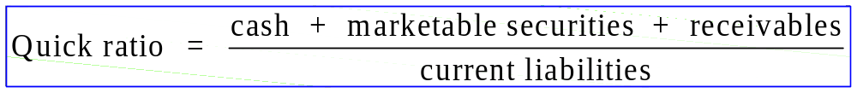

Liquidity Ratios
Notes:
6

Slide 23



Sustainable Growth
Notes:
10

Slide 24

Using Financial Statements
Ratios are not very helpful by themselves: they need to be compared to something
Time-Trend Analysis
  Used to see how the firm’s performance is changing through time
Peer Group Analysis
  Compare to similar companies or within industries
  SIC and NAICS codes
Notes:
SIC codes have been used many years to identify industries and allow for comparison with industry average ratios. The SIC codes are limited, however, and have not kept pace with a rapidly changing environment. Consequently, the North American Industry Classification System was introduced in 1997 to alleviate some of the problems with SIC codes.
Click on the web surfer to go the NAICS home page. It provides information on the change to the NAICS and conversion between SIC and NAICS codes.

Slide 25
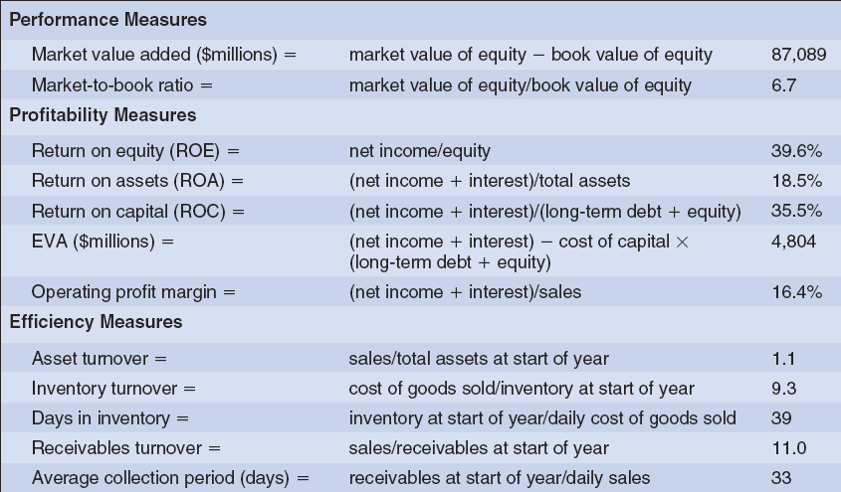
Interpreting Financial Ratios
PepsiCo Ratios

Slide 26
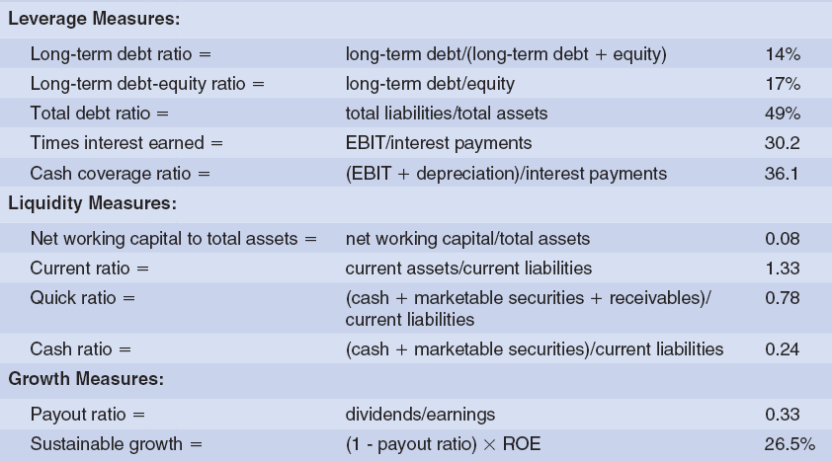
Interpreting Financial Ratios
PepsiCo Ratios (continued)

Slide 27

Web Resources
www.reportgallery.com
www.prars.com
www.corporateinformation.com
www.jaxworks.com
finance.yahoo.com
edgarscan.pwcglobal.com
www.sternstewart.com
www.ibm.com/investor/financialguide

