Slide 1
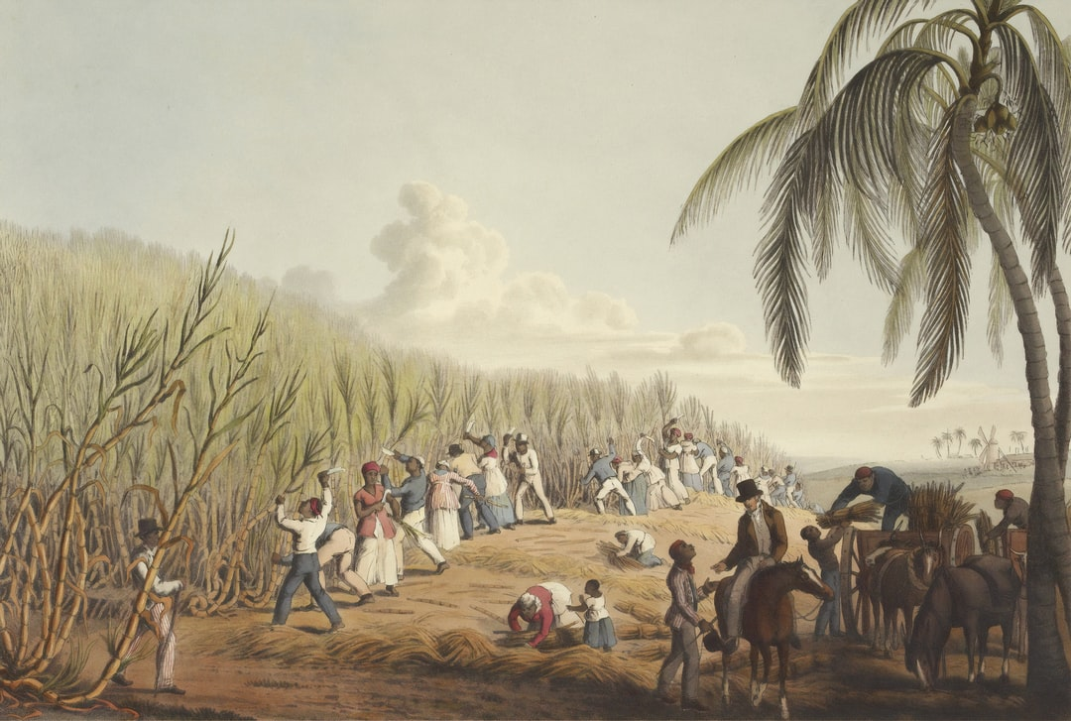
Black Inequality
African American Racism in the History of America

Slide 2
Inequality in History
Many American groups have pursued and be recognized as equal citizens except the African American Community.
It is Interesting of how they were considered of low reputation by the government itself and it was even drafted in to Americas constitution (Lakshmi & Abdulaziz al Suhaibani, 2016).
This illustrates the African American struggles through challenges such as racism, discrimination and inequality in society.
Other groups that had not received moral recognition, were encouraged through the struggles of the black community to also fight for their rights.

Slide 3
Discrimination in the USA
Discrimination was so rampant and widespread that it was even traced back to the mid seventeen century in American History. This was contributed due to slavery and the slave trade by the Trans Atlantic trade.
The blacks were affected with living in the superpower as they had to bear the negative effects that came with it such as the satisfying the demand for labor (Delle, 2019).
Racial discrimination was mostly observed through schools segregation, and other social amenities and the black people were no allowed to sshare this resources and this illustrated the rate of racism in America during tis time.

Slide 4

Conclusion
The hard living conditions that were experienced by the blacks people and the lack of social services such as education for the youth was a challenge that made the African American community to fight for the rights and formed groups within their communities.
This was then illustrated with the formation of Civil Rights movement that helped in the fighting for the rights of the youth. This therefore resulted to African American Communities to gain freedom

Slide 5
References
Lakshmi, B., & Abdulaziz al Suhaibani, Z. (2016). A Glimpse at the System of Slavery. International Journal of Humanities and Social Sciences, 5(1), 211.
Delle, J. A. (2019). The archaeology of northern slavery and freedom. University Press of Florida.

