Slide 1


Money, Banking, and the Financial System
Fourth Edition
Chapter 2
Money and the Payments System
Copyright © 2022, 2018, 2014 Pearson Education, Inc. All Rights Reserved
Notes:
If this PowerPoint presentation contains mathematical equations, you may need to check that your computer has the following installed:
1) MathType Plugin
2) Math Player (free versions available)
3) NVDA Reader (free versions available)

Slide 2
Learning Objectives
After studying this chapter, you should be able to:
2.1 Analyze the inefficiencies of a barter system.
2.2 List and describe the four key functions of money.
2.3 Explain the role of the payments system.
2.4 Explain how the U.S. money supply is measured.
2.5 Use the quantity theory of money to analyze the relationship between money and prices in the long run.

Slide 3
The Federal Reserve: Good for Main Street or Wall Street—or Both?
Several candidates in the 2020 presidential race, including President Trump, expressed dissatisfaction with the Fed.
They argued that the Fed used its independence to pursue policies that favored “Wall Street” (large financial firms) rather than “Main Street” (households and small businesses).
An example of a country without central bank independence is Zimbabwe, where the inflation rate during 2008 was 15 billion percent!
Most economists believe that there is a connection between central bank independence and inflation.

Slide 4
Key Issue and Question
Issue: The Federal Reserve’s actions in response to the financial crises of 2007−2009 and 2020 led to questions about whether it should continue to operate largely independently of oversight by the president and Congress.
Question: Should a central bank be independent of the rest of the government?

Slide 5
2.1 Learning Objective
Analyze the inefficiencies of a barter system.

Slide 6
Do We Need Money?
Money is anything that is generally accepted as payment for goods and services or in the settlement of debts.

Slide 7
Barter (1 of 2)
In fact, economies can function without money.
Barter is a system of exchange in which individuals trade goods and services directly for other goods and services.
Barter exchanges prevailed in the early stages of development in our economy, but they were inefficient.

Slide 8
Barter (2 of 2)
There are four main sources of inefficiency in a barter economy:
A double coincidence of wants increases the transactions costs.
  Transactions costs are the costs in time or other resources that parties incur in the process of agreeing and carrying out an exchange of goods and services.
Each good has many prices.
  When there are N items:
A lack of standardization exists for goods and services.
It is difficult to accumulate wealth.

Slide 9
The Invention of Money
To improve on barter, people sought to identify a specific product that most people would accept in an exchange.
Commodity money is a good used as money that also has value independent of its use as money.
Money allows people to specialize, so they become more productive and earn higher incomes.
Specialization occurs when individuals produce the goods or services for which they have relatively the best ability.

Slide 10
Apply the Concept: What’s Money? Ask a Taxi Driver in Moscow!
During a visit to Russia in 1989, one of the authors of this book had difficulties with taxis.
Taxi drivers quoted fares in dollars, marks, and yen, but not rubles.
For taxi drivers, Marlboro cigarettes were the commodity money of choice.

Slide 11
2.2 Learning Objective
List and describe the four key functions of money.

Slide 12
The Key Functions of Money (1 of 3)
Money serves four key functions in the economy:
It acts as a medium of exchange.
It is a unit of account.
It is a store of value.
It offers a standard of deferred payment.

Slide 13
The Key Functions of Money (2 of 3)
Medium of Exchange
Medium of exchange is something that is generally accepted as payment for goods and services.
Unit of Account
Unit of account is a way of measuring value in an economy in terms of money.

Slide 14
The Key Functions of Money (3 of 3)
Store of Value
Store of value is the accumulation of wealth by holding dollars or other assets that can be used to buy goods and services in the future—in effect moving your purchasing power forward in time.
Even though other assets offer a greater return as a store of value, people hold money because it is perfectly liquid.
Standard of Deferred Payment
As a standard of deferred payment, money can facilitate exchange over time (not only at a point in time).

Slide 15
Remember That Money, Income, and Wealth Measure Different Things
Money is part of wealth, which is the sum of the value of a person’s assets minus the value of the person’s liabilities.
Only if an asset serves as a medium of exchange can we call it money.
A person’s income is his or her earnings over a period of time.
So, a person typically has considerably less money than income or wealth.

Slide 16
What Can Serve as Money?
An asset is suitable to use as a medium of exchange if it is:
Acceptable to most people
Standardized in terms of quality
Durable
Valuable relative to its weight
Divisible
U.S. paper currency—Federal Reserve Notes—meets all these criteria.

Slide 17
The Mystery of Fiat Money
Fiat money has no value apart from its use as money, e.g., paper currency.
People accept paper currency as money partly because it is legal tender.
Legal tender is the government designation that currency is accepted for payment of taxes and people must accept it in payment of debts.
Our society’s willingness to use Federal Reserve Notes as money makes them an acceptable medium of exchange.

Slide 18
Apply the Concept: Say Goodbye to the Benjamins? (1 of 3)
Total currency in circulation has almost tripled since 2000, reaching more than $5,200 for every person in mid-2020.
As much as 70% of U.S. currency is held outside the United States.
Some countries, including Panama, E l Salvador, Ecuador, and Zimbabwe, use the U.S. dollar as their official currency.
Large-denomination bills are also useful for people engaging in illegal activities because those bills allow substantial transactions to be carried out in cash.

Slide 19
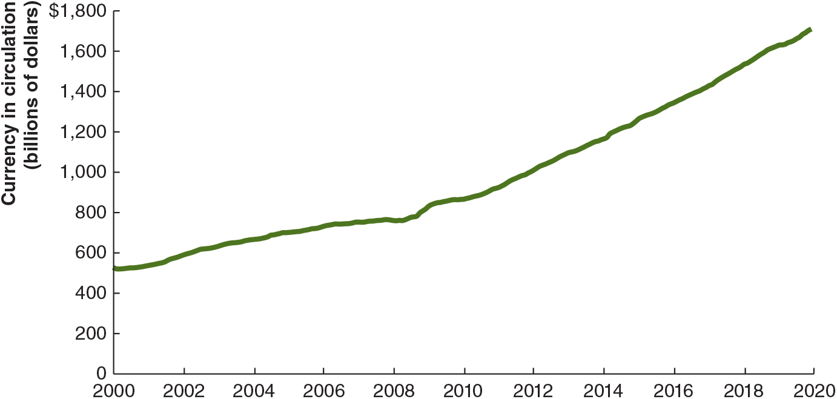
Apply the Concept: Say Goodbye to the Benjamins? (2 of 3)
Notes:
The vertical axis is labeled, currency in circulation (billions of dollars) and ranges from 0 to 1800 dollars in increments of 200. The horizontal axis lists dates from 2000 to 20 20 in 2 year increments. The line starts from 525 dollars in 2000 and slopes upward to the upper right corner. The line reaches to a value of 700 dollars by 2006, 900 dollars by 2009, 1200 dollars by 20 14. The line reaches to a value of 1700 dollars by 20 20. The values used in the description are approximate.

Slide 20
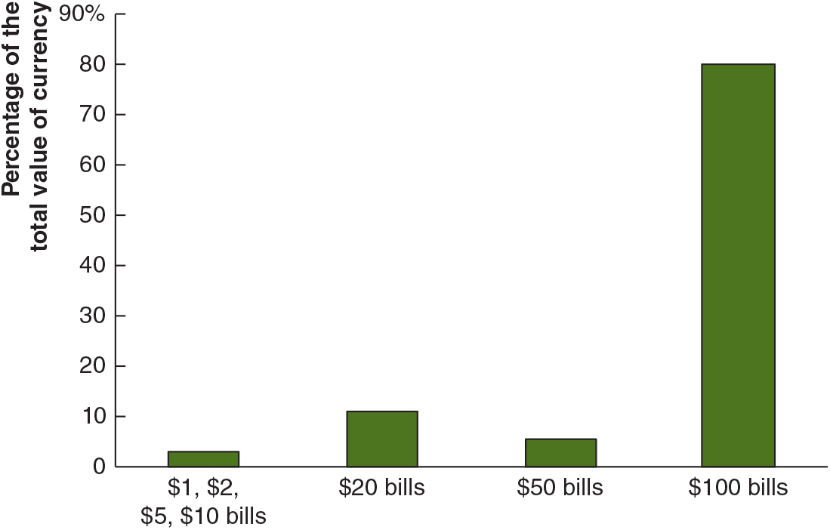
Apply the Concept: Say Goodbye to the Benjamins? (3 of 3)
Notes:
The data is as follows.
$1, $2, $5, $10 bills, 3%.
$20 bills, 12%.
$50 bills, 5%.
$100 bills, 80%.
The values used in the description are approximate.

Slide 21
2.3 Learning Objective
Explain the role of the payments system in the economy.

Slide 22
The Payments System
A payments system is the mechanism for conducting transactions in the economy.
The Transition from Commodity Money to Fiat Money
Gold and silver coins are cumbersome.
So, early banks began to store gold coins in safe places and issue paper certificates (paper currency).
Today, the central bank issues paper currency but does not exchange it for gold or anything else.

Slide 23
The Importance of Checks
Checks are promises to pay on demand money deposited with a bank or other financial institutions.
The use of checks avoids the drawbacks of paper money but also requires more trust on the part of the seller.

Slide 24
New Technology and the Payments System (1 of 2)
The Fed believes that the most desirable outcomes for a payments system are:
  Speed
  Security
  Efficiency
  Smooth international transactions
  Effective collaboration among participants in the system
Notes:
Teaching Tips: Ask students if they have bought items on eBay. Next, ask how many would have still bought the items if they could not have used PayPal.
The discussion that follows should help them to understand how money evolves over time and how increased efficiency of the payments systems allows for more economic activity.

Slide 25
New Technology and the Payments System (2 of 2)
Electronic funds transfer systems are computerized payment-clearing devices.
Debit cards and payment apps allow stores to instantly credit the store’s account, thus eliminating the problem of trust.
Automated Clearing House (A C H) transactions are direct deposits of checks and electronic transfers, which reduce transactions costs.
Automated teller machines (A T Ms) allow you to withdraw funds from your bank or another bank anytime.

Slide 26
The Real-Time Payments Systems
Real-time payments system is a system that makes checks and other payments available within a few minutes and which operates 24 hours per day, 365 days per year.
The current U.S. payments system is only available Monday through Friday during normal working hours on the east coast.
People are also concerned about the security of the U.S. payments system due to accounts of banking and credit card information being stolen.

Slide 27
Apply the Concept: Why Is the U.S. Payments System So Slow?
Unlike other countries, including Japan, Mexico, China, and many European countries, the United States does not have a real-time payments (R T P) system.
The Clearing House (T C H) is an association of 24 large banks from around the world that began operating an R T P system in 2017.
But T C H relies on the Federal Reserve’s Fedwire, which is available only during limited hours on weekdays.
In 2019, the Fed announced its own R T P system called FedNow, but it would take five years to become operational.

Slide 28
E-Money, Bitcoin, and Blockchain (1 of 2)
E-money (electronic money) is digital cash people use to buy goods and services over the Internet.
The PayPal service was the first widely used peer-to-peer payments system, followed by smartphone apps, such as Venmo and Zelle.
Bitcoin is a new form of e-money (cryptocurrency) not owned by a firm but is instead the product of a decentralized system of linked computers.
The popularity of bitcoin with some buyers is due to the convenience of using a smartphone to make a purchase. Transactions are more private because it doesn’t use transaction records.

Slide 29
E-Money, Bitcoin, and Blockchain (2 of 2)
Cryptocurrencies have not been widely used for buying and selling goods and services. Wide fluctuations of their prices undermine their usefulness as currencies.
Smartphone apps, such as Apple Pay and Google Pay, allow consumers to link credit cards to make payments.
Facebook has introduced a stablecoin as a medium of exchange, called Libra, whose value is linked to a basket of currencies.
The technology behind bitcoins is blockchain, which is technically a distributed ledger, or an online network that allows individuals and businesses around the world to settle transactions instantly and securely on encrypted sites.

Slide 30
Apply the Concept: Will Sweden Become the First Cashless Society?
Sweden is closer to becoming a cashless economy than are the United States and other countries.
Swish is a mobile banking app that makes it easy to transfer funds from one person’s bank account to another.
Most stores and restaurants in Sweden are equipped to handle payments by Swish, and some of those stores and restaurants now require payment only using credit cards, Swish, or a similar app.
Cash now accounts for only about 2% of transactions in Sweden, compared to about 30% in the United States.

Slide 31
2.4 Learning Objective
Explain how the U.S. money supply is measured.

Slide 32
Measuring the Money Supply
Measuring Monetary Aggregates
Monetary aggregates are measures of the quantity of money that are broader than currency.
M1 is a narrow definition of the money supply: The sum of currency in circulation and checking account deposits.
M2 is a broader definition of the money supply: All the assets that are included in M1, as well as time deposits with <$100,000, savings accounts, money market deposit accounts, and noninstitutional money market mutual fund shares.

Slide 33
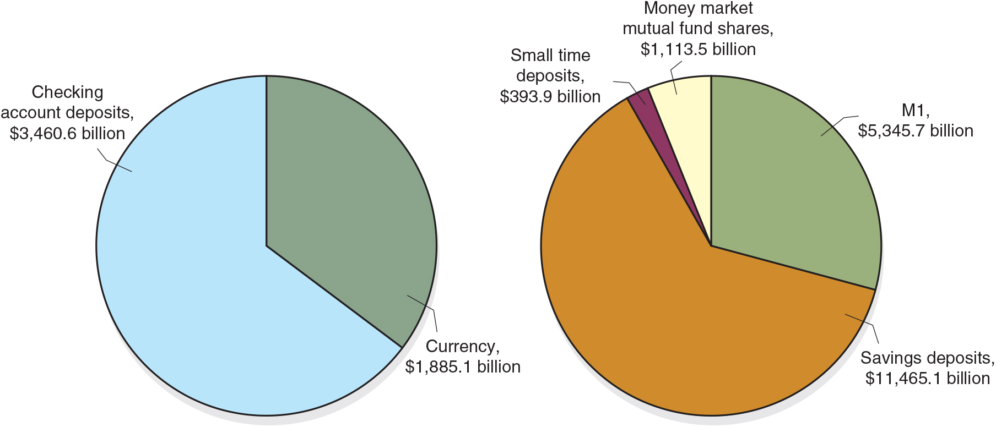
Figure 2.1 Measuring the Money Supply, July 2020
Source: Board of Governors of the Federal Reserve System. Federal Reserve Statistical Release, H6, July 30, 2020.
The Federal Reserve uses two different measures of the money supply: M1 and M2. M1 includes currency and checking account deposits. M2 includes all the assets in M1, as well as the additional assets shown in panel (b).
Notes:
Notes: In panel (b), savings deposits include money market deposit accounts. Checking account deposits are also called demand deposits.
The first pie chart for M1 = $5,345.7 billion shows data as checking account deposits, $3,460.6 billion and currency, $1,885.1 billion. The second pie chart for M2 = $18,318.2 billion shows data as savings deposits, $11,465.1 billion, M1, $5,345.7 billion, money market mutual fund shares, $1,113.5 billion, and small time deposits, $393.9 billion.

Slide 34
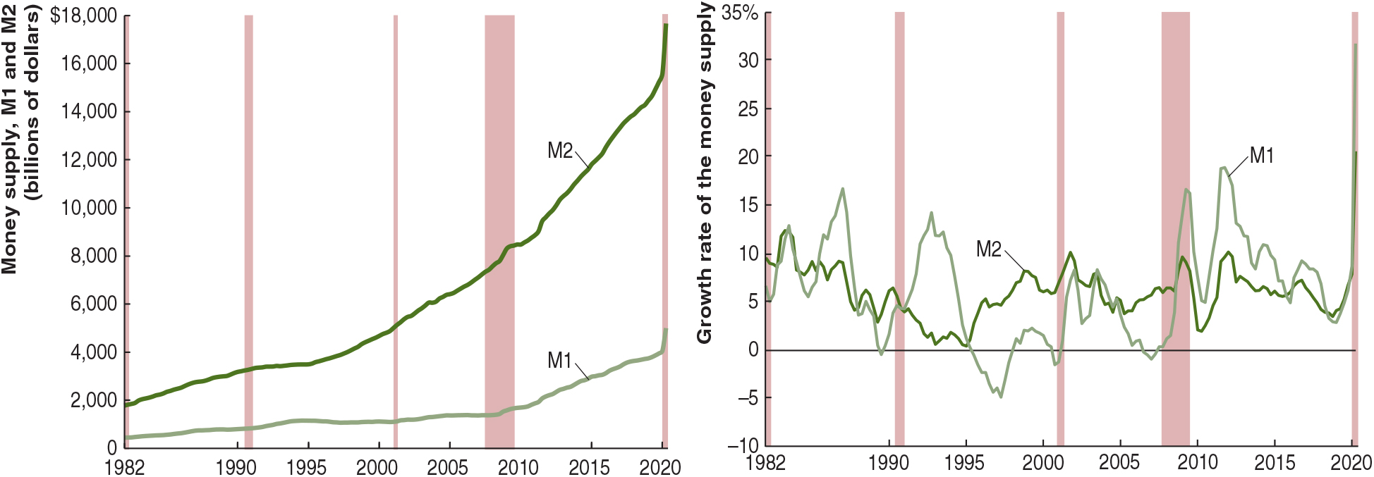
Does It Matter Which Definition of the Money Supply We Use?
Figure 2.2 M1 and M2, 1982-2020
Panel (a) shows that since 1982, M2 has increased much more rapidly than has M1.
Panel (b) shows that M1 has experienced much more instability than has M2. The shaded areas indicate recessions.
Source: Federal Reserve Bank of St. Louis.
Notes:
Teaching Tips: There has been much discussion about how the Fed “printed money” and more than doubled the size of the money supply during the financial crisis. As a result, some commentators have predicted that the United States will experience hyperinflation. Have students look at Figure 2.2 (both panel a and panel b) to see how much the money supply has really grown since the start of the crisis in Fall 2008 (pay particular attention to M2). You can use this figure to reinforce the meaning of the money supply and the limits to the Fed’s ability to increase it (though you should save the discussion of the difference between the monetary base and the money supply for a future chapter). Though M1 displays a couple of bursts of growth, neither was sustained. The growth of M2 does not differ much from its historical behavior.
Given the difference in growth rates of M1 and M2, can forecasters decide which measures to use to explain changes in other economic variables, such as the economy’s total output, the price level, and interest rates? The measure of the money supply that is best for forecasting remains an open question.
(a) The first graph is for level of M1 and M2. The graph shows the years from 19 82 to 20 15 on the x axis in increments of 5 years. The y axis is labeled, money supply, M1 and M2 in billions of dollars and ranges from 0 to 14,000 in increments of 2,000 dollars. The line for M1 starts in 400 in 19 82 and moves to the right with a low slope. The line reaches to 3,000 by 20 15 and to 4000 by 20 20. The line for M2 starts from 1,900 in 19 82 and slopes upward with a slope higher than that for M1. The line reaches to 5,000 by year 2000, 8,000 by 20 10, 12,000 by 20 15, and 16,000 by 20 20.
(b) The second graph is for growth rates of M1 and M2. The x axis shows the years from 19 82 to 20 20 in increments of 5 years. The y axis is labeled, growth rate of the money supply and ranges from negative 10 percent at the origin to 35 percent, in increments of 5 percent. The lines for both M2 and M1 are both quickly fluctuating over the years. The line for M1 starts from 5% while that for M2 starts from 9% and both the lines reach 7.5% by 202 02. The values used in the description are approximate.

Slide 35
2.5 Learning Objective
Use the quantity theory of money to analyze the relationship between money and prices in the long run.

Slide 36


The Quantity Theory of Money: A First Look at the Link Between Money and Prices
Irving Fisher and the Equation of Exchange
The equation of exchange states that the quantity of money (M) multiplied by the velocity of money (V) equals the price level (P) multiplied by the level of real G D P (Y).
P Y equals nominal G D P, so
Irving Fisher asserted that V is constant and turned the equation of exchange (an identity) into the quantity theory of money.
Quantity theory of money is a theory about the connection between money and prices that assumes that the velocity of money is determined mainly be institutional factors and so is roughly constant in the short run.

Slide 37
The Quantity Theory Explanation of Inflation
We use the quantity equation expressed in percentage changes:
% Change in M + % Change in V = % Change in P + % Change in Y.
The percentage change in the price level is inflation, so that:

Slide 38
Solved Problem 2.5 Relationship Between Money and Income (1 of 2)
Do you agree with this statement: “It is not possible for the total value of production to increase unless the money supply also increases. After all, how can the value of the goods and services being bought and sold increase unless there is more money available?”

Slide 39
Solved Problem 2.5 Relationship Between Money and Income (2 of 2)
Solving the Problem
Step 1 Review the chapter material.
Step 2 Explain whether output in an economy can grow without the money supply also growing.
The total value of production (P Y) is the right side of the equation of exchange, so for it to increase, the left side (M V) must also increase.
If V increases, nominal G D P can increase with the money supply remaining constant.

Slide 40
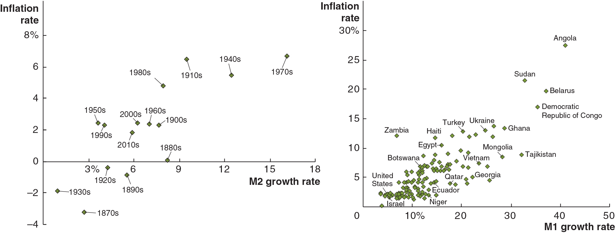
How Accurate Are Forecasts of Inflation Based on the Quantity Theory? (1 of 2)
Figure 2.3 The Relationship between Money Growth and Inflation over Time and Around the World
Panel (a) shows the relationship between M2 growth and inflation for the U.S. from the 18 70s to the 2010s. Panel (b) shows the relationship between M1 growth and inflation for 129 countries during the 2002-2018 period.
Notes:
In both panels, high money growth rates are associated with higher inflation rates.
The first graph is for growth rate of M2 and inflation in the United States. The vertical axis is labeled, inflation rate and ranges from negative 4 to 8% in increments of 2. The horizontal axis is labeled, M2 growth rate and ranges from 0 to 18% in increments of 3. The data is as follows.
A table has 14 rows and 3 columns. The columns have the following headings from left to right. Decade, M2 growth rate, Inflation rate. The row entries are as follows. Row 1. Decade, 1870s. M2 growth rate, 2.5%. Inflation rate, negative 3%. Row 2. Decade, 1880s. M2 growth rate, 8%. Inflation rate, 0%. Row 3. Decade, 1890s. M2 growth rate, 5.5%. Inflation rate, negative 1%. Row 4. Decade, 1900s. M2 growth rate, 7.5%. Inflation rate, 2%. Row 5. Decade, 1910s. M2 growth rate, 9%. Inflation rate, 6.5%. Row 6. Decade, 1920s. M2 growth rate, 4.5%. Inflation rate, negative 0.5%. Row 7. Decade, 1930s. M2 growth rate, 1%. Inflation rate, negative 2%. Row 8. Decade, 1940s. M2 growth rate, 12%. Inflation rate, 6%. Row 9. Decade, 1950s. M2 growth rate, 3.5%. Inflation rate, 2%. Row 10. Decade, 1960s. M2 growth rate, 7%. Inflation rate, 2%. Row 11. Decade, 1970s. M2 growth rate, 7%. Inflation rate, 16%. Row 12. Decade, 1980s. M2 growth rate, 8%. Inflation rate, 5%. Row 13. Decade, 1990s. M2 growth rate, 4%. Inflation rate, 2%. Row 14. Decade, 2000s. M2 growth rate, 6%. Inflation rate, 2%.
The second graph is for growth rate of M1 and inflation around the world. The vertical axis is labeled, inflation rate and ranges from 0 to 30% in increments of 5. The horizontal axis is labeled, M1 growth rate and ranges from 0 to 50% in increments of 10. The data is as follows.
A table has 20 rows and 3 columns. The columns have the following headings from left to right. Country, M1 growth rate, Inflation rate, . The row entries are as follows. Row 1. Country, Israel. M1 growth rate, 3%. Inflation rate, 0%. Row 2. Country, United States. M1 growth rate, 5%. Inflation rate, 3%. Row 3. Country, Niger. M1 growth rate, 7.5%. Inflation rate, 3%. Row 4. Country, Ecuador. M1 growth rate, 14%. Inflation rate, 4%. Row 5. Country, Botswana. M1 growth rate, 12%. Inflation rate, 9%. Row 6. Country, Zambia. M1 growth rate, 7%. Inflation rate, 13%. Row 7. Country, Haiti. M1 growth rate, 15%. Inflation rate, 12%. Row 8. Country, Egypt. M1 growth rate, 16%. Inflation rate, 10%. Row 9. Country, Qatar. M1 growth rate, 18%. Inflation rate, 4%. Row 10. Country, Georgia. M1 growth rate, 26%. Inflation rate, 4%. Row 11. Country, Vietnam. M1 growth rate, 24%. Inflation rate, 8%. Row 12. Country, Turkey. M1 growth rate, 20%. Inflation rate, 13%. Row 13. Country, Ukraine. M1 growth rate, 25%. Inflation rate, 13.5%. Row 14. Country, Mongolia. M1 growth rate, 28%. Inflation rate, 9%. Row 15. Country, Ghana. M1 growth rate, 29%. Inflation rate, 13%. Row 16. Country, Tajikistan. M1 growth rate, 32%. Inflation rate, 10%. Row 17. Country, Sudan. M1 growth rate, 32.5%. Inflation rate, 22.5%. Row 18. Country, Democratic Republic of Congo. M1 growth rate, 37%. Inflation rate, 12%. Row 19. Country, Belarus. M1 growth rate, 38.5%. Inflation rate, 19.5%. Row 20. Country, Angola. M1 growth rate, 42%. Inflation rate, 28%.
The values used in the description are approximate.

Slide 41
How Accurate Are Forecasts of Inflation Based on the Quantity Theory? (2 of 2)
Velocity is erratic in the short run, so the quantity theory does not provide accurate short-run forecasts of inflation.
Panel (a) of Figure 2.3 shows that most of the variation in U.S. inflation rates across decades comes from variation in money growth.
Panel (b) of Figure 2.3 shows that countries where the money supply grew rapidly tended to have high inflation rates.
Zimbabwe's inflation rate of 15 billion percent during 2008 is an example of hyperinflation.
Hyperinflation is extremely high inflation rates; >50% per month.

Slide 42
The Hazards of Hyperinflation
Examples of hyperinflation are years during the Civil War, Germany during the early 1920s, Argentina during the 1990s, and Zimbabwe in recent years.
Prices rose so rapidly that money purchased fewer and fewer goods and services each day.
Households and firms responded by refusing to accept money.
As a result, economic activity contracted sharply and unemployment soared.

Slide 43
What Causes Hyperinflation?
The quantity theory indicates that hyperinflation is caused by the money supply (M) rising more rapidly than real output (Y).
Why, then, do central banks allow the money supply to rise?
Hyperinflation occurs usually when governments spend more than they collect in taxes.
A country can monetize the government’s debt by forcing its central bank to print money.

Slide 44
Should Central Banks Be Independent?
The more independent a central bank is, the more it can resist political pressures to increase the money supply, and so the lower the country’s inflation rate is.
In 2019, President Donald Trump was reported to have considered firing Fed Chair Jerome Powell for not lowering interest rates enough to spur the economy.
Critics of the Fed’s independence argue that it violates democratic principles and that its actions exceed the authority granted under federal law.
As we will see in later chapters, the debate over the Fed may result in important changes in a key part of the financial system.

Slide 45
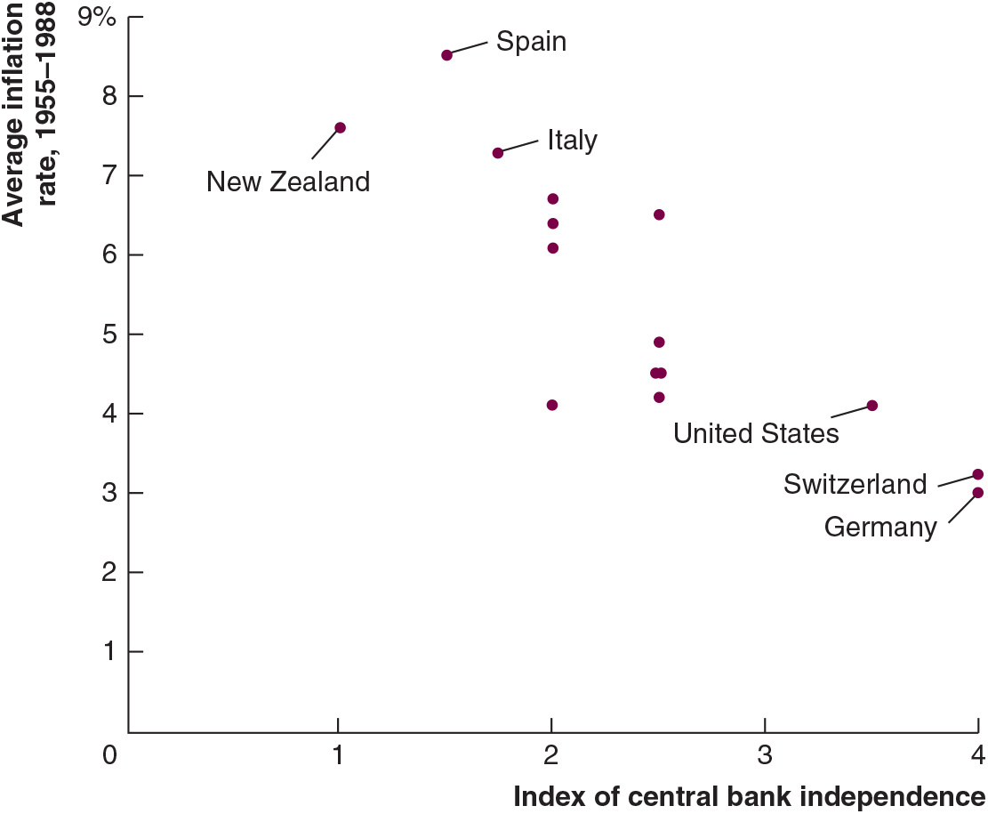
Figure 2.4 The Relationship Between Central Bank Independence and the Inflation Rate
Source: Alberto Alesina and Lawrence H. Summers, “Central Bank Independence and Macroeconomic Performance: Some Comparative Evidence,” Journal of Money, Credit and Banking, Vol. 25, No. 2, May 1993, pp. 151–162. Copyright 1993 by Ohio State University Press (Journals). Reproduced with permission of Ohio State University Press via Copyright Clearance Center.
Central bank independence is measured by an index ranging from 1 (minimum independence) to 4 (maximum independence).
Notes:
Notes: The figure shows that, for 16 high-income countries, the greater the degree of central bank independence, the lower the inflation rate.
Teaching Tips: Have students consider the implications of Figure 2.4 regarding the independence of the Federal Reserve. Discussion can involve what would likely happen to inflation in the United States if Congress reduced the independence of the Fed.
The vertical axis is labeled, average inflation rate, 19 55 to 19 88 and ranges from 0 to 9% in increments of 1. The horizontal axis is labeled, index of central bank independence and ranges from 0 to 4 in increments of 1. The data is as follows.
A table has 6 rows and 3 columns. The columns have the following headings from left to right. Country, Index of central bank independence, Average inflation rate from 19 55 to 19 88. The row entries are as follows. Row 1. Country, New Zealand. Index of central bank independence, 1. Average inflation rate from 19 55 to 19 88, 7.5%. Row 2. Country, Spain. Index of central bank independence, 1.5. Average inflation rate from 19 55 to 19 88, 8.5%. Row 3. Country, Italy. Index of central bank independence, 1.8. Average inflation rate from 19 55 to 19 88, 7.3%. Row 4. Country, United States. Index of central bank independence, 3.5. Average inflation rate from 19 55 to 19 88, 4.0%. Row 5. Country, Switzerland. Index of central bank independence, 4. Average inflation rate from 19 55 to 19 88, 3.5%. Row 6. Country, Germany. Index of central bank independence, 4. Average inflation rate from 19 55 to 19 88, 3.2%.
The values used in the description are approximate.

Slide 46
Answering the Key Question
At the beginning of this chapter, we asked the question:
“Should a central bank be independent of the rest of the government?”
The degree of independence that a country grants to its central bank is ultimately a political question.
Most economists believe that an independent central bank provides a check on inflation.

Slide 47

Copyright
This work is protected by United States copyright laws and is provided solely for the use of instructors in teaching their courses and assessing student learning. Dissemination or sale of any part of this work (including on the World Wide Web) will destroy the integrity of the work and is not permitted. The work and materials from it should never be made available to students except by instructors using the accompanying text in their classes. All recipients of this work are expected to abide by these restrictions and to honor the intended pedagogical purposes and the needs of other instructors who rely on these materials.

