Slide 1
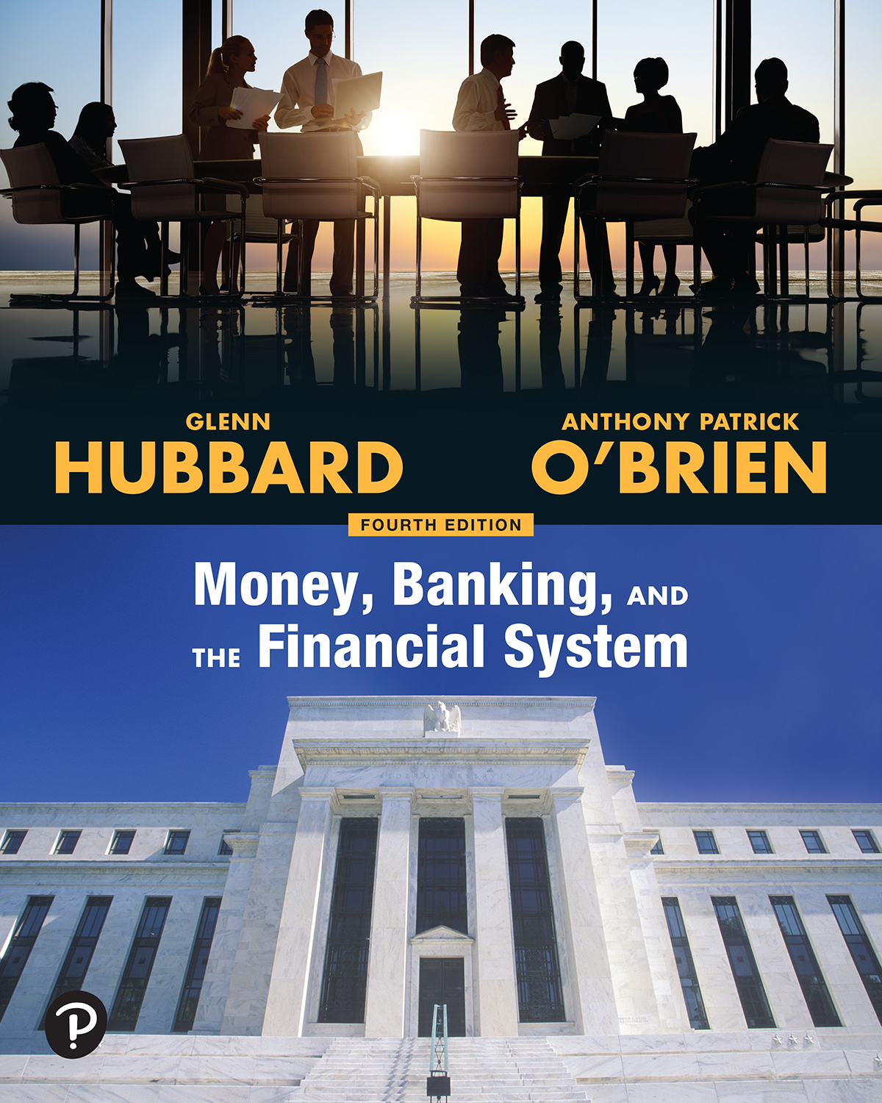

Money, Banking, and the Financial System
Fourth Edition
Chapter 3
Interest Rates and Rates of Return
Copyright © 2022, 2018, 2014 Pearson Education, Inc. All Rights Reserved
Notes:
If this PowerPoint presentation contains mathematical equations, you may need to check that your computer has the following installed:
1) MathType Plugin
2) Math Player (free versions available)
3) NVDA Reader (free versions available)

Slide 2
Learning Objectives
After studying this chapter, you should be able to:
3.1 Use the interest rate to calculate present values and future values.
3.2 Distinguish among different debt instruments and understand how their prices are determined.
3.3 Explain the relationship between the yield to maturity on a bond and its price.
3.4 Understand the inverse relationship between bond prices and bond yields.
3.5 Explain the difference between interest rates and rates of return.
3.6 Explain the difference between nominal interest rates and real interest rates.

Slide 3
Are Treasury Bonds a Risky Investment?
Treasury bonds have little default risk as the U.S. government is almost certain to make payments on its bonds.
In 2020, many investors and financial advisers believed Treasury bonds were subject to high interest-rate risk—the risk that bond prices will change in response to changes in market interest rates.
The Fed had responded to the weak U.S. economy by increasing the money supply that would lead to high inflation in the long run.
The expectation of high future inflation would lower the prices of bonds as a result of higher interest rates on those bonds.
Notes:
Make use of the chapter opener, “Are Treasury Bonds a Risky Investment?” to show how changing interest rates affect the price of bonds.
Begin by stating that a person purchased a bond that pays 2% interest per year for $1,000. Suppose that new bonds now pay an interest rate of 6%. Ask students how much interest they would receive each year if they held the original bond to maturity.
Now ask whether they would be willing to sell their bond for $1,000 and use the $1,000 to purchase a new bond yielding 6% interest.
Follow up by asking whether someone would be willing to purchase their bond for $1,000. If not, would they be willing to accept less than $1,000? Have them explain their reasoning.

Slide 4
Key Issue and Question
Issue: Some investment analysts argue that very low interest rates on some long-term bonds make them risky investments.
Question: Why do interest rates and the prices of financial securities move in opposite directions?

Slide 5
3.1 Learning Objective
Use the interest rate to calculate present values and future values.

Slide 6
The Interest Rate, Present Value, and Future Value: Why Do Lenders Charge Interest on Loans?
The interest rate on a loan should cover the opportunity cost of supplying credit so the interest should include:
Compensation for inflation: If prices rise, the payments received will buy fewer goods and services.
Compensation for default risk: The borrower might default on the loan.
Compensation for the opportunity cost of waiting to spend the money.

Slide 7
Most Financial Transactions Involve Payments in the Future
The importance of the interest rate comes from the fact that most financial transactions involve payments in the future.
The interest rate provides a link between the financial present and the financial future.

Slide 8



Compounding and Discounting
Future value is the value at some future time of an investment made today.
The future value of an investment (principal) in one year
with an
interest rate i:
Compounding for More Than One Period
Compounding is the process of earning interest on the principal of an investment and on the interest earned, as savings accumulate over time.
If you invest the principal for n years, then you will have at the end of n years:
Notes:
The subscript 1 in FV₁ indicates that we are looking at the future value after one year.

Slide 9
Solved Problem 3.1A: In Your Interest Using Compound Interest to Select a Bank C D (1 of 2)
Suppose you are considering investing $1,000 in one of the following bank C Ds:
First C D, which will pay an interest rate of 4% per year for 3 years
Second C D, which will pay an interest rate of 8% the first year, 1% the second year, and 1% the third year
Which C D should you choose?

Slide 10
Solved Problem 3.1A: In Your Interest Using Compound Interest to Select a Bank C D (2 of 2)
Solving the Problem
Step 1 Review the chapter material.
Step 2 Calculate the future value of your investment with the first C D.
Step 3 Calculate the future value of your investment with the second C D.
Step 4 Decision: You should choose the investment with the highest future value, so you should choose the first C D.

Slide 11
An Example of Discounting (1 of 2)
Funds in the future are worth less than funds in the present, so they have to be reduced, or discounted, to find their present value.
Present value is the value today of funds that will be received in the future.
Time value of money is the way that the value of a payment changes depending on when the payment is received.

Slide 12
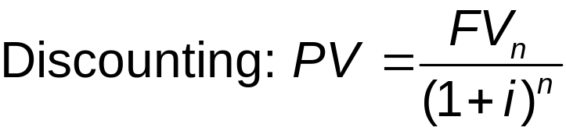
An Example of Discounting (2 of 2)
Discounting is the process of finding the present value of funds that will be received in the future (i.e., the opposite of compounding).

Slide 13
Some Important Points About Discounting (1 of 2)
Present value is also known as “present discounted value.”
The further in the future a payment is to be received, the smaller its present value.
The higher the interest rate used to discount future payments, the smaller the present value of the payments.
The present value of a series of future payment is simply the sum of the discounted value of each individual payment.

Slide 14
Some Important Points About Discounting (2 of 2)
Table 3.1 Time, the Interest Rate, and the Present Value of a Payment
Present value of a $1,000 payment to be received in …
Interest rate | 1 year | 5 years | 15 years | 30 years
1% | $990.10 | $951.47 | $861.35 | $741.92
2% | 980.39 | 905.73 | 743.01 | 552.07
5% | 952.38 | 783.53 | 481.02 | 231.38
10% | 909.09 | 620.92 | 239.39 | 57.31
20% | 833.33 | 401.88 | 64.91 | 4.21
Examples:
At an interest rate of 5%, a $1,000 payment has a P V of $952.38 in one year, but only $231.38 in 30 years.
A $1,000 payment you receive in 15 years has a P V of $861.35 when the interest rate is 1%, but only $64.91 when the interest rate is 20%.
Suppose the interest rate is 10%, and you will be paid $1,000 in one year and another $1,000 in 5 years, then the P V of both payments is $909.09 + $620.92 = $1,530.01.
Notes:
Teaching Tips: Ask the students how to identify the numbers in the table. Also, ask the students which specific point in the last slide that each example illustrates.

Slide 15
Solved Problem 3.1B: In Your Interest How Do You Value a College Education? (1 of 2)
The following data are the additional earnings of college graduates over high school graduates by age:
Age 22: $7,200
Age 23: $7,200
Age 24: $7,300
Age 25: $7,300
a. What is the present value of a college education from ages 22 to 25? Assume an interest rate of 5%.
b. Suppose you are 18 years old. Explain how you calculate the present value of a college education to make a decision about whether to take a job immediately after graduating from high school or to attend college and then work at age 22.

Slide 16
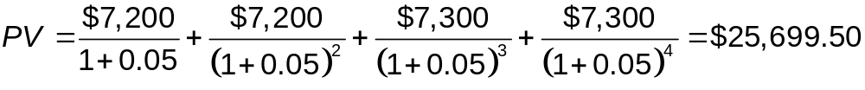
Solved Problem 3.1B: In Your Interest How Do You Value a College Education? (2 of 2)
Solving the Problem
Step 1 Review the chapter material.
Step 2 Answer part (a) by using the data given to calculate the P V of a college education.
Step 3 Answer part (b) by considering how to calculate the P V of a college education through the normal retirement age of 67.
You would also need to consider:
  Explicit costs of attending college, e.g., tuition and books
  The opportunity cost of attending college
  Income of the specific occupation you intend to enter after graduation

Slide 17
Discounting and the Prices of Financial Assets
Discounting lets you compare financial assets.
The price of an asset is determined by adding up the present values of all the payments from its sellers to buyers.

Slide 18
3.2 Learning Objective
Distinguish among different debt instruments and understand how their prices are determined.

Slide 19
Debt Instruments and Their Prices
The price of a financial asset is equal to the present value of the payments to be received from owning it.
Debt instruments are methods of financing debt, including simple loans, discount bonds, coupon bonds, and fixed payment loans.
  also known as credit market instruments or fixed income assets
Equity is a claim to part ownership of a firm.
  Example: common stock issued by a corporation.

Slide 20
Loans, Bonds, and the Timing of Payments
In this section, we discuss four basic categories of debt instruments:
Simple loans
Discount bonds
Coupon bonds
Fixed-payment loans

Slide 21
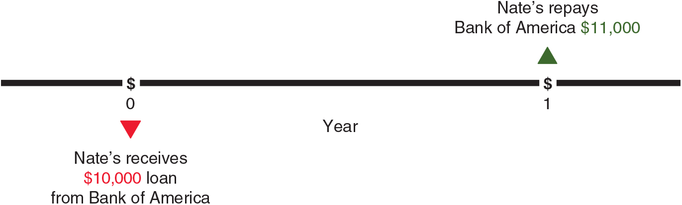
Simple Loan
Simple loan is a debt instrument in which the borrower receives from the lender an amount called the principal and agrees to repay the lender the principal plus interest on a specific date when the loan matures.
After one year, Nate’s would repay the principal plus interest:

Slide 22
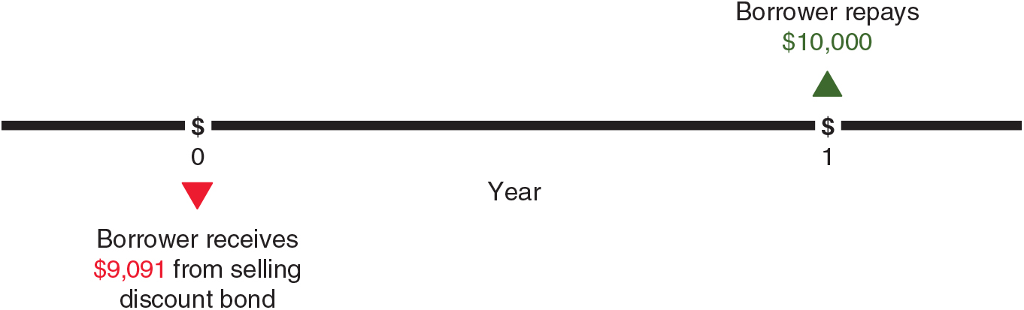


Discount Bond
Discount bond is a debt instrument in which the borrower repays the amount of the loan in a single payment at maturity but receives less than the face value of the bond initially.
The lender receives interest of
for the year.
Therefore, the interest rate is
Notes:
The most common types of discount bonds are U.S. savings bonds, U.S. Treasury bills, and zero-coupon bonds.

Slide 23
Coupon Bonds (1 of 2)
A coupon bond is a debt instrument that requires multiple payments of interest on a regular basis, and a payment of the face value at maturity.
Terminology of coupon bonds:
Face value (or par value): The amount to be repaid by the bond issuer (the borrower) at maturity.
Coupon: The annual fixed dollar amount of interest paid by the issuer of the bond to the buyer.
Coupon rate: The value of the coupon expressed as a percentage of the par value of the bond.
Current yield: The value of the coupon expressed as a percentage of the current price.
Notes:
The U.S. Treasury, state and local governments, and large corporations all issue coupon bonds.
The face value of the typical coupon bond is $1,000.
If the bond has an annual coupon of $50 and a face value of $1,000, its coupon rate is $50/$1,000 = 0.05, or 5%.
The price of the bond today may differ from its face value if the bond has been resold many times.

Slide 24
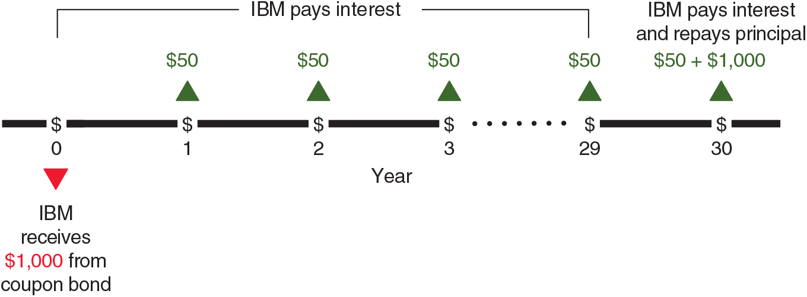
Coupon Bonds (2 of 2)
Maturity is the length of time before the bond expires and the issuer makes the face value payment to the buyer.
Example: I B M issued a $1,000 30-year bond with a coupon rate of 10%. The firm would pay $50 per year for 30 years and a final payment of $1,000 at the end of 30 years.
The timeline on the I B M coupon bond is:
Notes:
At year 0, IBM receives 1,000 dollars from the coupon bond. During years 1 to 29, IBM pays interest in the amount of 50 dollars each year. Finally, after year 30, IBM pays a final 50 dollars plus the principal amount of 1,000 dollars.

Slide 25
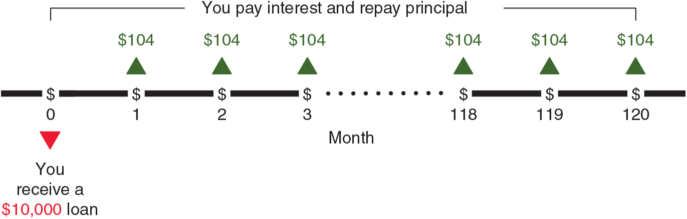
Fixed-Payment Loan
A fixed-payment loan is a debt instrument that requires the borrower to make regular periodic payments of principal and interest to the lender.
Example: You are repaying a $10,000 10-year student loan with a 4.6% interest rate, so your monthly payment is approximately $104.
The timeline of payments is:
Notes:
At month 0, the timeline shows that you receive a 10,000 dollar loan. From month 1 to month 120, you make a payment of 127 dollars each month, which includes both interest and principal amount.

Slide 26
Apply the Concept: In Your Interest Interest Rates and Student Loans (1 of 2)
More students are taking out student loans and in larger amounts.
Compounding and discounting help students understand the consequences of loan options:
  Not making interest payments while in college: The unpaid interest is added to the loan principal, so the monthly payments in the payback period would increase.
  Extending the payback period from 10 years to 25 years: Each monthly payment decreases, but since the principal is paid down more slowly, the total interest payments will increase.

Slide 27
Apply the Concept: In Your Interest Interest Rates and Student Loans (2 of 2)
Blank | Amount of Loan | Interest Rate | Interest You Pay | Your Loan Principal | Monthly Payment
You make no payment while in school | $20,000 | 4.53% | $3,624 | $23,624 | 10-year payback period: monthly payment rises from $208 to $245
Payback period of 10 years | $20,000 | 4.53% | $4,908 | $24,908 | $208
Payback period of 25 years | $20,000 | 4.53% | $13,452 | $33,452 | $112

Slide 28
3.3 Learning Objective
Explain the relationship between the yield to maturity on a bond and its price.
Notes:
Refer students to Solved Problem 3.3 on page 70, which provides a nice summary of how to solve for the yield to maturity for the different types of debt instruments.

Slide 29
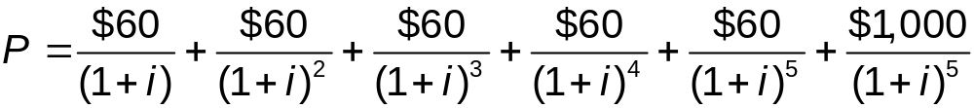
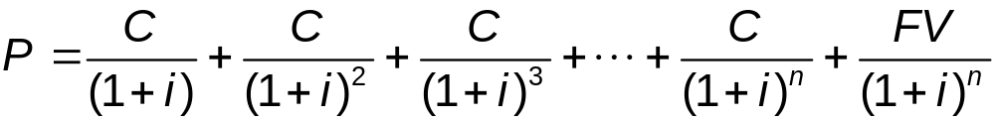
Bond Prices and Yield to Maturity Bond Prices
Consider a coupon bond with i = 6%, F V = $1,000, n = 5 years.
The price of the bond (P) is the sum of the present values of 6 payments:
For a bond that makes coupon payments (C) and matures in n years:
Notes:
P = start fraction C over left parenthesis 1 + i right parenthesis end fraction + start fraction C over left parenthesis 1 + right parenthesis squared end fraction + start fraction C over left parenthesis 1 + i right parenthesis cubed + ellipsis + start fraction C over left parenthesis 1 + i right parenthesis to the power of n end fraction + start fraction F V over left parenthesis 1 + i right parenthesis to the power of n end fraction.

Slide 30
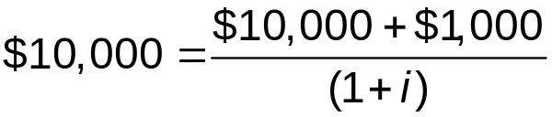
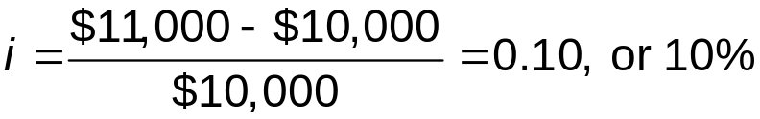
Yield to Maturity
Yield to maturity is the interest rate that makes the present value of the payments from an asset equal to the asset’s price today.
  the interest rate on a financial asset for financial markets participants.
Yields to Maturity on Other Debt Instruments
Simple Loans
For a $10,000 loan required to pay $11,000 in one year:
Value today = Present value of future payments
Solving for i:
Notes:
If you pay a price, P, today for a bond with a particular set of future payments, what is the interest rate at which you could invest P and get the same set of future payments?
For example, instead of calculating the present value of the payments to be received on a 30-year Treasury bond, we can calculate the interest rate at which the money paid for the bond could be invested for 30 years to get the same present value.

Slide 31
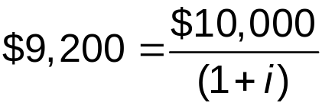
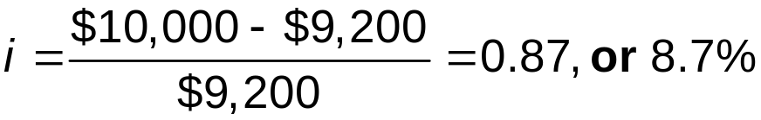
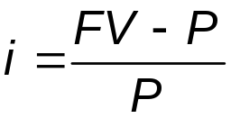
Discount Bonds
Consider a $10,000 one-year discount bond with a value today of $9,200.
Value today = Present value of future payments
Solving for i:
A one-year discount bond that sells for price P with face value F V. The yield to maturity is:

Slide 32
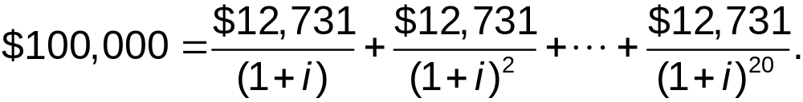
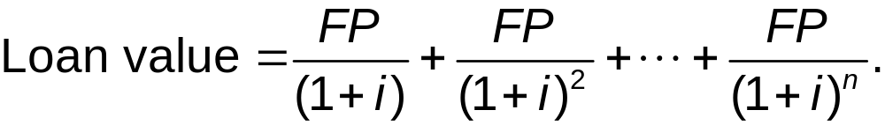
Fixed-Payment Loans
For a $100,000 loan with annual payments of $12,731:
Value today = Present value of future payments
For a fixed-payment loan with fixed payments F P and a maturity of n years, the equation is:
Notes:
Loan value = start fraction F P over left parenthesis 1 + i right parenthesis end fraction + start fraction F P over left parenthesis 1 + i right parenthesis squared end fraction + ellipsis + start fraction F P over left parenthesis 1 + i right parenthesis to the power of n end fraction.

Slide 33
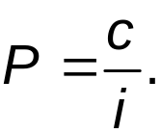
Perpetuities
A perpetuity does not mature. The price of a coupon bond that pays an infinite number of coupons equals:
So, a perpetuity with a coupon of $25 and a price of $500
has a yield to maturity of

Slide 34
Solved Problem 3.3: Finding the Yield to Maturity for Different Types of Debt Instruments (1 of 4)
For each of the following situations, write the equation that you would use to calculate the yield to maturity.
a) A simple business loan for $500,000 that requires a payment of $700,000 in 4 years.
b) A government discount bond with a price of $9,000, which has a face value of $10,000 and matures in one year.
c) A corporate bond with a face value of $1,000, a price of $975, a coupon rate of 10%, and a maturity of five years.
d) A student loan of $2,500, which requires payments of $315 per year for 25 years. The payments start in 2 years.

Slide 35
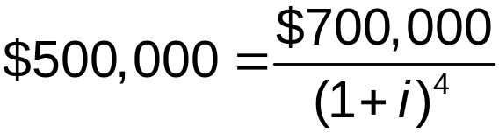
Solved Problem 3.3: Finding the Yield to Maturity for Different Types of Debt Instruments (2 of 4)
Solving the Problem
Step 1 Review the chapter material.
Step 2 Write an equation for the yield to maturity for the debt instrument in (a).
A simple loan for $500,000 that requires a payment of $700,000 in 4 years.

Slide 36
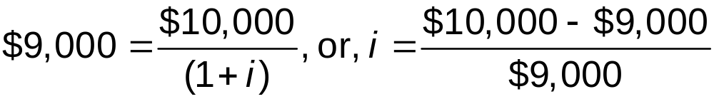
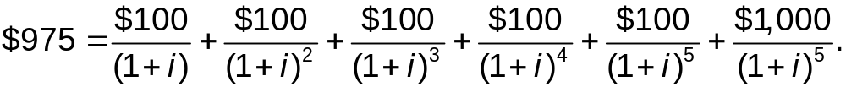
Solved Problem 3.3: Finding the Yield to Maturity for Different Types of Debt Instruments (3 of 4)
Step 3 Write an equation for the yield to maturity for the debt instrument in (b).
A discount bond with a price of $9,000, which has a face value of $10,000 and matures in 1 year.
Step 4 Write an equation for the yield to maturity for the debt instruments in (c).
A corporate bond with a face value of $1,000, a price of $975, a coupon rate of 10%, and a maturity of 5 years.

Slide 37
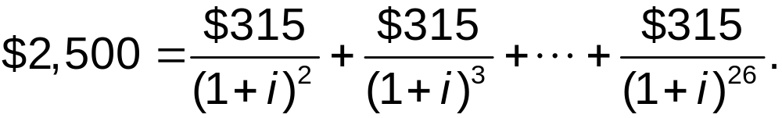
Solved Problem 3.3: Finding the Yield to Maturity for Different Types of Debt Instruments (4 of 4)
Step 5 Write an equation for the yield to maturity for the debt instruments in (d).
A student loan of $2,500, which requires payments of $315 per year for 25 years. The payments start in 2 years.

Slide 38
3.4 Learning Objective
Understand the inverse relationship between bond prices and bond yields.
Notes:
Apply the Concept: “How to Follow the Bond Market: Reading the Bond Table” on pages 76-77 helps students learn how to obtain and interpret real-world information about bonds instead of just understanding theoretical concepts.

Slide 39
The Inverse Relationship Between Bond Prices and Bond Yields
What Happens to Bond Prices When Interest Rates Change?
If new bonds are issued at a higher interest rate, holders of existing bonds would have to adjust their bond prices.
As the bond yield is higher, the bond’s market price will fall below its face value.
So, when interest rates rise, bond prices fall.
A capital gain occurs when the market price of an asset increases.
A capital loss occurs when the market price of an asset declines.

Slide 40
Apply the Concept: Banks Take a Bath on Mortgage-Backed Bonds
Banks reduced lending significantly during the financial crisis of 2007‒2009.
For mortgage-backed securities, borrowers began to default on their payments, so buyers required much higher yields to compensate for more default risk.
By 2008, the prices of many mortgage-backed securities had declined by 50% or more. Higher yields on these securities meant lower prices.
By early 2009, U.S. commercial banks had suffered losses of about $1 trillion on their investments.
Notes:
A brief discussion of bid and ask prices can reinforce how bond prices are determined by the interaction of buyers and sellers in the bond market.

Slide 41
Bond Prices and Yields to Maturity Move in Opposite Directions
Yields to maturity and bond prices move in opposite directions.
If interest rates on newly issued bonds rise, the prices of existing bonds will fall, and vice versa.
Reason: If interest rates rise, existing bonds issued with lower interest rates become less desirable to investors, and their prices fall.
This relationship should also hold for other debt instruments.

Slide 42
Secondary Markets, Arbitrage, and the Law of One Price
A trader buys and sells securities to profit from small differences in prices.
During the period before bond prices fully adjust to changes in interest rates, there is an opportunity for arbitrage.
Financial arbitrage is the process of buying and selling securities to profit from price changes over a brief period of time.
The prices of financial securities at any given moment allow little opportunity for arbitrage profits, so that investors receive the same yields on comparable securities.
This rationale follows the principle of the law of one price: Identical products should sell for the same price everywhere.

Slide 43
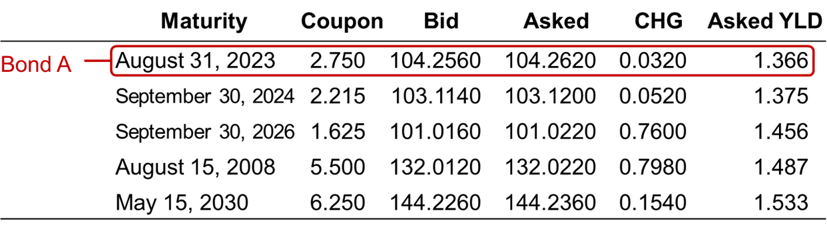
Apply the Concept: In Your Interest How to Follow the Bond Market: Reading the Bond Table (1 of 4)
Treasury Bonds and Notes
Bond A matures on August 31, 2023, and has a coupon rate of 2.75%, so it pays $27.50 each year on its $1,000 face value.
For Bond A, 104.2560 means a price of $1,042.560 for this $1,000 face value bond.
The bid price is the sell price; the asked price is the price to buy the bond.
For Bond A, the bid price rose by $0.0320 from the previous day.
Notes:
The table is as follows.
A table has 5 rows and 6 columns. The columns have the following headings from left to right. (1) Maturity, (2) Coupon, (3) Bid, (4) Asked, (5) C H G, (6) Asked YLD. The row entries are as follows. Row 1. (1) Maturity, August 31, 20 23. (2) Coupon, 2.75. (3) Bid, 104.256. (4) Asked, 104.262. (5) C H G, 0.032. (6) Asked YLD, 1.366. Row 2. (1) Maturity, September 30, 20 24. (2) Coupon, 2.215. (3) Bid, 103.114. (4) Asked, 103.12. (5) C H G, 0.052. (6) Asked YLD, 1.375. Row 3. (1) Maturity, September 30, 20 26. (2) Coupon, 1.625. (3) Bid, 101.016. (4) Asked, 101.022. (5) C H G, 0.76. (6) Asked YLD, 1.456. Row 4. (1) Maturity, August 15, 20 28. (2) Coupon, 5.5. (3) Bid, 132.012. (4) Asked, 132.022. (5) C H G, 0.798. (6) Asked YLD, 1.487. Row 5. (1) Maturity, May 15, 20 30. (2) Coupon, 6.25. (3) Bid, 144.226. (4) Asked, 144.236. (5) C H G, 0.154. (6) Asked YLD, 1.533.
The first row of the table is highlighted and is labeled, bond A.

Slide 44
Apply the Concept: In Your Interest How to Follow the Bond Market: Reading the Bond Table (2 of 4)
Treasury Bonds and Notes
The current yield of Bond A ($1000 face value):
The current yield of Bond A is well above the yield to maturity of 1.366%.
The current yield is not a good substitute for the yield to maturity for a short time to maturity because it ignores the effect of expected capital gains or losses.
Notes:
The table is as follows.
A table has 5 rows and 6 columns. The columns have the following headings from left to right. (1) Maturity, (2) Coupon, (3) Bid, (4) Asked, (5) C H G, (6) Asked YLD. The row entries are as follows. Row 1. (1) Maturity, August 31, 20 23. (2) Coupon, 2.75. (3) Bid, 104.256. (4) Asked, 104.262. (5) C H G, 0.032. (6) Asked YLD, 1.366. Row 2. (1) Maturity, September 30, 20 24. (2) Coupon, 2.215. (3) Bid, 103.114. (4) Asked, 103.12. (5) C H G, 0.052. (6) Asked YLD, 1.375. Row 3. (1) Maturity, September 30, 20 26. (2) Coupon, 1.625. (3) Bid, 101.016. (4) Asked, 101.022. (5) C H G, 0.76. (6) Asked YLD, 1.456. Row 4. (1) Maturity, August 15, 20 28. (2) Coupon, 5.5. (3) Bid, 132.012. (4) Asked, 132.022. (5) C H G, 0.798. (6) Asked YLD, 1.487. Row 5. (1) Maturity, May 15, 20 30. (2) Coupon, 6.25. (3) Bid, 144.226. (4) Asked, 144.236. (5) C H G, 0.154. (6) Asked YLD, 1.533.
The first row of the table is highlighted and is labeled, bond A.

Slide 45


Apply the Concept: In Your Interest How to Follow the Bond Market: Reading the Bond Table (3 of 4)
Treasury Bills
Maturity | Bid | Asked | C H G | Ask Y L D
February 4, 2020 | 1.455 | 1.445 | Negative 0.025 | 1.469
April 16, 2020 | 1.523 | 1.513 | Negative 0.002 | 1.543
May 21, 2020 | 1.538 | 1.528 | 0.010 | 1.560
Treasury bills are discount bonds, not coupon bonds.
Treasury notes and bonds quote prices, while Treasury bills quote yields.
The bid yield is the discount yield for sellers. The asked yield is for buyers.
Dealers’ profit margin is the difference between the asked and bid yields.
The yield to maturity (last column) is useful for comparing investments.

Slide 46
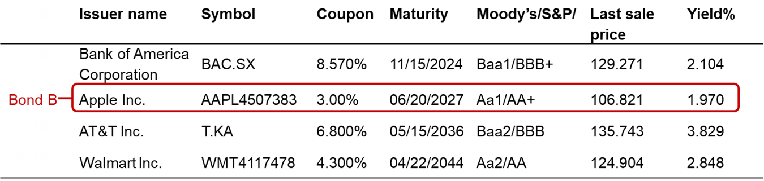
Apply the Concept: In Your Interest How to Follow the Bond Market: Reading the Bond Table (4 of 4)
New York Stock Exchange Corporation Bonds
A bond’s rating shows the likelihood that the firm will default on the bond.
Prices are quoted in decimals.
The last time this Apple bond was traded that day, it sold for a price of $1,068.21.
Notes:
The table is as follows.
A table has 4 rows and 7 columns. The columns have the following headings from left to right. (1) Issuer name, (2) Symbol, (3) Coupon, (4) Maturity, (5) Moody’s slash S and P, (6) Last sale price, (7) Yield %, . The row entries are as follows. Row 1. (1) Issuer name, Bank of America Corporation. (2) Symbol, BAC dot SX. (3) Coupon, 8.570%. (4) Maturity, 11/15/20 24. (5) Moody’s slash S and P, Baa1 slash BBB+. (6) Last sale price, 129.271. (7) Yield %, 2.104. Row 2. (1) Issuer name, Apple Inc. (2) Symbol, AAPL4507383. (3) Coupon, 3.000%. (4) Maturity, 06/20/20 27. (5) Moody’s slash S and P, Aa1 slash AA+. (6) Last sale price, 106.821. (7) Yield %, 1.97. Row 3. (1) Issuer name, AT and T Inc.. (2) Symbol, T dot KA. (3) Coupon, 6.800%. (4) Maturity, 05/15/20 36. (5) Moody’s slash S and P, Baa2 slash BBB. (6) Last sale price, 135.743. (7) Yield %, 3.829. Row 4. (1) Issuer name, Walmart Inc.. (2) Symbol, WMT4117478. (3) Coupon, 4.300%. (4) Maturity, 04/22/20 44. (5) Moody’s slash S and P, Aa2 slash AA. (6) Last sale price, 124.904. (7) Yield %, 2.848.
The second row of the table is highlighted and is labeled, bond B.

Slide 47
3.5 Learning Objective
Explain the difference between interest rates and rates of return.

Slide 48
Interest Rates and Rates of Return (1 of 2)
Return is a security’s total earnings.
For a bond, its return is the coupon payment plus the change in its price.
The rate of return (R) is the return on a security as a % of the initial price.
For a bond, R equals the coupon payment plus the change in the price of a bond divided by the initial price.

Slide 49
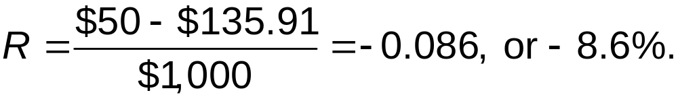
Interest Rates and Rates of Return (2 of 2)
Example: A bond with a $1,000 face value and a coupon rate of 5%.
If the end-of-year price is $1,169.84, then the rate of return for the year is:
If the end-of-year price is $864.09, then the rate of return for the year is:

Slide 50
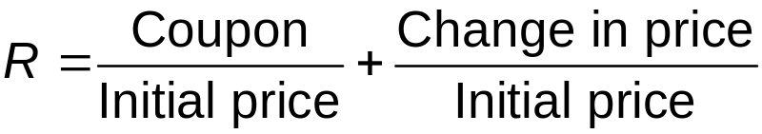
A General Equation for the Rate of Return on a Bond
A general equation for the rate of return on a bond for a holding period of one year is:
Rate of return = Current yield + rate of capital gain
Three important points:
For the current yield, the calculation uses the initial price.
If you sell the bond, you have a realized capital gain or loss; otherwise, your gain or loss is unrealized.
The current yield and the yield to maturity ignore capital gain or loss, so they may not be a good indicator of the rate of return.

Slide 51
Interest-Rate Risk and Maturity
Interest-rate risk is the risk that the price of a financial asset will fluctuate in response to changes in market interest rates.
Bonds with fewer years to maturity will be less affected by a change in market interest rates.

Slide 52









Table 3.2 The Effect of Maturity on Interest Rate Risk During the First Year of Owning a Bond When the Interest Rate Rises from 5% to 7%
Years to maturity | Current yield | Initial price | Price at the end of the year | Rate of capital gain or loss | Rate of return during the year
1 | 5% | $1,000 | $1,000.00 | 0% | 5.0%
2 | 5 | 1,000 | 981.31 | Negative 1.87 | 3.1
10 | 5 | 1,000 | 869.70 | Negative 13.0 | Negative 8.0
20 | 5 | 1,000 | 793.29 | Negative 20.7 | Negative 15.7
30 | 5 | 1,000 | 754.45 | Negative 24.6 | Negative 19.6
50 | 5 | 1,000 | 724.66 | Negative 27.5 | Negative 22.5
The table shows that the longer the maturity of your bond, the lower (more negative) your return after one year of holding the bond.
Notes:
Exercises for students:
Consider a three-year coupon bond that sells for $1,000 with an initial coupon rate of 5%. Solve for the price of the bond (present value), assuming the yield-to-maturity is equal to the coupon rate (answer is $1,000).
Now have students determine the new price if the interest rate rises to 6%. Have them note how much the bond price changes (new price is $973.27). Now consider what happens to the price if one year passes (new price is $981.67).
Point out to students that the three-year coupon bond now behaves as a two-year bond. Also, the price of the bond doesn’t decline as much as it did when it was a three-year bond (example of interest-rate risk). This is an example of how the interest-rate risk on bonds rises as the time-to-maturity increases.

Slide 53

How Much Interest-Rate Risk Do Investors in Treasury Bonds Face?
Although Treasury bonds have no default risk, as long-term bonds, they have significant interest-rate risk.
Table 3.2 on the previous slide shows that the longer the maturity of a bond, the lower (more negative) your return. With a maturity of 50 years, the rate of return for the first
year of owning the bond is

Slide 54
3.6 Learning Objective
Explain the difference between nominal interest rates and real interest rates.

Slide 55



Nominal Interest Rates Versus Real Interest Rates (1 of 2)
Nominal interest rates are interest rates that are not adjusted for changes in purchasing power.
Real interest rates are interest rates that are adjusted for changes in purchasing power.
Because lenders and borrowers don’t know what the actual real interest rate will be during the period of a loan, they must estimate an expected real interest rate.
The expected real interest rate (r) equals the nominal interest rate (i)
minus the expected rate of inflation
This means that:

Slide 56
Table 3.3 The Relationship Among the Nominal Interest Rate, the Expected Real Interest Rate, and the Real Interest Rate
If the inflation rate is … | the real interest rate will be … | and borrowers will … | and lenders will …
greater than the expected inflation rate … | less than the expected real interest rate … | gain | lose.
less than the expected inflation rate … | greater than the expected real interest rate … | lose | gain.

Slide 57
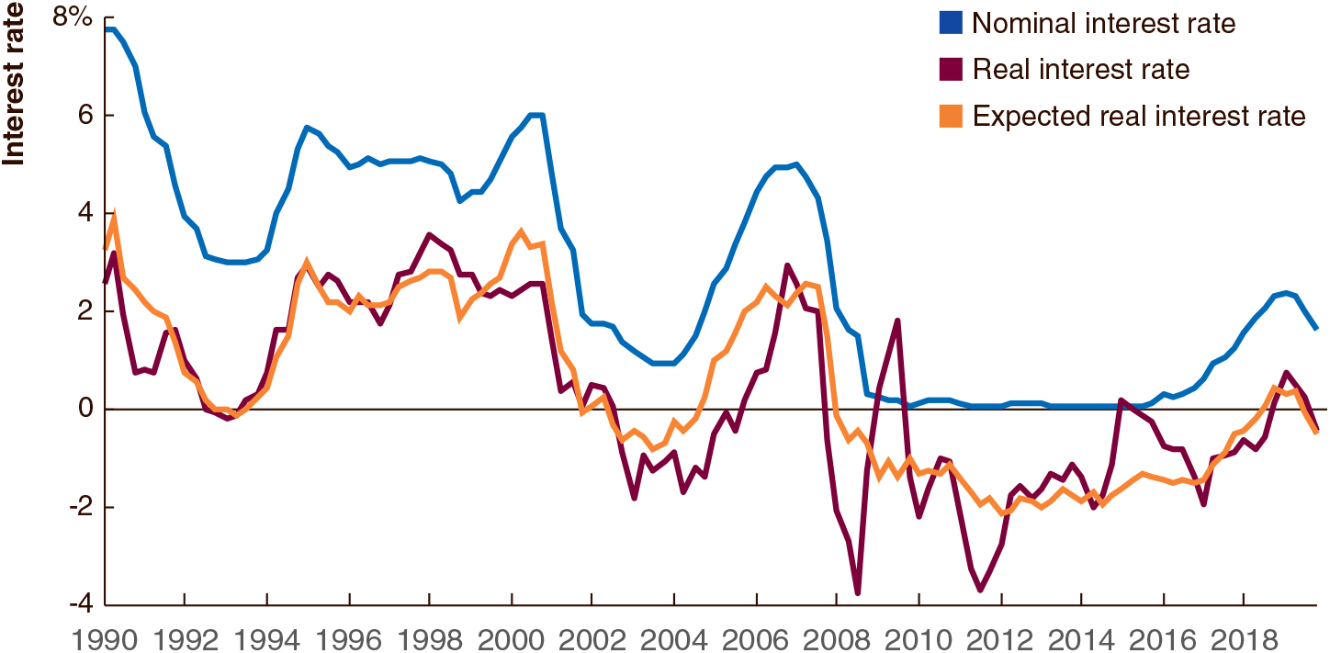
Figure 3.1 Nominal and Real Interest Rates, 1990–2019
The nominal interest rate is the interest rate on three-month U.S. Treasury bills.
The real interest rate (in red) is the nominal interest (in blue) minus the inflation rate, as measured by changes in the consumer price index.
The expected real interest rate is the nominal interest rate minus the expected rate of inflation as measured by a survey of professional forecasters.
Notes:
Notes: Observe that when the U.S. economy experienced deflation during 2009, the real interest rate was greater than the nominal interest rate.
The x axis shows the years from 19 90 to 20 18 in increments of 2 years. The y axis is labeled, interest rate and ranges from negative 4 to 8% in increments of 2. The line for nominal interest rate starts from 7.8% in 19 90 and falls down to 3% by 19 94. The line then recovers back and reaches 5% by 19 96 and remain unchanged until 19 98 where it falls suddenly and then rises to 6% by 2001. The line then slopes downward to fall down to 1% by 2004 and rises again to 5% by 2007. The line falls down immediately to a point close to the horizontal axis and remains unchanged until 20 16 where it shows a growing trend and reaches to 2% by 20 18. The other two line shows nearly a similar growth and decline trend over the years. The line for real interest rate starts from 2.8% in 19 90 and amid quick fluctuations falls to 0 by 19 93. The line then recovers back and reaches 3.7% by 19 98 but falls down to negative 1.8% by 2004. The line rises thereafter to reach to a value of 3% by 2007 but falls down suddenly to negative 3.9 just after 2008. The line shows quick fluctuations the following years and finishes at 0.3% by 20 18. The line for expected real interest rate overlaps the line for real interest rate at many places over the years. The values used in the description are approximate.

Slide 58
Nominal Interest Rates Versus Real Interest Rates (2 of 2)
It is possible for the nominal interest rate to be lower than the real interest rate.
This occurs when the inflation rate is negative (i.e., deflation).
Deflation is a sustained decline in the price level.

Slide 59
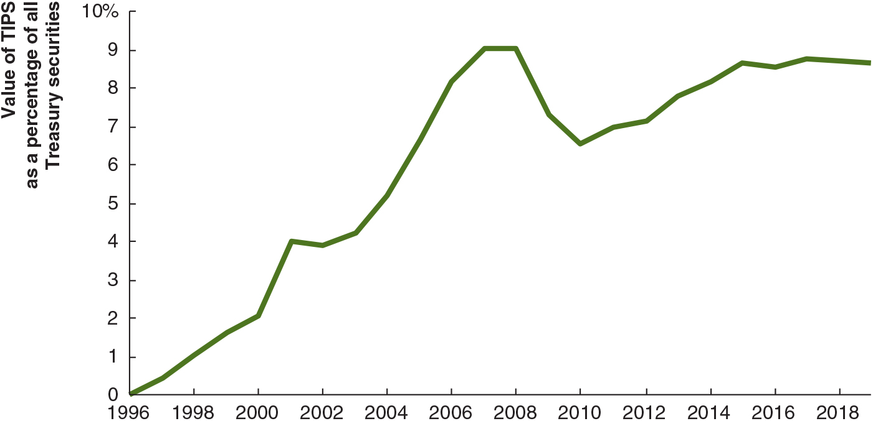
Figure 3.2 T I P S as a Percentage of All Treasury Securities
Since 1997, the U.S. Treasury has issued inflation indexed bonds called T I P S (Treasury Inflation Protection Securities). T I P S were an increasing percentage of all U.S. Treasury securities until 2008. After 2015, the share remained constant at 9%.
Notes:
Notes: Observe that when the U.S. economy experienced deflation during 2009, the real interest rate was greater than the nominal interest rate.
The x axis shows the years from 19 96 to 20 18 in increments of 2. The y axis is labeled, value of T I P S as a percentage of all Treasury securities and ranges from 0 to 10 percent. The line starts from the origin and shows a growing trend to reach to a value of 2% by the year 2000, 4% by 2002, 7.5% by 2006, and 9% by 2008. The line then slopes downward and falls to 7.5% by 20 10. The line after 20 10 shows a growing trend and reaches to a value of 8.5% by 20 28. The values used in the description are approximate.

Slide 60
Answering the Key Question
At the beginning of this chapter, we asked the question:
“Why do interest rates and the prices of financial securities move in opposite directions?”
The price of a financial security equals the present value of the payments an investor will receive from owning the security.
When interest rates rise, present values fall, and vice versa.
Therefore, interest rates and the prices of financial securities should move in opposite directions.

Slide 61

Copyright
This work is protected by United States copyright laws and is provided solely for the use of instructors in teaching their courses and assessing student learning. Dissemination or sale of any part of this work (including on the World Wide Web) will destroy the integrity of the work and is not permitted. The work and materials from it should never be made available to students except by instructors using the accompanying text in their classes. All recipients of this work are expected to abide by these restrictions and to honor the intended pedagogical purposes and the needs of other instructors who rely on these materials.

