Slide 1
Overview of Muldoon’s Hedge

Slide 2
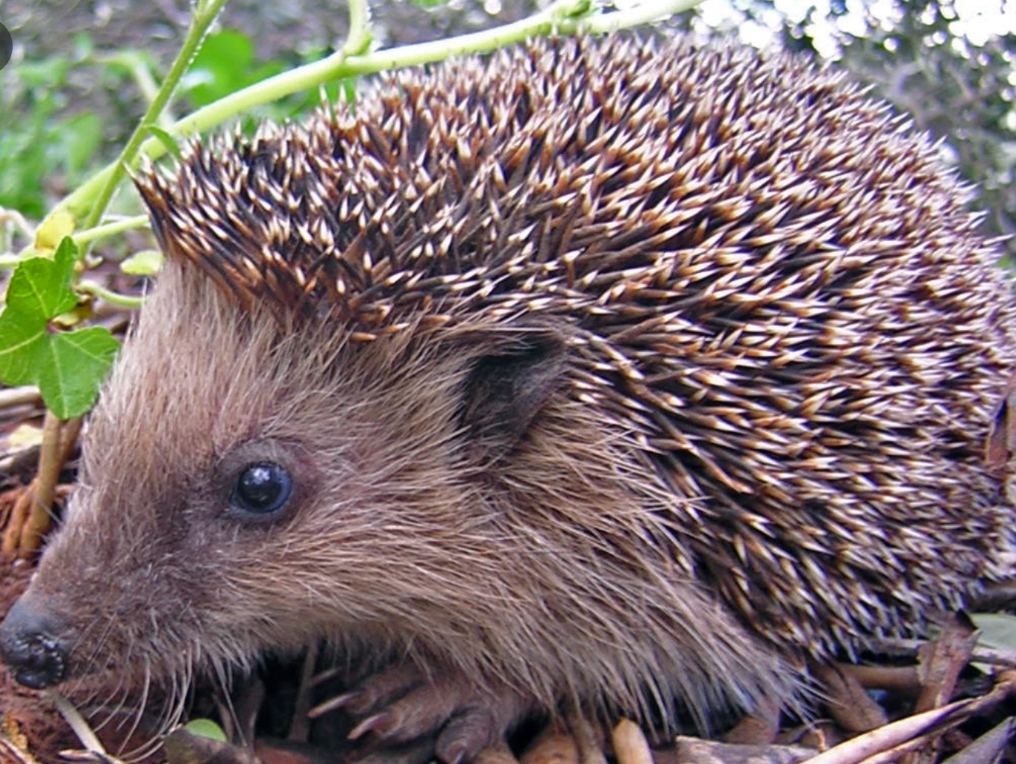
Hedgehog
self-enclosed
a creature able to turn in on itself for protection but in that act exposing itself to the risk of obliteration. (Armstrong 51)
Wears a crown of needles

Slide 3
Hedgehog
Later in the poem we find out that the Hedgehog has the “divine” in him and is able to hide it very well.
To represent the divine, the Hedgehog has to have these physical attributes:
  It can hide itself: can turn on itself for protection.
  His coat of needles that the hedgehog wears resembles the crown of thorns that Jesus wore.

Slide 4
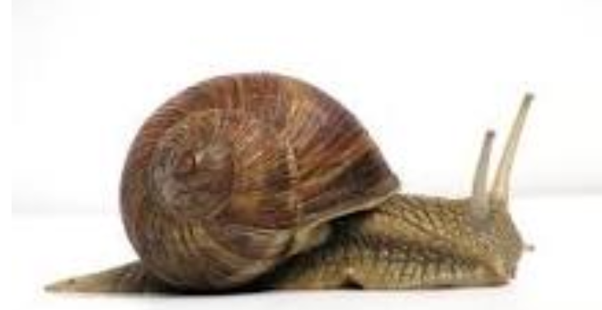
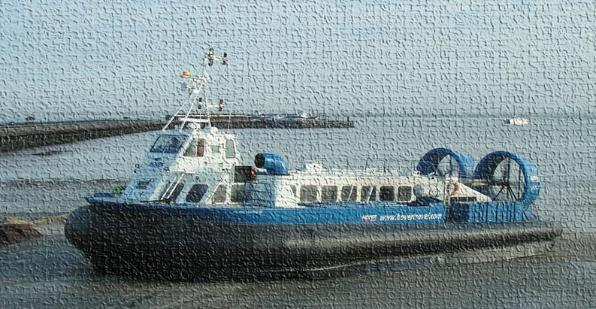
Snail compared to Hovercraft

Slide 5
Snail compared to Hovercraft
Snail →is an animal→ represents nature→natural world
Hovercraft →instance of technology→ Scientific World →from Human World
The quality or property that is being compared here is that of “motion.”
  For instance, “We” know how both hovercraft and snails MOVE.
The implication: not all truth about reality/existence is hidden from us. SOMETHINGS are KNOWABLE.

Slide 6
Snail compared to Hedgehog

Slide 7
Snail compared to Hedgehog
Both snail and hedgehog are from → animal→nature→natural world
Both are stand-ins for different aspects of natural world
Snails (knowable)
  Represent the aspects of nature/reality/existence that we understand quite well. For example, motion.
Hedgehog (not knowable)
  Represents the aspect of nature/reality/existence that we don’t really understand. For example, the divine or “meaning-of-it-all”
Hovercraft (knowable)
  Represents the aspects of the reality/human world/technological world we understand and have created.

Slide 8
Hedgehog is compared to God:
Hedgehog a “god”?
Hedgehog in the last stanza is declared to be a god “under THIS crown of thorns”
But the Hedgehog’s reticence prevents him from
  revealing (giving us answers to our deepest questions) nature of divinity and its relation to the human world.
The reason for this “distrust”:
  Humanity cannot be trusted: case in point “Crucifixion of Christ”

Slide 9
Theme 1: Reticence
Hedgehog:
  A symbol for poet’s reticence
  A poet who understands limitations of his knowledge of the world….knows the unknowability of the most important things in life.
  That “meaningfulness” is elusive.
  That “meaning” is not always available

Slide 10
Theme 2: Inscrutability
Inscrutability of Nature
Inscrutabity of reality, of our lives
“meaning of it all” not accessible to the “we” of the poem
Reading the book of nature
Science/rationality(“hovercraft”) reveals some aspects (“secrets”) of our existence
  BUT not all

Slide 11
Possible Theme 3: Distrust
Humanity cannot be trusted
  That we should not be privy to the deepest secrets/truths about
    Nature
    The Divine
    Ourselves

Slide 12
Possible theme 4: Divinity
The mystery of the presence of divine in nature
The poem presents a strange version of
  Christ’s sacrifice.

