Slide 1
Hegemony

Slide 2
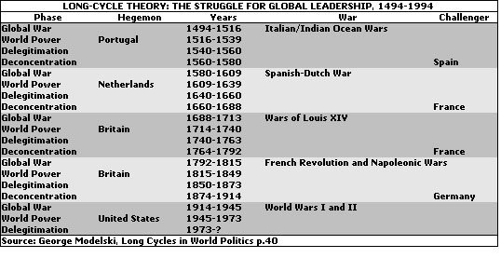
Cycles of World Leadership (hegemony)

Slide 3
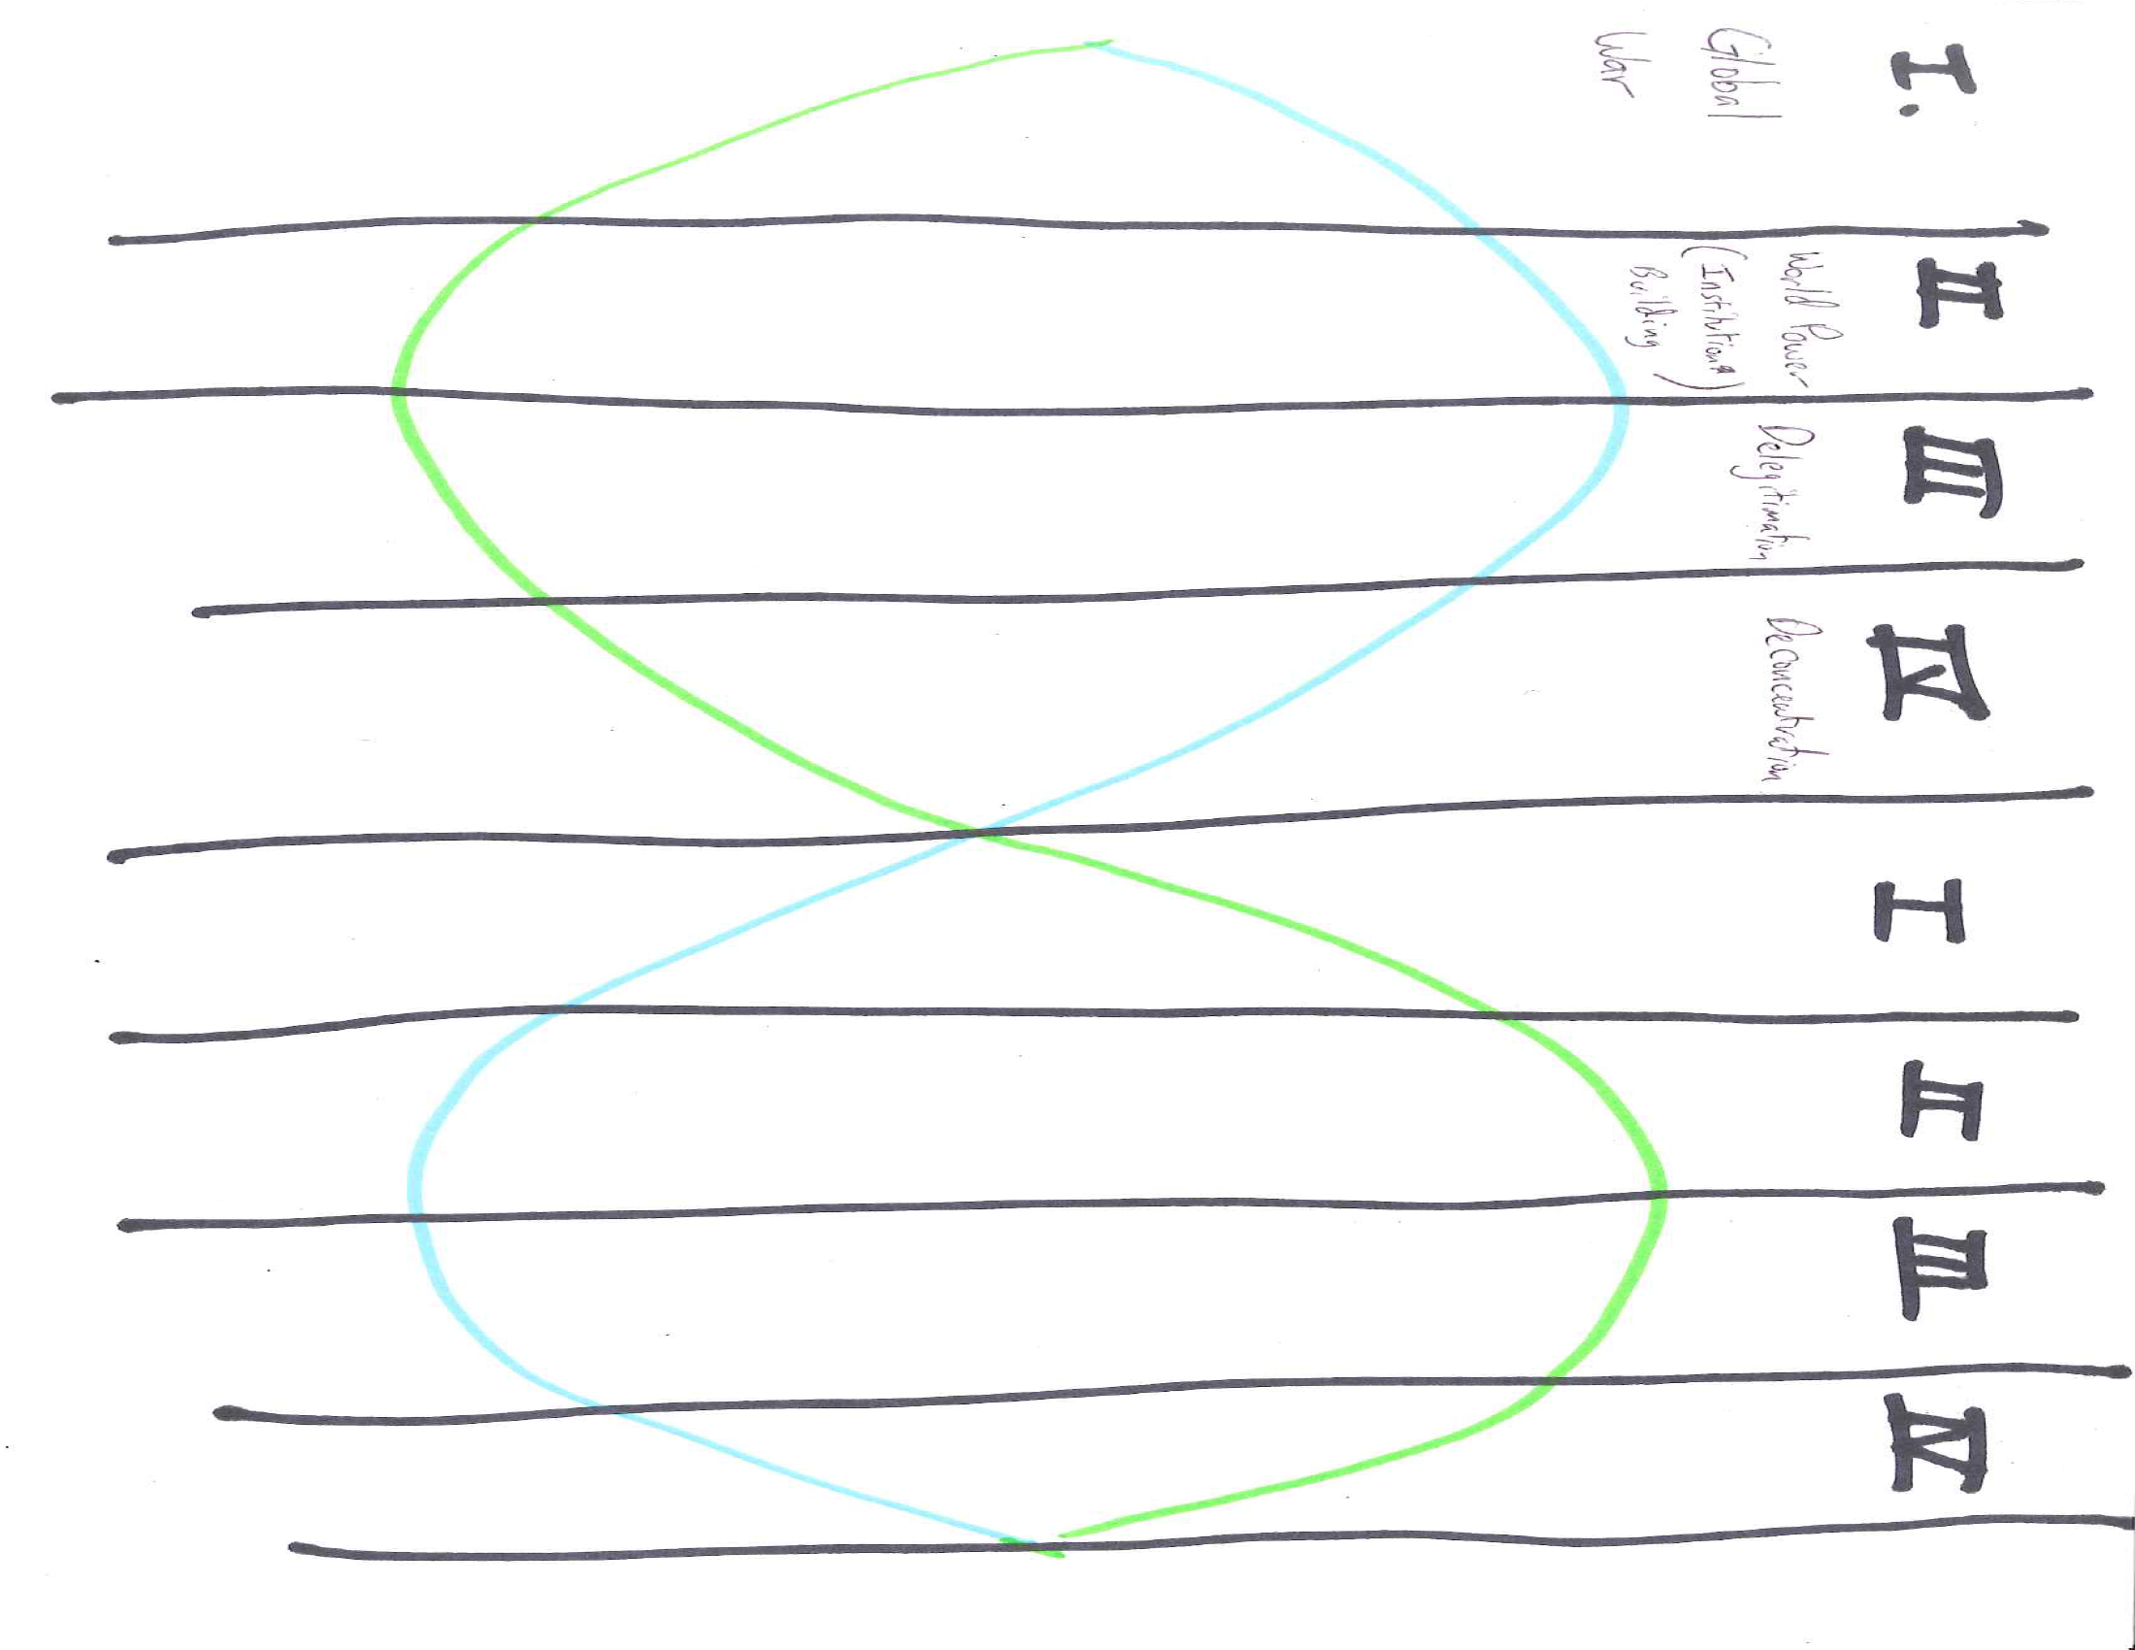

Slide 4
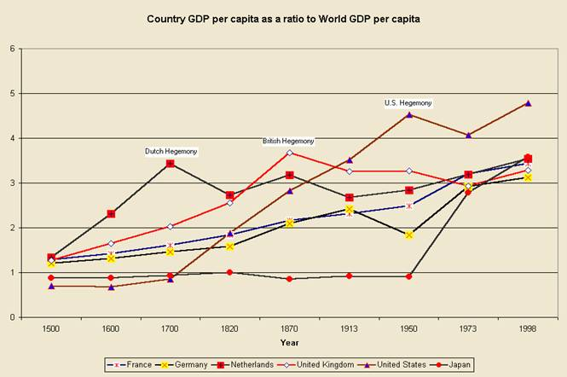
Economic Power and Hegemony

Slide 5
I. Global War
Changes in Power
Changes in Global Rules
Starts with power equally divided. With no clear hegemon, challengers attempt to establish themselves as the world leader and the result is a global war, with world leadership at stake.
Conflict starts , in part, because the hegemon is no longer able to enforce the rules. Global order is at a low point.

Slide 6
II. World Power
Changes in Power
Changes in Global Rules
After the global war, a hegemon has established itself as the leader. Challengers have been defeated/destroyed, so their ability to resist new rules is very low.
The global war has destroyed much of the old system, so there is an international “blank slate”. The hegemon can impose new rules, innovations and new values. This is sort of a golden age for the hegemon, and in addition to new rules, they establish economic and political innovations.

Slide 7
III. Delegitimation
Changes in Power
Changes in Global Rules
Challengers begin to recover, in part by adopting some of the innovations that made the hegemon so powerful. The hegemon is still the most powerful, but they are not head and shoulders above everyone else.
Hegemon’s rules are still in place, but their leadership is questioned more frequently. Challengers begin to assert themselves regionally. Projection of military/diplomatic power by hegemon is more difficult.

Slide 8
IV. Deconcentration
Changes in Power
Changes in Global Rules
One (or several challengers) start to come close to the power of the hegemon. The costs of hegemony begin to erode the power of the leader. Challengers are “free riders” and can benefit from putting the costs of leadership on the hegemon.
Hegemonic rules are openly challenged. Hegemon may face military defeat. Competing ideologies arise, regional powers grow. This is a period of growing disorder.

