Slide 1

Essentials of Sociology: A Down-To-Earth Approach
TWELFTH EDITION
Chapter 1
The Sociological Perspective

Slide 2
Learning Objectives (1 of 4)
1.1 Explain why both history and biography are essential for the sociological perspective
1.2 Trace the origins of sociology, from tradition to Max Weber
1.3 Trace the development of sociology in North America and explain the tension between objective analysis and social reform

Slide 3
Learning Objectives (2 of 4)
1.4 Explain the basic ideas of symbolic interactionism, functional analysis, and conflict theory
1.5 Explain why common sense can’t replace sociological research

Slide 4
Learning Objectives (3 of 4)
1.6 Know the main elements of the 7 research methods: surveys, participant observation, case studies, secondary analysis, analysis of documents, experiments, and unobtrusive measures; state why sociological research can lead to controversy

Slide 5
Learning Objectives (4 of 4)
1.7 Explain how gender is significant in sociological research
1.8 Explain why it is vital for sociologists to protect the people they study; discuss the two cases that are presented
1.9 Explain how research versus reform and globalization are likely to influence sociology

Slide 6
LO 1.1 The Sociological Perspective
Seeing the Broader Social Context
The Global Context—and the Local

Slide 7
LO 1.1—Seeing the Broader Social Context (1 of 2)
How People Are Influenced by Their Society
  People Who Share a Culture
  People Who Share a Territory
Social Location
  Jobs − Income
  Education − Gender
  Age − Race/Ethnicity

Slide 8
LO 1.1—Seeing the Broader Social Context (1 of 2)
C. Wright Mills
  History − Location in Broad Stream of Events
  Biography − Individual’s Specific Experiences
  External influences—our experiences—become part of our thinking and motivation

Slide 9
LO 1.1—The Global Context—and the Local
The Global Village
Instant Communication
  Pick up a telephone or use the Internet to communicate instantly with people anywhere

Slide 10
LO 1.2 Origins of Sociology
Tradition Versus Science
Auguste Comte and Positivism
Herbert Spencer and Social Darwinism
Karl Marx and Class Conflict
Emile Durkheim and Social Integration
Max Weber and the Protestant Ethic

Slide 11
LO 1.2—Tradition Versus Science
The Industrial Revolution
  Masses of people moved to cities in search of work
Grew Out of Social Upheaval
Imperialism of the Time
Rise of the Scientific Method

Slide 12
LO 1.2—Auguste Comte and Positivism (1 of 3)
Applying the Scientific Method to Social World
Comte began to wonder what holds society together
Coined the Term “Sociology”

Slide 13
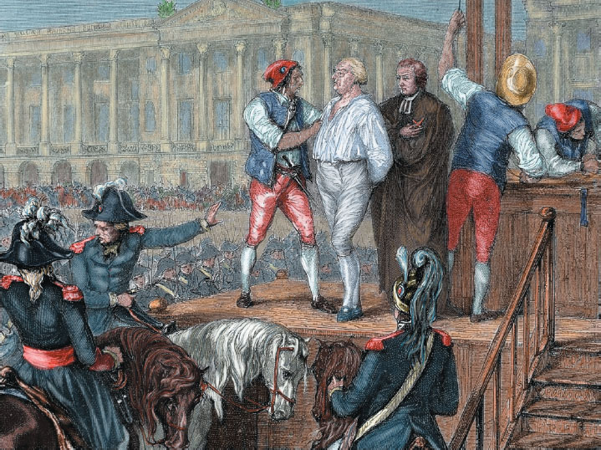
LO 1.2—Auguste Comte and Positivism (2 of 3)
Upsetting the entire social order, the French Revolution removed the past as a sure guide to the present. This stimulated Auguste Comte to analyze how societies change. Shown here is a battle at the Hotel de Ville in Paris in 1830.

Slide 14
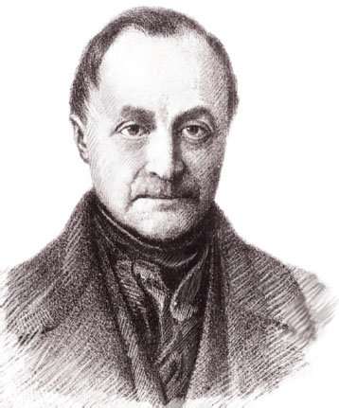
LO 1.2—Auguste Comte and Positivism (3 of 3)
Auguste Comte (1798–1857), who is credited as the founder of sociology, began to analyze the bases of the social order. Although he stressed that the scientific method should be applied to the study of society, he did not apply it himself.

Slide 15
LO 1.2—Herbert Spencer and Social Darwinism (1 of 2)
Second Founder of Sociology
Disagreed sharply with Comte’s idea that sociologists should guide social reform
Lower and Higher Forms of Society
Coined Phrase “Survival of the Fittest”

Slide 16
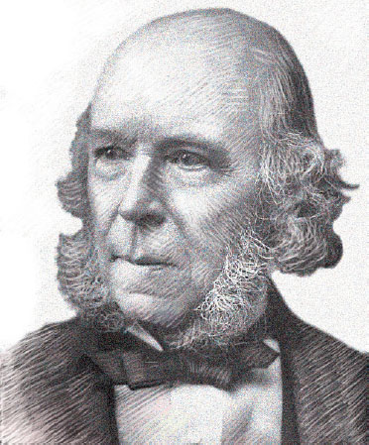
LO 1.2—Herbert Spencer and Social Darwinism (2 of 2)
Herbert Spencer (1820–1903), sometimes called the second founder of sociology, coined the term “survival of the fittest.” Spencer thought that helping the poor was wrong, that this merely helped the “less fit” survive.

Slide 17
LO 1.2—Karl Marx and Class Conflict (1 of 2)
Engine of Human History is Class Conflict
The Bourgeoisie vs. The Proletariat
Marxism Not the Same as Communism
Introduced Conflict Theory

Slide 18
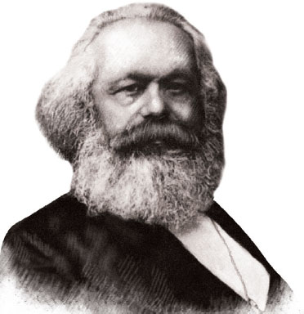
LO 1.2—Karl Marx and Class Conflict (2 of 2)
Karl Marx (1818–1883) believed that the roots of human misery lay in class conflict, the exploitation of workers by those who own the means of production. Social change, in the form of the workers overthrowing the capitalists, was inevitable from Marx’s perspective. Although Marx did not consider himself a sociologist, his ideas have influenced many sociologists, particularly conflict theorists.

Slide 19
LO 1.2—Emile Durkheim and Social Integration (1 of 2)
Got Sociology Recognized as Separate Discipline
Studied How Social Forces Affect Behavior
Identified “Social Integration” – Degree to Which People Are Tied to Social Group

Slide 20
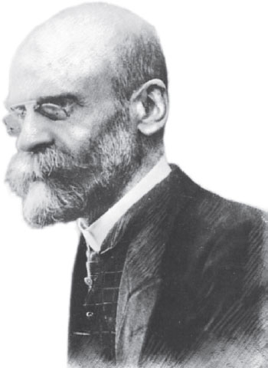
LO 1.2—Emile Durkheim and Social Integration (2 of 2)
The French sociologist Emile Durkheim (1858–1917) contributed many important concepts to sociology. His comparison of the suicide rates of several countries revealed an underlying social factor: People are more likely to commit suicide if their ties to others in their communities are weak. Durkheim’s identification of the key role of social integration in social life remains central to sociology today.

Slide 21
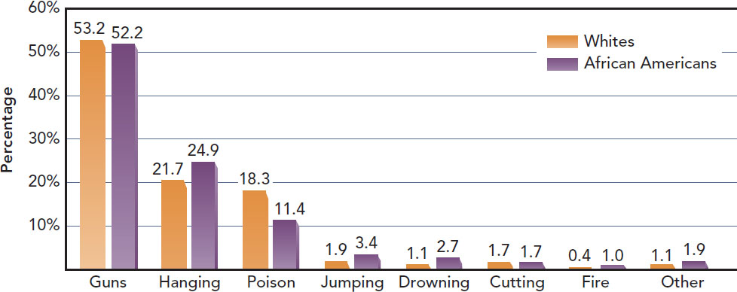
Figure 1.1 How Americans Commit Suicide
Note: These totals are the mean of years 2001–2011. (“Mean” is explained in Table 1.3 on page 25.)
Source: By the author. Based on Centers for Disease Control and Prevention 2012 and earlier years; Center for Injury Prevention and Control 2013.
Notes:
It is helpful for complex images (i.e., charts and graphs) to have descriptive text near the image (perhaps as a caption or in the Notes field). They would still require alt text.

Slide 22
LO 1.2—Max Weber and the Protestant Ethic (1 of 2)
Religion and the Origin of Capitalism
  Disagreed with Marx’s claim that economics is the central force in social change
  Said that role belongs to religion
Religion is Central Force in Social Change
Protestant Ethic and Spirit of Capitalism

Slide 23
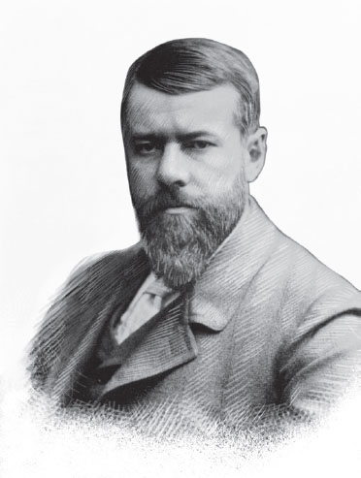
LO 1.2—Max Weber and the Protestant Ethic (2 of 2)
Max Weber (1864–1920) was another early sociologist who left a profound impression on sociology. He used cross-cultural and historical materials to trace the causes of social change and to determine how social groups affect people’s orientations to life.

Slide 24
LO 1.3 Sociology in North America
Sexism at the Time: Women in Early Sociology
Racism at the Time: W. E. B. Du Bois
Jane Addams: Sociologist and Social Reformer
Talcott Parsons and C. Wright Mills: Theory Versus Reform
The Continuing Tension: Basic, Applied, and Public Sociology

Slide 25
LO 1.3—Sexism at the Time: Women in Early Sociology (1 of 3)
Attitudes of the Time
  1800s Sex Roles Rigidly Defined
  Few People Educated Beyond Basics
Harriet Martineau
  Published Society in America Before Durkheim and Weber Were Born
  Her Work Was Ignored

Slide 26
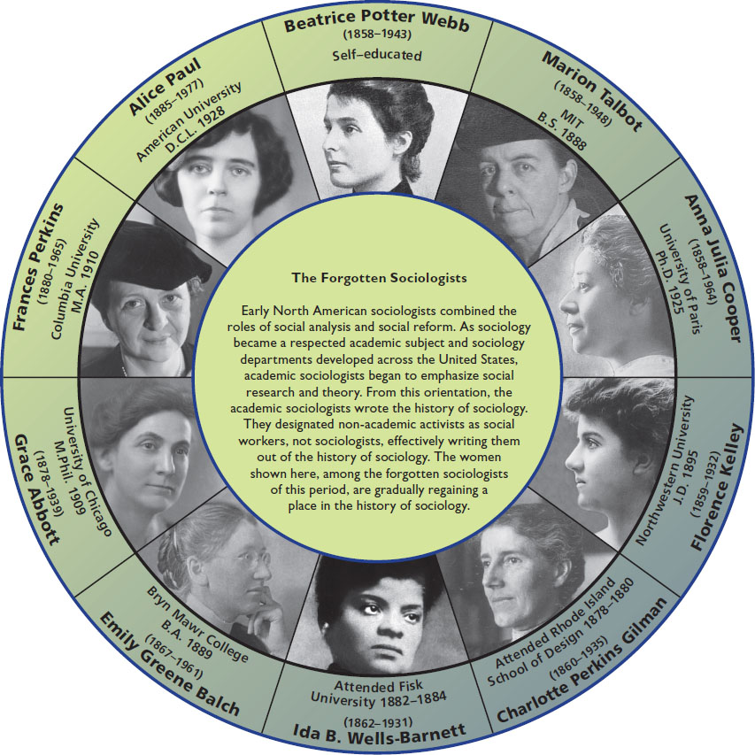
Figure 1.2 The Forgotten Sociologists
SOURCE: Photo wheel copyright 2017 © James M. Henslin.
Notes:
It is helpful for complex images (i.e., charts and graphs) to have descriptive text near the image (perhaps as a caption or in the Notes field). They would still require alt text.

Slide 27
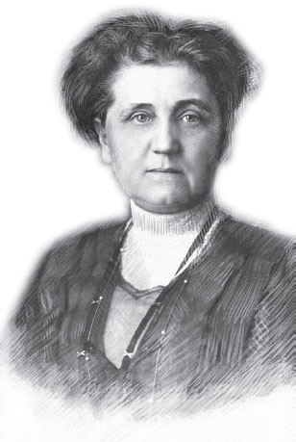
LO 1.3—Sexism at the Time: Women in Early Sociology (3 of 3)
Jane Addams (1860–1935), a recipient of the Nobel Prize for Peace, worked on behalf of poor immigrants. With Ellen G. Starr, she founded Hull-House, a center to help immigrants in Chicago. She was also a leader in women’s rights (women’s suffrage), as well as the peace movement of World War I.

Slide 28
LO 1.3—Racism at the Time: W. E. B. Du Bois (1 of 3)
First Harvard Ph.D. for African American
Published a Book Each Year from 1896 to 1914
Neglected by Sociologists Until Recently

Slide 29
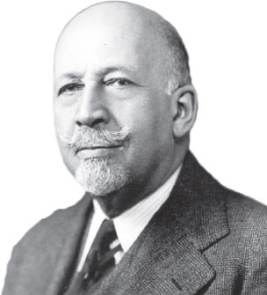
LO 1.3—Racism at the Time: W. E. B. Du Bois (2 of 3)
W(illiam) E(dward) B(urghardt) Du Bois (1868–1963) spent his lifetime studying relations between African Americans and whites. Like many early North American sociologists, Du Bois combined the role of academic sociologist with that of social reformer.

Slide 30
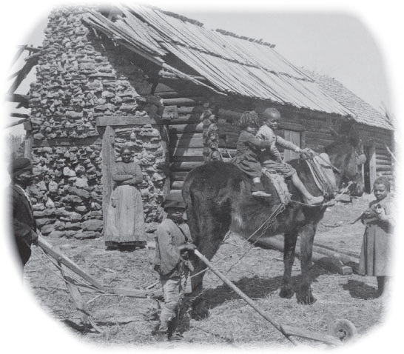
LO 1.3—Racism at the Time: W. E. B. Du Bois (3 of 3)
In the 1800s, most people were poor, and formal education beyond the first several grades was a luxury. This photo depicts the conditions of the people Du Bois worked with.

Slide 31
LO 1.3—Talcott Parsons and C. Wright Mills: Theory Versus Reform (1 of 2)
Many early North American sociologists saw society as corrupt and in need of reform
Parsons Developed Objective Analysis and Models of Society
Mills Deplored Theoretical Abstractions in Favor of Social Reform

Slide 32
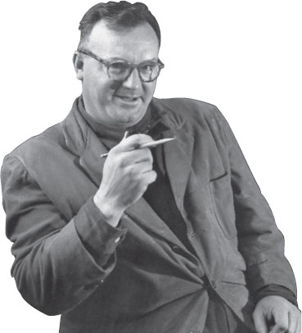
LO 1.3—Talcott Parsons and C. Wright Mills: Theory Versus Reform (2 of 2)
C. Wright Mills (1916-1962) was a controversial figure in sociology because of his analysis of the role of the power elite in U.S. society. Today, his analysis is taken for granted by many sociologists and members of the public.

Slide 33
LO 1.3—The Continuing Tension: Basic, Applied, and Public Sociology
Basic Sociology
  Analyzing some aspect of society to only gain knowledge
Applied Sociology
  Using sociology to solve problems
Public Sociology
  Using the sociological perspective for the benefit of the public
Social Reform is Risky
  Disrupting the status quo can be challenging

Slide 34
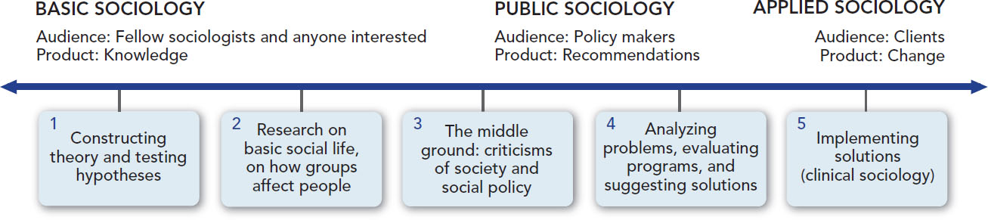
Figure 1.3 Comparing Basic and Applied Sociology
SOURCE: By the author. Based on DeMartini 1982, plus events since then.
Notes:
It is helpful for complex images (i.e., charts and graphs) to have descriptive text near the image (perhaps as a caption or in the Notes field). They would still require alt text.

Slide 35
LO 1.4 Theoretical Perspectives in Sociology
Symbolic Interactionism
Functional Analysis
Conflict Theory
Putting the Theoretical Perspectives Together
Levels of Analysis: Macro and Micro

Slide 36
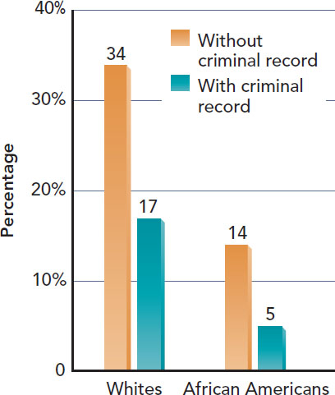
Figure 1.4 Call-Back Rates by Race-Ethnicity and Criminal Record
SOURCE: Courtesy of Devah Pager.
Notes:
It is helpful for complex images (i.e., charts and graphs) to have descriptive text near the image (perhaps as a caption or in the Notes field). They would still require alt text.

Slide 37
LO 1.4—Symbolic Interactionism (1 of 2)
How People Use Symbols in Everyday Life
Applying Symbolic Interactionism
  Changing meaning of symbols affects expectations
    The Meaning of Marriage
    The Meaning of Divorce
    The Meaning of Parenthood
    The Meaning of Love

Slide 38
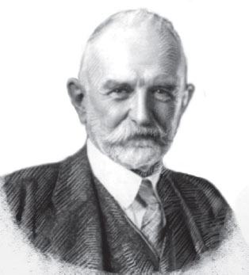
LO 1.4—Symbolic Interactionism (2 of 2)
George Herbert Mead (1863– 1931) is one of the founders of symbolic interactionism, a major theoretical perspective in sociology. He taught at the University of Chicago, where his lectures were popular. Although he wrote little, after his death students compiled his lectures into an influential book, Mind, Self, and Society.

Slide 39
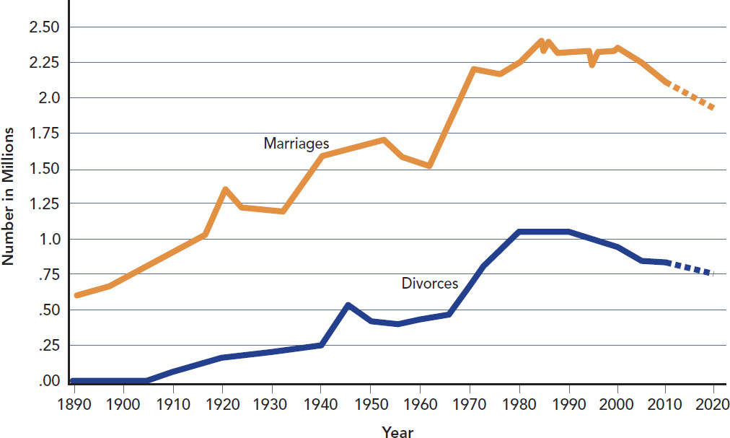
Figure 1.5 U.S. Marriage, U.S. Divorce
SOURCE: By the author. Based on Statistical Abstract of the United States 1998:Table 92 and 2014:84, 137; earlier editions for earlier years. The broken lines indicate the author’s estimates.
Notes:
It is helpful for complex images (i.e., charts and graphs) to have descriptive text near the image (perhaps as a caption or in the Notes field). They would still require alt text.

Slide 40
LO 1.4—Functional Analysis (1 of 3)
Society is a Whole Unit Made Up of Interrelated Parts that Work Together
Functionalism, Structural Functionalism
Robert Merton and Functionalism
  Manifest Functions
  Latent Functions
  Latent Dysfunctions
Applying Functional Analysis

Slide 41
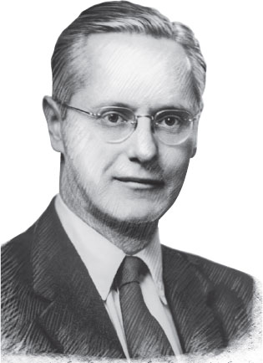
LO 1.4—Functional Analysis (2 of 3)
Robert K. Merton (1910–2003), who spent most of his academic career at Columbia University, was a major proponent of functionalism, one of the main theoretical perspectives in sociology.

Slide 42
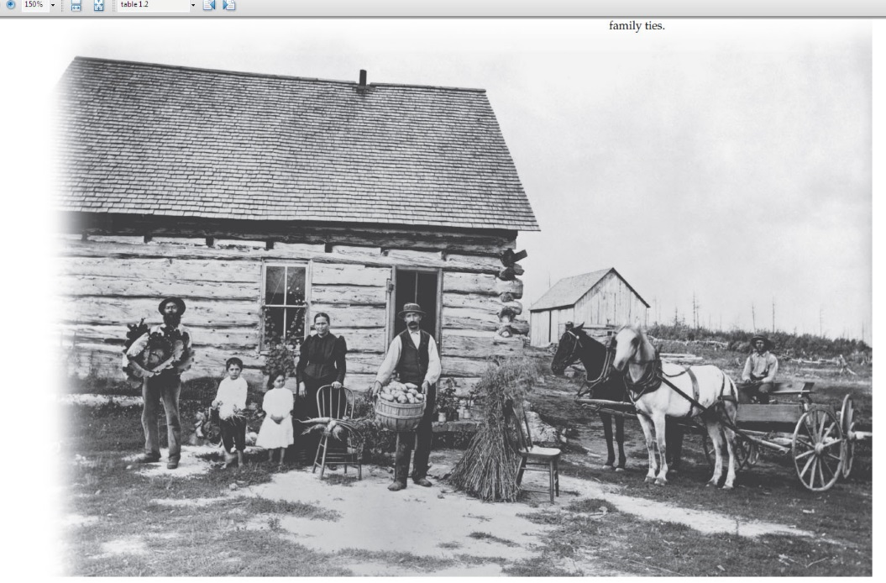
LO 1.4—Functional Analysis (3 of 3)
Sociologists who use the functionalist perspective stress how industrialization and urbanization undermined the traditional functions of the family. Before industrialization, members of the family worked together as an economic unit, as in this photo of a farm family in Minnesota in the 1890s. As production moved away from the home, it took with it first the father and, more recently, the mother. One consequence is a major dysfunction, the weakening of family ties.

Slide 43
LO 1.4—Conflict Theory
Karl Marx and Conflict Theory
Conflict Theory Today
Feminists and Conflict Theory
Applying Conflict Theory

Slide 44
LO 1.4—Putting the Theoretical Perspectives Together
Each Approach is a Lens

Slide 45
LO 1.4—Levels of Analysis: Macro and Micro (1 of 2)
Functionalists and Conflict Theorists − Macro Level
Symbolic Interactionists − Micro Level

Slide 46
LO 1.4—Levels of Analysis: Macro and Micro (2 of 2)
Table 1.1 Three Theoretical Perspectives in Sociology
Theoretical Perspective | Usual Level of Analysis | Focus of Analysis | Key Terms | Applying the Perspective to the U.S. Divorce Rate
Symbolic Interactionism | Microsociological: examines small-scale patterns of social interaction | Face-to-face interaction, how people use symbols to create social life | Symbols Interaction Meanings Definitions | Industrialization and urbanization changed marital roles and led to a redefinition of love, marriage, children, and divorce.
Functional Analysis (also called functionalism and structural functionalism) | Macrosociological: examines large-scale patterns of society | Relationships among the parts of society; how these parts are functional (have beneficial consequences) or dysfunctional (have negative consequences) | Structure Functions (manifest and latent) Dysfunctions Equilibrium | As social change erodes the traditional functions of the family, family ties weaken, and the divorce rate increases.
Conflict Theory | Macrosociological: examines large-scale patterns of society | The struggle for scarce resources by groups in a society; how the elites use their power to control the weaker groups | Inequality Power Conflict Competition Exploitation | When men control economic life, the divorce rate is low because women find few alternatives to a bad marriage. The high divorce rate reflects a shift in the balance of power between men and women.
SOURCE: By the author.

Slide 47
LO 1.5 Common Sense and the Need for Sociological Research
Common Sense May be Wrong

Slide 48
LO 1.5 A Research Model
Selecting a Topic
Defining the Problem
Reviewing the Literature
Formulating a Hypothesis
Choosing a Research Method
Collecting the Data
Analyzing the Results
Sharing the Results

Slide 49
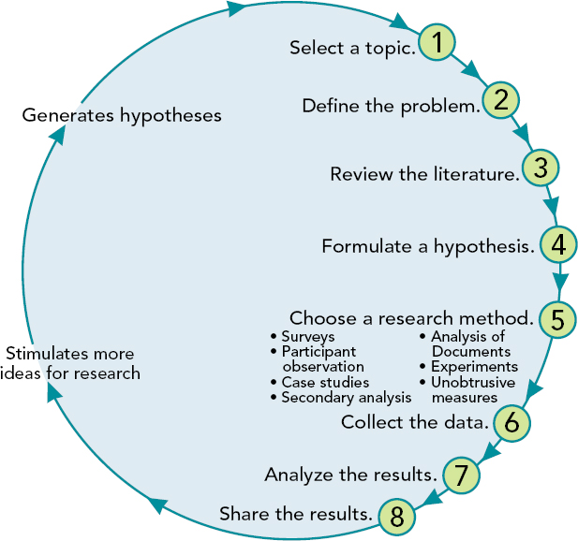
Figure 1.6 The Research Model
Notes:
It is helpful for complex images (i.e., charts and graphs) to have descriptive text near the image (perhaps as a caption or in the Notes field). They would still require alt text.

Slide 50
LO 1.6 Research Methods (Designs) (1 of 5)
Surveys
Participant Observation (Fieldwork)
Case Studies
Secondary Analysis
Analysis of Documents
Experiments
Unobtrusive Measures
Deciding Which Method to Use

Slide 51
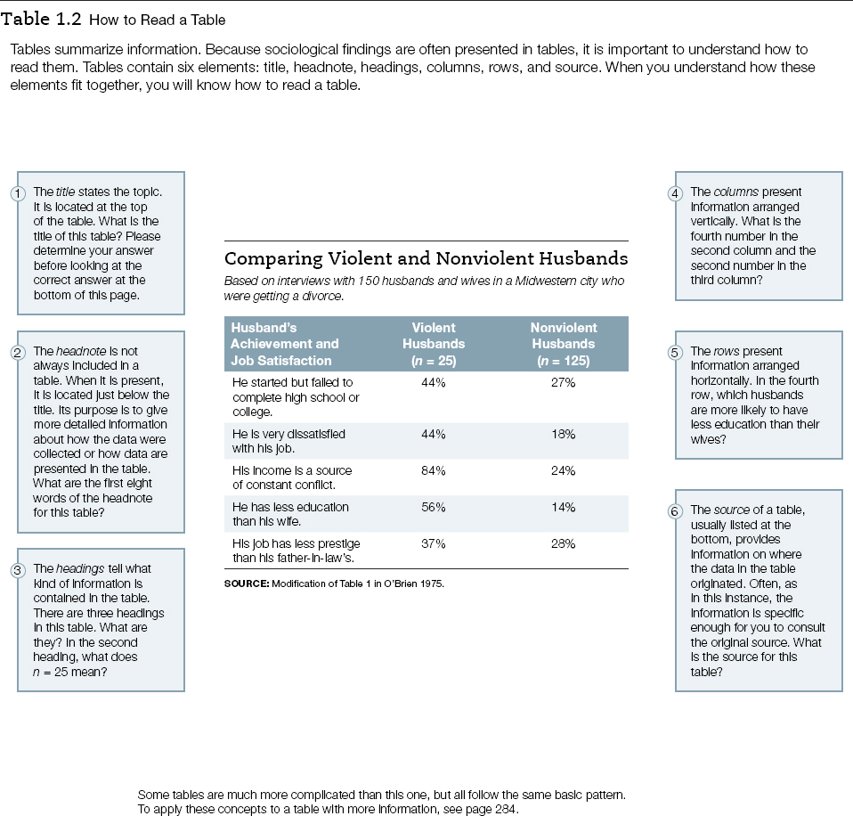
LO 1.6 Research Methods (Designs) (2 of 5)

Slide 52
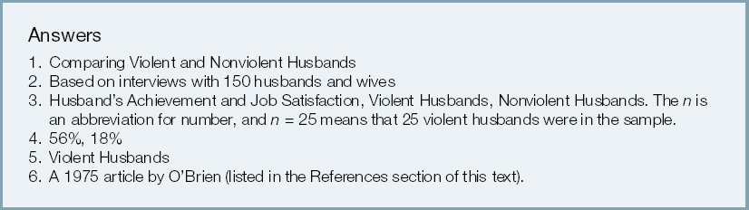
LO 1.6 Research Methods (Designs) (3 of 5)

Slide 53
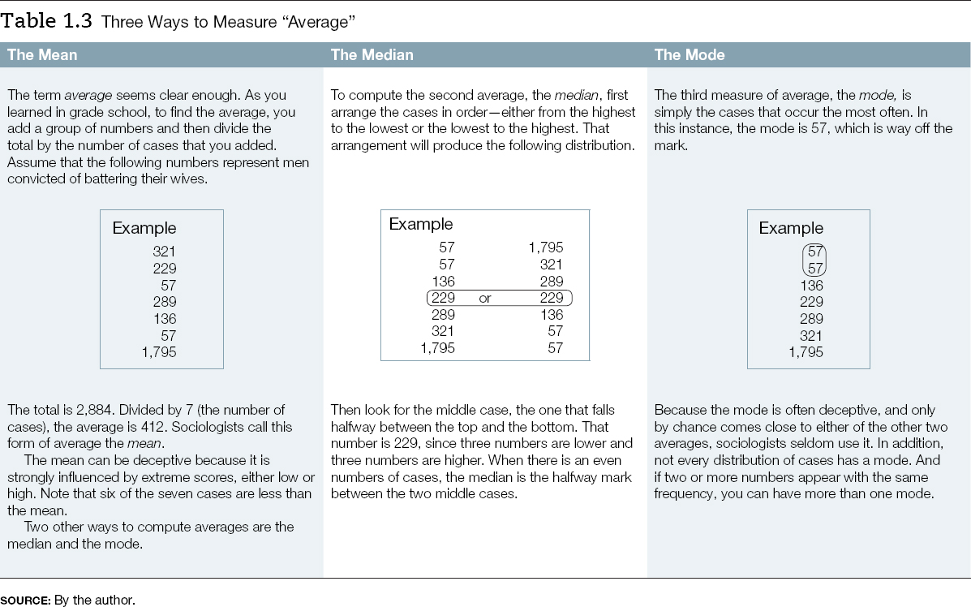
LO 1.6 Research Methods (Designs) (4 of 5)

Slide 54
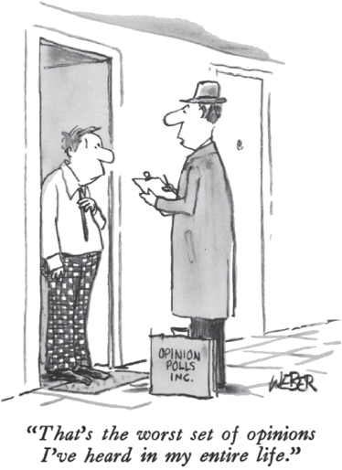
LO 1.6 Research Methods (Designs) (5 of 5)
To attain their goal of objectivity and accuracy in their research, sociologists must put away their personal opinions.

Slide 55
LO 1.6—Surveys (1 of 4)
Selecting a Sample
Representative Sample
Random Sample
Stratified Random Sample
Neutral Questions
Questionnaires and Interviews
Establishing Rapport

Slide 56

LO 1.6—Surveys (2 of 4)
If sociologists were to study a cock fight, such as this one in India, they would not be interested in which cock won the fight. They would want to know who organized the fight, who trains the cocks, how the cocks are matched, what the betting rules are, how those rules are enforced, and so on. To answer such questions, what research methods do you think sociologists would choose?

Slide 57
LO 1.6—Surveys (3 of 4)
Table 1.4 Closed- and Open-Ended Questions
A. Closed-Ended Question | B. Open-Ended Question
Which of the following best fits your idea of what should be done to someone who has been convicted of spouse abuse? 1. Probation 2. Jail time 3. Community service 4. Counseling 5. Divorce 6. Nothing—It’s a family matter | What do you think should be done to someone who has been convicted of spouse abuse?
SOURCE: By the author.

Slide 58
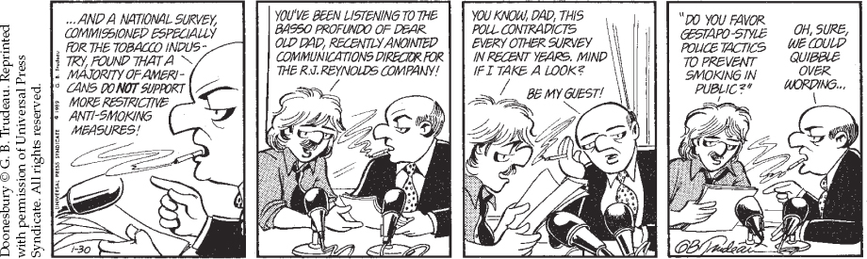
LO 1.6—Surveys (4 of 4)
Improperly worded questions can steer respondents toward answers that are not their own, which produces invalid results.

Slide 59
LO 1.6—Participant Observation (Fieldwork)
Researcher Participates
Generalizability

Slide 60
LO 1.6—Case Studies (1 of 3)
Focus on a Single Event, Situation, or Individual

Slide 61

LO 1.6—Case Studies (2 of 3)
Participant observation, participating and observing in a research setting, is usually supplemented by interviewing, asking questions to better understand why people do what they do. In this instance, the sociologist would want to know what this hair removal ceremony in Gujarat, India, means to the child’s family and to the community.

Slide 62
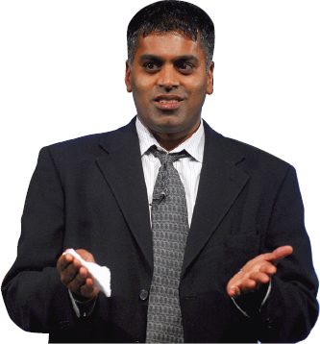
LO 1.6—Case Studies (3 of 3)
Sudhir Venkatesh, who now teaches at Columbia University, New York City.

Slide 63
LO 1.6—Secondary Analysis (1 of 2)
Analyze Data Collected by Others

Slide 64

LO 1.6—Secondary Analysis (2 of 2)
The research methods that sociologists choose depend partially on the questions they want to answer. They might want to learn, for example, which forms of publicity are more effective in increasing awareness of spouse abuse as a social problem.

Slide 65
LO 1.6—Analysis of Documents
Books, Newspapers, Diaries, Bank Records, Police Reports

Slide 66
LO 1.6—Experiments
Experimental and Control Groups
Independent and Dependent Variables

Slide 67
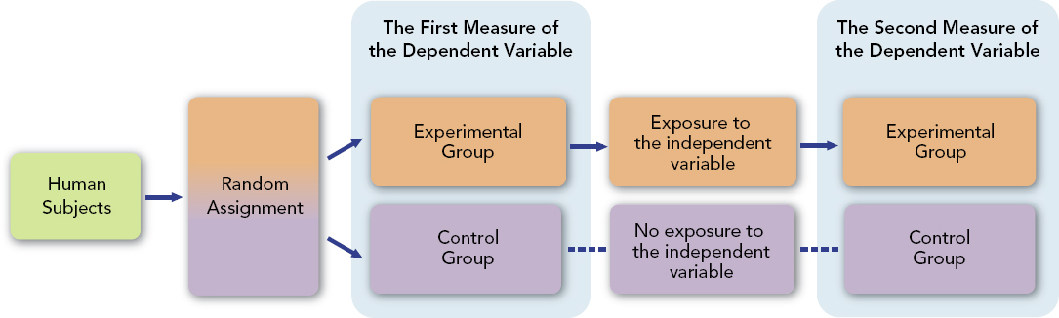
Figure 1.7 The Experiment
SOURCE: By the author.
Notes:
It is helpful for complex images (i.e., charts and graphs) to have descriptive text near the image (perhaps as a caption or in the Notes field). They would still require alt text.

Slide 68
LO 1.6—Unobtrusive Measures (1 of 2)
People May Not be Aware They are Being Studied

Slide 69
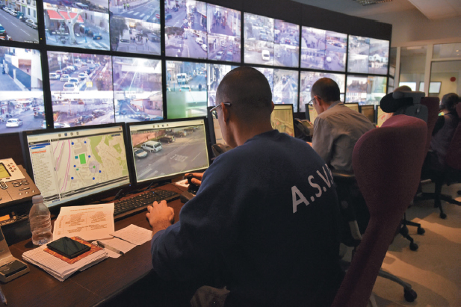
LO 1.6—Unobtrusive Measures (2 of 2)
The surveillance society is not limited to the United States. This photo was taken as Nice, France, added its 1000th video camera to its surveillance system. How do the unobtrusive measures of sociologists differ from hidden crime surveillance?

Slide 70
LO 1.7 Gender in Sociological Research (1 of 2)
Gender may lead to interviewer bias
Gender affects the kinds of research done

Slide 71
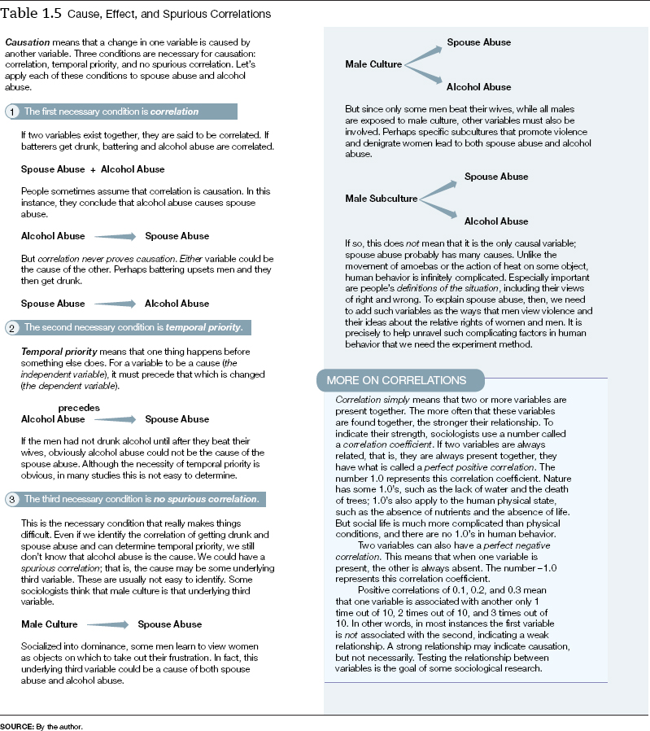
LO 1.7 Gender in Sociological Research (2 of 2)

Slide 72
LO 1.8 Ethics in Sociological Research (1 of 2)
Protecting the Subjects
  The Brajuha Research
Misleading the Subjects
  The Humphreys Research

Slide 73

LO 1.8 Ethics in Sociological Research (2 of 2)
Ethics in social research are of vital concern to sociologists. As discussed in the text, sociologists may disagree on some of the issue’s finer points, but none would approve of slipping LSD to unsuspecting subjects like this Marine. This was done to U.S. soldiers in the 1960s under the guise of legitimate testing—just “to see what would happen.”

Slide 74
LO 1.9 Trends Shaping the Fugure of Sociology
Sociology’s Tension: Research Versus Reform

Slide 75
LO 1.9—Globalization
Broaden our Horizons
Consider Global Issues
Universal Principles

