Slide 1
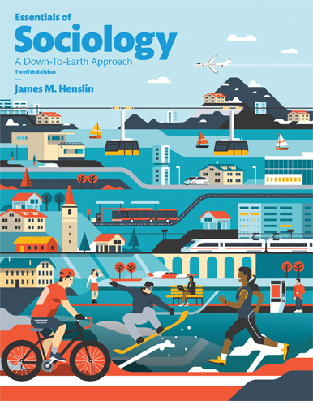
Essentials of Sociology: A Down-To-Earth Approach
TWELFTH EDITION
Chapter 2
Culture

Slide 2
Learning Objectives (1 of 3)
2.1 Explain what culture is, how culture provides orientations to life, and what practicing cultural relativism means
2.2 Know the components of symbolic culture: gestures, language, values, norms, sanctions, folkways, mores, and taboos; also explain the Sapir-Whorf hypothesis

Slide 3
Learning Objectives (2 of 2)
2.3 Distinguish between subcultures and countercultures
2.4 Discuss the major U.S. values and explain value clusters, value contradictions, value clashes, how values are lenses of perception, and ideal versus real culture

Slide 4
Learning Objectives (3 of 3)
2.5 Take a position on the issue of the existence of cultural universals and contrast sociobiology with sociology
2.6 Explain how technology changes culture and what cultural lag and cultural leveling are

Slide 5
LO 2.1 What Is Culture?
Culture and Taken-for-Granted Orientations to Life
Practicing Cultural Relativism

Slide 6
LO 2.1—Culture and Taken-for-Granted Orientations to Life (1 of 2)
What is Normal, Natural, or Usual?
The Culture Within Us
Culture as Lens
Culture Shock
Ethnocentrism

Slide 7
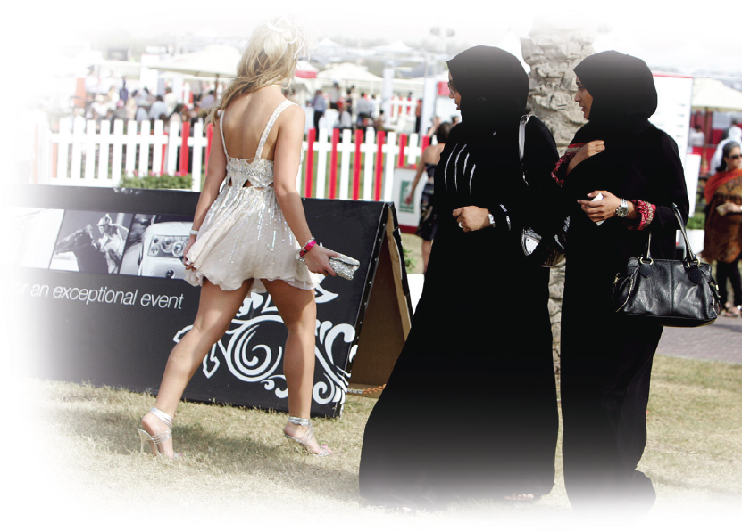
LO 2.1—Culture and Taken-for-Granted Orientations to Life (2 of 2)
What a tremendous photo for sociologists! Seldom are we treated to such cultural contrasts. Can you see how the cultures of these women have given them not only different orientations concerning the presentation of their bodies but also of gender relations?

Slide 8
LO 2.1—Practicing Cultural Relativism (1 of 4)
Understanding Cultures on Their Own Terms
“Sick Cultures” − Robert Edgerton
Confronting Contrasting Views of Reality

Slide 9
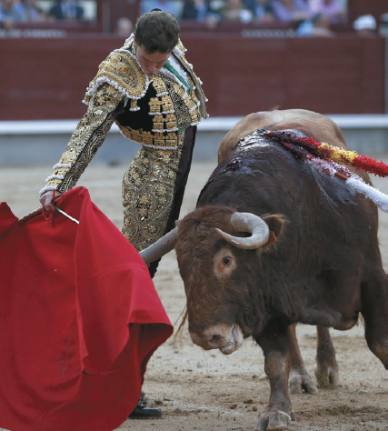
LO 2.1—Practicing Cultural Relativism (2 of 4)
Many Americans perceive bullfighting as a cruel activity that should be illegal everywhere. To most Spaniards, bullfighting is a sport that pits matador and bull in a unifying image of power, courage, and glory. Cultural relativism requires that we suspend our own perspectives in order to grasp the perspectives of others, something easier described than attained.

Slide 10
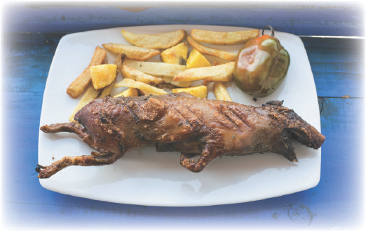
LO 2.1—Practicing Cultural Relativism (3 of 4)
What some consider food, even delicacies, can turn the stomach of others. Grilled guinea pigs are served in restaurants in the Peruvian Andes.

Slide 11
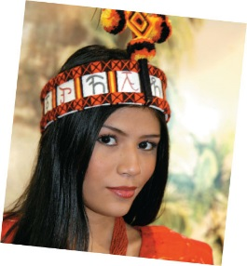

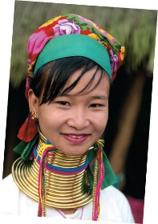
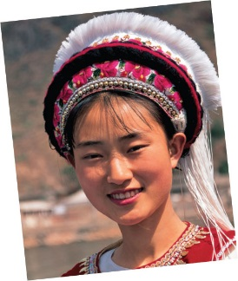
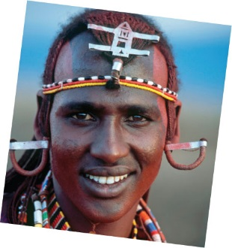
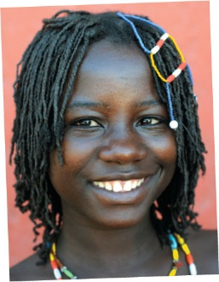
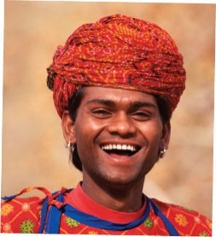
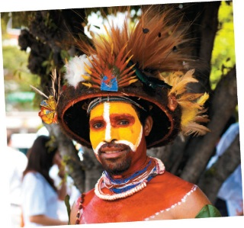
LO 2.1—Practicing Cultural Relativism (4 of 4)
Standards of beauty vary so greatly from one culture to another that what one group finds attractive, another may not. Yet, in its ethnocentrism, each group thinks that its standards are the best—that the appearance reflects what beauty “really” is.
As indicated by these photos, around the world men and women aspire to their group’s norms of physical attractiveness. To make themselves appealing to others, they try to make their appearance reflect those standards.

Slide 12
LO 2.2 Components of Symbolic Culture
Gestures
Language
Language and Perception: The Sapir-Whorf Hypothesis
Values, Norms, and Sanctions
Folkways, Mores, and Taboos

Slide 13
LO 2.2—Gestures (1 of 2)
Conveying Messages without Words
Gestures’ Meanings Differ Among Cultures
Can Lead to Misunderstandings
Is it really true that there are no universal gestures?

Slide 14
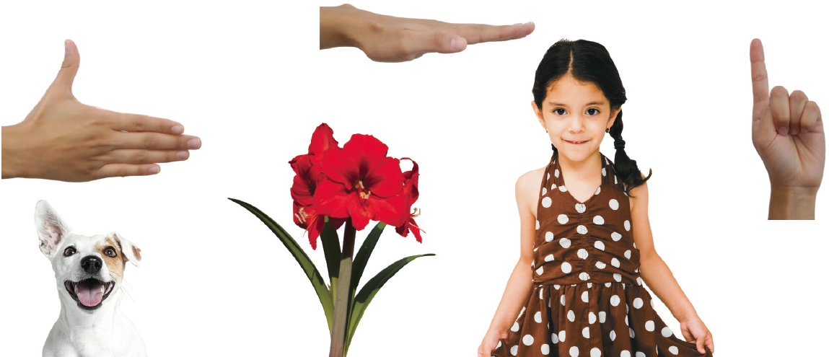
Figure 2.1 Gestures to Indicate Height, Southern Mexico
Source: By the author.
Notes:
It is helpful for complex images (i.e., charts and graphs) to have descriptive text near the image (perhaps as a caption or in the Notes field). They would still require alt text.

Slide 15
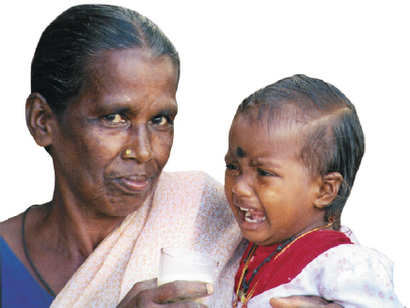
LO 2.2—Gestures (2 of 2)
Although most gestures are learned, and therefore vary from culture to culture, some gestures that represent fundamental emotions such as sadness, anger, and fear appear to be inborn. This crying child whom I photographed in India differs little from a crying child in China—or the United States or anywhere else on the globe. In a few years, however, this child will demonstrate a variety of gestures highly specific to his Hindu culture.

Slide 16
LO 2.2—Language (1 of 2)
Allows Cumulative Human Experience
Provides Social or Shared Past
Provides Social or Shared Future
Allows Shared Perspective
Allows Complex, Shared, Goal-Directed Behavior

Slide 17
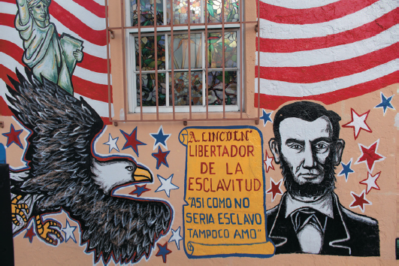
LO 2.2—Language (2 of 2)
Mural from Miami.

Slide 18
LO 2.2—Language and Perception: The Sapir-Whorf Hypothesis
Language Has Embedded Within It Ways of Looking at the World
Sapir-Whorf Reverses Common Sense

Slide 19
LO 2.2—Values, Norms, and Sanctions (1 of 3)
Values − What is Desirable in Life
Norms − Expectations or Rules for Behavior
Sanctions − Reaction to Following or Breaking Norms
  Positive & Negative Sanctions
Moral Holidays and Places

Slide 20
LO 2.2—Values, Norms, and Sanctions (2 of 3)
Many societies relax their norms during specified occasions. At these times, known as moral holidays, behavior that is ordinarily not permitted is allowed. This photo was taken at Mardis Gras in New Orleans. When a moral holiday is over, the usual enforcement of rules follows.

Slide 21
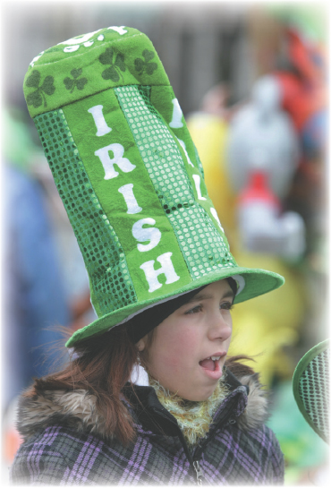
LO 2.2—Values, Norms, and Sanctions (3 of 3)
The ethnic terms we choose—or which are given to us—are major self-identifiers. They indicate both membership in some particular group and a separation from other groups.

Slide 22
LO 2.2—Folkways, Mores, and Taboos (1 of 2)
Folkways − Norms not Strictly Enforced
Mores − Core Values: We Insist on Conformity
Taboos

Slide 23
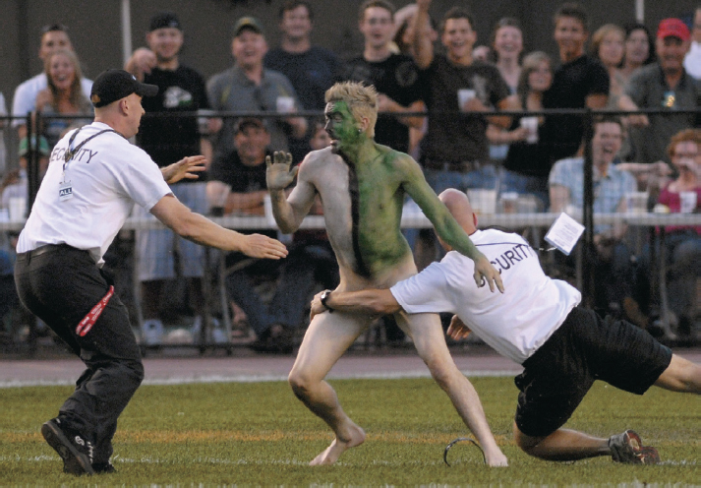
LO 2.2—Folkways, Mores, and Taboos (2 of 2)
The violation of mores is a serious matter. In this case, it is serious enough that the security at a football match in Edmonton, Alberta (Canada), have swung into action to protect the public from seeing a “disgraceful” sight, at least one so designated by this group.

Slide 24
LO 2.3 Many Cultural Worlds
Subcultures
Countercultures

Slide 25
LO 2.3—Subcultures (1 of 9)
Subculture − A World Within the Dominant Culture

Slide 26
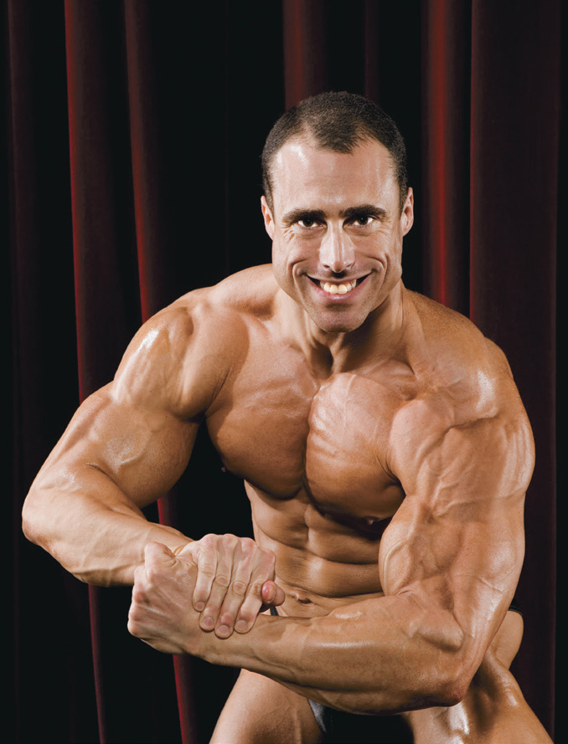
LO 2.3—Subcultures (2 of 9)
Each subculture provides its members with values and distinctive ways of viewing the world. What values and perceptions do you think are common among body builders?

Slide 27
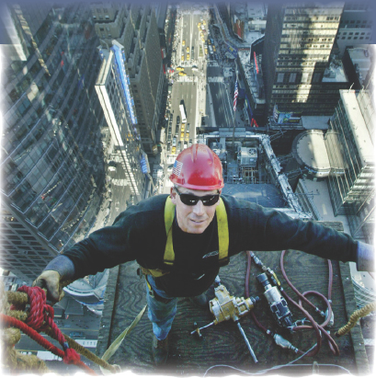
LO 2.3—Subcultures (3 of 9)
Membership in this subculture is not easily awarded. Not only must high-steel ironworkers prove that they are able to work at great heights but also that they fit into the group socially. Newcomers are tested by members of the group, and they must demonstrate that they can take joking without offense.

Slide 28
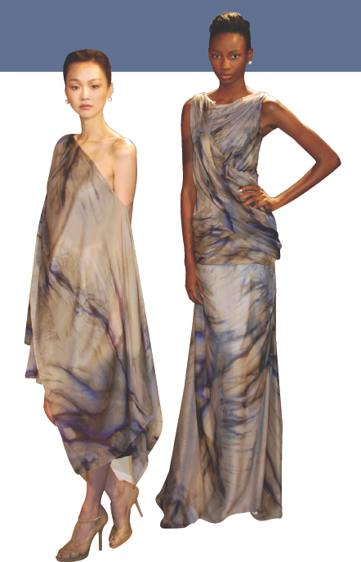
LO 2.3—Subcultures (4 of 9)
Specialized values and interests are two of the characteristics that mark subcultures. What values and interests distinguish the modeling subculture?

Slide 29
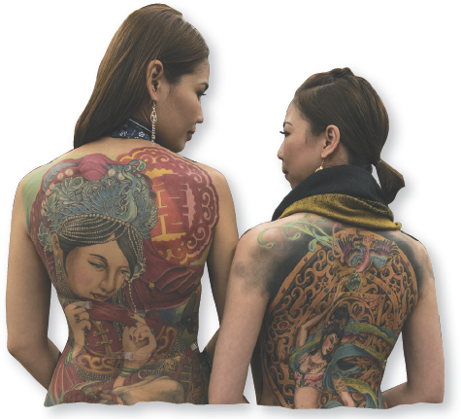
LO 2.3—Subcultures (5 of 9)
The subculture that centers around tattooing previously existed on the fringes of society, with seamen and circus folk its main participants. It now has entered mainstream society, but not to this extreme.

Slide 30
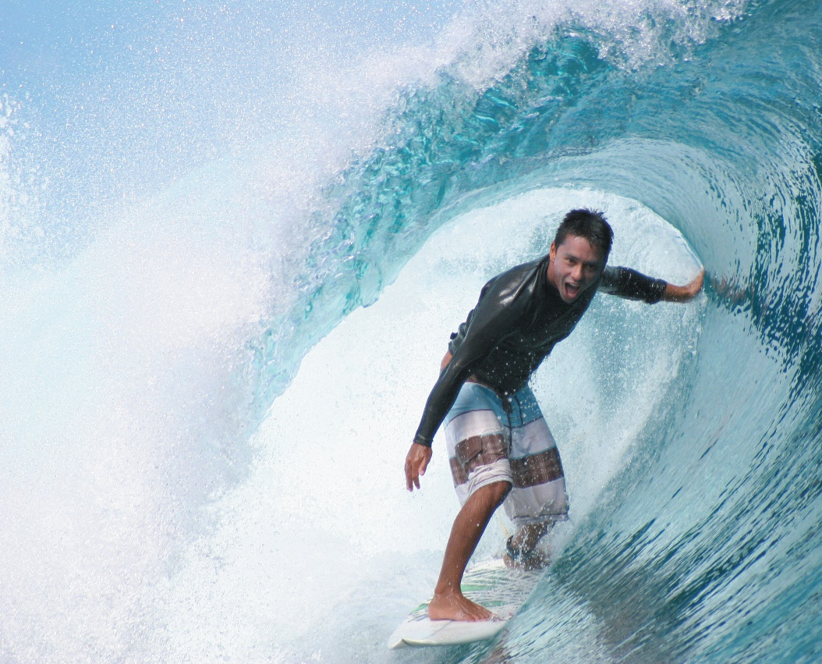
LO 2.3—Subcultures (6 of 9)
With their specialized language and activities, surfers are highly recognized as members of a subculture. This surfer is “in the tube.”

Slide 31
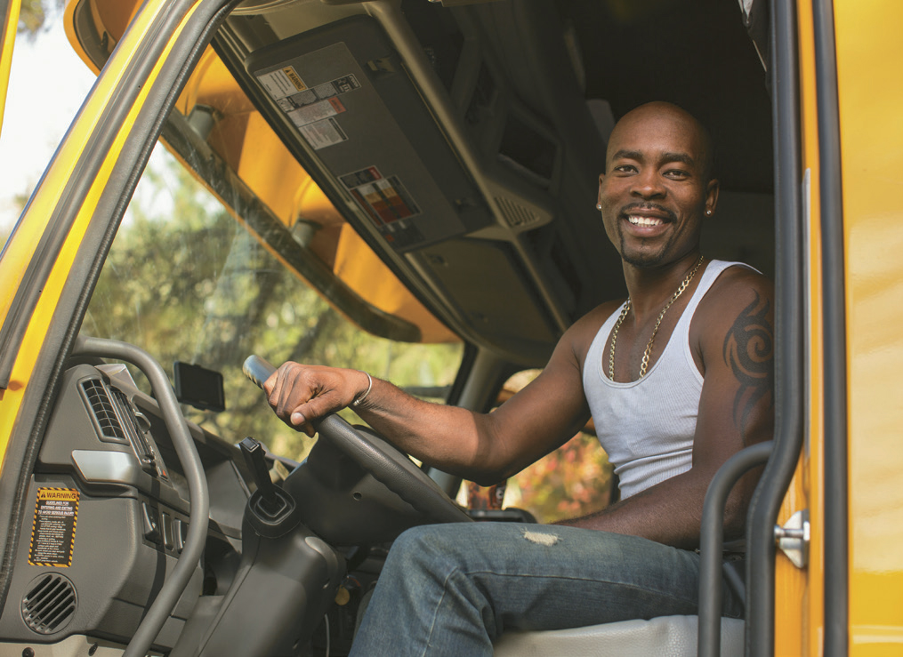
LO 2.3—Subcultures (7 of 9)
The cabbies’ subculture, centering on their occupational activities and interests, is also broken into smaller subcultures that reflect their experiences of race–ethnicity.

Slide 32
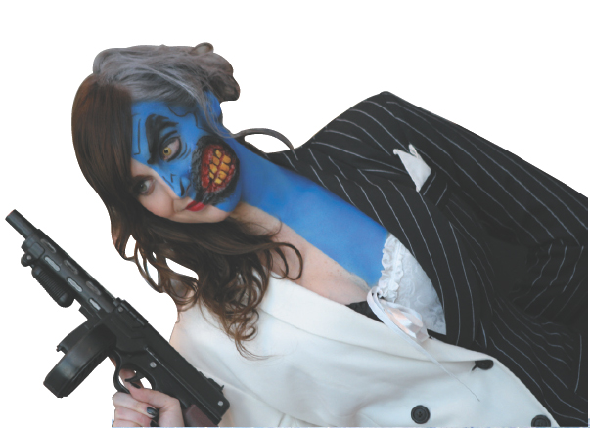
LO 2.3—Subcultures (8 of 9)
Why would anyone decorate herself like this? Among the many reasons, one is to show solidarity (appreciation, shared interest) with the subculture that centers on comic book characters.

Slide 33
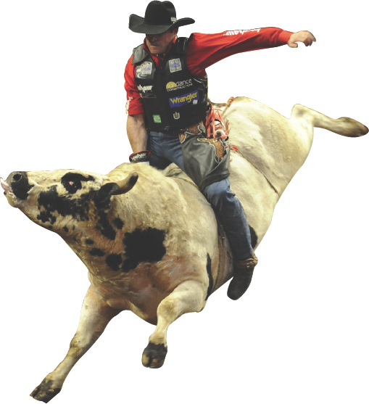
LO 2.3—Subcultures (9 of 9)
Even subcultures can have subcultures. The rodeo subculture is a subculture of “western” subculture. The values that unite its members are reflected in their speech, clothing, and specialized activities, such as the one shown here.

Slide 34
LO 2.3—Countercultures
Countercultures − Groups With Norms and Values at Odds With the Dominant Culture

Slide 35
LO 2.4 Values in U.S. Society
An Overview of U.S. Values
Value Clusters
Value Contradictions
An Emerging Value Cluster
When Values Clash
Values as Distorting Lenses
“Ideal” Versus “Real” Culture

Slide 36
LO 2.4—An Overview of U.S. Values (1 of 2)
Achievement and Success
Individualism
Hard Work
Efficiency and Practicality
Science and Technology
Material Comfort
Freedom

Slide 37
LO 2.4—An Overview of U.S. Values (2 of 2)
Democracy
Equality
Group Superiority
Education
Religiosity
Romantic Love

Slide 38
LO 2.4—Value Clusters
Success
  Education
  Hard work
  Material comfort
  Individualism

Slide 39
LO 2.4—Value Contradictions
U.S. values group superiority?
Change over time

Slide 40
LO 2.4—An Emerging Value Cluster (1 of 2)
Leisure
Self-fulfillment
Physical Fitness
Youthfulness
Concern for the Environment

Slide 41
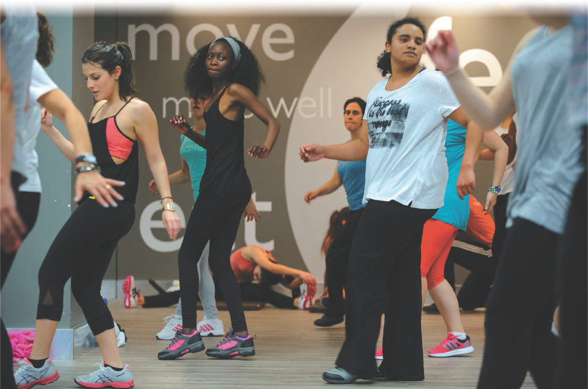
LO 2.4—An Emerging Value Cluster (2 of 2)
Physical fitness, as with this Zumba class, is part of an emerging value cluster.

Slide 42
LO 2.4—When Values Clash
Culture Wars

Slide 43
LO 2.4—Values as Distorting Lenses (1 of 2)
What society “ought” to be like

Slide 44
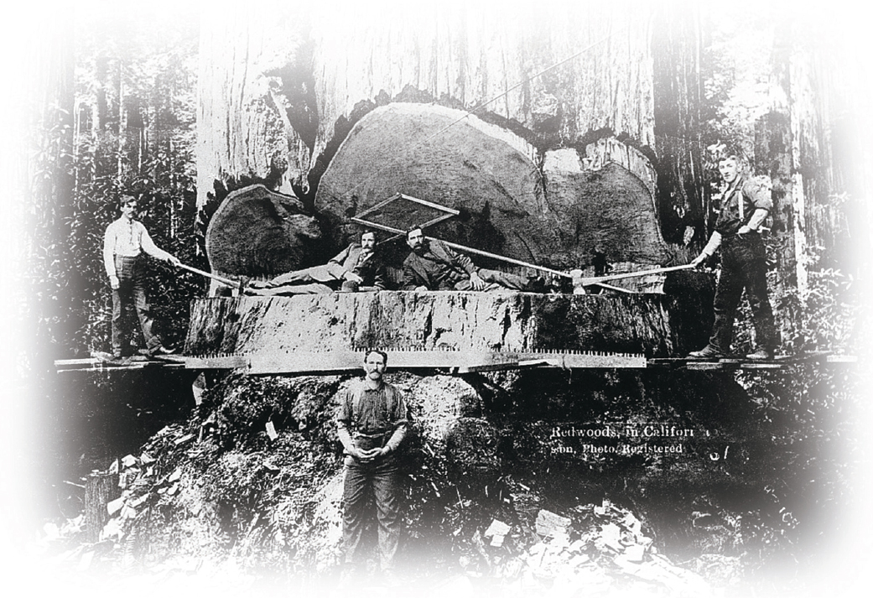
LO 2.4—Values as Distorting Lenses (2 of 2)
Values, both those held by individuals and those that represent a nation or people, can undergo deep shifts. It is difficult for many of us to grasp the pride with which earlier Americans destroyed trees that took thousands of years to grow, are located only on one tiny speck of the globe, and that we today consider part of the nation’s and world’s heritage. But this is a value statement, representing current views. The pride expressed on these woodcutters’ faces represents another set of values entirely.

Slide 45
LO 2.4—“Ideal” Versus “Real” Culture
Ideal: What a group considers worth aiming for
Real: What people actually do

Slide 46
LO 2.5 Cultural Universals (1 of 2)
Some Activities are Universal − Courtship, Marriage, Funerals, Games
Present in all cultures, but the specific customs differ from one group to another
  What are some examples of activities that you think might differ from culture to culture?
  What activities might be the same?

Slide 47
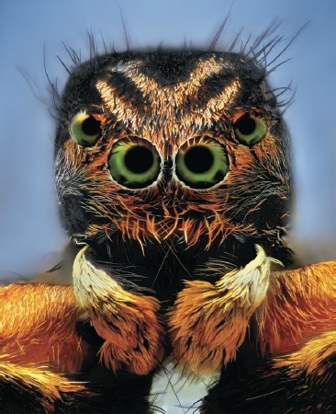
LO 2.5 Cultural Universals (2 of 2)
Unlike this beautiful ant, we humans are not controlled by instincts. Sociobiologists, though, are exploring the extent to which genes influence our behavior.

Slide 48
LO 2.6 Technology in the Global Village
The New Technology
Cultural Lag and Cultural Change
Technology and Cultural Leveling

Slide 49
LO 2.6—The New Technology (1 of 2)
Technology
New Technology

Slide 50
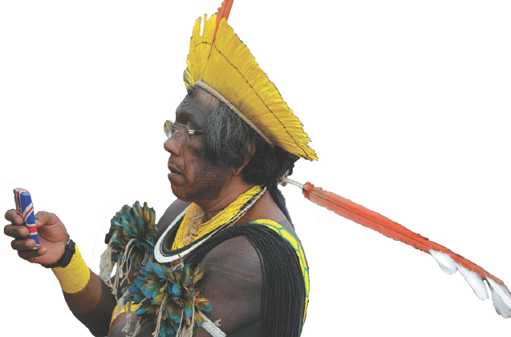
LO 2.6—The New Technology (2 of 2)
Language is the basis of human culture. Our new technology makes it easy to talk with people across the globe, something new in human history. This development is changing cultures. Shown here is a Kayapo Indian talking on his cell phone at the National Indigenous Mobilization conference in Brazil.

Slide 51
LO 2.6—Cultural Lag and Cultural Change (1 of 2)
Cultural Lag
Cultural Change

Slide 52
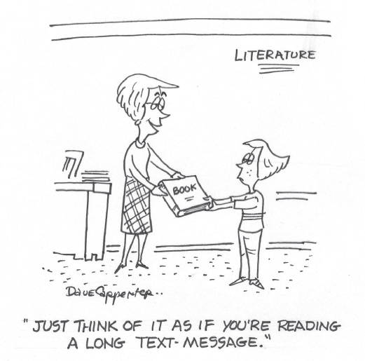
LO 2.6—Cultural Lag and Cultural Change (2 of 2)
Technological advances are now so rapid that there can be cultural gaps between generations.

Slide 53
LO 2.6—Technology and Cultural Leveling (1 of 2)
Cultural Leveling

Slide 54
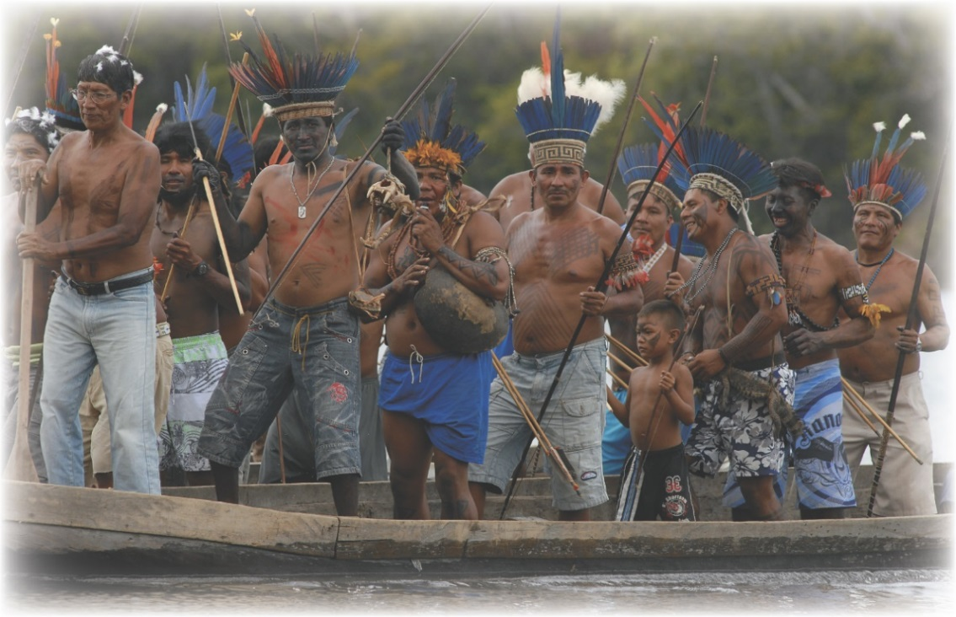
LO 2.6—Technology and Cultural Leveling (2 of 2)
Cultural leveling is occurring rapidly, with some strange twists. These men from an Amazon tribe, who have just come back from a week hunting in the jungle, are wearing traditional headdress and using traditional weapons, but you can easily spot something else that is jarringly out of place.

