Slide 1
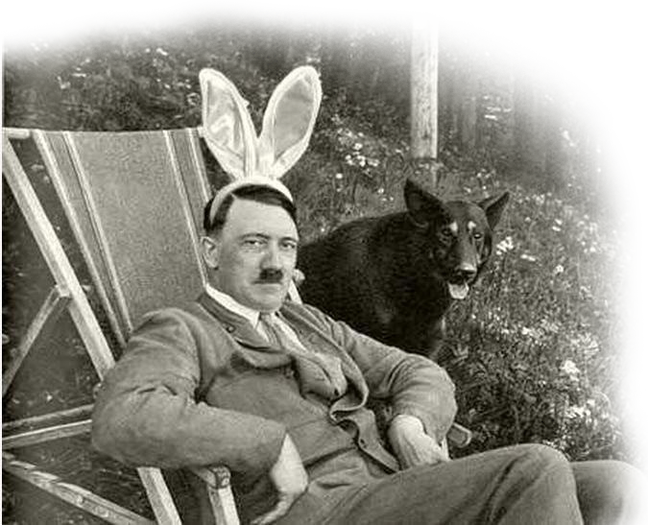
History Final Project
Hitler
History of World Civilization (1815 to Present)
Student Name
Florida SouthWestern State College
Date

Slide 2
“If you tell a big enough lie and tell it frequently enough, it will be believed.
Make the lie big, make it simple, keep saying it, and eventually they will believe it.” – Adolf Hitler

Slide 3
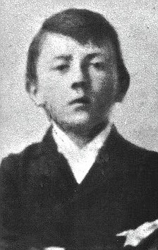
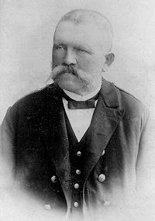
Hitler’s early life
Adolf’s stern-minded Father. Alois Hitler. (pictured below)
Adolf, a child raised in a family of five children did not have the brightest childhood growing up in a small farm house outside of Linz, Austria.
Between the strictness of his boarding school and his father at home, Adolf was always under someone’s eye and almost never had any enjoyment as a child. This is portrayed in Mein Kampf, his autobiography.
“When his oldest brother Alois Jr, at 13, ran away from home to escape the occasional brutal beatings from their father. Once his brother was gone, Adolf was in line for the same treatment” (Gavin, 1996).
Adolf Hitler, Twelve years old. (pictured above)

Slide 4
The National Socialist German Workers’ Party
(NSDAP)
Parties like the NSDAP became popular after the first war when the Imperial Government collapsed after the treaty of Versailles was signed and Germany gave up on the war. Civil unrest and workers strikes spread like wild fire across Germany.
“Hitler’s Manipulative public speaking skills launched him into the Nazi party’s leadership and drew increasingly larger crowds each time he spoke. Combining Anti-Semitism with populist resentment, the Nazi’s denounced both Communism and Capitalism as international Jewish conspiracy’s to destroy Germany” (Gendler, Hazard, 2016).

Slide 5
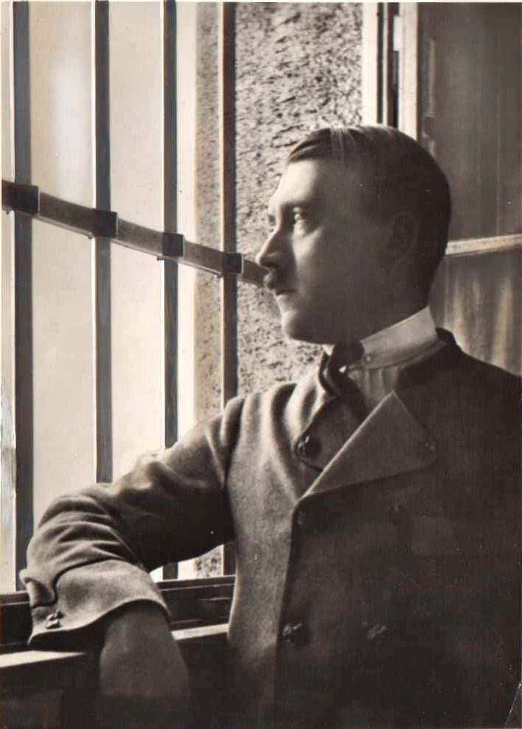
Hitler’s Imprisonment
Accused of high treason, Hitler was tried on February 26, 1924, and sentenced to a max five years in the Landsberg prison and a minimum of 6 months parol.
Although being imprisoned, Hitler used this as a political
advantage during his court appearance, “…Hitler used the courtroom as a propaganda platform from which he could speak at any length on his own behalf” (Gavin P.).
Hitler gave the people a reason to listen to him, and a reason to follow. This is all the man needed to get his party on the same playing field as the rest of them.
“During his imprisonment, Hitler also came to realization that the Nazis would have to come to power by constitutional means, not by overthrowing the Weimar Republic” (Duiker, Spielvogel, 2014, pg. 727)

Slide 6
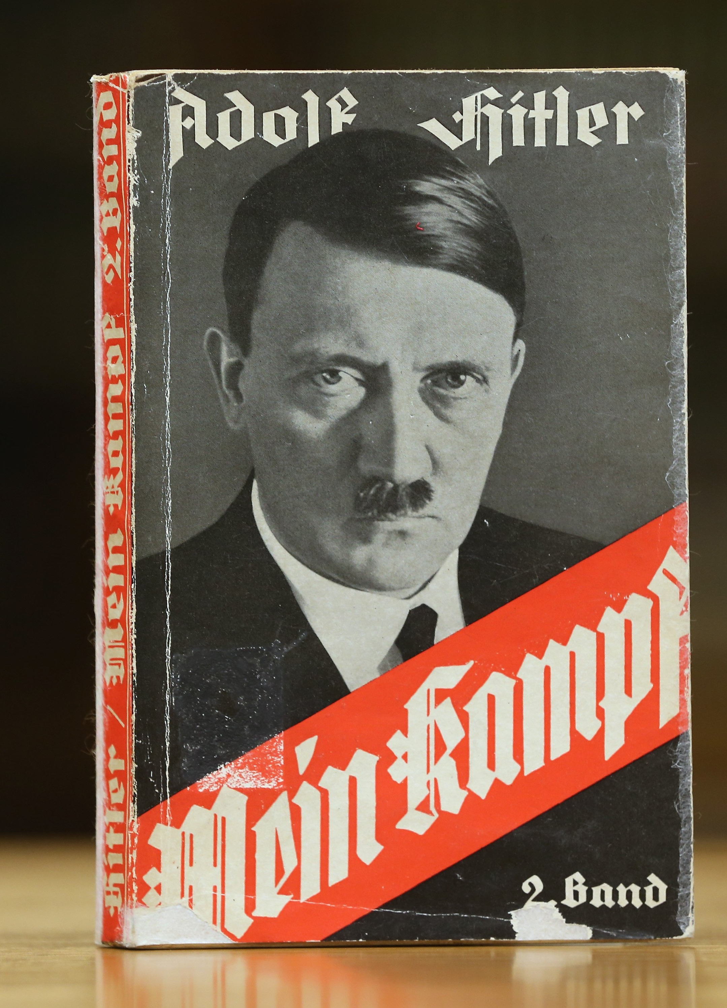
Mein Kampf
During Hitler’s short imprisonment, he wrote a book reflecting his political and social beliefs. Mein Kampf (My Struggle). The books speaks on his on his own movement and its underlying ideology. “Extreme German nationalism, virulent anti-Semitism and anticommunism are linked together by a social Darwinian theory of struggle that stresses the right of superior nations through expansion and the right of superior individuals to secure authoritarian leadership over the masses” (Duiker, Spielvogel, 2014, pg. 727)
In short, this is Hitler’s “political and racial ideas in brutally intricate detail, serving both as a blueprint for future actions and as a warning to the world” (Gavin, 1996).

Slide 7
The Election of Hitler
With Germany’s Government and Economy crumbling this left way for smaller parties to rise like the NSDAP.
The Great Depression made extremist parties promising dramatic quick fixes more attractive. Hitler vowed to create a new Germany free if class differences and party infighting” (Duiker, Spielvogel, 2014, pg. 727).
Although hitler lost the election, “higher bureaucrats came to see Hitler as the man who had the mass support to estabish righ-wing, authoritarian regime that would save Germany” (Duiker, Spielvogel, 2014, pg. 727).
Advisors and buisness leaders convinced Hindinburg to appoint Hitler as Chancelor, hoping to gain popularity for their own goals.

Slide 8

Nazi Party Comes to Rise
“Hitler offered something to everyone: work to the unemployed; prosperity to failed business people; profits to industry; expansion to the Army; social harmony and an end of class distinctions to idealistic young students; and restoration of German glory to those in despair. He promised to bring order amid chaos; a feeling of unity to all and the chance to belong” (Gavin, 1996).
“"Let us not play down the size of the danger awaiting us. Hitler's success in the elections of March 5 should serve as a sharp warning to us. And let us know that 'our Hitlerists' won't be any gentler in their wars and victories than the ones in Germany", wrote a Hehalutz member in the movement's Polish magazine” (Weiss, Y. 1999).

Slide 9
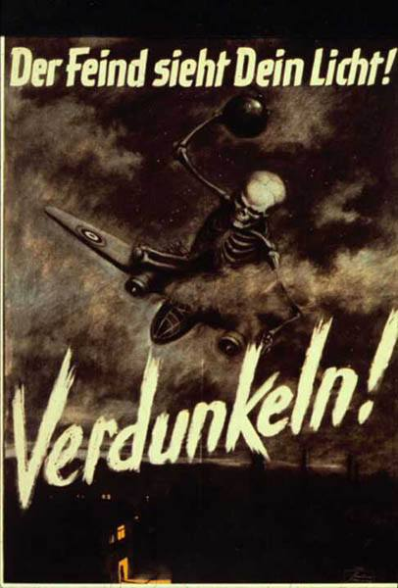
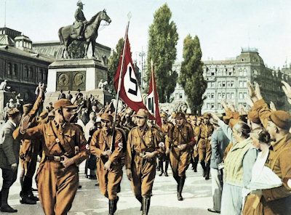
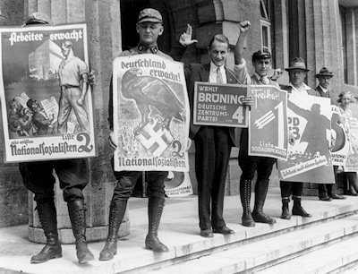
Propaganda
In order to control a population, you must first control the population’s minds. Adolf Hitler did this well through the use of propaganda as he even states in his own book, Mein Kampf. “Propaganda works on the general public from the standpoint of an idea and makes them ripe for the victory of this idea” (Hitler, 1925).
A poster promoting the Germans turn their lights off at night to hide from British Bombings.

Slide 10
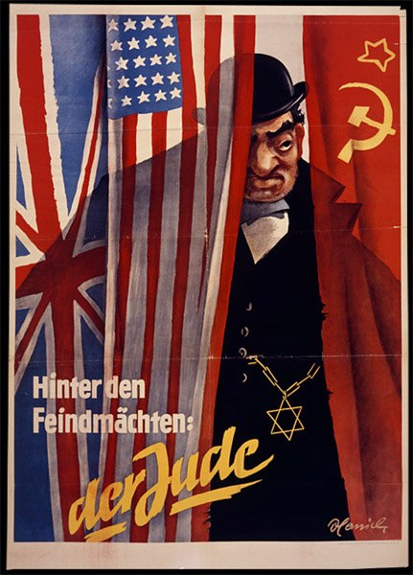
Reign of Power
Adolf had a way of speaking to people that made them want to believe.
The man turned Germany into a warhorse of economic success only by killing of millions of Jews and invading other countries for resources and expansion of Germany.
He was seen in Germany as a great leader only due to his propagation of his own beliefs by giving the people someone to blame, the Jews.
Hitler would promise to make Germany strong again.
Through Hitler’s reign he would turn children against their families, massacre millions, and invade a number of surrounding countries.
With the radical ideologies came powerful allies including Italy and japan who were illusive to the same dictatorship ideologies of Germany.

Slide 11
The invasions
The first invasion by Germany happened on March 7th, 1936 when Hitler sent German troops with Nazi demand to invade the demilitarized Rhineland (Duiker, Spielvogel, p. 734).
By the end of 1936, Hitler along with the help of Benito Mussolini had achieved their goal of a “diplomatic revolution” in all of Europe.
In 1938, Hitler decided to threaten a attack in Austria, sending the Austrian government into panic, which lead them to collapse to Hitler’s wishes. Hitler stormed into Vienna on March 13, 1938 (Duiker, Spielvogel, p. 734).
To Hitler’s wishes, when he arrived in Vienna, he was seen as royalty, and demanded to be welcomed with the highest of praise (The New York Times, 1939).

Slide 12
Invasions (continued)
After taking over his mainland of Austria, Hitler’s next goal was to conquer all of central Europe, and next was Czechoslovakia.
On September 15th, 1938, Hitler was successful, and his assumption of the Czech’s lack of power was right. German soldiers stormed into Sudetenland with the same power that he took over Austria with (Duiker, Spielvogel, p. 735).
On August 23rd, 1939, Hitler along with his new treaty with the Soviet Union gave the Germans the right to invade Poland. By September 1st 1939, Hitler had completely taken rule to all of Poland (Duiker, Spielvogel, p. 736).

Slide 13
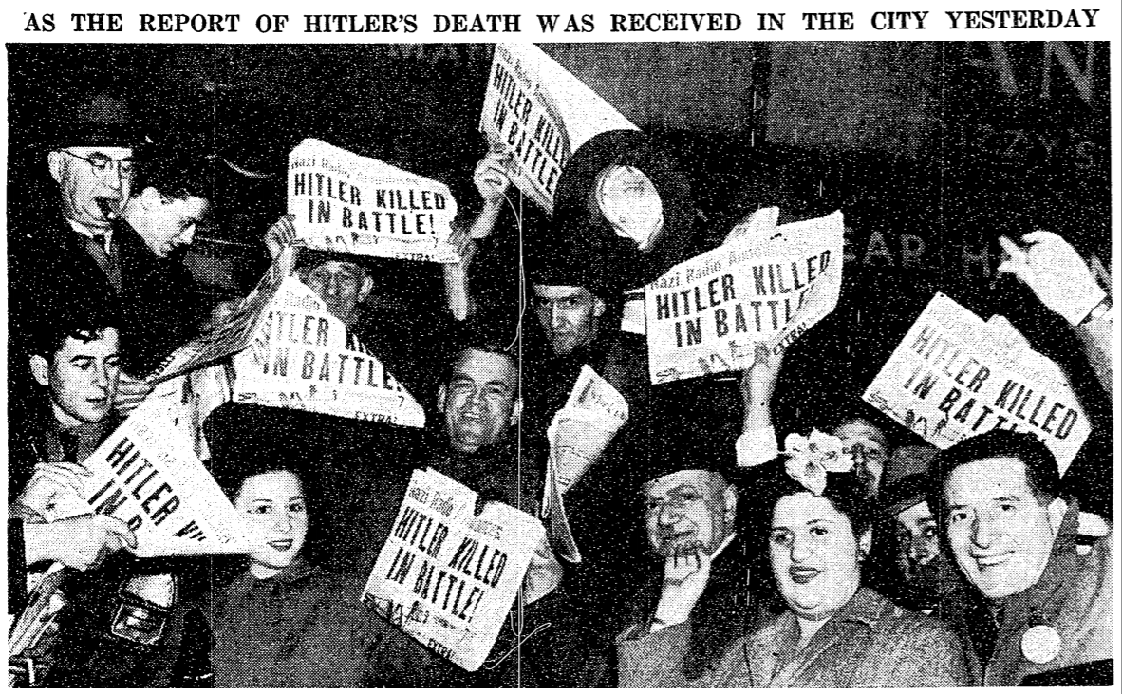
Hitler’s Death Shook the World in Disbelief
Hitler’s death, though a tremendous achievement by the allied forces, didn’t leave the people of the United States in tears or jumping for joy. By this time, we had already won the war, Hitler was just sealing the deal. “Reports of Adolf Hitler’s death like
the weather yesterday, left New Yorker’s cold.
they stopped only briefly in the chilly rain of
the evening rush hour to glance at headlines, to
shrug in disbelief before they divided like moles
into the subway. Skepticism was by far the
dominant reaction” (New York Times, 1945).
Hitler was no more, but he had left his mark
on the world.

Slide 14
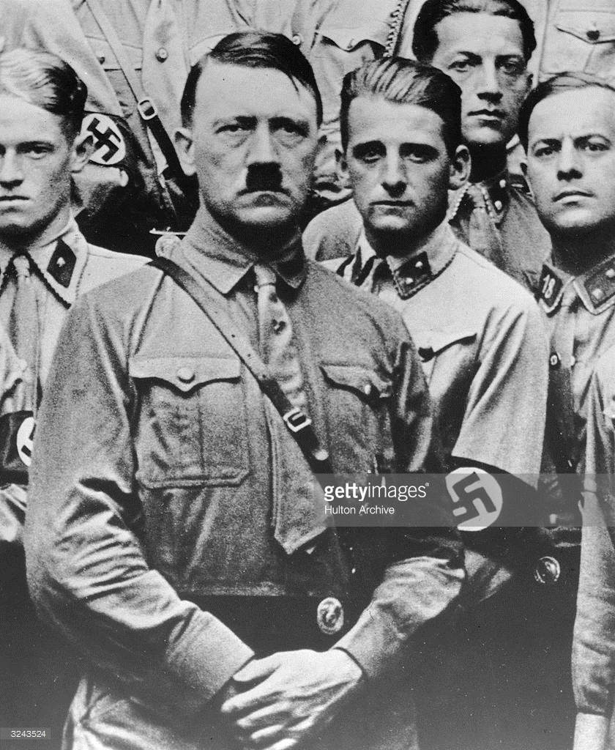
The Remaining Marks Left
Hitler left an ever lasting mark on the world. Events like the Holocaust, Operation Barbosa, and D-day leave an ever long lasting reminder of how inhumane and brutal humans can be to each-other. A country led and controlled by a man so smart but so outlandish and Anti-Semitic.

Slide 15
References
1. Duiker W. J., & Spielvogel J. J. (2014). World History (Eighth ed., Vol. II: Since 1500). Boston, MA: Cengage Learning.
2. Hitler, Adolf. (1925). Mein Kampf. Franz Eher Nachfolger.
3. Gavin P. The Rise of Adolf Hitler. (1996). The History Place. Retrieved fromhttp://www.historyplace.com/worldwar2/riseofhitler
4. Gendler A., Hazard A. (2016). How did Hitler rise to power? Ted-Ed. Retrieved from https://www.youtube.com/watch?v=jFICRFKtAc4
5. Meyer, B. The New York Times. (1945, May 02). City Takes Report Of Death In Stride. New York Times (1923-Current File). Retrieved from http://db07.linccweb.org/login?url=https://search-proquest-com.db07.linccweb.org/docview/107154809?accountid=10674
6. The New York Times. (1939). Hitler is Cheered By Vienna as Hero. (1939, Mar 18). New York Times. Retrieved from http://db07.linccweb.org/login?url=https://search-proquest-com.db07.linccweb.org/docview/102852440?accountid=10674
7. Weiss, Y. (1999). Polish and German Jews between Hitler's rise to power and the outbreak of the Second World War. Leo Baeck Institute Year Book, 44205-223.

