Slide 1
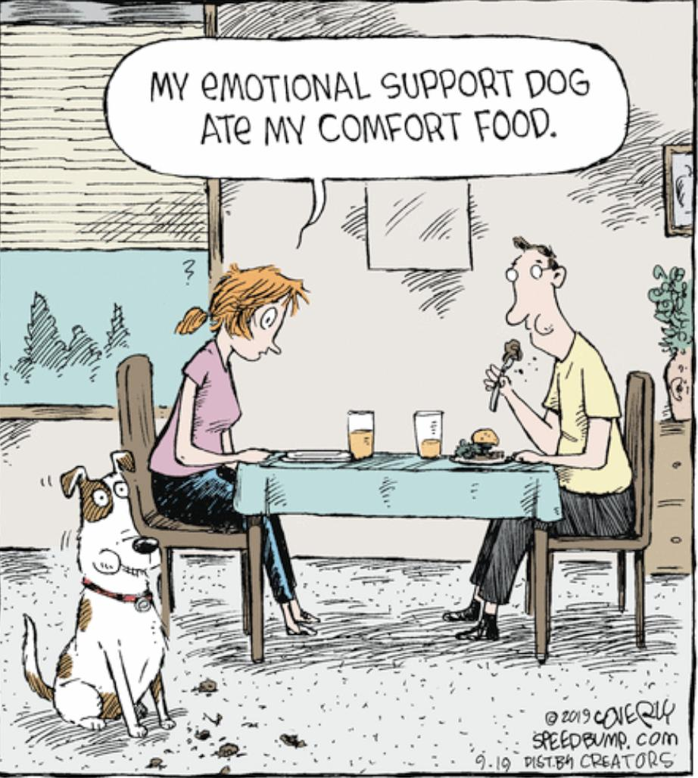
Welcome to FYS!
Feb. 8, 2021

Slide 2
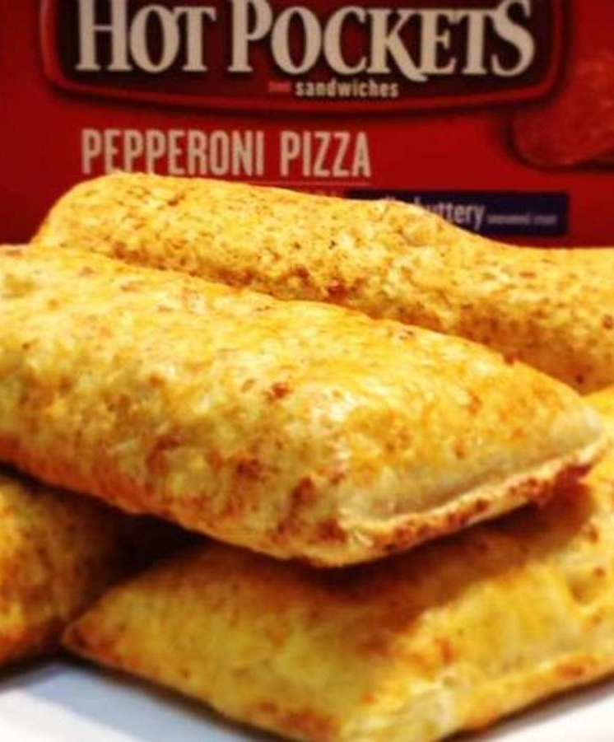
What do you know about the Hot Pocket Kid?
Cultural Heritage
Traditions
Beliefs
Identity
Geographic location
Religion
Political Identity
Physicality
Ethnicity
Socioeconomic Status
Age
Tastes
Ideas
Social Identity
Preferences
Attitudes
Extracurricular Activities

Slide 3
Food, Identity, and Kung Fu Panda
https://www.youtube.com/watch?v=X18z6dQWf2w
1. Why did Jimmy initially reject the food of his own culture?
2. What valuable lesson did Jimmy learn about his identity?

Slide 4
Food has taught me how important it can be in the discovering of the value of my upbringing and the shaping of my identity. I didn’t let the culture that surrounded me dictate who I was. Instead, I embraced my own.

Slide 5
I fell in love with food and cooking not through the culture that I wanted so badly to assimilate into but through the one that I was so eager to write off.

Slide 6
I began to realize how unique my own culture was and how unique my own experiences were and how great a resource it was for me to be able to express myself on a plate.

Slide 7
1. Why did Jimmy initially reject the food of his own culture?
2. What valuable lesson did Jimmy learn about his identity?

Slide 8

What does your comfort food say about you?
Cultural Heritage
Traditions
Beliefs
Identity
Geographic location
Religion
Physicality
Ethnicity
Socio-economic Status
Age
Tastes
Ideas
Preferences
Attitudes
Extracurricular Activities

Slide 9
Reflection Activity/Homework
Write a reflection paragraph describing the connection between the food you eat and who you are.

