Slide 1
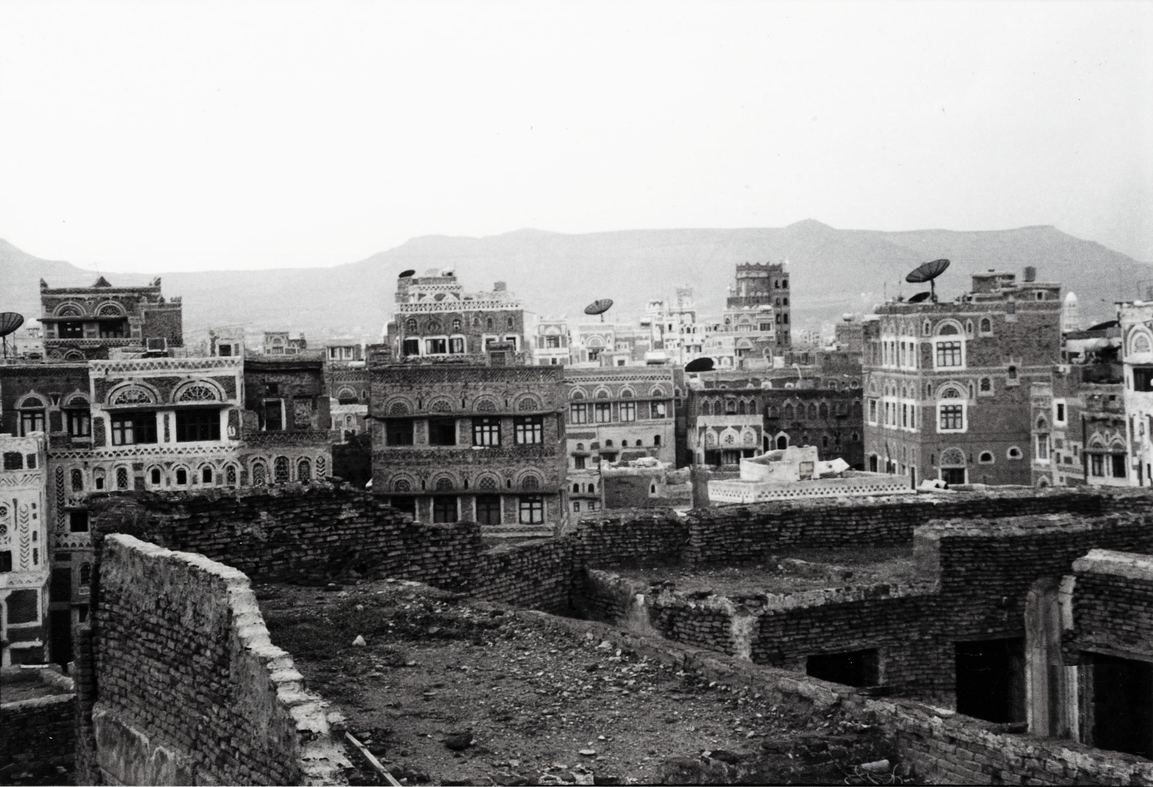
Humanitarian Crisis in Yemen
HUMANITARIAN CRISIS IN YEMEN | May 5, 2021 | Name of the student
01 – Introduction to Humanitarian crisis in Yemen
02 – Study on the prolonged humanitarian crisis in Yemen
03 – Conclusion on Humanitarian crisis in Yemen
04 – Citations
Notes:
On March 26th 2021, Yemen marked the sixth anniversary of conflict in the country, which has resulted in the largest humanitarian crisis in the world, with 66% of its population in dire need of aid. The Internally displaced person (IDPs)is over 4 million people. By the end of 2021, it estimated that 67200 could be displaced in Yemen if the level of conflict level continues at the same rate. They are considered one of the longest humanitarian crisis in the world has raged for six years. The conflict has had a devastating effect on the Yemeni people, Economy and crippled most public institutions such as schools and hospitals. It is estimated that more than17500 Yemeni citizens have been killed since 2015, but the figure is an estimate, and the actual number is considered to be higher than reported. The largest percentage of the victims are women and young children, according to the Yemen data project. Airstrikes in the populated area have been the highest cause of fatalities in Yemen. As the world still feeling the impact of Covid -19 on various super economies, the situation in Yemen is dire. If the conflict continues in Yemen, the Yemenis face a humanitarian crisis of extreme proportion, and the future seems bleak for the country.

Slide 2
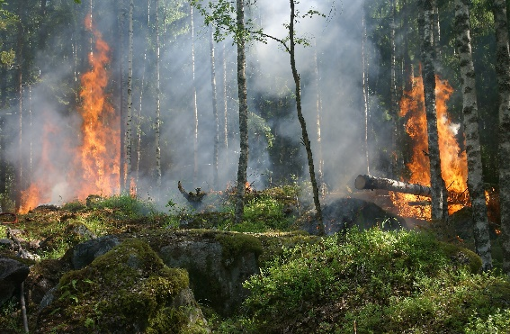


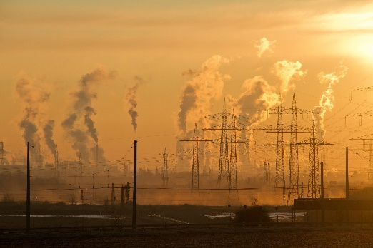

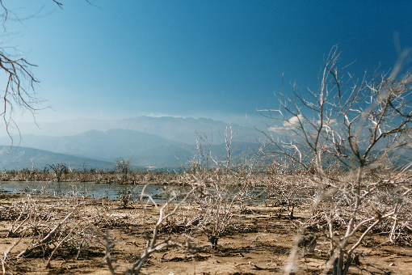
01 - Introduction to Humanitarian crisis in Yemen
Sources of Unrest:
- Calamities
- Natural Disasters
- Climate Change
- Pandemic
- Human Activities
Yemen
Yemen has experienced the most prolonged durations of unrest that has had adverse effects to the citizens of the country. The unrest has thus attracted humanitarian assistance, but the continued unrest has led to the country's humanitarian crisis.
Some countries that have experienced unrest:
- Syria
- Iraq
- Iran
Notes:
The humanitarian situation continues to deteriorate with casualties caused by
I) Calamities-Natural calamities have led to the deterioration of the humanitarian situation in Yemen. Earth quack and floods are the two major calamities affecting the country.
II) natural disasters, Heavy rains, strong winds, and flooding have also led to the worsening of the situation. Flooding in Lahj and Aden, the southern governorates, has led to massive property loss and destruction of shelters, food stocks, and health clinics, affecting thousands of internally displaced persons (IDPs) directly.
III)Climate change-Global warming has resulted in deterioration of the water supply and resulted in rural-urban migration, causing pressure on the town's limited resources. This has heightened the political and social tension, which eventually led to open conflict in the country.
IV)Pandemic human activities, etc.-Covid -19 has affected all countries in the world. Still, it has severely hit Yemen due to its poor health infrastructure that has almost become nonexistent due to the country's turmoil. Scarce resources available are heightening the tension in the country even after European Union intervention (E.U.) INTERVENTION
Other countries that are experiencing unrest include:
-Syria
-Iraq
-Iran

Slide 3
01 - Introduction to Humanitarian crisis in Yemen (continuation)
Humanitarian Assistance
They play the role of ensuring the war does not cause extremes in the country by helping the wounded, providing food and water for the displaced and building temporary homes for the displaced (Sowers et al.)
When problem arises it is practical to take action on the situation that led to the emergence of the problem to ensure it will not occur again
Prevention/Intervention Measures:
(1) Alleviation
(2) Readiness
Emergence/Actual Situation:
Putting the response strategies into practice
Recovery Measures:
Putting in place recovery measures after a problem strike
Notes:
INTERVENTION
The collapse of Yamenian public institutions such health care sanitation, and schools have been destroyed and some rendered non-existence due to the conflict. Before the conflict the country was among the poorest in the Arab region suffering from food insecurity and uncertainty in political transition. Half of the Yamenian population leave in extreme poverty. The United Nations and other partners are funding specialised programmes aiding the citizens in these tough times.
The UN has laid down various strategies to elevate the Yamenian citizen who have been directly affected by the conflict. The UN has laid down 17-strategies to help the humanitarian crisis. The top 10 strategies include:
No poverty
Zero hunger
Good health
Quality Education
Gender Equality
Clean water and sanitation
Clean energy
Descent work and economic growth
Industry Innovation
Climate Action
Recovery measures
Financial Challenge experienced by Yemen is being tackled by the following:
Oil and gas production sector to be supported as production restarts.
Stabilization of the Yemeni Rial and priotization of the currency by the Yamenian central bank.
Social challenges recovery measures
Rebuilding of schools
Establishment of empowerment programmes to prepare college graduates to enter the local job market.
Establishment of graduate programmes to improve the capacity of the state officials.
Infrastructure recovery measures:
Rebuilding of Yemen’s electricity grid emphasise on Renewable energy source
Rehabilitation of ports and airports

Slide 4
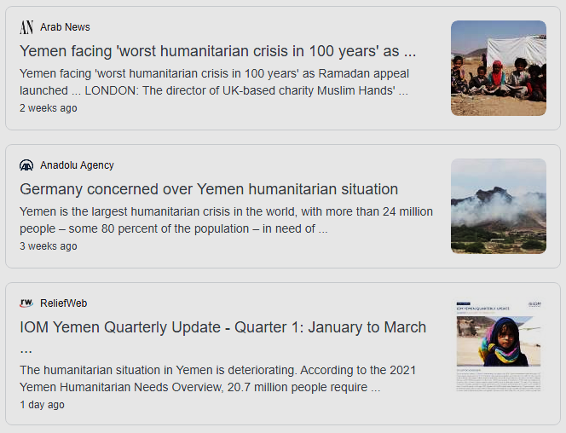
01 - Introduction to Humanitarian crisis in Yemen (continuation)
Based on the recent IOM situation report humanitarian situation in Yemen is deteriorating
This is according to the 2021 Yemen Humanitarian Needs Overview where:
About 20.7 million people require humanitarian and protection assistance
While more than 16.2 million face the threat of famine
The crisis caused by either conflict or lack of humanitarian assistance has led to increased demand for humanitarian assistance, as many organizations extending help to Yemen fear being in the country, thus causing the prolonged humanitarian crisis in Yemen.
Notes:
The collapse of Yamenian public institutions such as health care sanitation and schools have been destroyed, and some rendered nonexistence due to the conflict. Before the conflict, the country was among the poorest in the Arab region suffering from food insecurity and uncertainty in the political transition—half of the Armenian population lives in extreme poverty. The United Nations and other partners are funding specialized programs aiding the citizens in these tough times.
The U.N. has laid down various strategies to elevate the citizen who has been directly affected by the conflict. The U.N. has laid down 17-strategies to help the humanitarian crisis. The top 10 strategies include:
No poverty
Zero hunger
Good health
Quality Education
Gender Equality
Clean water and sanitation
Clean energy
Decent work and economic growth
Industry Innovation
Climate Action
Recovery measures
The financial Challenge experienced by Yemen is being tackled by the following:
Oil and gas production sector to be supported as production restarts.
Stabilization of the Yemeni Rial and prioritization of the currency by the Armenian central bank.
Social challenges recovery measures
Rebuilding of schools
Establishment of empowerment programs to prepare college graduates to enter the local job market.
Establishment of graduate programs to improve the capacity of the state officials.
Infrastructure recovery measures:
The rebuilding of Yemen's electricity grid emphasizes Renewable energy sources.
Rehabilitation of ports and airports
4. Based on a recent report, i.e., the IOM situation report, the humanitarian situation in Yemen is deteriorating.
According to the 2021 Yemen Humanitarian Needs Overview,20.7 million people require protection assistance, while more than 16.2 million faces the threat of famine.
The crisis has led to increased demand for humanitarian assistance as many organizations fear being in the country, thus causing prolonged drought.

Slide 5
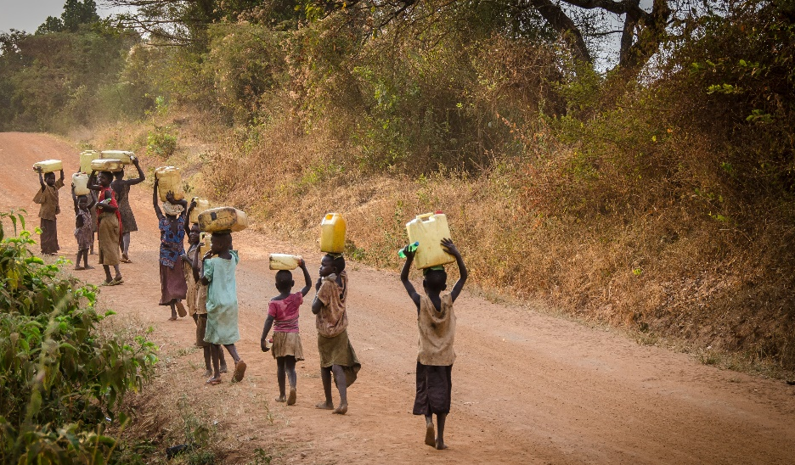
02 – Study on the prolonged humanitarian crisis in Yemen
Contributing factors to the humanitarian crisis in the Yemen
(1) Conflict on scarce resources such as Water
Yemen was one of the areas having severe water problem.
Water available in Yemen is scarce and for the little that is available, it is not safe for human consumption
To address this, the humanitarian assistance delivers clean water to the country, however since everyone wants to access the water first, only the strong in terms of arms and politically get to benefit from the humanitarian assistance thus causing conflict. (Charles Darwin’s - survival of the fittest)
Yemen has gone a notch higher to bomb humanitarian assistants’ camps. As a result, the humanitarian assistants get out of the country until the situation of unrest has calmed down to ensure that they don’t become culprits in the chaos. (Literature by Dunning)
Conflict - is one of the major contributing factor to the emergence of a crisis
Unending conflict
Humanitarian aid endanger themselves from getting involve in environments that look like war zones
Slow humanitarian assistance
Notes:
Scarcity of water-The country is located in a semi-arid region of the Middle East region where water availability is severely limited. The country faces a water crisis due to a high population growth rate and poor agricultural practices that pollute the available water towers making the water unfit for human consumption. The growth rate in town has almost doubled, increasing scarcity of water. The cultivation of Khat has also resulted in a shortage of water. Khat is a popular drug in Yemen, with an 80% usage by the country population. Due to its high demand in the country, farmers grow it even after the government directive to prevent the plant's growth since it's the only source of income. Lack of enforcement laws by the government has also contributed to the scarcity of water in the country. The government has no law prohibiting water wastage in the country. People are also drilling wells on natural water reservoirs. There are also the issues of leaking pipes which cause a 60% Water loss. If the government can introduce and implement the relevant laws on water usage, it can help in mitigating this shortage.The Yemeni government is mitigating the shortage by the implementation and formulation of laws and policies helping to minimize water wastage.-With the Aid of Germany Development Agency(GTZ), The government has introduced a national mascot (ROWYAN) to sensitize people on proper water usage

Slide 6




02 – Study on the prolonged humanitarian crisis in Yemen (Continuation)
Given that all kinds of assistance becomes absent in Yemen, there is no one to console the displaced through food, water or shelter. As conflicts in the country continue, more people become culprits who need humanitarian assistance, however due to civil unrest humanitarian organizations can’t lend help and thus leading to a humanitarian crisis.
(2) Deteriorated health conditions
Due to the absence of humanitarian assistance, outbreak of Cholera disease became a pandemic. (Federspiel et al) Also, the large population of people who contracted the disease presented a health crisis that could only be rectified through massive contributions from humanitarian organizations.
(3) Lost livelihoods
A country's economic situation continues deteriorating where development projects stagnate due to losing the economically strong population to the war or through displacement. As a result of the loss of the economically productive population, food
shortages continue to exist in Yemen (Sowers et al.)
(4) Death in war
(5) Famine
Notes:
2.Deterioration of health condition Due to conflict and the surge of the population, the health condition and facilities of the country are overstretched. The situation has been worsened by the land restrictions on purchasing necessary vaccines and drugs. The destruction of health facilities and lack of salaries to the medical workforce has led to the health conditions in the country being crippled.3.Lost of livelihoodThe economy shrunk after the countries unrest. This resulted in many of the workforce being laid off, and the remaining group worked for longer hours with less or no pay at all from the government. This has led to a loss of income for most of the Yamenian families.4.Death in warThe war has resulted in massive loss of life either directly from airstrikes or the terrorist attacks on civilians. The war has resulted in negative growth in the economy, which has affected the citizens.5.FamineSince 2016 famine has ravaged Yemen and resulting in an estimated death toll of more than 85000 children. The united nation estimates that more than 13 million people face starvation, and this situation has been described as the worst famine globally in more than a century.

Slide 7
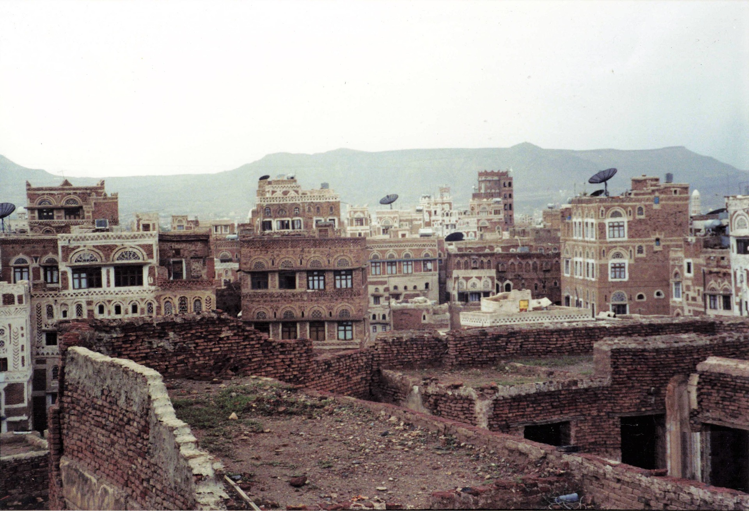
03 – Conclusion on Humanitarian crisis in Yemen
The conflicts in the county have led to the stagnation of developmental projects either by humanitarian assistants or by the government of Yemen (Kiefer et al.) The situation in the country has crippled the economy, has led to the prevalence of diseases in the country, caused a famine, has led to improper medical care and has made the economy short of resources.
One way to address the country's situation of unrest is by acknowledging that there has been a problem. The country must make it a priority to overturn the situation. The country should take effort on strengthening humanitarian responses, boost humanitarian principles, and consider humanitarian assistance fundamentals (Coppi)
The crisis caused by either conflict or lack of humanitarian assistance has led to increased demand for humanitarian assistance, as many organizations extending help to Yemen fear being in the country thus causing the prolonged humanitarian crisis in Yemen.
Notes:
In conclusion, the conflict has led to stagnation of development projects either by humanitarian assistants or by the government of Yemen. The situation has crippled the economy leading to diseases prevalence in the country.
Lack of assistance has led to increased demand for humanitarian assistance.
The way to address the country's unrest is by acknowledging that there has been a problem.
The country should make an effort to strengthen humanitarian responses, boost humanitarian principles, and consider humanitarian assistance fundamentals.

Slide 8
04 – Citations
Coppi, Giulio. “The Humanitarian Crisis in Yemen: Beyond the man-made disaster.” International Peace Institute, 2018. https://css.ethz.ch/content/dam/ethz/special-interest/gess/cis/center-for-securities-stud ies/resources/docs/IPI%20Humanitarian-Crisis-in-Yemen.pdf
Dunning, Tristan. "Yemen—the ‘worst humanitarian crisis in the world continues." Parliament of Australia | Department of Parliamentary Services (2018). https://www.researchgate.net/profile/Tristan_Dunning/publication/329544463_Yemen _-_the_'worst_humanitarian_crisis_in_the_world'_continues/links/5c0ef069a6fdcc49 4feb08a8/Yemen-the-worst-humanitarian-crisis-in-the-world-continues.pdf
Federspiel, Frederik, and Mohammad Ali. "The cholera outbreak in Yemen: lessons learned and ways forward." BMC public health 18.1 (2018): 1-8. https://bmcpublichealth.biomedcentral.com/articles/10.1186/s12889-018-6227-6
Kern, Anna, and I. A. Sioux City. "Yemen: The Worst Humanitarian Crisis in History." https://www.worldfoodprize.org/documents/filelibrary/youth_programs/2018_gyi_pa pers/KernAnna_74D3293C0986C.pdf
Kiefer, Layne, and I. A. Wayland. "Yemen: Implementing a Unique Response Plan to the World’s Worst Humanitarian Crisis." https://www.worldfoodprize.org/documents/filelibrary/youth_programs/2018_gyi_pa pers/KieferLayne_7B45A81C60699.pdf
Lopour, Jacqueline. "Yemen, water and conflict." Centre for International Governance Innovation 20 Years (2018). https://www.cigionline.org/articles/yemen-water-and-conflict
Mansoor, Ahmed Salmen, and Mokhtaruddin Ahmad. "The Role of Social Media Use in Social Coordination among Relief Local Organizations during Response to Humanitarian Crisis in Yemen." Malaysian Journal of Media Studies 22.1 (2020): 51-68. https://jpmm.um.edu.my/article/view/21240
Sowers, Jeannie, and Erika Weinthal. "Humanitarian challenges and the targeting of civilian infrastructure in the Yemen war." International Affairs 97.1 (2021): 157-177. https://academic.oup.com/ia/article-abstract/97/1/157/6041480
Photos used:
yemen-6037293_1920
pexels-julia-volk-5273095
pexels-laker-6156554
pexels-pixabay-221012
pexels-markus-spiske-3970330
pexels-pixabay-51951
jeff-ackley-YwDo_HwORXs-unsplash
evgeni-tcherkasski-nEH_eq_PtRA-unsplash
chitto-cancio-EtelvFxuw2c-unsplash
eyasu-etsub-j3R9C-Xqe1w-unsplash
Notes:
The citations are as follows.

