Slide 1
Husky Air
Muhammad Umar
Ali Al Kindi
Ragheeb Clarke
Mohammed Albaqami

Slide 2
Summary

Slide 3
Learning Record
Fact | Assumption | Questions to be Answered
The company wants to have a system to keep track of volunteer records | They don't have any current system installed. All are paper work | What kind of information system they need?
The company needs to have a new way of inputting data | They don't have the information saved | How do they want to input the data?
The company wants to know more about the people, hospitals, clinics, and organ banks that request their service | they never collected any data for these | How will we get these data?
The company wants a list of all Pilot Angels flights in order to pay recognition to volunteers and their contributions. | they have criterias to define which pilots contributed more | is it by distance, number of flight, or total hours spent for the cause?

Slide 4
MOV
Track and reduce the costs of organizations and people that request the Husky Air Service by an accuracy of 80% by 19th of January 2018.

Slide 5
Business Case
1- Keep the current paper file records
Keeping the current paper tracking system would result in low accuracy when inputting and locating data.
2- Purchase an existing system
Purchasing an existing system will provide the company with a system that is able to enter and retrieve data in real time as well as exchanging them with pilots, patients and hospitals.
3- Develop their own system
Develop their own system that would satisfy all requirements.

Slide 7
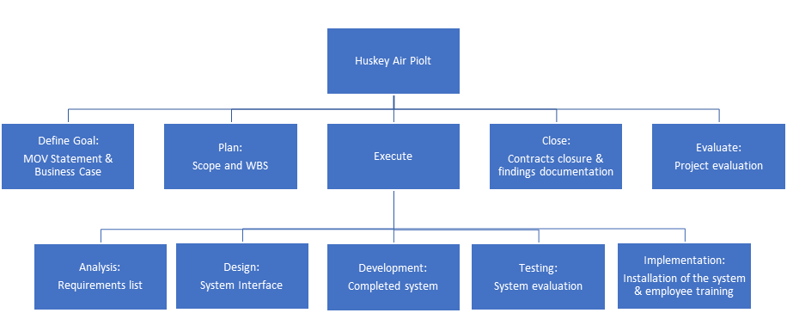
Deliverable structure chart

Slide 8
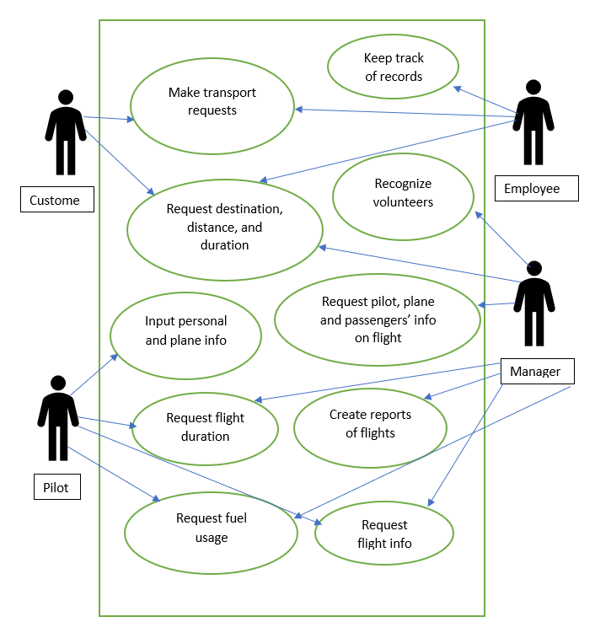
Use case diagram

Slide 9
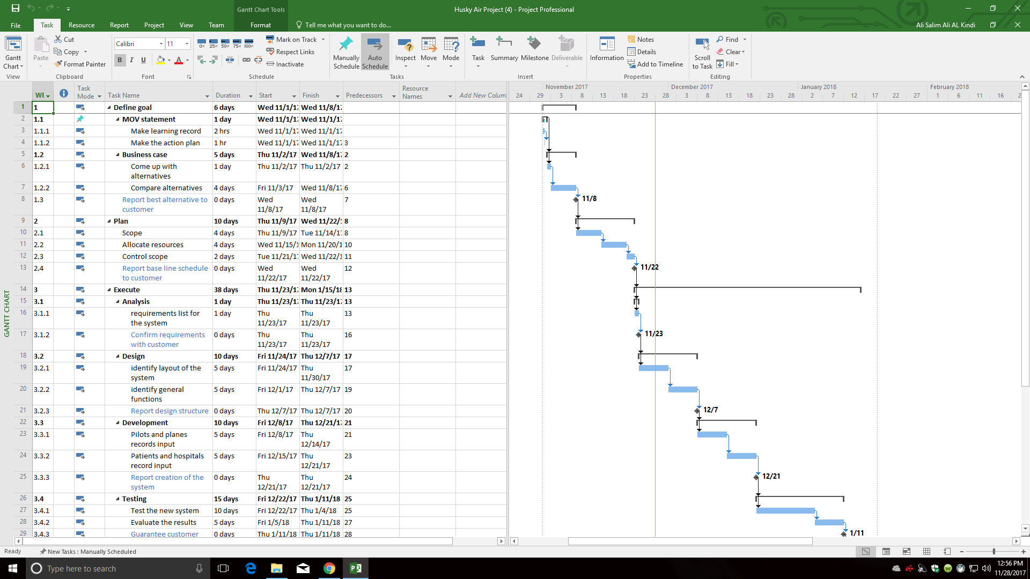
Work breakdown structure

Slide 10
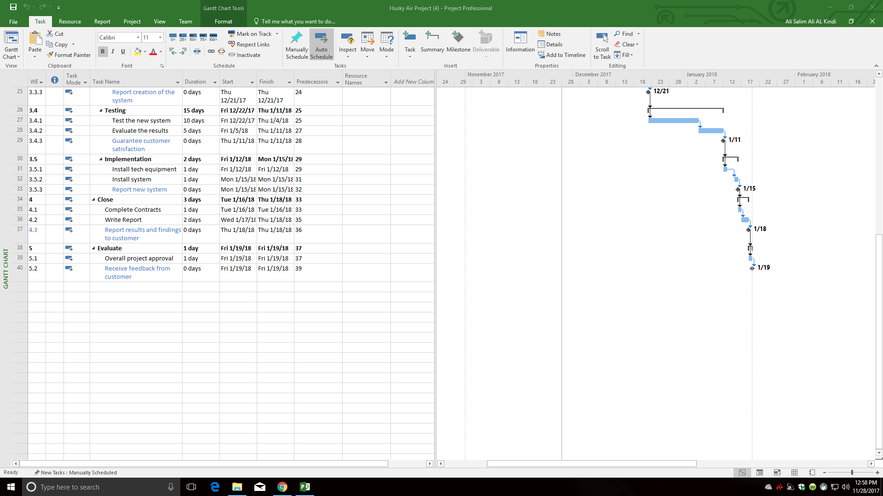
Work breakdown structure

Slide 11
Budget
Task | Month 1 | Month 2 | Month 3
MOV Statement | 90$
Business Case | 450$
Planning | 900$
Analysis | 260$
Design | 830$ | 830$
Development |  | 1660$
Testing |  | 900$ | 990$
Implementation |  |  | 560$
Close |  |  | 270$
Evaluate |  |  | 120$
Total | 2530$ | 3390$ | 1940$

Slide 12
Risk management matrix
Risk | Consequence | Probability (L,M,H) | Severity (L,M,H) | Action Trigger | Responsibility | Response Plan
Team member leaving | Delay the project | L | H | Fail to meet team norms | Ali | Have replacements ready
Disapproval of the system | Delay the project | L | M | Expensive | Ragheeb | Have other option ready
Wrong data validation method | Delay the project Exceed budget | L | L | Incorrect data entry | Muhammed | Review data
Failure to accept the new system | Modify the system | M | H | Difficulty to use the system | Ragheeb | Develop a user guide
Fail to negotiate price with software development team | Exceed budget | H | H | Huge variance in in the base pay for software engineers | Mohammed | Have back up funds in reserve

Slide 13
Risk management matrix
Inaccurate estimates for prices | Exceed budget | L | M | Prices of electronics vary with time | Ali | Have back up funds in reserve
Inaccurate estimates for schedule | Delay the project | M | H | tasks may take longer to be complete | Muhammed | Increase number of working hours per day
Lack of technical skills | Delay the project | M | H | No training was conducted to ensure system compliance | Ali | Ensure to have a training team stand by
Delay of completing/ delivering the system | Delay the project | M | H | The duration of the system design phase took more time. | Mohammed | Increase number of working hours per day

Slide 14
Earned value analysis
Task | Planned Value | Actual Value | Earned Value | Cost Variance | Schedule Performance Index | Cost Performance Index
Learning record | 60$ | 60$ | 60$ | 0$ | 1.00 | 1.00
Action plan | 30$ | 30$ | 30$ | 0$ | 1.00 | 1.00
Come up with alternatives | 90$ | 90$ | 90$ | 0$ | 1.00 | 1.00
Compare alternatives | 360$ | 360$ | 360$ | 0$ | 1.00 | 1.00
Create scope | 360$ | 360$ | 360$ | 0$ | 1.00 | 1.00
Allocate resources | 360$ | 360$ | 360$ | 0$ | 1.00 | 1.00
Control scope | 60$ | 60$ | 60$ | 0$ | 1.00 | 1.00

Slide 15
Lessons learned

