Slide 1
I308: Information Representation
Chapter 7: Normalization
William Helling
Catherine Walsh

Slide 2
Chapter 7: Normalization
“Normalization is a procedure in relational database design that aims at converting relational schemas into a more desirable form. The goal is to remove redundancy in relations and the problems that follow from it, namely insertion, deletion and update anomalies.…. Normalization is a step-wise process, where each step transforms the relational schemas into a higher normal form. Each Normal form contains all the previous normal forms and some additional optimization over them.”
Database Fundamentals (96)

Slide 3
Logical vs Physical Terms
Logical | Physical
Relation (Entity) | Table
Unique identifier | Primary key
Attribute | Column
Tuple | Row
The normalization process is on the logical design although many tend to think (and speak) with the physical terms…
At this point, note that we are transitioning from the logical to the physical phase, where the relational database vocabulary changes. Don't be confused by seemingly inconsistent usage when you read about database development.

Slide 4
1NF, 2NF, 3NF
You will study just the first, second, and third normal forms. In brief:
First Normal Form – Eliminate repeating data and non-atomic values; add keys
The data is stored in a relation (table) and each attribute (column) contains atomic values. There are no repeating groups of attributes (attributes having more than one value in each row).
Second Normal Form – Eliminate partial dependencies.
The relation is in first normal form and all the attributes depend on the relation’s unique identifier (primary key). [This means any relation WITHOUT a concatenated primary key is already in 2NF]
Third Normal Form – Eliminate transitive dependencies.
The relation is in second normal form and all of its attributes are not transitively dependent on the unique identifier.
Notes:
https://www.essentialsql.com/get-ready-to-learn-sql-database-normalization-explained-in-simple-english/

Slide 5
DISCLAIMER
You will find many normalization samples online or in print books. Realize that approaches differ greatly, which may prove confusing at first. Some authors also make it a very complicated process while other oversimplify the process.
Over the next several modules we will practice, using different starting points, and using different ways to display results.

Slide 6
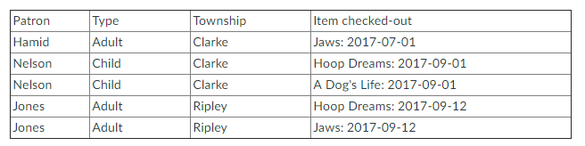
Library Circulation: 0NF
Imagine an effort by someone who has attempted to make a database of library item circulation. This is a simplified example, of course, but assume we were trying to track patrons and the items they checked out. A table to hold all this data could look like:
Note: This is the logical design stage. Many designers are not concerned with the proper tech parameters for entity and attribute names until the physical stage.

Slide 7
There are problems with this potential database!
Insertion anomaly: We can’t add a new patron type or township name to the database without leaving a blank for a patron name (and that is not usually a good thing to do).
Update anomaly: Some item names are repeated in multiple rows. If an item changes in any way (e.g., an item may be lost or withdrawn), updates may not be made consistently across all rows.
Deletion anomaly: If Nelson moves away and we delete that patron record, we also lose information on that item (perhaps she is the only one to check out A Dog's Life).
Search and sort issues: To look for all instances of an item's checked-out stats, you would need to parse a lot of data within a column.

Slide 8
First Normal Form
Each set of related data is identified with a primary key.
Each attribute contains atomic values,* and there are no repeating groups of attributes (attributes having more than one value in each row).
* When a value is atomic, the values cannot be further subdivided.

Slide 9
So we put this table into First Normal Form: Each table must be identified with a key and each column must contain only atomic values.
To start off, we can add a key.
NOTE: The key is best when it is a surrogate number not based on any meaningful information. The RDBMS can actually add this number for you automatically, so you don't need to assign it manually.
In this example, we'll indicate the key's column name in bold/underline.

Slide 10
And then to get rid of non-atomic values (besides the fact that they are also different data types: text vs. date), we need to create two tables out of this one table.
We can put the item circulation data into its own CIRCS table, giving the item an ID as well as retaining the IDs from the PATRONS table so that the combination of Patron ID, Item ID, and Checked-out make the unique identification (because the values in these columns can repeat, they can't be single-column keys in this table).
Remember: A multi-column primary key is called a composite key.

Slide 11
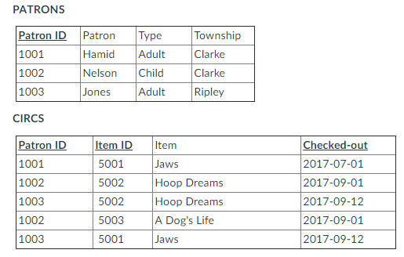
1NF
If you are concerned that the columns and the rows of tables seem to be in random order, don't worry. Order does not make a difference in a relational database table. You can sort later, if you output the data.

Slide 12
Now to get to Second Normal Form we need to get rid of partial dependencies (where no column is dependent on only a portion of the key).
For the CIRCS table, we have the Item data that really depends on the Item ID column for identification, but does not depend on the Patron ID or Checked-out.
So we can take the item values out and make an ITEMS table -- and the CIRCS table can remain with its combination of columns to identify those circulation transactions.

Slide 13
Second Normal Form
The relations are in 1NF
All nonkey attributes are functionally dependent on the entire primary key.
Relate these relations with a foreign key.
Second normal form includes no partial dependencies: no attribute is dependent on only a portion of the primary key.

Slide 14
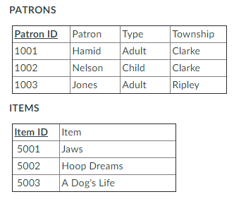
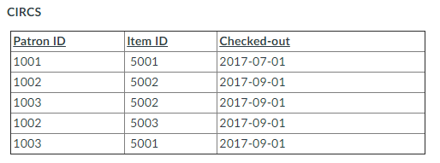
2NF

Slide 15
Third Normal Form
The relations are in 2NF.
A relation contains only columns that are non-transitively dependent on the primary key.
No transitive dependencies! All the nonkey attributes depend only on the primary key (and not on each other).

Slide 16
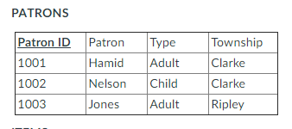
And for Third Normal Form, no transitive dependencies are allowed! All the columns that are not keys must depend only on the key.
The ITEMS and CIRCS tables are not a problem, but the PATRONS table has Type and Township columns that don't depend on PatronID. We can make them their own tables but then make sure we include their keys as regular columns in the PATRONS table so we can combine and retrieve all that data when needed. But at least now we won't suffer those anomalies as discussed earlier if we want to add more patron types or townships before we have patrons for them.

Slide 17
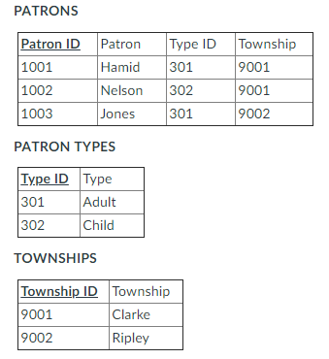
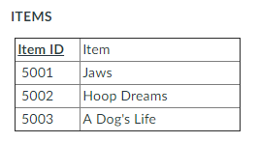
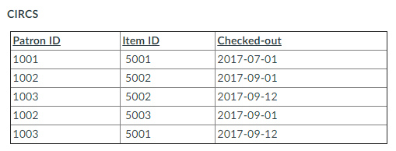
3NF

Slide 18
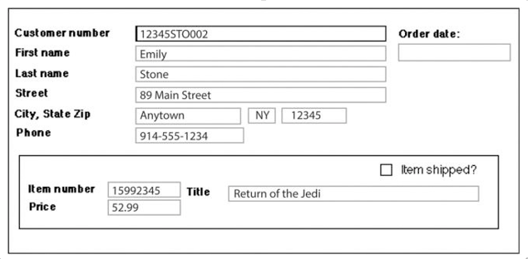
Normalization Exercise
Antique Opticals Invoice (customer number, order date, first name, last name
street, city, state, zip, phone, (item number, price, title, shipped))

Slide 19
0NF
Antique Opticals:
orderDate | customerNum | firstName | lastName | street | city | state | zip | phone | item
 | 12345STO002 | Emily | Stone | 89 Main Street | Anytown | NY | 12345 | 914-555-1234 | 15992345, 52.99, Return of the Jedi, yes
 | 12345STO002 | Emily | Stone | 89 Main Street | Anytown | NY | 12345 | 914-555-1234 | 19339900, 75.99, Lawrence of Arabia, yes
orderDate | customerNum | firstName | lastName | street | city | state | zip | phone | itemNum | price | title | shipped
 | 12345STO002 | Emily | Stone | 89 Main Street | Anytown | NY | 12345 | 914-555-1234 | 15992345 | 52.99 | Return of the Jedi | yes
 | 12345STO002 | Emily | Stone | 89 Main Street | Anytown | NY | 12345 | 914-555-1234 | 19339900 | 75.99 | Lawrence of Arabia | yes

Slide 20
1NF:
Each set of related data is identified with a primary key.
Each column contains atomic values,* and there are no repeating groups of columns.
invoiceNum | orderDate | customerNum | firstName | lastName | street | city | state | zip | phone
1001 |  | 12345STO002 | Emily | Stone | 89 Main Street | Anytown | NY | 12345 | 914-555-1234
1002 |  | 12345STO002 | Emily | Stone | 89 Main Street | Anytown | NY | 12345 | 914-555-1234
Invoice
Invoice Item
invoiceNum | itemNum | price | title | shipped
1001 | 15992345 | 52.99 | Return of the Jedi | yes
1002 | 19339900 | 75.99 | Lawrence of Arabia | yes
Invoice (invoice number, order date, customer number, first name, last name
street, city, state, zip, phone)
Invoice Item (invoice number, item number, price, title, shipped)
Notes:
The title is functionally dependent on the item number (only one value of an item number will be associated with a title), but it is not functionally dependent on the entire primary key! Different invoice numbers can be associated with the same title.

Slide 21
2NF:
The tables are in 1NF
All the nonkey columns are dependent on the table’s primary key. (All nonkey attributes are functionally dependent on the entire primary key.)
Invoice
invoiceNum | orderDate | customerNum | firstName | lastName | street | city | state | zip | phone
1001 |  | 12345STO002 | Emily | Stone | 89 Main Street | Anytown | NY | 12345 | 914-555-1234
1002 |  | 12345STO002 | Emily | Stone | 89 Main Street | Anytown | NY | 12345 | 914-555-1234
Invoice Item
Product
invoiceNum | itemNum | price | shipped
1001 | 15992345 | 52.99 | yes
1002 | 19339900 | 75.99 | yes
itemNum | title
15992345 | Return of the Jedi
19339900 | Lawrence of Arabia
Invoice (invoice number, order date, customer number, first name, last name
street, city, state, zip, phone)
Invoice Item (invoice number, item number, price, shipped)
Product (item number, title)
Notes:
The title is functionally dependent on the item number (only one value of an item number will be associated with a title), but it is not functionally dependent on the entire primary key! Different invoice numbers can be associated with the same title.

Slide 22
3NF:
The tables are in 2nd normal form.
A table contains only columns that are non-transitively dependent on the primary key (i.e., all nonkey attributes depend only on the primary key)
Customer
Invoice
invoiceNum | orderDate | customerNum
1001 |  | 12345STO002
1002 |  | 12345STO002
customerNum | firstName | lastName | street | city | state | zip | phone
12345STO002 | Emily | Stone | 89 Main Street | Anytown | NY | 12345 | 914-555-1234
12345STO002 | Emily | Stone | 89 Main Street | Anytown | NY | 12345 | 914-555-1234
Product
Invoice Item
itemNum | title
15992345 | Return of the Jedi
19339900 | Lawrence of Arabia
invoiceNum | itemNum | price | shipped
1001 | 15992345 | 52.99 | yes
1002 | 19339900 | 75.99 | yes
Invoice (invoice number, order date, customer number)
Invoice Item (invoice number, item number, price, shipped)
Product (item number, title)
Customer (customer number, first name, last name, street, city, state, zip, phone)
Notes:
The title is functionally dependent on the item number (only one value of an item number will be associated with a title), but it is not functionally dependent on the entire primary key! Different invoice numbers can be associated with the same title.

