Slide 1
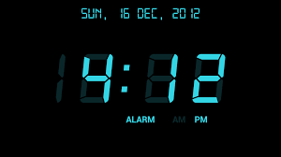
CDA3103
Project 1: Digital Clock
Spring 2021
Due : March 28, 2021

Slide 2
General Info
  Topic: A digital clock (Time and Date)
    If you are interested to work on a special topic, please send your topic to the lecturer. If it was approved, you can work on your own topic.
  Deadline: March 28, 2021
  Early Submission: March 28, 2021 (5 points bonus)
  Total Points: 100 points (25 bonus points)
  It should be completed individually.

Slide 3
Objectives
  To practice how to design and implement combinational and sequential digital systems.
  To design, implement and simulate a digital clock capable of displaying seconds, minutes and 12 or 24 hours timing, with a date indicator that display days ,months and years.

Slide 4
Marks Breakdown
Element | Points
Second counter circuit section | 15
Minute counter circuit section | 10
Hours counter circuit section | 15
Days counter Circuit section | 15
Months counter circuit section | 15
Years counter circuit section | 15
AM/PM | 5
Report | 10
Bonus: Stop watch | 5
Bonus: Adjustable Clock | 10
Bonus: Creativity in design, implementation | Max 5
Bonus: Early submission | 5
Total | 100 + 25 (bonus)

Slide 5
Introduction
  A digital clock is a type of clock that displays the time digitally. It uses digital counters that count second, minute and hours. Each sixty seconds make a minute and each sixty minutes an hour. After twenty four hours the clock resets and starts from initial condition. The functional unit of a digital clock is a counter that represents a second, minute or hour block.
  A counter may be defined as a register i.e. a group of flip-flops that goes through a predetermined sequence of states upon the application of input pulses. The logic gates in a counter are connected in such a way as to produce a prescribed sequence of binary states in the register.

Slide 6
DESIGN PROCEDURES
For easier design, the general circuit of the digital clock is divided into nine sub sections (4,8, and 9 are optional) namely;
  Second counter circuit section
  Minute counter circuit section.
  Hour counter circuit section.
    Two options: 12 and 24 hours. Select one of them
  AM/PM (optional. Hour counter should be in mode 12.)
  Days counter Circuit section. (30 days)
  Months counter circuit section. (12 month)
  Years counter circuit section. (initial value 2021)
  Stopwatch section. (Bonus : 5 points)
  Adding extra inputs for adjusting the time and date to a certain time and date (Bonus : 10 points)
  There is an extra video explaining how you can design a sequence counter counting from 0 to 60. this counter can be used as a second counter and a minute counter.
  A similar technique used for second counter could be used for Hours, Days, Month and years.

Slide 7
DESIGN PROCEDURES
For easier design, the general circuit of the digital clock is divided into nine sub sections (4,8, and 9 are optional) namely;
  Second counter circuit section
  Minute counter circuit section.
  Hour counter circuit section.
    Two options: 12 and 24 hours. Select one of them
  AM/PM (optional. Hour counter should be in mode 12.)
  Days counter Circuit section. (30 days)
  Months counter circuit section. (12 month)
  Years counter circuit section. (initial value 2021)
  Stopwatch section. (Bonus : 5 points)
  Adding extra inputs for adjusting the time and date to a certain time and date (Bonus : 10 points)
  Then Add the subcircuit to the library of LOGISIM.

Slide 8
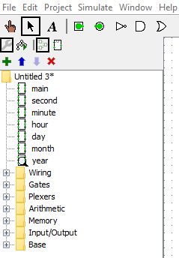
DESIGN PROCEDURES (cont.)
  There is an extra video explaining how you can design a sequence counter counting from 0 to 60. this counter can be used as a second counter and a minute counter.
  A similar technique used for second counter could be used for Hours, Days, Month and years.
  In this video, you will learn how you to create and add the designed subcircuits to the Logisim libraries.
The new subcircuits added in the library of LOGISIM

Slide 9
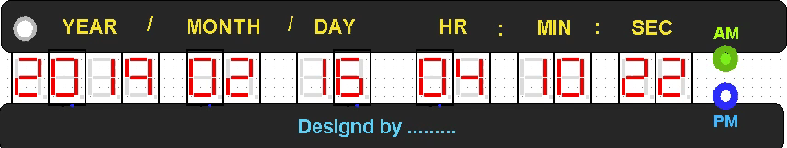
DEMO
    There is a template for the display. You can use it and connect your design to this display or you can use your own configuration.
    In this template some inputs are fixed and a digital system using build-in counters and comparators for seconds have been designed. The display should be connected to your own design and the extra elements should be removed.
    Play the clip below. In this clip, the frequency is changed to help you to see the changes in a faster speed, but the frequency should be 1 HZ.

Slide 10
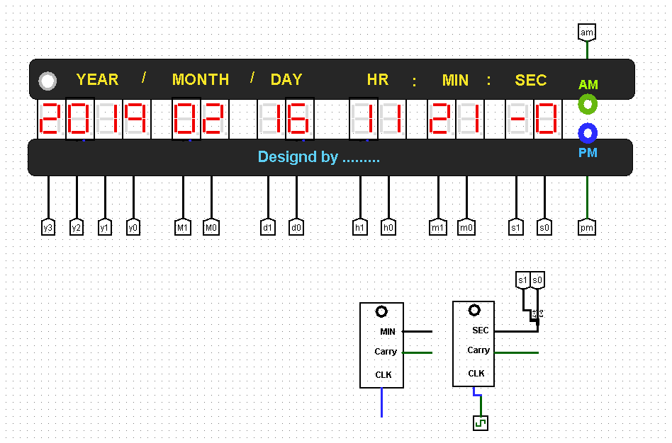
DEMO (Cont.)
    The layout of the subcircuits could be like the subcircuits below or any other form that you prefer.
    The final design should be completed by
      adding the other required subcircuits, and connecting them to the display.

Slide 11
SUBMISSION
    A . circ file named Yourname_DigitalClock.circ
    A report (Yourname_DigitalClock.doc or Yourname_DigitalClock.pdf) explaining the process of designing. Your report should have enough details such as truth table, state table, state diagram, block diagram or everything that you used for the design and implementation.

Slide 12
Recommended Recourses
  The Text (Digital Design by M. Morris Mano)
  Logisim Help
  Design, Implementation and Simulation of 12/24 Hours Digital Clock
  YouTube Resources:
    Link1
    Link2
Please see me or TAs if you need any question or help.

