Slide 1
Improving Employee Retention Rate
Name
Institution of Affiliation

Slide 2
Introduction
Employees are companies’ most crucial assets.
Organizations are now placing special focus on employee retention rate and turnover rate.
This emerged from the revelation that high turnover rate have a negative effect on firms’ productivity.
Global Protech is grappling with the issue of turn over and employee retention.
Notes:
Employees are companies’ most crucial assets. Organizations are now placing special focus on employee retention rate and turnover rate. This emerged from the revelation that high turnover rate have a negative effect on firms’ productivity. Global Protech is grappling with the issue of turn over and employee retention (Markovich, 2019).

Slide 3
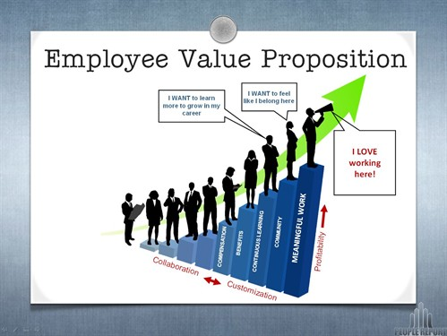
Notes:
The value proposition of employees based on the time they stay in an organization and their propensity to promotion.
(https://www.google.com/url?sa=i&url=https%3A%2F%2Fwww.lbisoftware.com%2Fblog%2Fwhat-is-a-companys-most-valuable-asset-its-employees%2F&psig=AOvVaw1NL8C9nC4jwfsxRmfj1N2n&ust=1590856634605000&source=images&cd=vfe&ved=0CAIQjRxqFwoTCIiRwILB2ekCFQAAAAAdAAAAABAD)

Slide 4
Variations in Turnover
In Global Protech, the employees in the VP of marketing have the highest turnover rate of 40 percent (2 out of 5 employees leave the firm)
Accountants have a turnover rate of 36 percent
Call center representatives have a turnover rate of 34 percent.
The cost of these turnover rates also depending on the cost of wages, benefits, and turnover.
Notes:
In Global Protech, the employees in the VP of marketing have the highest turnover rate of 40 percent (2 out of 5 employees leave the firm). Accountants have a turnover rate of 36 percent. Call center representatives have a turnover rate of 34 percent. The cost of these turnover rates also depending on the cost of wages, benefits, and turnover.

Slide 5
Variations in Turnover
The position of the call center representatives is the least affected with the cost of turnover being 33 percent.
Loss of accountants through termination causes a turnover of 100 percent.
This indicates that the two positions are barely affected by employee turnover.
Regardless, company misses out on the benefits of employee retention such as the learning curve effect.
Notes:
The position of the call center representatives is the least affected with the cost of turnover being 33 percent. Loss of accountants through termination causes a turnover of 100 percent. This indicates that the two positions are barely affected by employee turnover. Regardless, company misses out on the benefits of employee retention such as the learning curve effect.

Slide 6
Positions with the Highest Turnover Rates
The position of the vice president of marketing is the most affected.
The turnover cost as a percentage of the what employees get is 350 percent.
This comes from the cost of contract termination, hiring, onboarding, and development.
Number of employees in this position is limited; termination would drastically affect the culture and stability of the company.
Notes:
The position of the vice president of marketing is the most affected. The turnover cost as a percentage of the what employees get is 350 percent. This comes from the cost of contract termination, hiring, onboarding, and development. Number of employees in this position is limited; termination would drastically affect the culture and stability of the company.

Slide 7
Reasons Why Employees are Leaving
Low benefits and compensation.
For instance, benefits given to call center representatives are just 28 percent of their wages.
Relying heavily on data analytics to promote workers and ignoring other attributes such as personality.
This caused the promotion of the wrong people; especially who do not blend with other employees.
Notes:
A look at the compensation and benefits accrued by workers in the company indicate that they are low. For instance, benefits given to call center representatives are just 28 percent of their wages. Besides, the company relies heavily on performance data analytics to promote workers and ignore other attributes such as personality. This leads to the promotion of the wrong people, especially those who do not blend with other employees (Global Protech, n.d.).

Slide 8
Reasons Why Employees are Leaving Cont…
The company lacks a defined metric to evaluate the satisfaction rate of the employees.
Workers could be unhappy with some of the administrative structures at Global Protech
Lack of commitment to the firm would cause them to terminate their contract once they get a better firm.
Career advancement and employee engagement is limited at Global Protech.
Notes:
A survey of the information presented at the company’s website shows that it lacks a defined metric to evaluate the satisfaction rate of the employees (Global Protech, n.d.). Workers could be unhappy with some of the administrative structures at Global Protech and this would authenticate them to terminate their contract once they get a better firm. In addition, career advancement and employee engagement is limited at Global Protech.

Slide 9
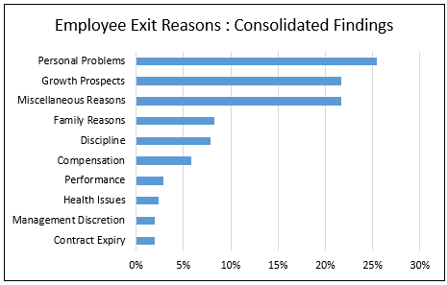
Notes:
Typical reasons why employees leave a firm.
(https://149362086.v2.pressablecdn.com/wp-content/uploads/2018/02/Employee-exit-reasons.png)

Slide 10
Retention Recommendation
Develop a 1-year retention policy; employee cannot terminate their work contract before completion of one year at the firm.
Exit interviews; help the firm to know why employees are leaving; help improve retention rate by making necessary changes.
Satisfaction surveys; sensitize the firm on the satisfaction levels of the workers and the possibility of terminations.
Notes:
It is imperative for Global Protech to develop a one-year retention policy. In this case, employees would only be able to terminate their work contract before completion of one year at the firm. The return on hiring would then have surpassed the cost of hiring and absorption. Besides, introduction of exit interviews would help the firm to know why employees are leaving; help improve retention rate by making necessary changes. Satisfaction surveys would help the firm to know how satisfied the employees and adopt ways to increase the level of satisfaction, thereby increasing the commitment of workers to the firm and reducing the possibility of termination.

Slide 11
Retention Recommendation Cont…
Employee training for Improved work effieciency and satisfaction with the tasks.
Sponsor employees in online courses for career advancement.
Introduce annual paid leave in the benefits program.
Introduce paid holidays for all employees.
Establish clarity in the procedure for promotion and achievement of other performance rewards.
Notes:
The training may involve workplace communication and culture, conflict management, and development of creative and critical skills. It can happen through conferences, workshops, and seminars. Sponsoring employees in online courses for career advancement would improve their loyalty to the company. Paid leave and holidays can also be a way of motivating the employees and improving their commitment to the organization. Some of the workers may be leaving the firm because of the feeling that they may never be promoted and a clear procedure for promotion and achievement of other performance rewards would reduce the employee turnover rate (Altman, 2017).

Slide 12
Cost Per Employee of the Recommended Retention
Aspects of the program that would cost intensive; paid leave, paid holiday, employee training, and sponsoring workers.
Each employee can consume around $500 in training.
Sponsorship of up to $4000 in course fees per year.
Cost of holidays is calculated as a total of amount to be spent for all employees with a cap being placed to avoid overspending.
Notes:
The aspects of the retention program that would be cost intensive include paid leave, paid holiday, employee training, and sponsoring workers. While employee training tend to be collective for all workers, each employee would consume an average of $500. The organization can also sponsor the workers for career advancement with payments of at least $4000 per year. However, there ought to be evaluation metrics for qualification to this sponsorship. The cost of holidays is calculated as a total of amount to be spent for all employees with a cap being placed to avoid overspending.

Slide 13
Return on Investment of the Program
The return on the investment will surpass the expenditure of the program.
For instance, if the turnover rate of marketing vice presidents drop to 20 percent, the company will save at least $33000 per year for that position.
Performance of employees would increase because of the training and career advancement.
Low turnover rate and high retention of talent would increase productivity and the benefits of the learning curve effect.
Notes:
The return on the investment will surpass the expenditure of the program. For instance, if the turnover rate of marketing vice presidents drop to 20 percent, the company will save at least $33000 per year for that position. It is already known that the turnover cost per employee in the position of the marketing VP is 350 percent of the employees’ monthly pay. Reducing the terminations by 20 percent will save the turnover cost of at least one marketing vice president. Performance of employees would increase because of the training and career advancement. Low turnover rate and high retention of talent would increase productivity and the benefits of the learning curve effect.

Slide 14
References
Altman, J. (2017, Jan). How much does employee turnover really cost? Huffpost. Retrieved on May 29 2020 from https://www.huffpost.com/entry/how-much-does-employee-turnover-really-cost_b_587fbaf9e4b0474ad4874fb7
Global Protech. (n.d.) Retrieved on May 29 2020 from https://mym.cdn.laureate-media.com/2dett4d/Walden/MHRM/PROG/Global_ProTech/index.html
Markovich, M. (2019, Feb). The Negative Impacts of a High Turnover Rate. Chron. Retrieved on May 29 2020 from https://smallbusiness.chron.com/negative-impacts-high-turnover-rate-20269.html

