Slide 1
I
POSTTRAUMATIC STRESS DISORDER
Institutional afflation
Student
Name

Slide 2
POSTTRAUMATIC STRESS DISORDER
Commonly referred to as PTSD in the corridors of medicine.
Posttraumatic stress disorder is a psychological condition caused by the witnessing of a terrifying event (Briere & Scott 2015).
The victim fails to recover witnessing.
Experiencing a traumatic event leading to high levels of anxiety, constant flashbacks, and nightmares during sleep

Slide 3
POSTTRAUMATIC STRESS DISORDER
The disorder is caused by natural and anthropological disasters, violence, accidents, sexual assault, terrorism, kidnapping, combat, and many other violent elements.
In standard terms, exposure to the few mentioned factors is inevitable in people's lives.
Human beings will either experience or witness a traumatizing event at one point in their lives or another because their occurrences are common and, in some cases, unexpected

Slide 4
POSTTRAUMATIC STRESS DISORDER
Some victims recover from such ordeals while others may need medical attention.
It includes counseling due to deterioration of both mental and physical health of the affected persons.

Slide 5
Causal factors of posttraumatic stress disorder
As mentioned earlier, the disorder is caused by both natural and human-made factors.
The magnitude of the effects depends on gender, genetic makeup, and the severity of the event.

Slide 6
Natural causes of disasters
A disaster can be defined as an adverse event, catastrophe, or accident that results in damages and even the loss of lives.
Natural disasters or merely 'God's acts' are devastating events that emanate from natural Earth's processes.
Natural processes have had the worst effects on properties and lives (in both flora and fauna).
The disasters include floods, hurricanes, volcanic eruptions, natural bushfires, floss, and earthquakes

Slide 7
Natural causes of disasters
Others include storms, landslides, cyclones, and drought.
In the USA, the yearly occurrences of hurricanes.
The Central Pacific Hurricane Center and the National Hurricane Center records the hurricane occurrences by giving them names.
For instance, Jeanne (2004), Katrina (2005), and Ike (2008).
Ike originated from Cape Verde and caused rampant damages and loss of lives along the Caribbean coasts and the coasts of Louisiana and Texas

Slide 8
Natural causes of disasters
The hurricane killed 74 Haitians, 2 Dominicans,7 Cubans, and 28 Americans.
It also resulted in over 1 billion in asset damages.
Bushfires emanating from tree friction are frequent in Australia, while earthquakes are a common phenomenon in Asia.
An example is the Osaka earthquake of 2018.
One of the worst earthquakes to take place was the Sumatra that happened in Indonesia in 2004.
The disaster caused displaced approximately 1.7 million people, 286,000 people lost their lives while over 50,000 people were unaccounted for

Slide 9
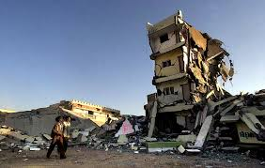
Natural causes of disasters
The witnessing or the experiencing of such disasters, especially those that humble the whole world, result in PTSD.

Slide 10
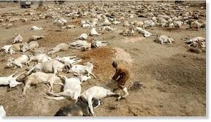
Natural causes of disasters

Slide 11
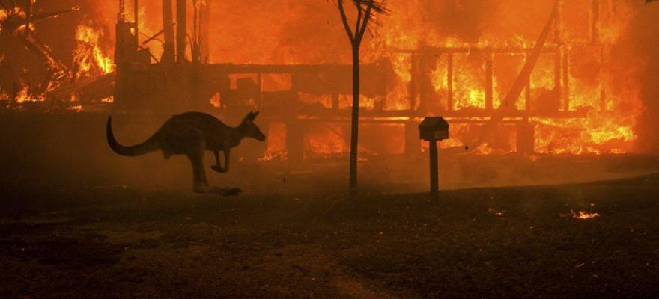
Natural causes of disasters

Slide 12
Human-made disasters
As suggested by the human-made-made disasters are caused by human factors.
Human being engage harmful activities either by accident or intentionally.
Some of the causal factors ignited by human beings include; sexual assault, severe accident (airplane crashes, the capsizing of ships, accidents, machine accidents, and construction falls).
The acts of terrorism, kidnap, witnessing war the killing of another person and loosing of a loved one.

Slide 13
Human-made disasters
Other human factors include losing a job, being held hostage, and facing a tough situation, for instance, the COVID-19 pandemic.
Research reveals that most victims who were raped or sexually assaulted while still young experience PSTD for the rest of their lives, especially those who keep the traumatizing ordeal to themselves.
Such victims end up developing a negative attitude towards the opposite sex and may not enjoy sexual intercourse during their adulthood (Levers 2012).
Another significant threat to humans is the act of terrorism.

Slide 14
Human-made disasters
Terrorism is defined as the use of intimidation and violence in an unlawful manner for either political, religious or personal aims.
Statistics compiled by Hannah Rithie , Joe Haell ,Cameron Appel and Max Roser.
In their article Terrorism reveal that terrorism claimed lives of 21,000 people.0.05 % of deaths in 2017 was attributed to terrorist activities with 95% of them occurring in Middle East, South Asia and Africa.

Slide 15
Human-made disasters
The Bible categorically condemn the act of terrorism.
Roman's 12: 19-21, God is against vengeance.
He says that vengeance is to be practiced by God Himself and not human beings.
Other deadly manmade disasters that ever happened are air crashes and ship accidents.
One of them is the disappearance of Flight 370 (a Malaysia Airline) in 2014. The flight was from Kuala Lumpur to Beijing International Airport.
Since then, the plane that had 275 passengers has never been traced.

Slide 16
Human-made disasters
Maritime disasters have never spared mankind either.
One of them is the capsizing of Le Joola (a Senegalise ship) in 2002.
The disaster claimed 1.864 lives.
The current disaster that has humbled the world is the COVID-19 pandemic.
The disease has grounded economic operations and resulted into more than 418,000 deaths worldwide.
The united states alone has more than 2.09 million cases with 116,000 deaths.

Slide 17
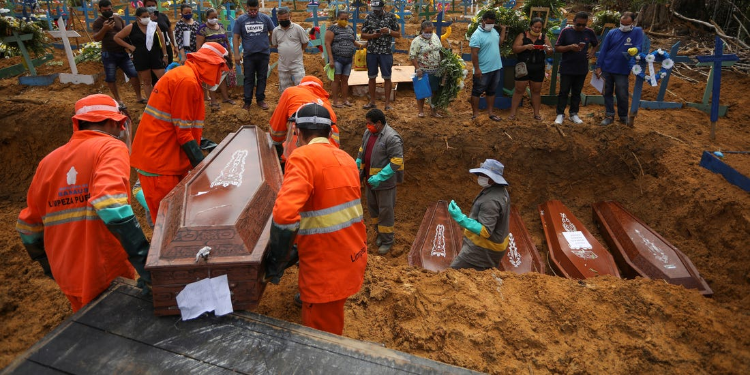
Human-made disasters
The easy transmission of the virus and the lack of cure coupled with loosing loved ones and means of earning has resulted into high levels of stress amongst people due to helplessness and the lose of hope.

Slide 18
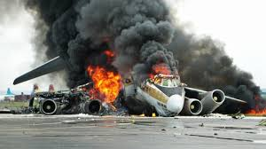
Human-made disasters

Slide 19
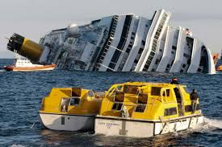
Human-made disasters

Slide 20
The Prevalence of Posttraumatic Stress Disorder
Prevalence means the rate of people in a population with a certain disorder at a specified time.
Any person is at risk of developing PTSD in his/her life (Sapolsky 2004).
A study carried out by the National Center for PTSD revealed that averagely, seven to eight out of 100 people will experience the disorder at one point of their lives.
The ratio equates to 7% of the entire population.

Slide 21
The Prevalence of Posttraumatic Stress Disorder
The study also unearthed that females have a higher likelihood of developing the disorder as compared to men.
40 % of the victims of PTSD worldwide are those who served in the army in various capacities or witnessed the war.
In other words, victims of war.
The USA has a prevalence of 6.8% to 16.9%with women accounting for 9.7% while men have 3.6 %.

Slide 22
The Prevalence of Posttraumatic Stress Disorder
The prevalence escalates with age especially from 18 to 59 is 57.4% .
Most cases occur in the active –duty personnel of the military.
In 2012, 11,033 personnel were hospitalized of PTSD a per the statistics of the Army Mental Health Advisory Te.

Slide 23
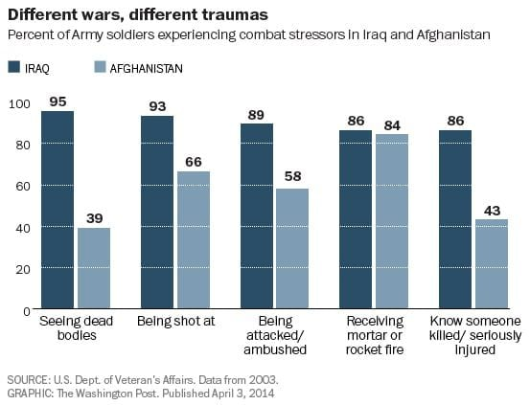
The Prevalence of Posttraumatic Stress Disorder

Slide 24
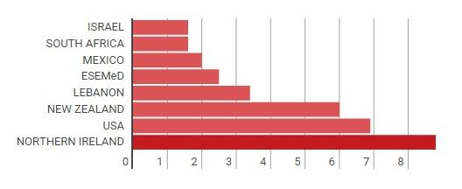
The Prevalence of Posttraumatic Stress Disorder
Research also reveals that Northern Ireland and the USA have high levels of PTSD worldwide

Slide 25
Harms/Dangers of PTSD
Posttraumatic stress disorder possess deadly harms to the victims if the condition is not given the necessary attention that it deserves.
The disorder has the potential of disrupting a person’s life which causes negative implications to a person’s job, general health, social relationships and the enjoyment of life activities.
The disorder can welcome other mental complications for instance, high anxiety levels and depression.

Slide 26
Harms/Dangers of PTSD
Such a combination of mental strains lead to suicidal thoughts and even actions ( Liberty University 2017 ).
A study by Journal of Affective Disorders shows that nearly 20 soldiers and the police suffering from PTSD commit suicide daily in USA .
45% of the security personnel report that they have suicidal thoughts.
A majority of the victims seek solace in drugs and alcoholism hence aggregating the situation.

Slide 27
Harms/Dangers of PTSD
The indulgence in drugs and alcoholism beckons other vices for instance engaging in usage sex, becoming violent and stealing to oil their drug expenses.
It is estimated that about 11 million adults are victims of physical attacks.
They end up leading a desolate life that has no meaning.
The life is marked with agents of Poverty due to embezzlement of the available resources to secure drugs and alcohol.
The victims also suffer from eating disorders that emanates from mental stress, depression and or the influence of drugs which may lead to either binge eating or loss of appetite.

Slide 28
Harms/Dangers of PTSD
In addition most of the adult victims fail to hold on their marital bonds and provision of the necessities leading into high cases of divorce.
The disorder also has far reaching consequences in children.
The children who suffer from learning disabilities.
The children find it hard to concentrate in their studies.
The trend leads to poor results while others quick school.
Also, the children may suffer from social dysfunction.

Slide 29
Harms/Dangers of PTSD
They tend to isolate themselves from others and restrain from the formation of relationships with other peers or emotional control.
Some end up becoming bullies, a trend that they extent into their adulthood including their future marriages.
Just like adults, children may also suffer from eating disorders originating from the loss of appetite .
The poor eating habits interfere with their normal physical and mental growth and development.

Slide 30
Harms/Dangers of PTSD
Again, the children may suffer from sleep disorders.
Some of them experience nightmares due to flashbacks that are deeply engraved in the unpleasant ordeals that they underwent.
Another unwelcome implication of PTSD is the coining of other conditions that amplify the situation.
PTSD leads into the development of heart diseases for instance cardiac arrest, diabetes and liver diseases for instance liver cirrhosis.

Slide 31
Possible Spiritual factors
Considering that the universe was designed by God, natural disasters happen as a direct message from God.
In Deuteronomy 31: 17, the Bible says that natural disasters are the sign language of God.
He sends calamities and disasters to destroy those who do not listen to him hence, the Almighty God hides his face from them as a sign of abandoning them.
The step by God aims at revealing that people need to repent because God is angry with them.

Slide 32
Possible Spiritual factors
The Bible also foretells the occurrence of disasters in Mathew 24:7. 1, “Nation will rise against nation, and Kingdom against kingdom.
There will be famines and earth quakes in various places”.
Another message that God delivers through the occurrence of natural disasters is to warn that these are the last days.
Matthew 24:3-2 says that “For example, concerning our time, Jesus said:
“There will be food shortage and earthquakes in one place after the other.”
The readings also offer solace to those affected by the natural calamities by saying that God will soon relieve the Earth from all the suffering and pain which also encompasses the natural disasters.

Slide 33
Symptoms of PTSD
PTSD is a mental disorder that alters the normal functioning of the brain ( Levers 2012).
The disorder displays various symptoms that include the avoidance of any event or objects that might resurrect the memories about the traumatic event.
The people might avoid places, activities, feelings, people and objects that signify the dreadful event.

Slide 34
Symptoms of PTSD
An excellent example is the incident of terrorism that happened in Kenya in Westgate mall.
Some of the survivors admitted that they never wish to see the building again and would use all the necessary avenues to avoid passing by the mall.
They swore never to shop in the Westgate mall again because of the bad encounters that they experienced in the hands of the ruthless Al-Shabaab insurgents.

Slide 35
Symptoms of PTSD
Another common symptom is re-living the traumatizing event.
Re-living means putting oneself into the same situation again and again through unnecessary memories ,distressing and nightmares.
Victims also experience flashbacks that sway them back into the very situation of the event.
Also whenever reminded of the event,the victims feel upset and may also experience physical responses for instance heart palpitations and difficulties in breathing.

Slide 36
Symptoms of PTSD
In addition, the victims encounter negative feelings and thoughts for example gulkit, anger and fear.
They sometimes feel numb and might put blame on themselves or other people about what happened.
They feel the guilt of causing the accident, or failing to rescue their loved ones.
Others will blame their legs for taking them to the dreadful site of the event.
Some victims cut off friends and family ties as they withdraw into isolation.

Slide 37
Symptoms of PTSD
They lose interests in activities that used to make them happy.
Another notable symptom is the development of sleeping disorders and concentration.
They feel angry about everything and might engage in risks for instance engaging in unprotected sex and theft.
They put their bodies into an improper use for feeling less important and rejected.

Slide 38
Symptoms of PTSD
The victims are much sensitive about their immediate environmental a measure of being on the lookout for any other potential threat.
Some of the victims may develop other habits for example drug abuse and alcoholism as a means of coping with the situation or running away from the reality.
Some of the victims are highly irritable and may easily engage in physical confrontations at a slight provocation.
Children may start withdrawing themselves from their peers while others might start bullying others.

Slide 39
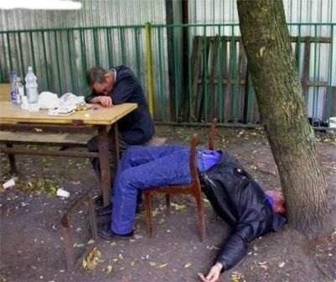
Symptoms of PTSD
Figure 9 Some victims seek solace in drugs and alcohol

Slide 40
Diagnosis of PTSD
Diagnosis is entails determining a certain condition or disease based on signs and symptoms.
The diagnosis of PTSD requires following a certain criteria. In the first criterion, a single stressor is required.
The stressors include, direct exposure and trauma witnessing.
Criterion B ( Intrusion symptoms) requires that one of the symptoms is identified.
They include, nightmares and flashbacks.
.

Slide 41
Diagnosis of PTSD
Criterion C (avoidance) entails trauma evasion.
There are, trauma external reminders and thoughts.
Criterion D requires the choosing of two elements about negative alterations (Levers 2012) .
Criterion E entails reactivity and arousal alterations.
The factors considered include aggression and difficulty in sleeping.
In F, the duration of symptoms is examined (It should be more than a month).

Slide 42
Diagnosis of PTSD
In criterion G, the significance of the symptoms are examined eg, functional impairment and distress.
The last criterion is H (exclusion).
It entails examination to determine whether the symptoms are from other sources eg substance use.

Slide 43
Treatment of PTSD
The treatment modes of PTSD are medications, psychotherapy and spiritual/religious intervention (Briere & Scott 2015).
In this case, therapy aims at the improvement of the symptoms, the restoration of self-esteem and teaching the patient the necessary skills to tackle the disorder.
The therapies that are mostly used are under the cognitive behavioral therapy( the change of the disturbing thought patterns ).

Slide 44
Treatment of PTSD
They include
Cognitive processing therapy- Is a treatment session of 12 weeks.
It has averagely 75 minutes weekly sessions.
The process helps the patient to examine how he/she thinks about the event and come up with ways of living with it.
Prolonged exposure therapy (PE)- The therapist teaches the patient breathing techniques to ease the levels of anxiety while thinking of the event.

Slide 45
Eye movement desensitization and processing- The treatment covers about 3 months.
It aims at enabling one to think of positive things as he/she remembers the ordeal.
Stress Inoculation training-The training can be done either by an individual or in a group.
It aims at working towards changing the ways of dealing with the event..

Slide 46
Treatment of PTSD
Medications
They easily ignite the flight of fight response that make the individuals jumpy and uneasy.
Several medications can be used to treat and improve the situation.
The doctor starts by giving medicines that suppress the norepinephrine and neurotransmitters serotonin.
They include paroxetine, venlafaxine and fluoxetine.

Slide 47
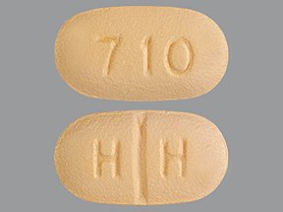
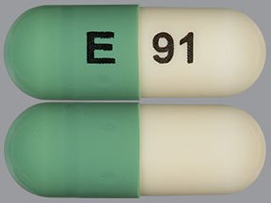
Treatment of PTSD
Other medications include the off-label medicines for instance, antidepressants and beta-blockers.

Slide 48
Religious / spiritual intervention
Religious and spiritual intervention is a powerful tool of tackling trauma.
Victims and medical practitioners employ the power of religion in dealing with trauma.
The reason is that religious and spiritual coping give the victims of PTSD hope by offering spiritual support and coming up with religious reappraisals that are benevolent in nature.
Chaplains and spiritual leaders play a vital role of praying for the victims for strength and quick recovery

Slide 49
References
Briere, J. & Scott, C. (2015). Principles of trauma therapy: A guide to symptoms, evaluation, and treatment (2nd ed.). Thousand Oaks, CA: Sage Publications. ISBN: 9781483351247.
Levers, L. L. (2012). Trauma counseling: Theories and interventions. New York, NY: Springer Publishing Company. ISBN: 9780826106834.
Liberty University. (2017). Crisis and Trauma Counseling 4.0 - Flashdrive (Custom). Forest, VA: AACC . ISBN: 9780981678832.
Sapolsky, R. M. (2004). Why zebras don't get ulcers: The acclaimed guide to stress, stress-related diseases and coping (3rd ed.). New York, NY: St. Martin's Griffin. ISBN: 9780805073690.

