Slide 1
SCRIBBLE PAD
What is IQ?

Slide 2
General Definition:
Intelligence is a very general mental capability that involves the ability to reason, plan, solve problems, think abstractly, comprehend complex ideas, learn quickly and learn from experience.

Slide 3
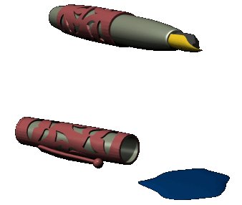
Intelligence is NOT
Book learning
A narrow academic skill
Test –taking smarts

Slide 4


Intelligence includes
Abstract reasoning
Problem-solving ability
Capacity to acquire knowledge
Some experts also include
  Memory
  Mental speed
Others include social characteristics
  E.g. the ability to understand and empathize with others

Slide 5
IQ=Intelligence Quotient
Originally designed to predict school achievement. Predict academic grades. Correlation between scores and performance is about .50.
Typically include items such as:
  Information
  Vocabulary
  Comprehension
  Similarities
  Arithmetic
  Picture completion
  Object assembly
  Block design

Slide 6
Varieties of Intelligence: Sternberg
Analytic:
  Clearly defined problems
  all info necessary to solve are embedded in problem
  1 right answer
  1 strategy
  not related to everyday experience
Practical:
  Problem not well defined
  Recognition of what needs to be solved
  Need to seek out information relevant to solution
  Several possible answers
  Related to everyday experience

Slide 7
Sternberg:
Creative:
  Ability to create, invent, or imagine something
Analytic Alice
Creative Cathy
Practical Patty

Slide 8
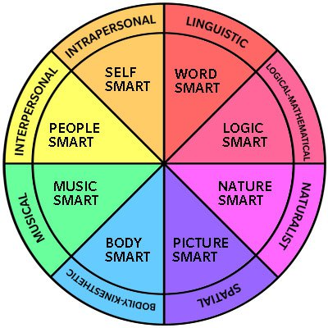
Varieties of Intelligence: Gardner

Slide 9

Template Provided By
www.animationfactory.com
500,000 Downloadable PowerPoint Templates, Animated Clip Art, Backgrounds and Videos

