Slide 1
Internal Business Proposal Presentation
Student Name
Institution Affiliation

Slide 2
Wells Fargo Problem
Revenue Loss resulting from Sales Scandal
Wells Fargo has recently being laying off workers due to increased revenue losses
Revenue loss has also made Wells Fargo owe less tax in the future on income from a set of all its businesses including mortgage servicing where revenues are much recognized at different times.
Notes:
We are currently experiencing revenue loss due to the sales scandal that happened to our company more than two years ago. This problem is hurting our business as a bank much; hence the reason we need immediate intervention. If you remember, we recently laid off a number of employees, and we are still planning to lay off more as announced in February this year. All this is because of the increased revenue losses making us unable to compensate the large number of employees we currently have. Additionally, revenue loss has also impacted our business in that we recently owe less tax in the future on income from a set of all our businesses including mortgage servicing where revenues are much recognized a different time.

Slide 3
Research Findings
100 Employees sampled
Preferred solutions to loss in revenue and miscommunication were sought from the sampled employees.
Each of the sampled employees needed quick stakeholder intervention.
Notes:
I decided to conduct research to come up with various solutions to the loss of revenue and miscommunication within our bank. I sampled 100 employees at random. I requested each of the sampled employees to suggest the solutions that they found to be the best to help solve the problem of revenue loss and miscommunication within our bank. Each of the sampled employees showed their deep concern with this problem and all asked me to let you as stakeholders know that the problem required quick intervention.

Slide 4
Solution to Loss of Revenue
Solutions to Loss of Revenue | Respondents
Customer Importance | 44
Production Efficiency | 15
Services Quality | 19
Employee Satisfaction | 12
Cost Effectiveness | 10
Total | 100
Notes:
The sampled employees suggested 5 solutions to revenue. Customer importance, services quality and production efficiency respectively were the best solution to revenue loss that the sampled employees outlined.

Slide 5
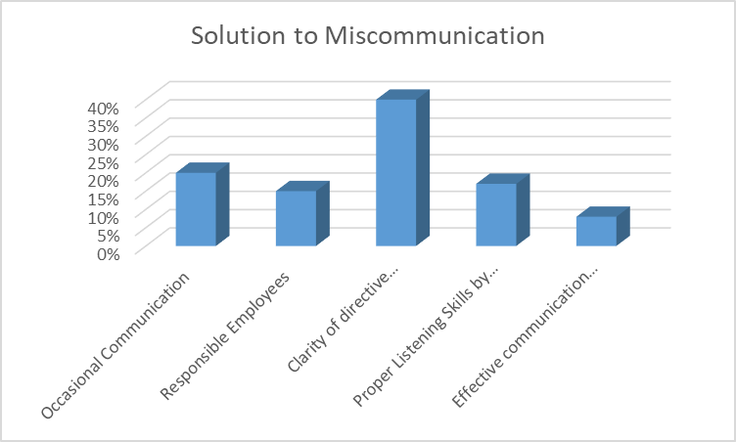
Solutions to Miscommunication
Notes:
When I further requested the respondents to provide the best solution that they thought fitted to solve miscommunication within the bank, the utmost of them prioritized clarity of directive information as the best solution. Other solutions identified include occasional communication, responsible employees, proper of directive information, and effective communication medium.

Slide 6
Proposed Primary Solutions For Implementation
Notes:
I found Customer importance, service quality, and production efficiency respectively to be the three primary solutions to revenue loss. Under customer importance, the bank needs to focus on protecting the customers rather than exploiting them. Under service quality., employees need to be motivated to provide quality services to the customers. Under production quality, constant monitoring of the production sections of the bank (loans) should be made to ensure threat they remain effective and efficient.

Slide 7
Solution Implementation
Precise support to the leading principal.
Equal treatment to all customers
Customer assistance
Availability of lending products
Transparency within the organization
Notes:
As the key stakeholders in our bank, you all need to work closely to ensure that these there best solutions to revenue loss are implemented. We all need to offer our support to the recently introduced leading principal. To effectively implement customer importance solution, we need to ensure that all customers visiting the bank are equally treated regardless of their race, income levels etc. on the other hand, to effectively implement service quality we need to make our customer service department more active so that they can customers can be precisely assisted anytime when they require assistance. Additionally, we need to ensure transparency in all what we undertake which will always make customers comfortable when they print their bank statements. Lastly, to effectively implement production efficiency solution, we need to ensure that all leading products are available all the time which will ensure that no customer lacks anything they need from the bank.

Slide 8
Implementation Steps
Goal development
Development of action plan
Implementation of the action plan
Notes:
The first step that we need to take to implement these solutions is setting up the goals that will be much helpful in the future during the evaluation period. After developing the solution goals, we need to come up with an action plan which should show the future of the organization that we are trying to install. The last step is the implementation of the action plan where an awareness week should be set to ensure that employees, bank management and customers get a better understanding of the proposed solutions.

Slide 9
Proposed Solutions Evaluation
Evaluation to be done after every three months
Formation of evaluation committee
Customer feedback
Customer survey
Loan books performance
Notes:
I propose that the evaluation of the achievement of the proposed solution to be done after every three months after we implement the solutions. To begin the a=evaluation, we will need an evaluation committee where the project manager and change manager must be members of the committee. The committee should evaluate the customer feedback that they leave after they receive banking serv9ces to see how effective the service quality solution is. Next, a small survey where less than 100 customers should be sampled to see how effective customer importance solution has been. Lastly, the loan book should be checked to evaluate how different loans are performing in the effort of evaluating production efficiency solution.

Slide 10
References
Cavico, F. J., & Mujtaba, B. G. (2017). Wells Fargo's fake accounts scandal and its legal and ethical implications for management. SAM Advanced Management Journal, 82(2), 4.
Kostry, N., Malloy, T., Wang, M., & O’Rourke, J. S. (2017). Wells fargo & company: Accusations of illegal customer account management (A). The Eugene D. Fanning Center for Business Communication, Mendoza College of Business, University of Notre Dame.
Tayan, B. (2019). The Wells Fargo cross-selling scandal. Rock Center for Corporate Governance at Stanford University Closer Look Series: Topics, Issues and Controversies in Corporate Governance No. CGRP-62 Version, 2, 17-1.
Teo, T. S., & Kimes, S. E. (2019). Wells fargo bank: The fake accounts scandal. SAGE Publications: SAGE Business Cases Originals.

