Slide 1

START

Slide 2
What is basketball?

Slide 3
Basketball is a team sport.
It is played indoors.
Two teams of five players each try to score
points against one another by throwing a ball through a 3 m high hoop.
Each hoop is placed at the end of a rectangular court.

Slide 4
HISTORY OF BASKETBALL
James Naismith,
a Canadian physical education instructor invented basketball in 1891. Back then the game was played with an ordinary soccer ball and peach baskets between 2

Slide 5
Soon metal rims replaced the peach baskets with netting underneath. Later people cut the netting so that the ball could go through.
Senda Abbott first introduced basketball to woman in 1892.
Professional basketball started in 1869 in New Jersey, USA.

Slide 6
HOW IS BASKETBALL PLAYED

Slide 7
Basketball is played by two teams who score points by throwing a ball into the opposing team's basket. The team who scores the most points are the winners.
Each team has a squad of 12 players to choose from. Five of those players are allowed on the court at any one time, with unlimited substitutions.
Players can move the ball around the court by passing, tapping, throwing, rolling or dribbling.

Slide 8
The game consists of four quarters of 10 minutes each, with a 15-minute break at half-time.
There are also two-minutes interval between the first and second periods, and between the third and fourth periods.
If the game is tied after the fourth period, it continues with an extra period of five minutes, then as many five-minute periods as are necessary to break the tie.

Slide 9
Main officials
include one referee and one umpire.
The court is divided between them and they swap places after each foul involving a free throw penalty, as well as after each jump ball decision.
They use whistles and hand signals to make and explain their decisions.
Each game begins with a jump ball.
The referee throws the ball into the air in the centre circle and two opposing players leap up and try to tap it away.
Each player is allowed two taps before the ball hits the ground, a basket, a backboard or another player.

Slide 10
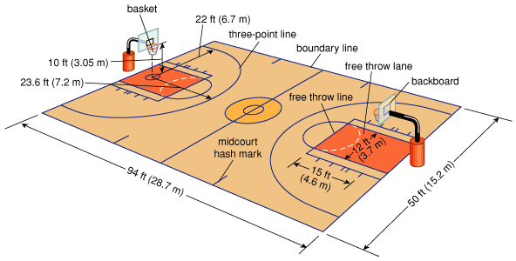
NBA BASKET COURT

Slide 11
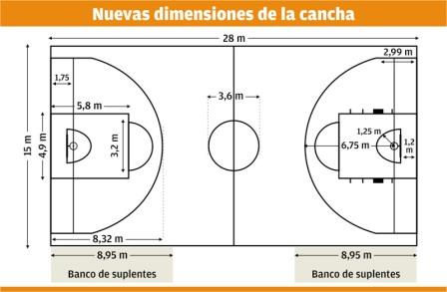
FIBA BASKET COURT

Slide 12
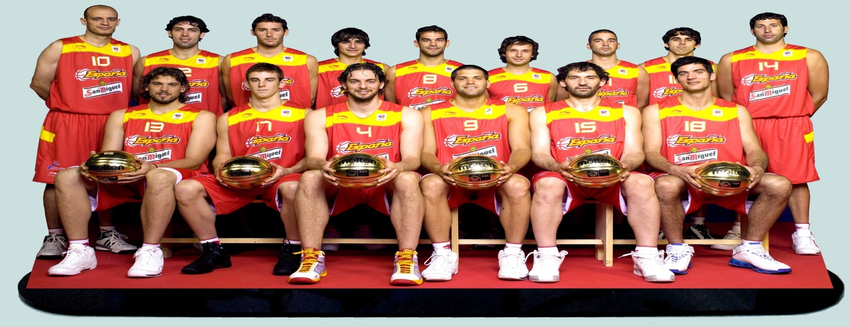
SPANISH NATIONAL TEAM

Slide 13



