Slide 1
Jeremiah O’Brien
O’Brien was born in Kittery, province of Massachusetts Bay, in 1944, Jeremiah O’Brien was the eldest son of Morris and Mary O’Brien. He was an Irish American captain in the Massachusetts State Navy. He is remembered for the contribution he made to the American revolution between 1965 and 1983. Below is an account of how he participated.

Slide 2
The American Revolution
It is recorded that The American Revolution was an extraordinary struggle that was both military and political and was waged by 13 of Britain’s North American colonies.
According to Cohen (2016), they had rejected its imperial rule. They did so by protesting to oppose the taxes that were levied without colonial representation, in this case, by the parliament and the British monarchy.
These sorts of political disagreements persisted and escalated to a perpetual cycle of deviant acts and punitive laws. As a result, there was an open rebellion.

Slide 3
The Battle of Machias
It was the very fast time the navy was engaged in the American revolution.
Being a captain, Jeremiah O'Brien participated in the battle of Machias. It all started when three ships appeared in the harbour of Machias, where two of them had goods that were to be sold. One was a British Naval vessel that had the responsibility of offering protection to the envoy.
The boats had the intention to gain profits and use them in the mission of bringing lumber and supplies back to Boston that had been put under siege by the continental army (Cohen, 2016).
The people of this town got into a meeting where they were to decide whether to buy from those merchants or not, after which they unanimously agreed not to do business with them. This got them threatened by the naval ship that their town would be bombarded with cannon fire. Out of fear, the townspeople decided to buy from the merchants.

Slide 4
Cont.…
This situation made Jeremiah and many other citizens very upset. He organized 30 men whereby they boarded one of the vessels used in trading named Unity.
Their captain being Jeremiah, sailed out to capture the British ship, Margaretta. The Margaretta had many mechanical issues as it had survived another encounter with another group of the residents of Marchia.
This resulted in it moving at a slow pace. The unity, therefore, had an easy time catching up with Margaretta, according to Williams (2014). After this was done, Jeremiah began to board. The smaller boat that was also confiscated caught up and the British were overwhelmed.
Margaretta’s captain was then killed, and immediately, his first mate signalled for surrender.

Slide 5
Cont.…
After this was done, Jeremiah began to board. The smaller boat that was also confiscated caught up and the British were overwhelmed. Margaretta’s captain was then killed, and immediately his first mate signalled for surrender.
This prompted Jeremiah to change the name of the vessel from unity to Machia's liberty. The following December, the Massachusetts State Navy was created, and Jeremiah was commissioned as the first captain. He continued to sail Machia liberty which he continued to sail for the next two years Williams (, 2014).
Obrien did not stop at that. It happened that in the next two months, he was able to lead a personal mission that aimed at invading Nova Scotia in “ the raid of St. John”. It is recorded that the Americans burnt a British fort to the ground.
This led to O’Brien being captured and imprisoned though he could escape and go back to the Navy.

Slide 6
Jeremiah O’Brien is then recorded to have joined hands with a partner where they built a larger ship that he used to fight the continental Navy. This he did as a privateer up to when the revolution came to an end.
Jeremiah O’Brien was able to create the first act of colonial privacy in the revolutionary war.
He led a fight that was furious where both sides were determined to either conquer or die yet he conquered.
This made him become the first naval hero of the revolution.

Slide 7
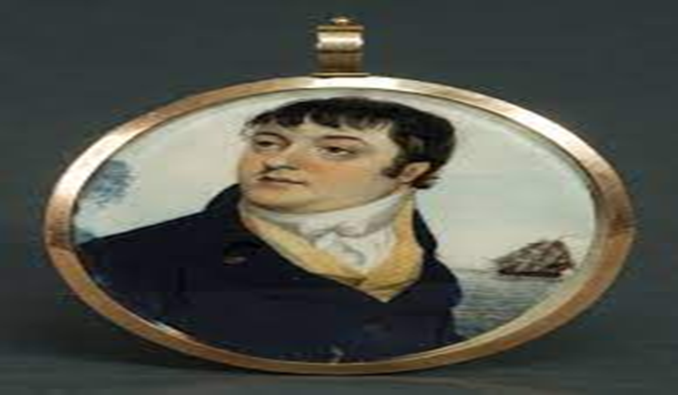
Captain Jeremiah O’Brien

Slide 8
References
Cohen, S. S. (2016). Captain Jeremiah O’Brien: Maine Mariner. Maine History, 50(1), 79-107.
Williams, G. H. (2014). The Liberty Ships of World War II: A Record of the 2,710 Vessels and Their Builders, Operators and Namesakes, with a History of the Jeremiah O'Brien. McFarland.

