Slide 1
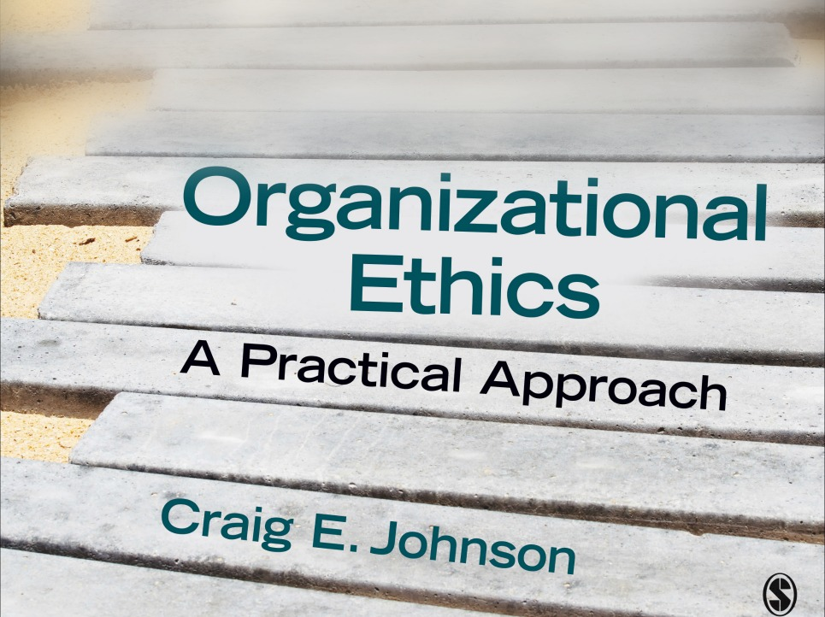
Chapter 1: Ethical Perspectives

Slide 2
Utilitarianism
“Do the Greatest Good for the Greatest Number”
Theorists: Jeremy Bentham (1748-1832), John Stuart Mill (1806-1873)
Premise: make decisions based on their outcomes or consequences (consequentialism)
The best decisions
  generate the most benefits relative to their disadvantages
  benefit the largest number of people

Slide 3
Utilitarianism: Evaluation
Strengths
  Promotes human welfare
  Commonly used
  Appropriate for policy decisions and emergency situations
Weaknesses
  Hard to define and measure the “greatest good.”
  Hard to identify all possible consequences of a choice
  We favor short term consequences and personal interests when making choices
  Overlooks the needs of the individual

Slide 4
Kant’s Categorical Imperative
“Do What’s Right Despite the Consequences”
Theorist: Immanuel Kant (1724-1804)
Premise: do your duty (deontological)
Categorical Imperative: to determine if a behavior is moral, decide if it should be universally followed, without exception
Treat “humanity as an end” (respect for persons)

Slide 5
Kant’s Categorical Imperative: Evaluation
Strengths
  Prevents unethical behavior
  Builds moral courage
  Recognizes that people are intrinsically valuable
Weaknesses
  There appear to be exceptions to universal principles
  Following misguided duties
  Duties may conflict with one another

Slide 6
Rawls Justice as Fairness
“Balancing Freedom and Equality”
Theorist: John Rawls
Two principles of justice
  Principle 1: Each person has an equal right to the same basic liberties that are compatible with similar liberties for all. (equal liberty)
  Principle 2: Social and economic inequalities are to satisfy two conditions: (a) they are to be attached to offices and positions open to all under conditions of fair equality of opportunity (equal opportunity principle), and (b) they are to be to the greatest benefit of the least advantaged members of society. (difference principle)
Step behind a veil of ignorance when making decisions
Base decisions on the maximin rule--the best choice is the one that guarantees a minimum level of benefits

Slide 7
Justice as Fairness: Evaluation
Strengths
  Reconciles tension between individual freedom and social justice, personal liberty and the common good
  Guarantees a minimum level of benefits and equal opportunity
  Protects individuals, rights, and the least advantaged
Weaknesses
  Definitions of justice and fairness differ
  Debate over giving too much or too little to the have-nots
  Can reach different conclusions behind the veil of ignorance

Slide 8
Aristotelian Ethics
Live well
Theorist: Aristotle: (384-322)
Premise: will make ethical decisions if we develop character traits or virtues (intellectual and moral)
Find the middle ground between extremes (the Golden Mean)
Build character through habits (repeated patterns of behavior)
Goods of the soul are most important
Strive to flourish: eudemonia

Slide 9
Aristotelian Ethics: Evaluation
Strengths
  Addresses the most important questions of life
  Happiness is a worthy pursuit
  Combats materialism
  Builds high character
Weaknesses
  Fails to provide specific guidance to decision makers
  Finding the middle ground depends on the situation
  Treats emotion with suspicion
  Some may never be able to live well

Slide 10
Confucianism
Build Healthy Relationships
Theorist: Confucius (551-479 B.C.E.)
Premise: humans are social creatures connected through networks of relationships
Policies, norms, procedures (etiquette or li) maintain relationships
Follow the Golden Rule: “Do not do to others what you do not want them to do to you”)
Key virtue: benevolence
Recognize status and power differences

Slide 11
Confucianism: Evaluation
Strengths
  Recognizes the importance of relationships
  Offers a blueprint for building healthy relationships
  Emphasizes treating others with respect, putting their needs first
  Highlights the importance of setting a moral example
Weaknesses
  Relationships can undermine justice or fairness
  Can lead to corruption
  Can foster authoritarian leadership
  Can suppress individual rights and dissent
  Confucians have been slow to endorse universal human rights

Slide 12
Altruism
Concern for others
Theorists: Jesus, Confucius, major faiths
Premise: help others regardless of personal cost or benefit; people are the ends
Promotes healthy relationships and organizational citizenship behavior (routine altruistic acts in the organizational setting)
Promotes the ethic of care--concern for individuals

Slide 13
Altruism: Ethic of Care
Theorists: Carol Gilligan, Nel Noddings
Premise: focus on the individual needs of others
“A different voice” (originally a women’s perspective)
Be alert to the needs of others and then meet those needs
Five key components
  Note and meet the needs of those we are responsible for
  Value emotions
  Specific needs and relationships take priority over universal principles
  Break down the barriers between the public and private spheres
  View persons as both relational and interdependent

Slide 14
Altruism: Evaluation
Strengths
  A powerful force for good
  Prevents ethical abuses
  Promotes healthy relationships and organizations
  Lays the foundation for high moral character
Weaknesses
  Not easy to put into practice
  Disagreement over what constitutes loving behavior
  Conflicts with the ethic of justice

