Slide 1
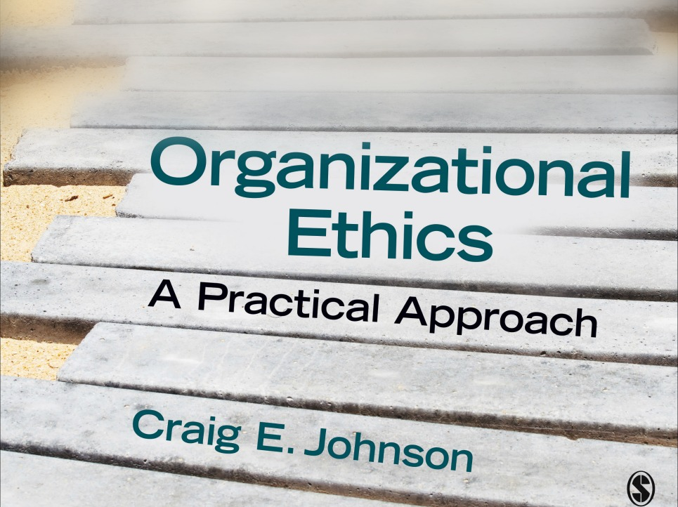
Chapter 2: Personal Ethical Development

Slide 2
Component 1: Realistic Self-Appraisal
Need to acknowledge our potential to do harm as well as good
The shadow side of the personality = embarrassing, socially unacceptable, dangerous
Ignoring the shadow side of the personality puts us at great risk
Benefits of confronting the shadow side of the personality
  Breaks the hold of undesirable characteristics
  Provides a clearer sense of self
  Become more tolerant of others
  Less likely to project shadows
  Encourages others to acknowledge heir weaknesses as well

Slide 3
Realistic Self-Appraisal
Managing the Shadow Side
  Take personal responsibility for your actions
  Recognize the danger of projecting undesirable qualities onto others
  Learn from your mistakes
  Find a supportive partner to help explore weaknesses
  Accept criticism
  Keep yourself out of harm’s way—adjust behavior and environment to keep from unleashing shadow forces

Slide 4
Component 2: Discovering Vocation
Vocation = calling. Determining our purpose in life. Can be on or off the job
Ethical benefits of discovering one’s calling
  Perseverance
  A greater sense of personal satisfaction
  Better stewardship of time and energy
  Service to others

Slide 5
Discovering Vocation
Steps to Discovering Your Vocation
  Step 1: Determine your unique gifts
  Step 2: Identify your specific concern for others
  Step 3: Identify your interests
  Step 4: Find the right job fit
Barriers to Obeying Callings
  Ambition (seeking culturally defined success)
  Avoidance due to doubts, self-imposed limitations or orders from authority figures
  Overcome the barriers by acknowledging the power of the trappings of success and break free of low self-esteem

Slide 6
Component 3: Identifying Personal Values
Values—”desirable goals, varying in importance, that serve as guiding principles in people’s lives”
Values drive ethical decision making, behavior and serve as standards for determining right from wrong
How to identify or clarify values
  Generate a list of values
  Rate lists of values
  Use indirect means—reflect on what you admire, enjoy, how you spend your time and money and so on
Strive for person-organization fit (compatibility with your organization)
Avoid materialistic (external) values which don’t satisfy

Slide 7
Component 4: Developing Character
Character =“deep-rooted dispositions, habits, skills or traits of character that incline persons to perceive, feel, and act in ethically right and sensitive ways.”
Positive Psychology’s Six Virtues
  Wisdom and knowledge—cognitive strengths
  Courage: exercise of will in the face of opposition
  Love: caring for and befriending others
  Justice: building healthy communities
  Temperance: protecting against excess
  Transcendence: forging connections to the larger world

Slide 8
Developing Character: Direct Approaches
Direct: deliberately develop virtues
Strategies
  character education
  service learning (hands on experience)
  psychological interventions
    Reframing negative thoughts
    Mastering progressively greater dangers
    Realistic assessment of weaknesses

Slide 9
Developing Character: Indirect Approaches
Practice Habits (Covey)
  Habit 1: Be proactive
  Habit 2: Begin With the End in Mind
  Habit 3: Put First Things First
  Habit 4: Think win-win
  Habit 5: Seek First to Understand, Then to Be Understood
  Habit 6: Synergize
  Habit 7: Sharpen the Saw

Slide 10
Developing Character: Indirect Approaches
Follow Role Models
Observation and imitation (virtues are more “caught than taught”)
Types of role models (moral exemplars)
  Moral Episodes
    Moral crises—dangerous, call for moral heroes
    Moral confrontations—call for moral champions
  Moral Processes
    Moral projects—limited time efforts that call for moral leaders
    Moral work—ongoing efforts that call for moral workers

Slide 11
Developing Character: Indirect Approaches
Stories (Narratives)
Help us makes sense of the world
Promote desired behavior
We live up to the organizational stories we share with others
Literature as a source of stories
  Fiction reflects the complexity of life
  The best stories are
    Vivid—introduce characters we care about
    Vexing—place characters in difficult ethical situations

Slide 12
Developing Character: Indirect Approaches
Passages: intense experiences that push us out of our comfort zones
Types
  Diverse work experiences (joining a new company, accepting a new assignment)
  Work adversity (failure, losing a job, coping with a bad boss)
  Diversity of life experiences (living abroad, blending work and family)
  Life adversity (death, divorce, illness)

Slide 13
Developing Character: indirect approaches
Growing Through Passages
  Step 1: Learn resilience
  Step 2: Accept personal responsibility
  Step 3: Reflect
  Step 4: Seek support from your partner, family, friends, and professionals
  Step 5: Develop and use a professional network
  Step 6: Seek refuge
  Step 7: Gain perspective
  Step 8: Retirement
  Step 9: Pass on your experience

Slide 14
Component 5: Creating a Moral Identity
Definition: Define self in terms of ethical commitments and values
  To betray ethical commitments is to betray the self
How moral identity develops
  Grows beyond childhood
  Work with others on ethical tasks and projects
  Adopt a joyful attitude

Slide 15
Component 6: Drawing Upon Spiritual Resources
A foundation for moral exemplars and moral identity
Workplace spirituality: “the recognition that employees have an inner life that nourishes and is nourished by meaningful work that takes place in the context of community.” (Duchon & Plowman)
Inner life—bring the whole person to work
Meaningful work—motivated by more than material rewards
Community—desire for connection

Slide 16
Drawing Upon Spiritual Resources
Nurture spiritual values by “caring for the soul” through intimacy, creative work, nature and beauty, and spirituality (dedicating work to higher purposes)
Track your spiritual progress
  Stage 1: unprincipled—narcissistic and egocentric
  Stage 2: conventional—self-doubt
  Stage 3: self-actualizing—high self-awareness and living out values
  Stage 4: integral—leave the ego behind
  Beware of the dangers of organizational spirituality: proselytizing, invasion of privacy, manipulation of employees, lack of a strong theoretical base

