Slide 1
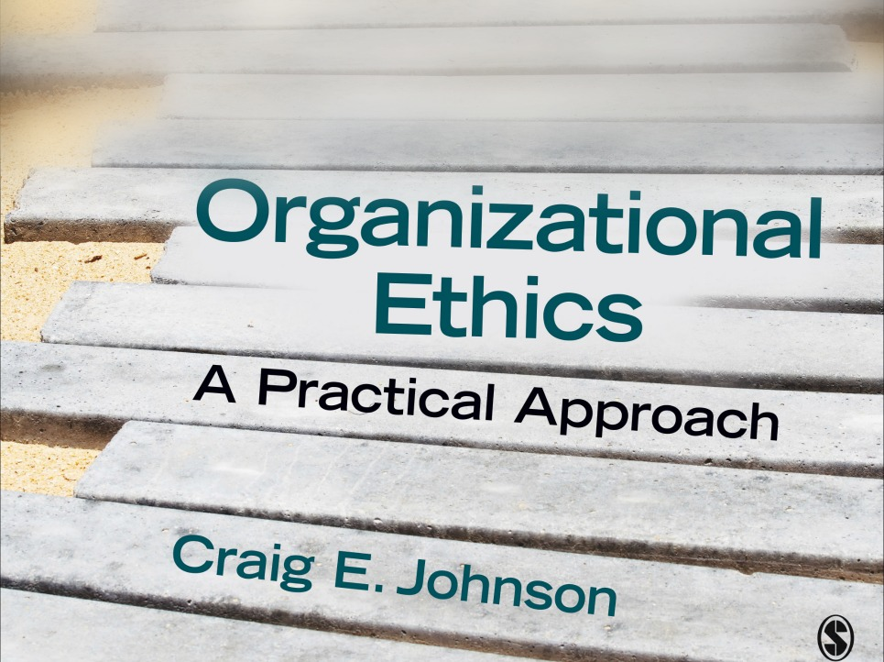
Chapter 3: Ethical Decision-
Making and Action

Slide 2
Emotion in Moral Decision Making
Traditional perspective: focus on reason and reject emotion
Contemporary perspective: emotions are central to ethical decision-making
  Evidence from brain damage
  Evidence from neuroimaging
  Social intuitionist model
  Dual Process Approach
  Both logic and emotions are important to making good choices
  Emotions are most important in life/death, bodily/personal harm and deeply held belief situations
  Cognition more important when balancing competing claims or when engaged in abstract reasoning

Slide 3
Components of Ethical Behavior
Theorist: James Rest
Research question: “What must happen psychologically in order for moral behavior to take place?”
Answer: Four Component Model
  Moral Sensitivity (Recognition)
  Moral Judgment or Reasoning
  Moral Motivation
  Moral Character

Slide 4
Component 1: Moral Sensitivity (Recognition)
Definition: the recognition that an ethical problem exists
Elements of moral sensitivity
  Being aware of how our behavior impacts others
  Identifying possible courses of action
  Determining the consequences of each potential strategy
Key skills
  Perspective taking
  Moral imagination

Slide 5
Moral Imagination
Definition: stepping outside current frame of reference to assess and evaluate
Types of moral imagination (based on degree of consensus about the problem and the power of decision makers to act)
  Creation (low consensus/low power)
  Coercion (low consensus/high power)
  Compromise (low consensus/distributed power)
  Coalition (high consensus/low power)
  Consent (high consensus/high power)
  Collaboration (high consensus/distributed power)

Slide 6
Moral Intensity
Definition: elements of the issue itself that draw attention
The greater the intensity, the more likely the issue will be recognized
Components of moral intensity
  Magnitude of consequences (amount of harms and benefits)
  Social consensus (degree of consensus about harm or good)
  Probability of effect (likelihood of happening)
  Temporal immediacy (how soon harm or good will happen)
  Proximity (social, cultural, psychological, physical distance)
  Concentration of affect (intensity of suffering and damage)

Slide 7
Tips for Enhancing Your Ethical Sensitivity
Engage in active listening and role-playing
Pay attention to your feelings
Speak up about ethical issues
Challenge mental models or schemas
Adapt to the situation
Be creative
Increase the moral intensity of the issue

Slide 8
Component 2: Moral Judgment
Definition: choosing among the alternatives generated in Component 1; determining the right or wrong thing to do
The most studied element of the model
Three keys to understanding moral judgment
  Cognitive moral development
  Destructive motivations
  Cognitive biases

Slide 9
Cognitive Moral Development
Kohlberg’s Stage Model
  Pre-conventional (Level 1): decide on basis of direct consequences
  Conventional (Level II): look to others for guidance
  Post-convention or principled (Level III): reason based on universal ethical principles
Rest’s Schema Model
  Schemas = cognitive structures
  Shift to higher ethical schemas in moral development
  Highest schema: reason like moral philosophers

Slide 10
Destructive Motivations
Definition: motivating factors that undermine moral judgment
Insecurities
  Low self-esteem
  Self-doubt
  Tying self-identity to organizational roles
Greed (winner-take-all culture)
Ego
  Overestimate abilities
  Overconfident
  Ignore risks
  Take too much credit or too little blame
  Demand more than fair share of resources
  Greatest temptation at the highest level of the organizational hierarchy
Destructive motivations are magnified by time pressures and short-term orientation

Slide 11
Cognitive Biases
Definition: perceptual, unconscious distortions
Common biases
  Overestimating our ethicality
  Forgiving our own unethical behavior
  Overlooking other people’s unethical behavior
  Implicit prejudice
  Favoring members of our own group
  Judging on outcomes rather than on the quality of decision-making processes

Slide 12
Tips for Improving Your Moral Judgment
Stay in school (college contributes to moral development)
Be intentional (take ethics courses and units)
Reject ethical pessimism (we can continue to develop morally)
Take a broader view (consider those outside the immediate group)
Look to underlying moral principles when making choices
Acknowledge your dark side (be alert for self-interest and self-doubt)
Step outside yourself (check perceptions against reality)
Keep your ego in check (be accountable to others)
Take a long term perspective (allow space for reflection and deliberation)
Apply rational remedies to overcome your cognitive biases

Slide 13
Component 3: Moral Motivation
Definition: motivation to follow through on choices; giving moral considerations priority
Key barrier to follow through: self-interest (moral hypocrisy)
Factors that promote follow through
  Rewards for ethical behavior
  Moral emotions which increase motivation
    Other-suffering (pro-social) emotions--sympathy, empathy, compassion
    Self-conscious (self-blame) emotions—shame, embarrassment, guilt

Slide 14
Tips for Increasing Your Moral Motivation
Put moral integrity above moral hypocrisy
Seek out ethically rewarding environments
Reward yourself for doing the right thing
Harness the power of moral emotions to encourage follow through

Slide 15
Component 4: Moral Character
Definition: executing the plan
Must overcome opposition, fatigue and distractions
Keys to execution
  Persistence
  Competence
  Implementation skills
  Stand up for your values

Slide 16
Tips for Fostering Your Moral Character
Take a look at your track record--take steps to improve
Believe that you can have an impact
Take personal responsibility—don’t shift the blame or excuse your behavior
Watch your language—avoid euphemisms and dehumanizing talk
Master the context to better respond
Be good at what you do to earn the right to be heard
Develop your voice—anticipate values conflicts and prepare for them

Slide 17
Decision-Making Formats
Designed to enhance ethical performance while helping us avoid decision making blunders
Step by step procedures
Five formats
  Kidder’s Ethical Checkpoints
  The Lonergan/Baird Method
  The Moral Compass
  The Foursquare Protocol
  The Five “I” Method

Slide 18
Kidder’s Ethical Checkpoints
Checkpoint 1: Recognize That There Is a Moral Issue
Checkpoint 2: Determine the Actor
Checkpoint 3: Gather the Relevant Facts
Checkpoint 4: Test for Right-Versus-Wrong Issues
Checkpoint 5: Test for Right-Versus-Right Paradigms
Checkpoint 6: Apply Resolution Principles
Checkpoint 7: Look for a Third Way (Investigate the “Trilemma” Option)
Checkpoint 8: Make the Decision
Checkpoint 9: Revisit and Reflect on the Decision

Slide 19
The Lonergan/Baird Method
Act as a natural scientist
  Empirical (observe)
  Intellectual (generate hypotheses and develop understanding)
  Rational (make a judgment)
  Responsible (take action)
Framework
  Step 1: Be attentive—consider what works—or doesn’t
  Step 2: Be intelligent—sort through the data
  Step 3: Be reasonable—evaluate the options
  Step 4: Be responsible—act with courage

Slide 20
The Moral Compass
Make sure that ethical considerations are factored into every organizational decision
Moral Lenses
  Lens 1: Purpose—Will this action serve a worthwhile purpose?
  Lens 2: Principle—Is this action consistent with relevant principles?
  Lens 3: People—Does this action respect the legitimate claims of the people likely to be affected?
  Lens 4: Power—Do we have the power to take this action?

Slide 21
Foursquare Protocol
Protocol = procedures used to make ethical decisions
Protocol Element One: Close description of the situation
Protocol Element Two: Gathering accumulated experience in similar situations
Protocol Element Three: Recognizing the significant similarities between the current problem and past ones.
Protocol Element Four: Situating yourself to decide

Slide 22
The Five “I” Format
Identify the problem and set goals for the decision-making process
Investigate the problem by analyzing it and collecting additional information; develop criteria for judging solutions
Innovate by generating a variety of solutions
Isolate a solution using criteria developed in the investigate stage
Implement the solution

