Slide 1
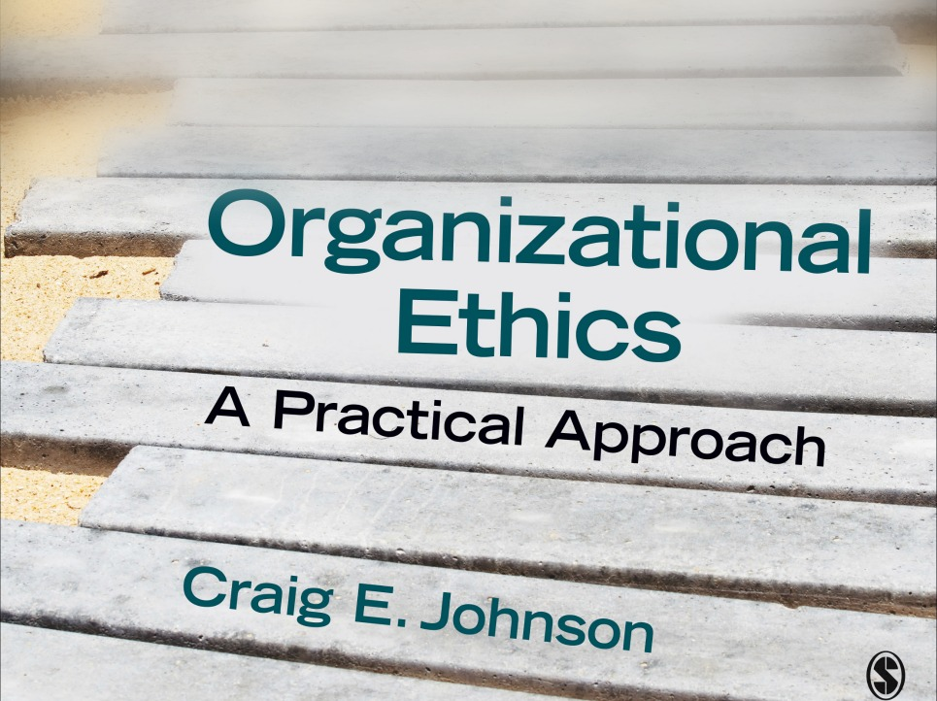
Chapter 4: Ethical
Interpersonal Communication
Organizational Ethics: A Practical Approach (3rd ed.)

Slide 2
Dialogue
Theorist: Martin Buber
Premise: Attitudes set the moral tone of conversations
  I-It—treat others as objects
  I-Thou (You)—treat others as unique human beings
Monologue: self-centered, I-It communication
Technical dialogue: gathering and processing information
Dialogue: I-Thou communication between equal partners

Slide 3
Characteristics of Dialogue
Presence—unscripted and unrehearsed
Emergent unanticipated consequence—unpredictable results
Recognition of “strange otherness”—test your understanding of the other party
Collaborative orientation—come up with a joint solution
Vulnerability—risky
Mutual implication—keep listeners in mind
Temporal flow—unfolds over time
Genuineness and authenticity—give the benefit of the doubt and share thoughts and feelings

Slide 4
Ethical Communication Competencies
Key Skills for Dialogue
  Mindfulness
  Effective listening
  Confirmation
  Emotional Intelligence
  Trust Building
  Moral argument

Slide 5
Mindfulness
Definition: devoting full attention, being fully present
Mindlessness—inflexible, thoughtless, often unethical
Mindfulness processes
  Creation of new categories
  Welcoming new information
  Openness to different points of view
  Can develop through practice in routine interactions

Slide 6
Effective Listening
HURIER listening model
Component 1: Hearing (focusing)
Component 2: Understanding (processing)
Component 3: Remembering (memory)
Component 4: Interpreting (assigning meaning)
Component 5: Evaluating (making a judgment)
Component 6: Responding (adjust messages)

Slide 7
Effective Listening
Listening styles
  People-oriented: priority on maintaining relationships
  Action-oriented: task focused
  Content-oriented: evaluate complex messages
  Time-oriented: value effectiveness and efficiency
  Recognize the shortcomings of each style
  Adapt your style to match the communication context

Slide 8
Confirmation
Definition: the process of recognizing and acknowledging the presence and value of others
Confirming behaviors
  Express recognition of the other person’s existence
  Acknowledge a relationship or affiliation
  Express awareness of the significance or value of the other
  Accept or “endorse” the other person’s experience or way of seeing the world
Disconfirming responses devalue others

Slide 9
Types of Confirming/Disconfirming Behaviors
Confirming Responses
  Recognition: responding, treating the other party with respect
  Acknowledgement: a direct, relevant response
  Endorsement: accepting the other party
Disconfirming Responses
  Impervious: failing to acknowledge the other
  Interrupting: cutting the other speaker short
  Irrelevant: responding in an unrelated way
  Tangential: taking the conversation in a new direction
  Impersonal: conducting a monologue
  Ambiguous: responding with messages with multiple meanings
  Incongruous: nonverbal behavior inconsistent with verbal message

Slide 10
Emotional Intelligence
Definition: the capacity to identify and influence emotions in others and in the self
Intelligence skills sets
  Identifying emotions—reading and conveying feelings
  Using emotions—employing feelings in decision making and tasks as well as to motivate others
  Understanding emotions—understanding the causes of and progression of feelings
  Managing emotions—controlling feelings to lead to positive outcomes

Slide 11
Trust Building
Trust = being vulnerable based on positive expectations of others
Involves a obligation or duty to protect those who rely on us
Fostered through character, competence, and openness
Types of trust betrayal
  Major: intense feelings of distress and disappointment
  Minor: damaging over time
  Intentional
  Unintentional (inadvertent)

Slide 12
Coping With Betrayal
Observe and acknowledge what has happened
Work through the pain
Get support from others
Reframe the experience (what can you learn from it?)
Take responsibility for your choices and actions
Forgive yourself and others
Let go and move on

Slide 13
Moral Argument
Discourse ethics—ground rules for engaging in moral argument
Theorist: Jergen Habermas
To have a moral argument:
  Everyone impacted by the decision must freely participate
  Individuals have equal power
  All ideas can be challenged
  Claims must be justified

Slide 14
How to Promote and Engage in Moral Argument
Practice perspective taking
Engage in active listening
Ensure that everyone has an equal voice
Develop your ability to make and evaluate claims
  Use sound evidence (reliable, recent, relevant, objective)
  Employ sound reason or logic
    Analogical--comparisons
    Inductive—from few to many
    Deductive—from many to few
    Causal—one event causes another

