Slide 1
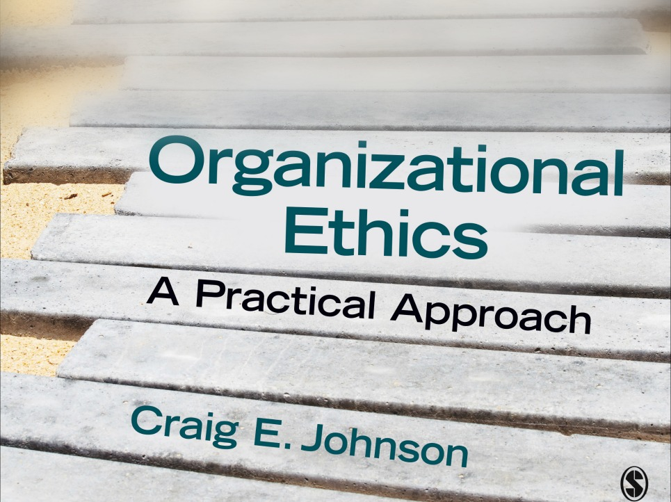
Chapter 7: Improving
Group Ethical Performance
Organizational Ethics: A Practical Approach (3rd ed.)

Slide 2
Acting as a Morally Responsible Team Member
Individual behaviors have a significant impact on a team’s ethical success or failure
Have a responsibility to:
  Adopt a cooperative orientation
  Do your fair share of the work
  Be open and supportive
  Offer dissent

Slide 3
Adopting a Cooperative Orientation
Cooperative orientation: everyone does his or her part; work together to reach shared goals
Individualistic orientation: rely on own efforts to reach personal agendas
Competitive orientation: achieve personal objectives at the expense of others
Cooperative groups have higher levels of achievement and productivity than individualistic or competitive groups
How to foster cooperation
  Put group success first
  Engage in collaborative communication behaviors (concessions, carrying through on promises, asking for help)
  Pursue a joint product
  Divide work fairly
  Hold individuals accountable
  Involve everyone in decision making
  Engage in constructive conflict
  Emphasize shared values

Slide 4
Doing Your Fair Share (Not Loafing)
Social loafing: reducing personal effort when working in a group
Combat social loafing by raising
  Expectancy: expectation that individual effort will lead to high group performance
  Instrumentality: the strength of the perceived relationship between personal and group effort and group achievement
  Valence: the desirability of the outcome for individual group members

Slide 5
Displaying Openness and Supportiveness
Openness: willingness to surface and discuss issues and problems
Supportiveness: desire to help other succeed
Defensive vs. supportive behaviors
  Control versus problem orientation
  Strategy versus spontaneity
  Neutrality versus empathy
  Superiority versus equality
  Certainty versus provisionalism
Psychological safety (the belief that individuals can speak up without fear of being embarrassed or rejected) is a byproduct of open, supportive communication

Slide 6
Being Willing to Stand Alone
Minority opinion can significantly improve group performance
  Encourages thought about the dilemma
  Encourages divergent thinking
Minority opinion can lead the rest of the group to change its mind
Spark dissent by
  Recruiting members from different backgrounds
  Protecting those who disagree

Slide 7
Responding to Ethical Danger Signs
Team interaction accounts for the ethical failure of many groups
Be alert to these signs that a group is in ethical danger
  Groupthink
  Mismanaged agreement
  Escalating commitment
  Excessive control
  Moral exclusion

Slide 8
Groupthink
Definition: when the team puts unanimous agreement ahead of reasoned problem solving
Antecedents to groupthink
  Highly cohesive team
  Isolation
  Operate without a decision making format when making choices
  Highly directive leaders
  Members close themselves off from outside information
  Under stress

Slide 9
Groupthink Symptoms
Signs of Overconfidence
  The illusion of invulnerability
  Belief in the inherent morality of the group
Signs of Closed-Mindedness
  Collective rationalization
  Stereotypes of outside groups
Signs of Group Pressure
  Pressure on dissenters
  Self-censorship
  The illusion of unanimity
  Self-appointed mind-guards

Slide 10
Mismanaged Agreement
Definition: public support for decisions that are opposed in private (the Abilene Paradox)
  Mistaken belief that consensus exists
Causes of the Abilene Paradox
  Action anxiety—fear of speaking up
  Negative fantasies—imagined negative consequences for speaking up
  Real risk—getting fired, lost income, damaged relationships
  Fear of separation—worry about being cut off from the rest of the team
  Psychological reversal of risk and certainty—imagined fears lead to real dangers
Breaking out of the Paradox
  Recognize the symptoms
  Speak up!

Slide 11
Escalation of Commitment
Definition: continuing along a failed course of action
Impact
  Wastes resources and puts the organization at risk
  Encourages unethical behaviors
To de-escalate commitment:
  Be alert to red flags
  Bring in new group members
  Hire an outside auditor
  Don’t be afraid to withhold further funding
  Isolate the project

Slide 12
Excessive Control
Concertive (unobtrusive) control = excessive control of team members by other members
  Often goes unrecognized
  Arises when shared vision and values generate strict rules that limit the freedom of members
Combat excessive control through setting aside regular times to evaluate moral reasoning and rules

Slide 13
Moral Exclusion
Definition: setting a boundary around justice and excluding outsiders from fair treatment
Signs of moral exclusion
  Conflicts of interest which focus on differences
  Group categorizations which give negative labels to outside groups
  Moral justifications are offered for damaging behavior
  Unjust procedures are described as expedient
  Physical and psychological damage occurs
Deter moral exclusion adopting a pluralistic perspective that acknowledges the legitimacy of a variety of groups

