Slide 1
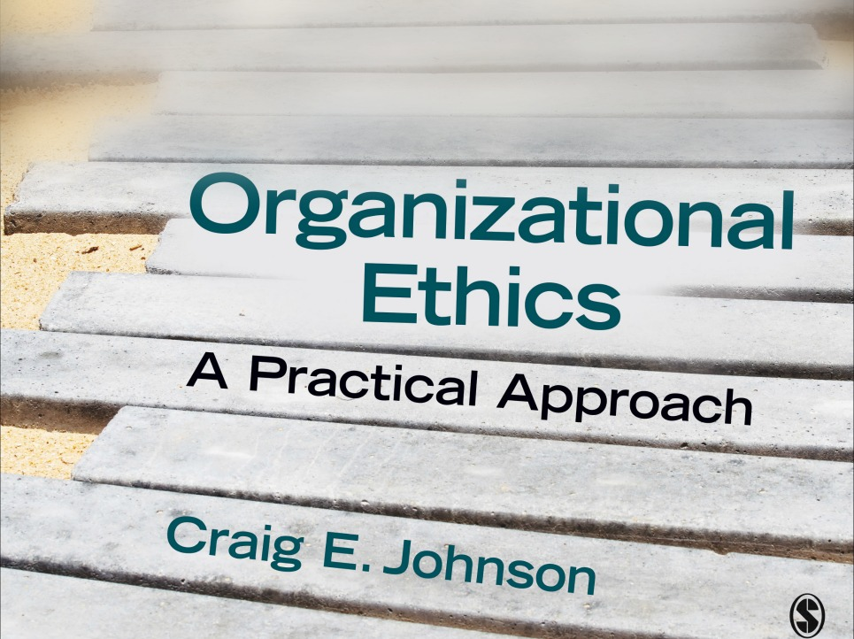
Chapter 8: Leadership Ethics
Organizational Ethics: A Practical Approach (3rd ed.)

Slide 2
The Role of Ethical Leaders
Ethical leaders are critical to the ethical performance of any organization
Organizational members look to leaders as role models and follow their example (social learning theory)
Ethical leaders function as
  Moral persons (behave ethically)
  Moral managers (create ethical organizational cultures)
Unethical leaders fail as moral persons and/or moral managers

Slide 3
The Ethical Challenges of Leadership
The Challenge of Power: abuse, concentration of power
The Challenge of Privilege: wide gap between haves and the have nots
The Challenge of Responsibility: accountability for follower behavior
The Challenge of Information Management: access to and release of information,;information gathering tactics
The Challenge of Consistency: determining how to treat followers fairly
The Challenge of Loyalty: balancing loyalty to a variety of groups

Slide 4
The Shadow Side of Leadership
Failure to meet the ethical challenges of leadership leads to misbehaviors—the dark or shadow side of leadership
Four approaches to the nature and origins of destructive leadership:
  Bad leadership
  Toxic leadership
  Destructive leadership
  Selfish leadership

Slide 5
Bad Leadership
Bad leaders are ineffective or unethical or both ineffective and unethical
Seven types of bad leaders
  Incompetent leaders—lack motivation or ability to be effective
  Rigid leaders—competent but inflexible
  Intemperate leaders—lack self-control
  Callous leaders—uncaring or unkind
  Corrupt leaders—put self interest above public interest
  Insular leaders—ignores the welfare of outsiders
  Evil leaders—commit atrocities

Slide 6
Steps to Overcoming Bad Leadership
Limit your tenure as leader
Share power
Don’t believe your own hype (favorable publicity)
Get real and stay real (live in reality)
Compensate for your weaknesses
Stay balanced (don’t be a workaholic)
Remember the mission of the organization
Stay healthy
Develop a personal support system
Be creative (don’t get stuck in the past)
Know and control your appetites
Be self-reflective

Slide 7
Toxic Leadership
Definition: toxic leaders engage in destructive behaviors and demonstrate dysfunctional characteristics like avarice, arrogance and insatiable ambition
Recognize the early signs of toxicity
  Do I inflict harm on my enemies and organizational members?
  Do I demonstrate disdain for others?
  Do I avoid my old acquaintances and colleagues?
  Do I keep my own counsel or take advice from close advisors?
  Do I use other to do my dirty work and then get rid of them?
  Have I begun to mistreat the lowest or weakest members of the group?
  Have I begun to engage in excess?
  Have I become evasive?
  Do I blame others?
  Am I acting in self-interest?
  Do I attempt to disguise unethical behavior as noble and altruistic?

Slide 8
Destructive Leadership
Definition: unhealthy leadership aimed at subordinates, the organization, or both
Types of leadership behavior:
  Constructive: serves the interests of the organization and followers (most common)
  Tyrannical: achieves organizational objectives at the expense of subordinates
  Derailed: anti-organization and anti-subordinate
  Supportive-disloyal: benefit followers at the cost of the organization
  Laissez-faire: passive, inactive

Slide 9
Types of Selfish Leadership
Impulsive
  Often extraverts
  Fill selfish desires
  Often silence critics
Narcissistic
  Highly self-absorbed
  Engage in unethical behaviors to satisfy personal wants
  Pursue unrealistic visions
Machiavellian
  Skilled at manipulating others for their own ends
  Deceptive
  Often less qualified to lead

Slide 10
Combating Selfishness
Look for selfish tendencies in ourselves
Keep selfish individuals from assuming leadership roles
Curb selfish tendencies in current leaders
  Build in checks and balances
  Hold leaders accountable
  Hold performance reviews
  Confront unethical behavior
  Encourage employee development and succession planning
  Create a culture of honesty and collaboration

Slide 11
Normative Leadership Theories
Definition: leadership theories that tell leaders how to act ethically
Encourage selfless behavior
Theories
  Transformational Leadership
  Servant Leadership
  Authentic Leadership
  Benevolent Paternalistic Leadership

Slide 12
Transformational Leadership
Transactional leadership = based on exchanges between leaders and followers
  Contingent reward (rewards based on performance)
  Management-by-exception (punishing poor behavior)
  Passive-avoidant (inactive)
Transformational leadership = powerful and inspiring
  Idealized influence (serve as admired role models)
  Individualized consideration (act as coaches and mentors)
  Inspirational motivation (provide meaning and challenge)
  Intellectual stimulation (foster creativity and innovation)

Slide 13
Servant Leadership
Premise: leaders should put the needs of followers first
Servant leadership themes
  Person-centered/altruistic
  Promotes equity or justice
  Rests on ethical character
  Incorporates stewardship (being entrusted with positions and organizations)

Slide 14
Authentic Leadership
Premise: authenticity is the “root construct” underlying all forms of positive leadership
“Know thyself” and “To thine own self be true”
Components of Authentic Leadership:
  Self-awareness—knowing and trusting the self
  Balanced processing—remaining objective in the face of feedback (positive and negative)
  Internalized moral perspective—regulating behavior according to internal values and standards
  Relational transparency—presenting the authentic self to others
  Trigger events—dramatic events that promote the development of authentic leadership

Slide 15
Benevolent Paternalistic Leadership
Paternalistic leaders act like father (mother) figures who treat their employees as extended family
Popular in collectivist, high power distance cultures
Draws from Confucian tradition
Characteristics of benevolent leaders
  Focus on needs of employees
  Set a high moral standard through high character
  Express concern for employees outside the workplace

