Slide 1
Taekwondo In
Korea
Formerly goryeo

Slide 2
History Of Korea
Goguryeo also called Goryeo was a Korean kingdom foundin the Korean peninsula
At its peak – controlled most of the Korean peninsula

Slide 3
Goguryeo was founded in 37 BCE by Jumong
Jumong was a prince from Buyeo

Slide 4
Was enthroned as Dongmyeong
Goryeo is a shortened form of Goguryeo

Slide 5
Was adopted as official name in the 5th century
It is the origin of the English name ‘Korea’

Slide 6
From 1st century, Goguryeo, Baekje and silla grew to control the peninsula
The three were know as the Three Kingdoms of Korea

Slide 7
Taekwondo in Korea
Taekwondo originated in Korea
It is a martial art of self defense
Competitors use both hands and feet.

Slide 8
With time Taekwondo became a folk sport
In 1971, it became Korea’s national sport

Slide 9
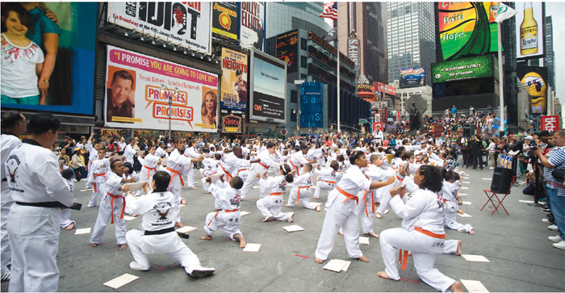

Slide 10
In 1973, the 1st World Taekwondo Championship were held in Seoul.
In 1980, the IOC adopted it as an official event of the Olympic games

Slide 11
It has grown into an international sport
Has around 100 million participants globally

Slide 12
Muju, Jeollabuk-do province, where Taekwondowon was established, hosted the 2017 Muju WTF World Taekwondo Championships

Slide 13
Taekwondo stresses the importance of spiritual discipline
It therefore enjoys popularity among men and women

Slide 14
The south Korean government assists with the dispatching of Taekwondo masters worldwide
UN peacekeeping forces teach Taekwondo to local residents in disputed territories

Slide 15
Taekwondo in many parts of the world is viewed as the symbol of Korea

Slide 16
Taekwondo is emerging as an option for treatment of young people suffering from addictions

Slide 17
Taekwondo In the Olympics
Taekwondo made its first appearance in Olympics as a first appearance demonstration

Slide 18
The opening ceremony featured a mass demonstration of taekwondo with hundreds of adults performing in unison

Slide 19
It was again a demonstration sport at the summer 1992 Olympics in Spain
Became a full medal sport at the 2000 Summer Olympics in Sydney, Australia

Slide 20
Has been a sport in the Olympics since 2000 at Sydney, Australia

Slide 21
Background of Taekwondo in the Olympics
The quest to bring Taekwondo to the Olympics began in 1974
Taekwondo was admitted into the Amateur Athletic Union

Slide 22
The role of AUU is to establish standards for various sports worldwide
The world Taekwondo Federation’s technical standards were adopted by the AUU Taekwondo group

Slide 23
1975 – Taekwondo became an affiliate of the General Association of International Sports Federations
GAISF promotes cooperation among various international sports federations

Slide 24
1980 – The world Taekwondo Federation was granted recognition
1981 – Taekwondo was one of the primary events in the World Games

Slide 25
1982 – Taekwondo was designated an official demonstration sport for the 1988 Olympic Games in Seoul, Korea

Slide 26
1986 and 1987 – Taekwondo included in the following sporting events:
World cup
Asian Games
All-African games
Pan American Games

Slide 27
1994 – IOC adopted Taekwondo as an official Olympic Sport for the 2000 Olympic Games in Sydney, Australia

Slide 28
Olympic Competition Format
A single elimination tournament for each of the weight categories
Winner of tournament final receives the gold medal

Slide 29
Loser receives the silver medal
A repechage competition occurs for the bronze medal contest.

Slide 30
Repechage
Anyone that loses to a finalist in the single elimination competition enters the repechage.

Slide 31
In the repechage, losers of the semifinals during the elimination phase will be seeded directly to each repechage finals

Slide 32
Other losers will advance to the repachage unseeded at the same side of the bracket

Slide 33
Athletes that lost to the two finalists in the round of 16 each face the athlete that lost to the same finalist in the quarterfinals

Slide 34
Winners of those contests face the athlete that lost to the same finalist in the semifinals.
The two finalists of the repechage each receive a bronze medal

Slide 35
Up until the 2012 summer Olympics, a National Olympic Committee could only send a max of two men and two women

Slide 36
This restriction did not regard whether it was the host nation or not.
Applied across the world.

Slide 37
Restriction was lifted in the 2016 Summer Olympics
Each National Committee may now qualify one athlete per weight category

Slide 38
Events
Medals awarded in four different weight classes for both men and women.

Slide 39
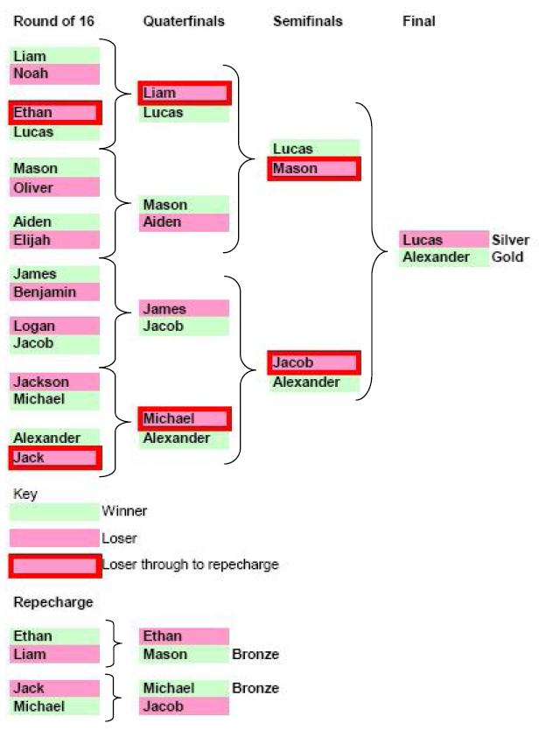
Taekwondo Competition Format

Slide 40
References
Kim, J., Dattilo, J., & Heo, J. (2011). Taekwondo participation as serious leisure for life satisfaction and health. Journal of Leisure Research, 43(4), 545-559.
Madis, E. (2003). The evolution of taekwondo from Japanese karate. Martial arts in the modern world, 185-209.

