Slide 1
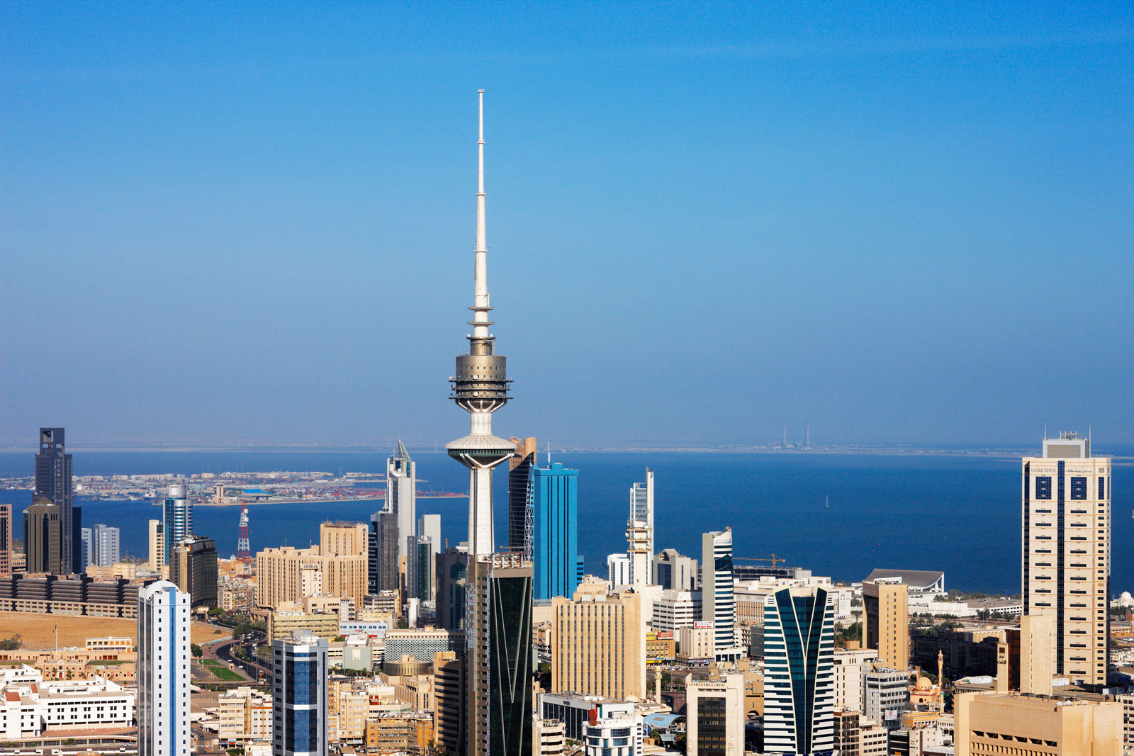
Kuwait
Institution:
Course:
Name:

Slide 2
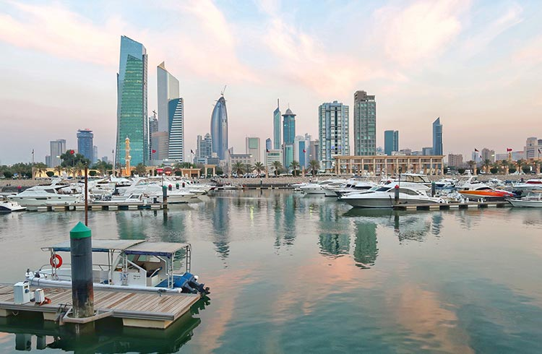
Introduction
Kuwait is a small emirate that is located between Iraq and Saudi Arabia.
Most of the people in Kuwait live in the towns.
It is one of the world’s most-urbanized nations.
It has a conservative government.
The government has been providing generous materials to the citizens.
Notes:
Kuwait is a small town that is located between Iraq and Saudi Arabia. Most of her population lives in towns and thus the country has been named one of the world’s most-urbanized country. The country has in place a conservative government that has been concerned a lot with its citizens (Kuwait Travel Information, 2020). This concern has led to the government providing generous materials to its citizens.

Slide 3
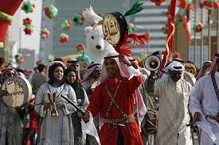
Kuwait’s Culture
Kuwait has a rich culture.
The culture is characterized by social and conservative social values and traditions.
Kuwait has also embraced various aspects of Western culture.
Kuwait’s cultural practices have remained largely unaltered.
Notes:
Kuwait is a country that is known and respected for its rich culture. Kuwait’s culture is characterized by both social and conservative social traditions and values. However, Kuwait has also been embracing many different aspects of the Western culture (Kuwait Travel Information, 2020). This means that the country has not been left behind by the Western culture. Many other countries have also been integrating the Western culture into theirs. However, Kuwait’s cultural practices have remained largely unchanged despite embracing the western culture.

Slide 4
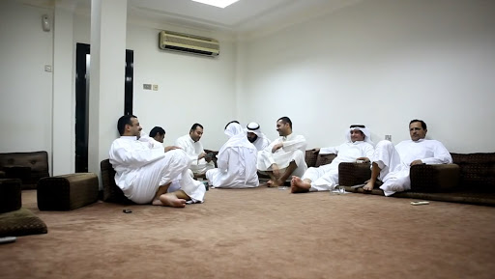
Kuwait’s Culture
Its culture is male dominated.
At its heart, is diwaniyyah.
A gathering of men in a separate room where they can play games, talk and enjoy refreshments.
Heterosexual , homosexual acts and alcohol are illegal.
They have a holy month of Ramadan.
They are allowed to work for six hours a day and must fast.
There is no smoking, drinking, eating or chewing gum before sunset.
Foreigners must not do any of the above things in public during the Ramadan month.
Notes:
Kuwait’s culture is male-dominated. At its heart is diwaniyyah which refers to a separate room where men can enjoy refreshments, talk and play games (Kuwait Travel Information, 2020). There are certain things that are not allowed with the country’s culture such as alcohol, homosexual acts and heterosexual partners dwelling in the same room. They also have a holy month of Ramadan. Within this holy month, all Muslims are allowed to work for only six hours a day and fasting. No Muslim is allowed to smoke, drink, eat or even chew gum before sunset. The foreigners must not do any of the above things in public during the holy month of Ramadan.

Slide 5

Kuwait’s Culture
Majority of the Kuwaitis are Muslims and are governed by the social norms in Kuwait.
They are expected to pray five times during a day as follows:
At dawn.
Noon.
Afternoon.
Sunset.
Evening.
There exists strong ties between friends, neighbors and family.
There are special occasions such as Islamic new Year, Eid el-Fitr and Ramadhan.
Notes:
Most of the population of the Kuwait country is made up of Muslims and is normally governed by the social norms in Kuwait. Kuwaitis are expected to pray five times during the day. These five times during the day which Muslims are expected to pray are at down, noon, afternoon, sunset and in the evening. There exists a strong tie between family, neighbors and friends. Kuwaitis, just like any other Muslims have special occasions within a year such as the Islamic New Year, Eid el-Fitr and Ramadhan (Kuwait Travel Information, 2020).

Slide 6
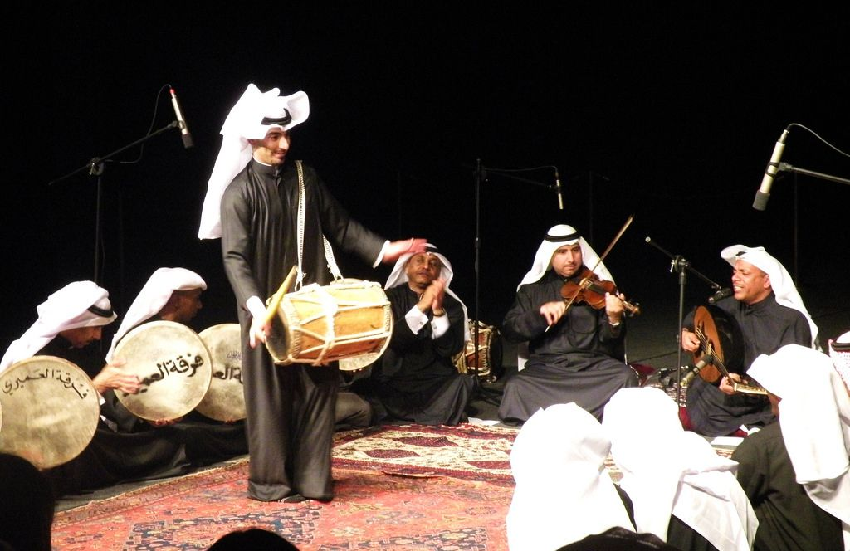
Kuwait’s Music
Kuwait has various musical genres.
Music genres in Kuwait include: sawt, bahri, samra, leywa, khadri, and maplah.
These musical genres originate from the Keralan community residing in Kuwait.
Samra features two groups of singers.
Leywa an African-influenced ritual dance (Rolf, 2014).
Khadri and bahris are a devotional genre music.
There are musical instruments such as the drum.
Notes:
Kuwaitis enjoys different musical genres. Some of the most common music genres in Kuwait are sawt, bahri, samra, leywa, khadri and maplah. These musical genres are associated with the Keralan community residing in Kuwait. Samra is a music genre that features two groups of singers, leywa is an African-influenced ritual dance, while khadri and bahris are a devotional genre music (Rolf, 2014). There are also musical instruments such as the drum.

Slide 7
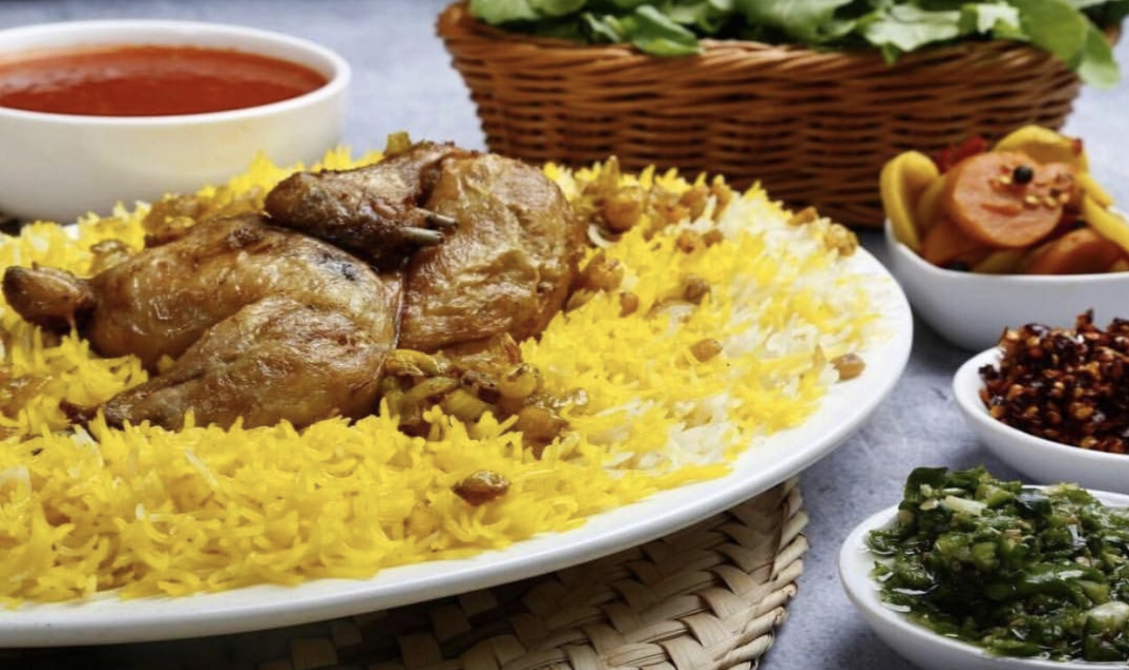
Kuwait’s Food
There are various dishes prepared in Kuwait.
Machboos which is rice served with sauce.
Is a prominent delicacy in Kuwait.
Considered to be the national dish of the nation.
Prepared by using fragrant basmati rice which is spiced with different spices and chicken or mutton.
Quozi which is a stuffed lamb served on spiced rice.
Contains spiced rice.
Stuffed with vegetables and nuts.
Notes:
There are various dishes that are served in Kuwait. However, there are two dishes that are considered traditional ones within the country. one of these dishes is the Machboos which is considered to be the most prominent delicacy in Kuwait. It is prepared using basmati rice which is spiced with different spices and served with mutton or chicken. The other dish considered to be traditional delicacy in Kuwait is the Quozi Manjiri, 2020). This dish contain spiced rice which is stuffed with nuts and vegetables.

Slide 8

Kuwait’s Economy
The country’s economy is dependent on oil production.
The country is a major member of the OPEC.
The country has over 10% of world oil reserves.
Oil accounts for over half of its gross domestic product.
Oil accounts for 92% of its export revenues (Yasser, 2020).
The country also has some other economic activities such as:
Agriculture.
Fishing
Real estate.
Banking and finance
Notes:
Kuwait’s economy is almost wholly-dependent on oil production. In fact, the country is a key player of the OPEC organization. Kuwait accounts for more than 10% of the world’s economy and oil accounts for 92% of the country’s export revenues (Yasser, 2020). The other percentage is occupied by some other economic activities such as agriculture, fishing, real estate, banking and finance among others.

Slide 9
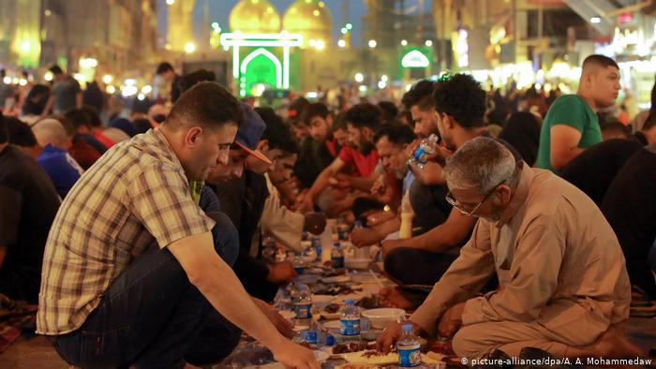
Conclusion
Kuwait is a conservative country.
It has embraced western culture.
Male dominated.
Various musical genres; sawt, bahri, samra, leywa, khadri, and maplah.
Various dishes such as Machboos, and Quozi among others.
Its economy largely relies on oil export.
Notes:
Kuwait is a conservative nation. It’s a society that is dominated by male. In addition, the country has embraced the Western culture but its traditions and values have not changed. The community has various music genres such as sawt, bahri, samra, leywa, khadri and maplah. Kuwaitis enjoy various dishes but the most prominent ones are Machboos and Quozi. Its economy relies largely on oil export.

Slide 10
References
Kuwait Travel Information. (2020). Customs and Traditions in Kuwait. Kuwait Visa, Retrieved from: https://kuwaitvisa.com/customs-traditions-culture-kuwait/#:~:text=Kuwaiti%20culture%20is%20characterized%20by,as%20social%20norms%20in%20Kuwait.
Manjiri. (2020). 10 Delicious Traditional Kuwait Food. Trip 101, Retrieved from: https://trip101.com/article/traditional-food-in-kuwait.
Rolf, K. (2014). Hidden Treasures: Reflections on Tradtional Music in Kuwait. Qatar National Library, Retrieved from: https://www.qdl.qa/en/hidden-treasures-reflections-traditional-music-kuwait.
Yasser, A.-Z. (2020). Economy of Kuwait. Fanack, Retrieved from: https://fanack.com/kuwait/economy-of-kuwait/.

