Slide 1

Two-Sample t-Test
Inferences About Means from Two Independent Groups
Each slide has its own narration in an audio file.
For the explanation of any slide click on the audio icon to start it.
Professor Friedman's Statistics Course by H & L Friedman is licensed under a
Creative Commons Attribution-NonCommercial-ShareAlike 3.0 Unported License.

Slide 2
The Two-Sample t-Statistic
Similar to one-sample hypothesis testing, we use the Z statistic if we can.
Use Z if σ₁ and σ ₂ are known OR if samples are large enough
  What is large enough? Both samples together must be at least 32. Some say 60, or more.
Therefore we must use t when
  σ₁ and σ ₂ are unknown AND
  the samples are small AND
  the populations are normally distributed
  NOTE if the samples are small and NOT normally distributed, then t-statistic can NOT be used and NON-parametric methods must be used (see software!)

Slide 3
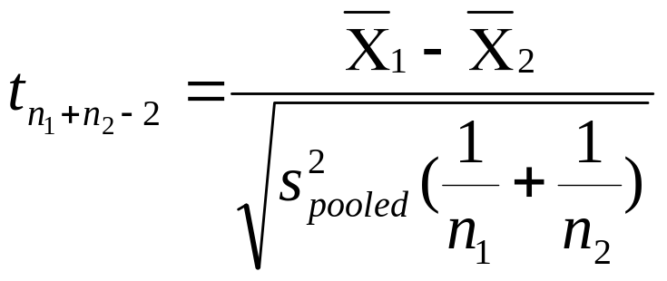
The Two-Sample t-Statistic
To calculate the two-sample t statistic:
We have to calculate s²_{pooled} first.
  This pooled variance is the variance you would get if you combined the two groups into one and calculated the variance.
  It is a weighted average of s₁² and s₂², the variances of the two groups, weighted by degrees of freedom.

Slide 4
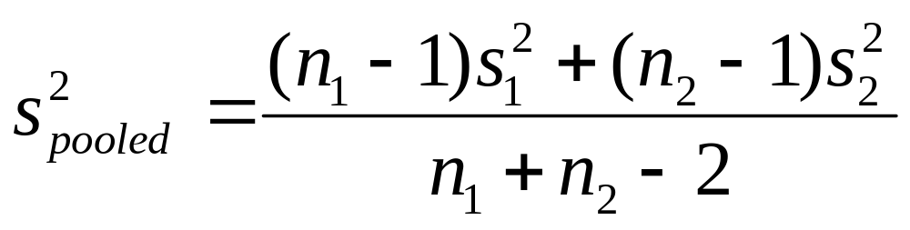
The Two-Sample t-Statistic
The pooled variance is the variance you would get if you combined the two groups into one and calculated the variance.
It is a weighted average of s₁² and s₂², the variances of the two groups, weighted by degrees of freedom.

Slide 5
About Homoskedasticity
Technically, to use this formula one must know (or be able to prove statistically) that the two variances are “equal” – this property is called homoskedasticity.
An F-test may be performed to test whether σ₁ and σ₂ and are statistically equivalent, i.e., to test for homoskedasticity.
  We will learn about this F-test in other courses.
If we do not have homoskedasticity, i.e. the variances are not proved to be statistically equivalent, then we have to make adjustment to the formula (degree of freedom is computed differently – done automatically in software).

Slide 6
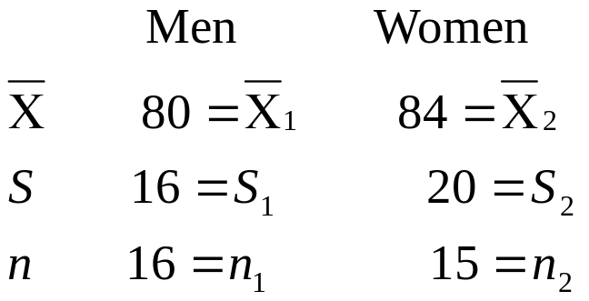
Problem 1: Reading Scores
Suppose we want to compare the reading scores of men and women on a standardized reading test.
We take a random sample of 31 people and obtain the results below.
Note that the women outperform the men by 4 points. Of course, this might simply be sampling error.
We would like to test whether or not this difference is significant at the α=.05 level.

Slide 7
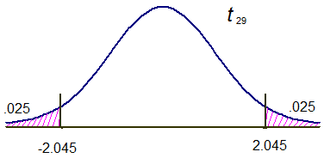

Problem 1:
Reading Scores (cont’d)
H₀: μ₁= μ₂
H₁: μ₁≠ μ₂
Note that
  σ₁,σ₂ are not given
  n₁+ n₂ = 31
We will use a t statistic with n₁+ n₂ -2 = 29 degrees of freedom

Slide 8
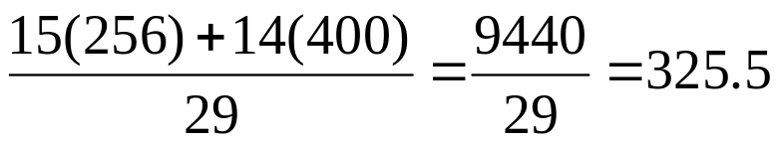
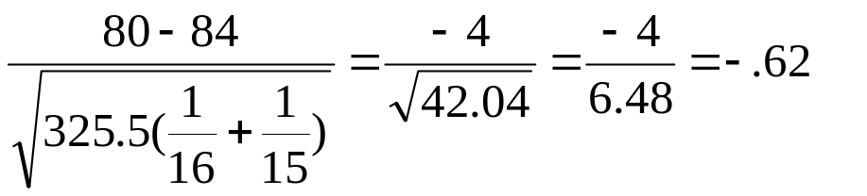
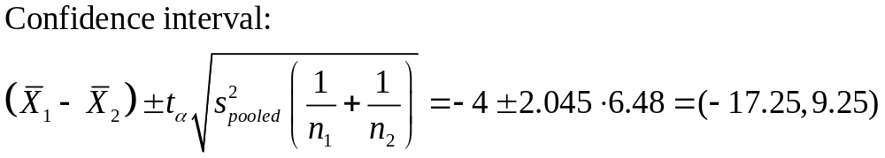
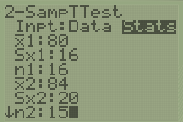




To calculate the t₂₉ test statistic, first get the pooled variance:
  s²_{pooled} =
    Note that, since it is a weighted average, s²_{pooled} is between s₁ (=256) and s₂ (=400).
t₂₉ =
Conclusion: Do not reject H₀. There is no statistically difference between men and women on test scores.
TI>Stat>Tests>2-SampTtest
P-value = 2P(t<-0.62) = 0.54>0.05
Therefore fail to reject H0
Also 2*tcdf(-100,-0.62,29) =0.54
H0 is inside CI

Slide 9
Problem 2: Company Pay
We would like to determine whether the difference in daily pay between two companies is statistically significant. α = .01
 | Company 1 | Company 2
Sample average | X̅₁= $210 | X̅₂ = $175
Standard deviation | s₁ = $25 | s₂ = $20
Sample size | n₁ = 10 | n₂ = 20

Slide 10
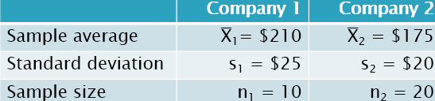

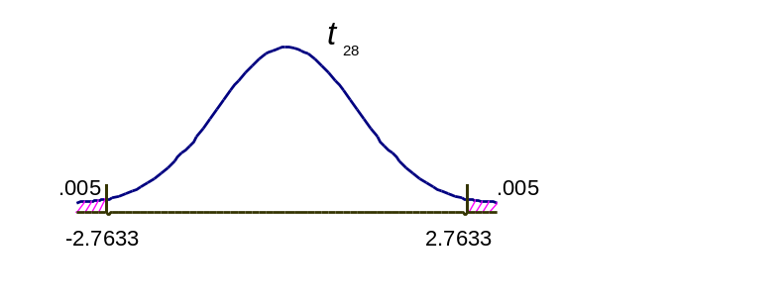



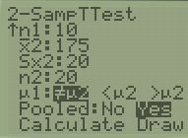

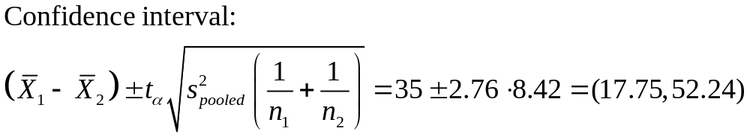
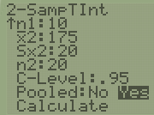

Problem 2: Company Pay
Conclusion: Reject H₀.
Since the calculated value of 4.16 is in the rejection region (right tail), we conclude that the pay rates at the two companies are indeed different: A pays more!
TI>Stat>Tests>2-SampTtest
P-value = 2P(t>4.16) = 2.7e-4<0.05
Therefore reject H0
Also 2*tcdf(4.16,100,28) =2.7e-4
TI>Stat>Tests>2-SampTInt
H0 is not inside CI

Slide 11
Problem 3: Strength of Concrete Beams
Two types of precast concrete beams are being considered for sale.
The only difference between the two beams is in the type of material used.
Strength is measured in terms of pounds per square inch (psi) of pressure.
Is there a significant difference in beams supplied by Supplier A and Supplier B? Or, is the difference of 25 psi explainable as sampling error? Test at α = 0.05
 | Supplier A | Supplier B
Sample average | X̅₁= 5000 psi | X̅₂ = 4975 psi
Standard deviation | s₁ = 50 psi | s₂ = 60 psi
Sample size | n₁ = 12 batches | n₂ = 10 batches

Slide 12
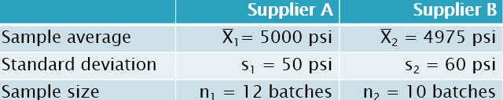




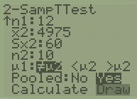


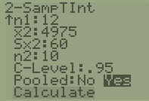
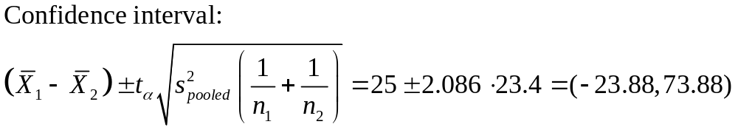

Problem 3: (cont’d)
Do not reject H₀;
There is no statistically significant difference between the beams made by Supplier A and Supplier B.
TI>Stat>Tests>2-SampTtest
P-value = 2P(t>1.06) = 0.3>0.05
Therefore fail to reject H0
Also 2*tcdf(1.06,100,20) =0.3
TI>Stat>Tests>2-SampTInt
H0 is inside CI

Slide 13
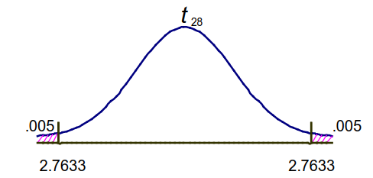

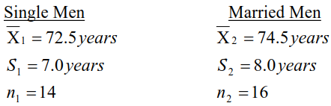

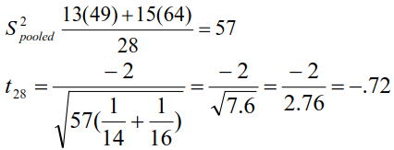

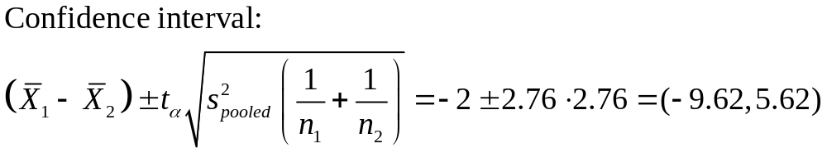
Example: Who lives longer?
TI>Stat>Tests>2-SampTInt
H0 is inside CI

Slide 14
Using MS Excel to Solve Two-Sample t-Tests
  Instructions for using MS Excel to solve two-sample t-test problems may be found on the Virtual Handouts page at:
    http://sites.google.com/site/proffriedmanstat/home/handouts

Slide 15
Using MS Excel: Spending on Wine
A marketer wants to determine whether men and women spend different amounts on wine.
(It is well known that men spend considerably more on beer.)
The researcher randomly samples 34 people (17 women and 17 men) and finds that the average amount spent on wine (in a year) by women is $437.47. The average amount spent by men is $552.94.
Given the Excel printout (next slide), is the difference statistically significant?

Slide 16
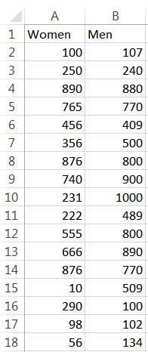
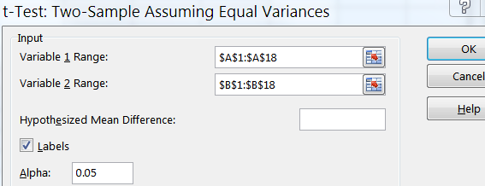
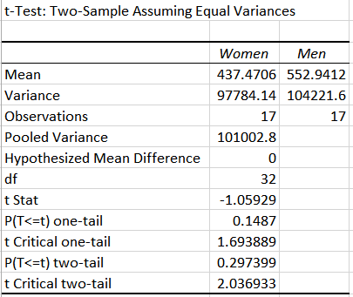
Using MS Excel: Spending on Wine (cont’d)
Excel. Enter the data.
Note: Variable 1 represents women; Variable 2,men.
Data>Data Analysis Tool>t-test-Two sample assuming equal variance
NOTE that for independent samples number of subjects in each group does NOT have to be the same as we have seen in previous examples, it just happens to be so here.

Slide 17
Using MS Excel:
Spending on Wine (cont’d)
Given the printout, is the difference statistically significant?
  Answer: If a two-tail test was done, the probability (p-value) of getting the sample evidence (or sample evidence showing an even larger difference) given that there is no difference in the population (H0) means of job satisfaction scores for men and women is .30 (rounded from .297399288).
In another words, if men and women (in the population) spend the same on wine, there is a 30% chance of getting the sample evidence (or sample evidence indicating a larger difference between men and women) we obtained.
Statisticians usually test at an alpha of .05 so we do not have evidence to reject the null hypothesis.
Conclusion: There is no statistically significant difference between men and women on how much they spend on wine consumption.

Slide 18
Using MS Excel: Spending on Wine (cont’d)
In the printout, the calculated t-statistic is -1.059287941. Why is it negative?
  Answer: The amount spent on wine by women is less than that spent by men (although the difference is not statistically significant).
  If you make men the first variable the t-value will be positive but the results will be exactly the same (the t-distribution is symmetric).
What would the calculated t-value have to be for us to reject it?
  Answer: If a two-tail test is being done, the critical value of t is 2.036931619.
  To reject the null hypothesis, we would need a calculated t-value of more than 2.036931619 or less than -2.036931619.

Slide 19
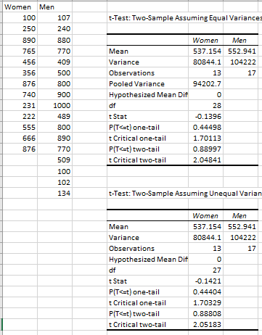
FYI
If the sample sizes are not equal, the two sample t-test assuming Unequal variance will give a slightly different results.
The t-statistic and p-values however are very close and lead to the same conclusion!!!
In the case of equal sample sizes, they are really the same!

Slide 20
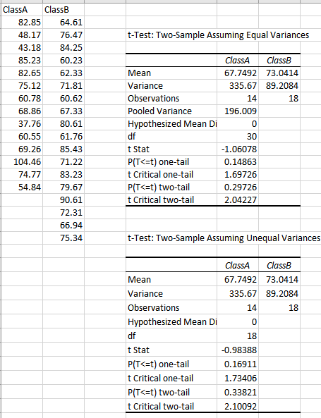
Comparting two class grades
In this example the variances
are very different.
However the outcomes are the
same and even t-stat and
p-values are not very far from
Each other.
t-Stat = -1.06>-2.04
P-value = 0.33> 0.05
The two classes are not
significantly different

Slide 21
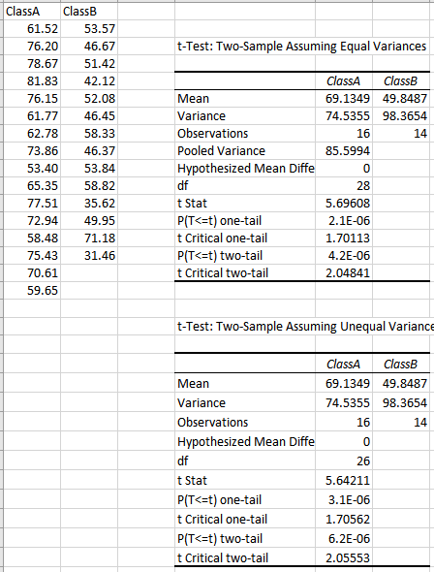
Comparting two class grades
t-Stat = 5.7> 2.05
P-value = 4.2e-6< 0.05
The two classes are
significantly different

Slide 22
Using MS Excel: Job Satisfaction
Comparing men and women on job satisfaction
  10 is the highest job satisfaction score; 0 the lowest
MEN |  | WOMEN
7 | 1 | 1 | 4
8 | 7 | 10 | 3
6 | 2 | 3 | 5
5 | 4 | 4 | 6
6 | 6 | 1 | 4
5 | 7 | 1 | 2
6 | 8 | 2 | 5
9 | 9 | 3 | 1
8 | 7 | 5 | 4

Slide 23
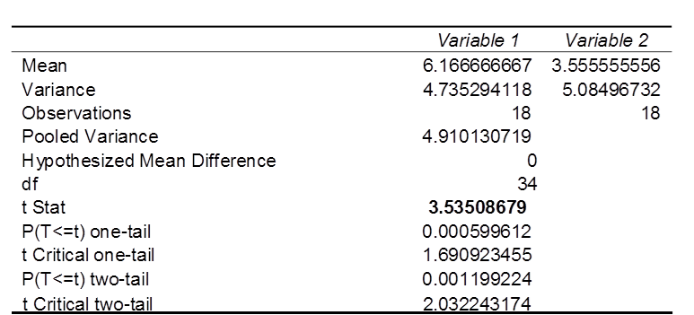
Using MS Excel:
Job Satisfaction (cont’d)
Variable 1 represents Men (n₁ = 18)
Variable 2 represents Women (n₂ = 18)
Question: It appears that men have more job satisfaction than women at this firm.
The company claims that a sample of 36 is quite small given the fact that 5,000 people work at the company and they are asserting that the difference is entirely due to sampling error.
Given the Excel printout above, what do you think?
Answer: If a two-tail test was done, the probability of getting the sample evidence given that there is no difference in the population means of job satisfaction scores for men and women is .0012.
In another words, if men and women feel the same about working in this firm, there is only a 12 out of 10,000 chance of getting the sample evidence we obtained (or worse - one showing an even larger difference).
Statisticians usually test at an alpha of .05 so we are going to reject the null hypothesis.

Slide 24
In this section we develop methods for testing hypotheses and constructing confidence intervals involving the mean of the differences of the values from two dependent populations.
With dependent samples, there is a relationship whereby each value in one sample is paired with a corresponding value in the other sample.
Examples:
Matched twin studies on the use of drugs
Weight measurement on the same patient before and after 10 week exercise course.
Weight of freshmen students on Sep 1st and Apr 1st.
Husband and wife ages.
Measuring reaction time of the same drivers before and after drinking 2 beers.
NOTE that if instead we separate the group into 2 samples in advance, and give 1st sample beer and 2nd not, then two independent samples design.
Thus, it all depends on how the testing is done

Slide 25
Notation for Dependent Samples
d = individual difference between the two values of a single matched pair.
NOTE that there is ONLY ONE set of difference
µ_{d} = mean value of the differences d for the population of paired data
d = mean value of the differences d for the paired sample data (equal to the mean of the x – y values)
s_{d} = standard deviation of the differences d for the paired sample data
n = number of pairs of data.
Copyright © 2010 Pearson Education

Slide 26
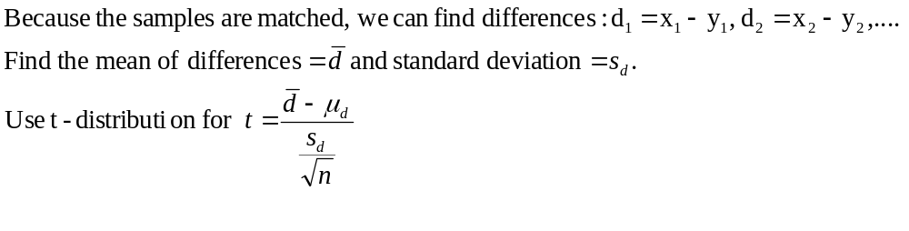
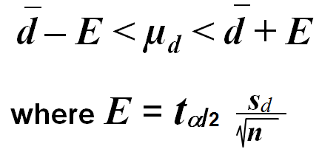
Hypothesis Test Statistic for Matched Pairs
where degrees of freedom = n – 1 = number of pairs
P-values and Critical Values: TI calculator
Confidence Intervals for Matched Pairs:
Critical values of t_{α/2} : Use invT()
Notes:
page 485 of Elementary Statistics, 10th Edition

Slide 27
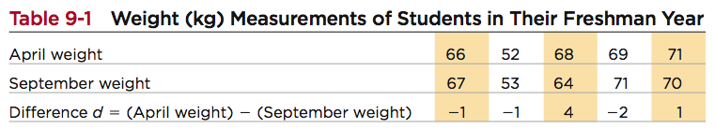
Example:
Data Set 3 in Appendix B includes measured weights of college students in September and April of their freshman year.
Table 9-1 lists a small portion of those sample values.
Here we use only a small portion of the available data so that we can better illustrate the method of hypothesis testing.
Use the sample data in Table 9-1 with a 0.05 significance level to test the claim that for the population of students, the mean change in weight from September to April is equal to 0 kg.
Copyright © 2010 Pearson Education

Slide 28
Example:
Weight gained = April weight – Sept. weight
μ_{d} denotes the mean of the “April – Sept.” differences in weight; the claim is μ_{d} = 0 kg
Step 1: claim is μ_{d} = 0 kg
Step 3: H₀: μ_{d} = 0 kg original claim
H₁: μ_{d} ≠ 0 kg
Step 4: significance level is α = 0.05
Step 5: use the student t distribution
Copyright © 2010 Pearson Education

Slide 29

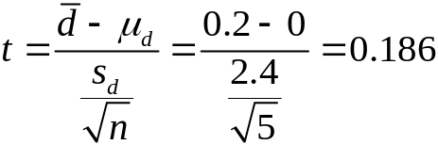
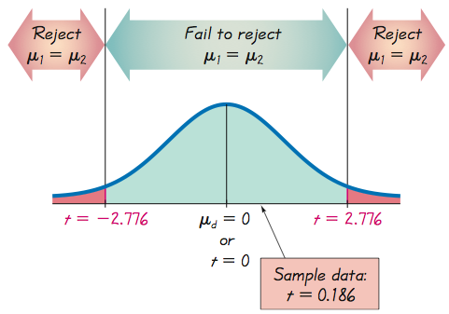
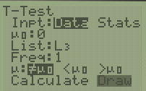
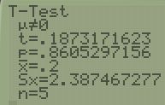
Step 6: find values of d and s_{d} differences are: –1, –1, 4, –2, 1
d = 0.2 and s_{d} = 2.4 now find the test statistic
TI Enter two data sets into lists L1 and L2
Create list L3 = L1 – L2
STAT->TESTS->T-test
Make sure to use Data option and enter L3
df = n – 1, area in two tails is 0.05,
yields a critical value t = ±2.776
TI 2nd Vars
invT(0.975,4) = 2.776
Step 7: Because the test statistic does not fall in the critical
region, we fail to reject the null hypothesis.
The P-value method: Using technology, we can find
the P-value = 2*tcdf(0.18,100,3) =0.86.
We again fail to reject the null hypothesis, because the P-value
is greater than the significance level of α = 0.05.
I.e. there is not sufficient evidence to warrant rejection of the claim that for the population of students, the mean change in weight from September to April is equal to 0 kg, there does not appear to be a significant weight gain from September to April.
TI>Stat>Tests>T-test
P-value = 2P(t>0.19) = 0.86>0.05
Therefore reject H0
Also 2*tcdf(0.18,100,3) =0.86
Copyright © 2010 Pearson Education

Slide 30
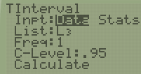


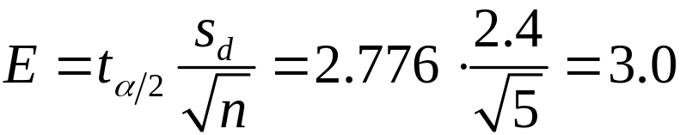
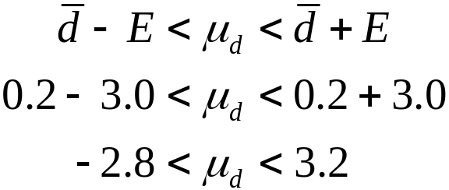
Confidence Interval method:
Construct a 95% confidence
interval estimate of μ_{d} , which
is the mean of the “April–September”
weight differences of college
students in their freshman year.
TI STAT->TESTS->TInterval
= 0.2, s_{d} = 2.4, n = 5, t_{a/2} = 2.776
Find the margin of error, E
We have 95% confidence that the limits of -2.8 kg and 3.2 kg contain the true value of the mean weight change from September to April.
In the long run, 95% of such samples will lead to confidence interval limits that actually do contain the true population mean of the differences.
Note that CI contains 0 => it is very possible that the mean of the weight changes is 0kg.

Slide 31
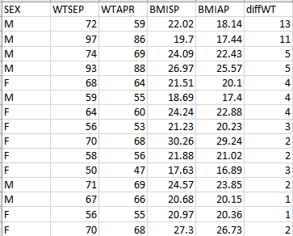
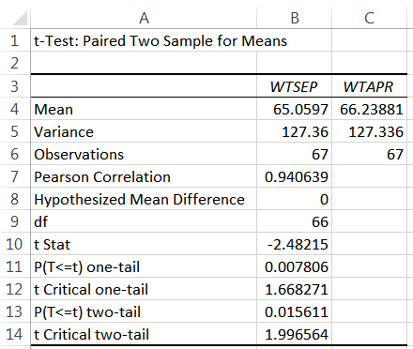

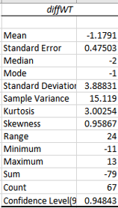
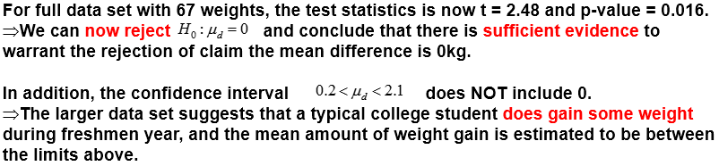
Using Full Data Set via Excel
The full data set includes measured weights of 67 college students in September and April of their freshman year. Same student ⇛paired (dependent) data.
Use 0.05 significance level to test the claim that for the population of students, the mean change in weight from September to April is equal to 0 kg.
Data> Data Analysis>
T-test paired two samples for means.
(If you do not have Data Analysis-Analysis Tools, you have to use the Add-in feature and add it to MS Excel).

Slide 32
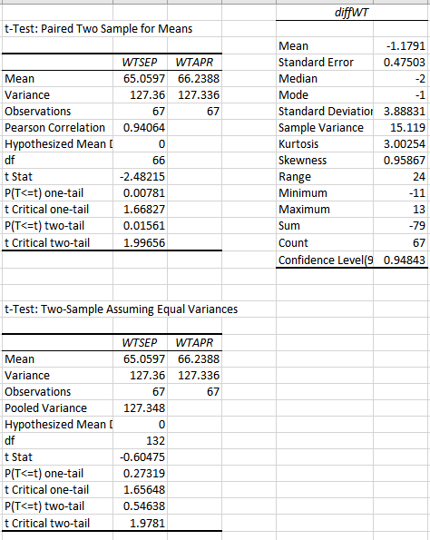
NOTE that in the student weight example if we WRONGLY use the unpaired test we get NON-significant difference

Slide 33
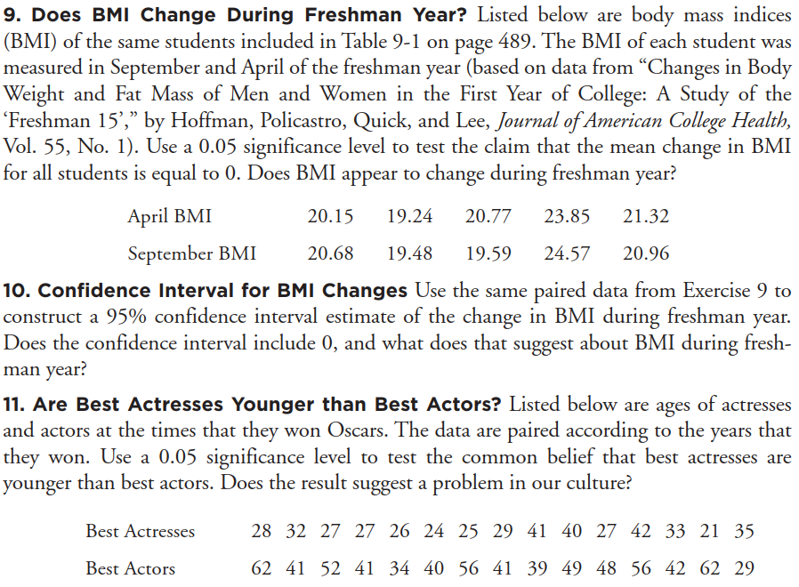
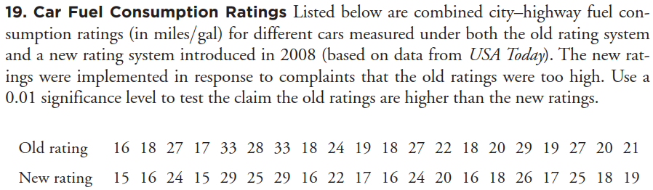
Do two sided in 11 and 19
even though they ask for
one-sided tests.

Slide 34
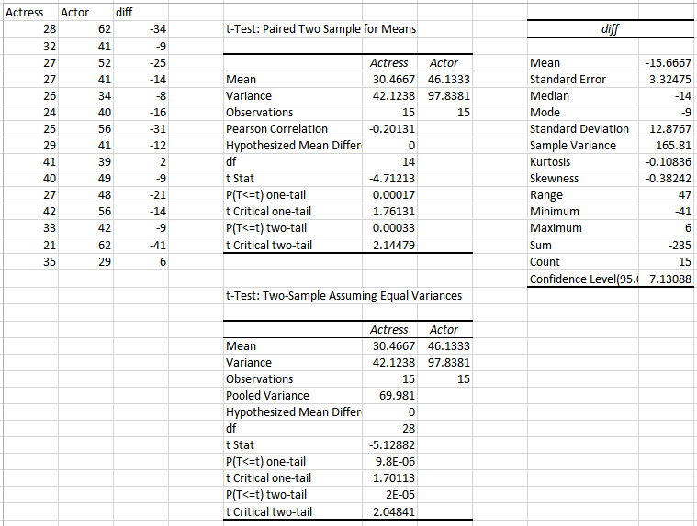
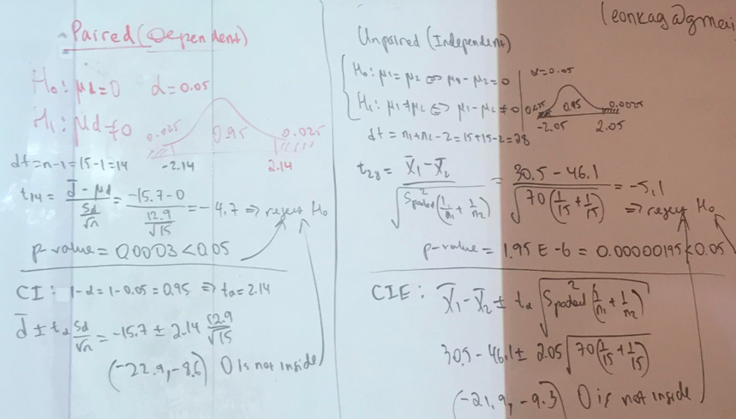
Excel output for problem 11 above

Slide 35
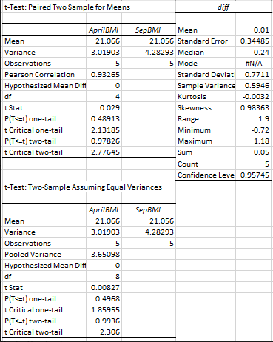
Excel output # 9

Slide 36
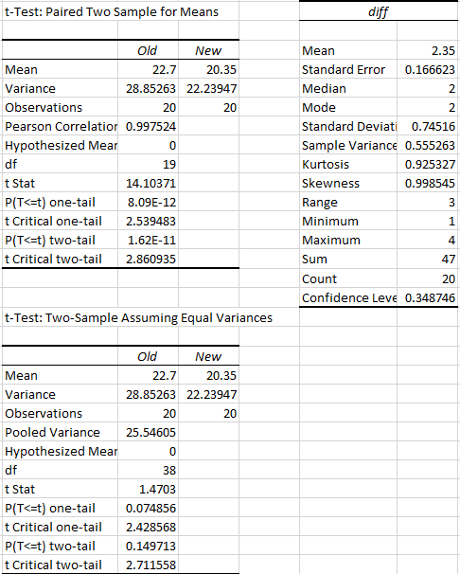
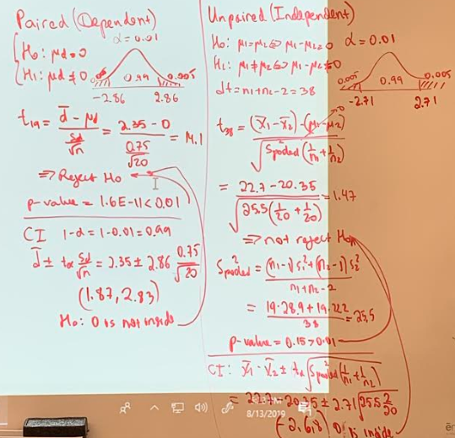
Problem 19 solution from HW

Slide 37




