Slide 1

Intro to Regression
Simple Linear Regression
Each slide has its own narration in an audio file.
For the explanation of any slide click on the audio icon to start it.
Professor Friedman's Statistics Course by H & L Friedman is licensed under a
Creative Commons Attribution-NonCommercial-ShareAlike 3.0 Unported License.

Slide 2
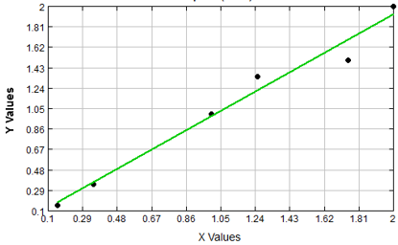
Regression
Using regression analysis, we can derive an equation by which the dependent variable (Y) is expressed (and estimated) in terms of its relationship with the independent variable (X).
  In simple regression, there is only one independent variable (X) and one dependent variable (Y). The dependent variable is the outcome we are trying to predict.
  In multiple regression, there are several independent variables (X1, X2, … ), and still only one dependent variable, Y. We are trying to use the X variables to predict the Y variable.
We will be studying Simple Linear Regression, in which we investigate whether X and Y have a linear relationship.

Slide 3
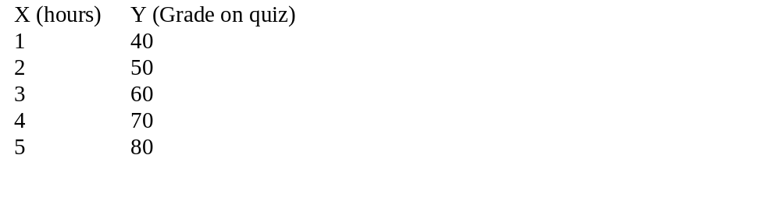
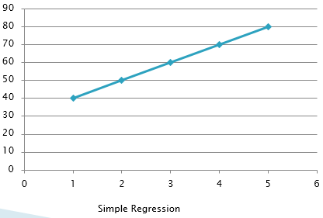
A Simple Regression Example
A researcher wishes to determine the relationship between X and Y.
It is important to know which is the dependent variable, the one you are trying to predict. Presumably, hours studied affects grades on a quiz, not the other way around.
Consider an artificially simple data which represent a perfect straight line

Slide 4
A Simple Regression Example
If X and Y have a linear relationship, and you would like to plot the line, what would it look like?
  Take a moment and try it. Note that the data points fall on a straight line.
  Now, add another point: If X=6, then Y= ?
We see that as X changes by 1, Y changes by 10. That is, the slope, called b₁ is equal to 10.
  b₁ = ∆Y / ∆X = rise/run = 10.
The Y-intercept, or the value of Y when X=0, called b₀ is equal to 30.
  When X = 0, then Y= 30. Someone who studies 0 hours for the quiz, should expect a grade of 30.
  Then, every additional hour studied adds 10 points to the score on the quiz.
The equation for the plot of this data is: Ŷ = 30 + 10X

Slide 5
A Simple Regression Example
If you plot the above X and Y, you will find that all the points are on a straight line. This, of course, means that we have a perfect relationship between X and Y and all the points are on the line.
From studying correlation you know that for this data r=+1 and R²=100%.

Slide 6

Simple Linear Regression
In general, the simple linear regression equation is:
Ŷ_{i} = b₀ + b₁X_{i}
Why do we need regression in addition to correlation?
  To predict a Y for a new value of X
  To answer questions regarding the slope. For example,
    With additional shelf space (X), what effect will there be on sales (Y)?
    If we raise prices by a particular amount or percentage, will it cause sales to drop? (This measures elasticity.)
  It makes the scatter plot a better display (graph) of the data if we can plot a line through it. It presents much more information on the diagram.
In correlation, on the other hand, we just want to know if two variables are related. This is used a lot in social science research.

Slide 7
Simple Linear Regression
The regression equation Ŷ_{i} = b₀ + b₁X_{i} is a sample estimator of the true population regression equation, which we could build were we to take a census:
Y_{i} = β₀ + β₁X_{i} + ε_{i}
where,
β₀ = true Y intercept for the population
β₁ = true slope for the population
ε_{i} = random error in Y for observation i
In regression analysis, we hypothesize that there is a true regression line for the population. The b₀ and b₁ coefficients are estimates of the true population coefficients, β₀ and β₁.

Slide 8
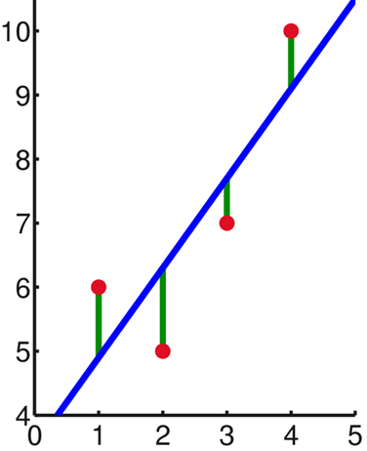
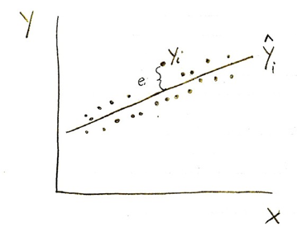
Simple Linear Regression
Ŷ_{i} is a point on the regression line
Y_{i} is an individual data value
The deviations of the individual observations (the points) from the regression line, (Y_{i} - Ŷ_{i}), the residuals, are denoted by e_{i} where e_{i} = (Y_{i} - Ŷ_{i}).
  Some deviations are positive (for the points above the line); some are negative (for the points below the line).
  If a point is on the line, its deviation = 0.
  Note that the Σe_{i} = 0.

Slide 9
Simple Linear Regression
Mathematically, the regression line minimizes the sum of the squared errors (SSE):
Σe_{i}² = Σ(Y_{i} - Ŷ_{i})² = Σ[Y_{i} – (b₀ + b₁X_{i})]²
  Regression is called a “least squares” method.
  Taking partial derivatives, we get the “normal equations” that are used to solve for b₀ and b₁.
  In regression, the levels of X are considered to be fixed.
  Y is the random variable.

Slide 10
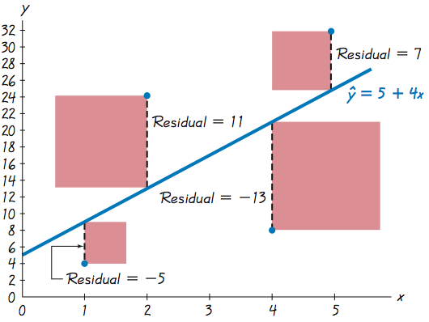

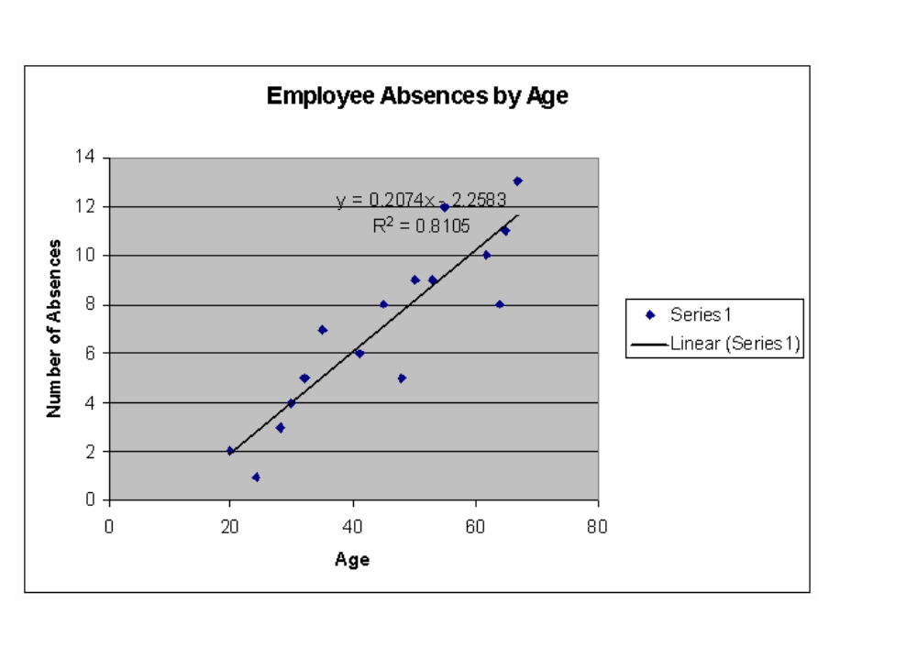
Simple Linear Regression
For example consider data with predicted line:
An actual data point is (4,8).
While predicted value at x = 4 is 5 + 4*4 = 21
=> residual = 8 – 21 = - 13
A straight line satisfies the least-squares property if the sum of the squares of the residuals is the smallest sum possible.
In the this picture example sum of residuals is:
This sum of squares is visualized by the sum red-square areas -- as small as possible (proved by Calculus).
Any other straight line will produce larger total area.
In the example below, we see that most of the points are either above the line or below the line. Only about 5 points are actually on the line or touching it.

Slide 11
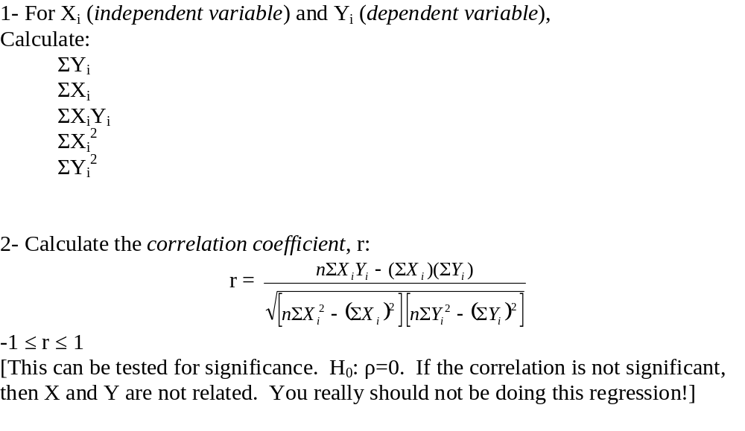
Steps in Regression

Slide 12
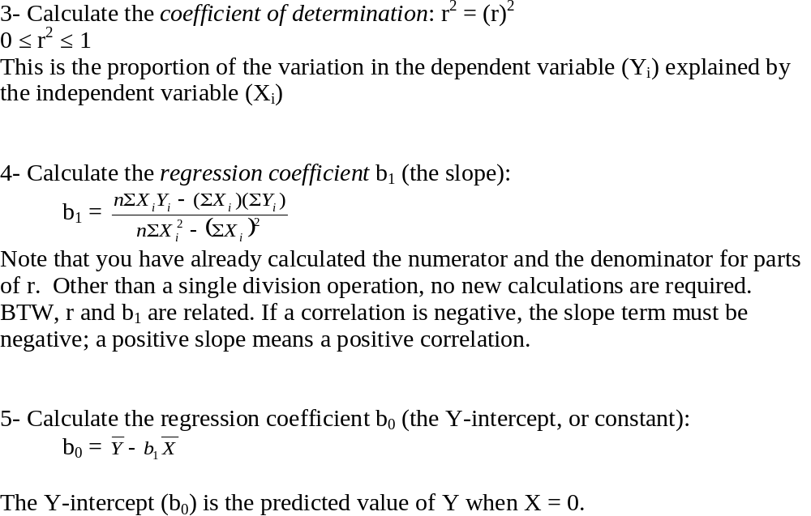

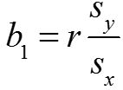
Steps in Regression

Slide 13
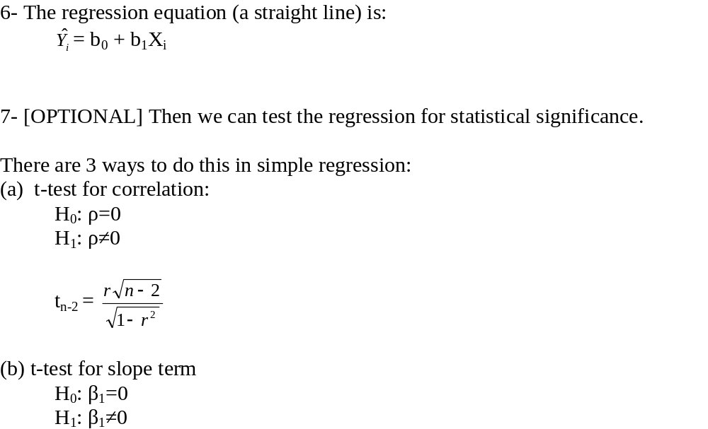
Steps in Regression
-- not done in Excel
-- done in Excel

Slide 14
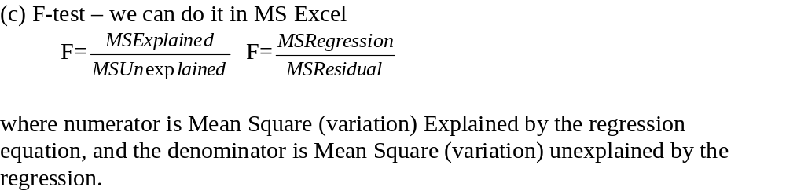
Steps in Regression
This is part of the output you see when you do regression in MS Excel.
-- done in Excel

Slide 15
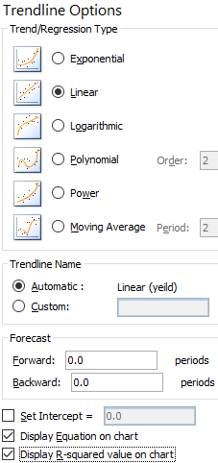
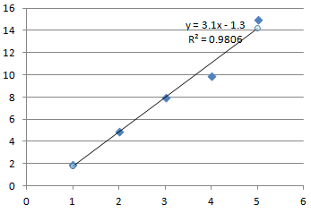
Example: Water and Tomato Yield
Y_{i} | X_{i} | X_{i}Y_{i} | X_{i}² | Y_{i}²
2 | 1 | 2 | 1 | 4
5 | 2 | 10 | 4 | 25
8 | 3 | 24 | 9 | 64
10 | 4 | 40 | 16 | 100
15 | 5 | 75 | 25 | 225
40 | 15 | 151 | 55 | 418
n = 5 pairs of X,Y observations
Independent variable (X) is amount of water (in gallons) used on crop
Dependent variable (Y) is yield (bushels of tomatoes).
Excel>Insert>Scattrplot
Click on graph, at upper left
Add Chart Element>Trendline>More Options

Slide 16
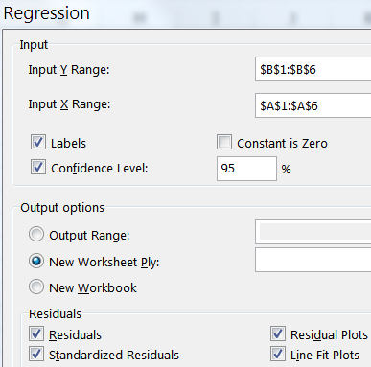
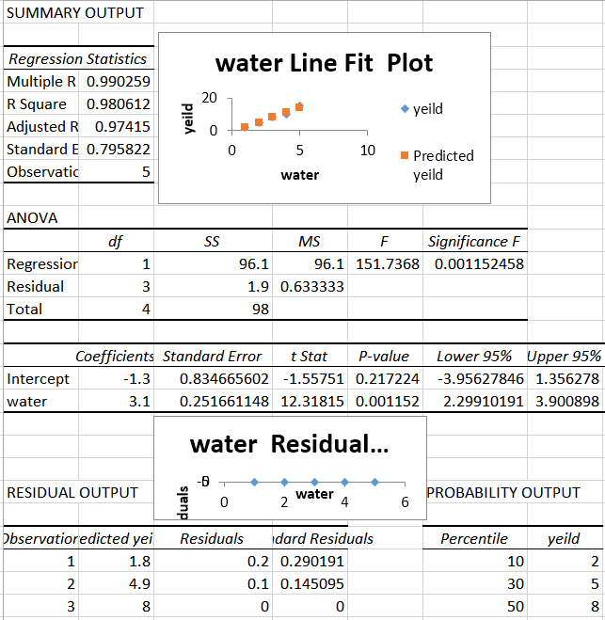
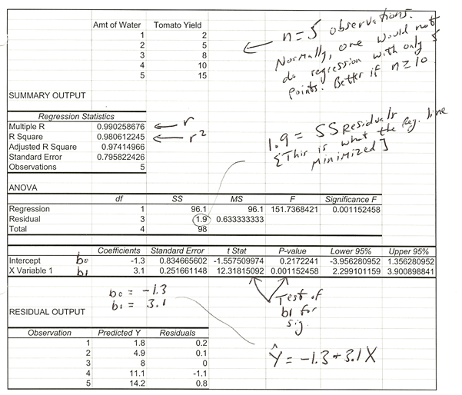
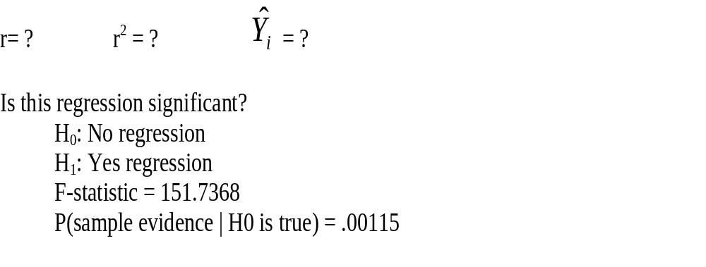
Excel>Data>
Data Analysis>
Regression

Slide 17
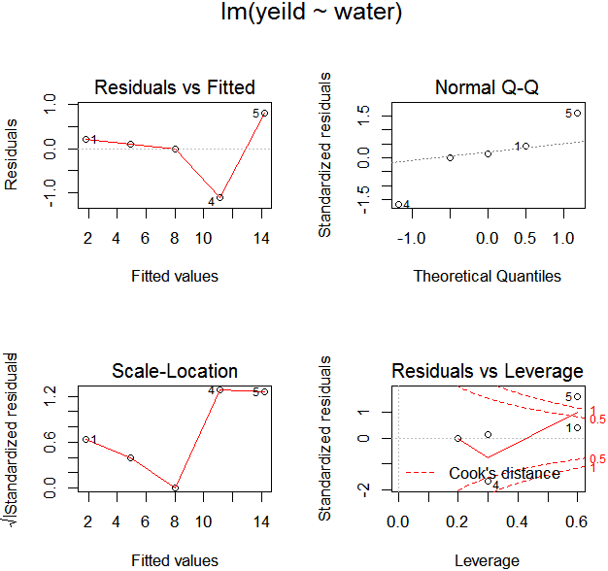
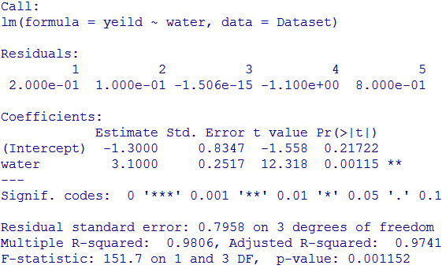

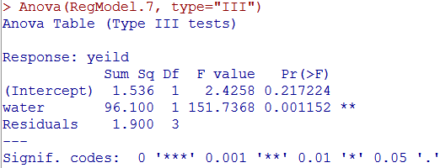
Rcmdr has very extensive modeling capability
Rcmdr>Statistics>Fit Models>Linear Regression
The summary gives a plethora of information including regression coefficients with their standard errors, t statics and resulting p-values, Residual standard error, R-squared, Overall F-test, etc…
Once a model is produced, Rcmdr>Models gives many options to additionally study the model both numerically and graphically.
Here I show Basic Diagnostic Plots, confidence intervals for the model parameters and ANOVA table, but there are many others.
Optional

Slide 18
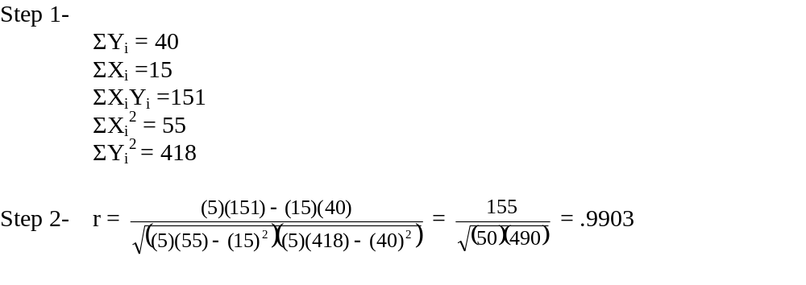
Example: Water and Tomato Yield
Y_{i} | X_{i} | X_{i}Y_{i} | X_{i}² | Y_{i}²
2 | 1 | 2 | 1 | 4
5 | 2 | 10 | 4 | 25
8 | 3 | 24 | 9 | 64
10 | 4 | 40 | 16 | 100
15 | 5 | 75 | 25 | 225
40 | 15 | 151 | 55 | 418

Slide 19
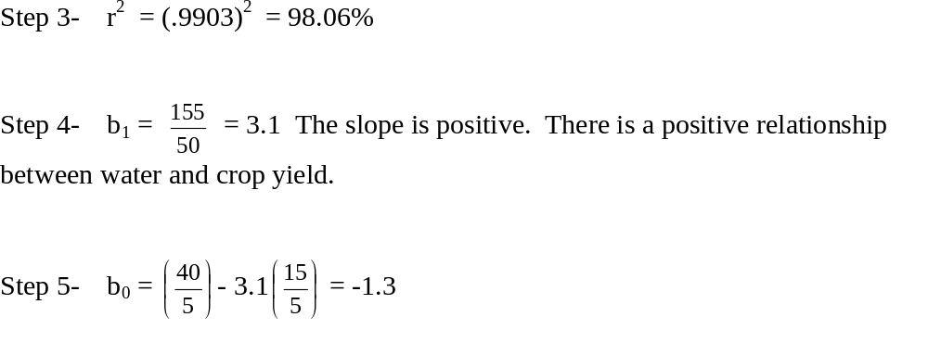
Example: Water and Tomato Yield

Slide 20
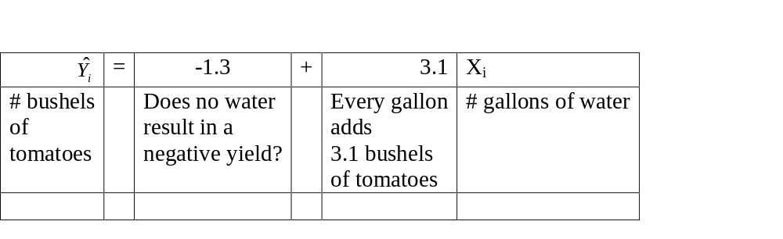
Example: Water and Tomato Yield

Slide 21



Example: Water and Tomato Yield
Y_{i} | X_{i} |  | e_{i} | e_{i}²
2 | 1 | 1.8 | .2 | .04
5 | 2 | 4.9 | .1 | .01
8 | 3 | 8.0 | 0 | 0
10 | 4 | 11.1 | -1.1 | 1.21
15 | 5 | 14.2 | .8 | .64
 |  |  | Σe_{i} = 0 | Σe_{i}² = 1.90
Σe_{i}² = 1.90. This is a minimum, since regression minimizes Σe_{i}² (SSE)
Now we can answer a prediction question like:
How many bushels of tomatoes can we expect if we use 3.5 gallons of water? -1.3 + 3.1 (3.5) = 9.55 bushels.
Notice the danger of predicting outside the range of X. The more water, the greater the yield?
No. Too much water can ruin the crop.
If we did not have a significant regression (i.e., X does not predict Y) we would use average(Y) as our regression equation, or something else...

Slide 22
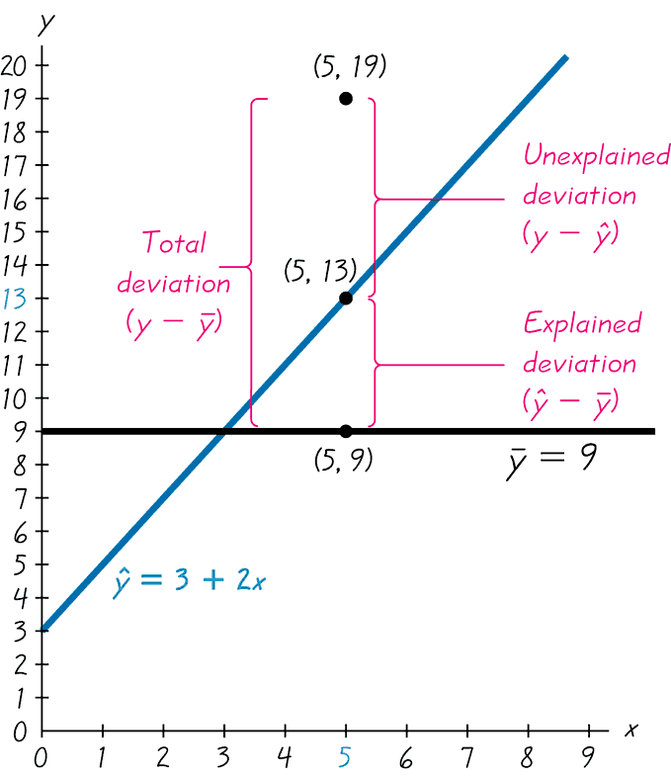
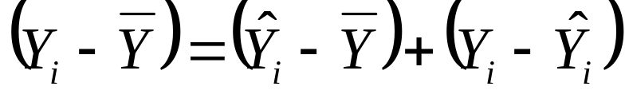
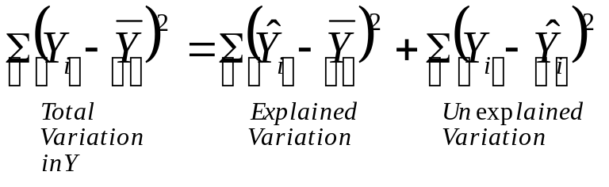
Sources of Variation in Regression

Slide 23
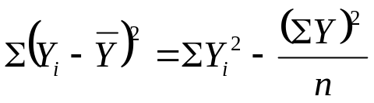
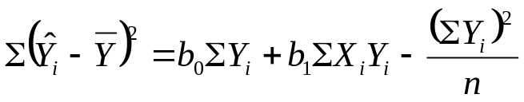

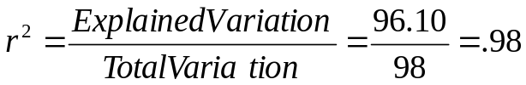
Sources of Variation in Regression
Total Variation:
Explained Variation:
Unexplained Variation:
From our previous problem,
  Total variation in Y = 418 – (40)²/5 = 98
  Explained variation (explained by X) = -1.3(40) + 3.1(151) – (40)²/5 = 96.10
  Unexplained variation = 418 - -1.3(40) - 3.1(151) = 1.90
The coefficient of determination, r², is the proportion of Y explained by X.
  In other words, 98% of the total variation in crop yield is explained by the linear relationship of yield with amount of water used on the crop.

Slide 24
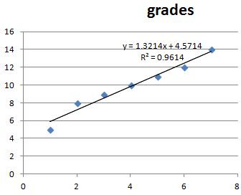
Example: Hours Studied & Grades
Let’s examine the relationship between hours studied and grade on a quiz.
n=7 pairs of data. Highest grade on quiz is a 15.
X ≡ hours studied; Y ≡ grade on quiz.
X_{i} | Y_{i} | X_{i}Y_{i} | X_{i}² | Y_{i}²
1 | 5 | 5 | 1 | 25
2 | 8 | 16 | 4 | 64
3 | 9 | 27 | 9 | 81
4 | 10 | 40 | 16 | 100
5 | 11 | 55 | 25 | 121
6 | 12 | 72 | 36 | 144
7 | 14 | 98 | 49 | 196
ΣX= 28 | ΣY= 69 | ΣXY= 313 | ΣX²= 140 | ΣY²= 731

Slide 25
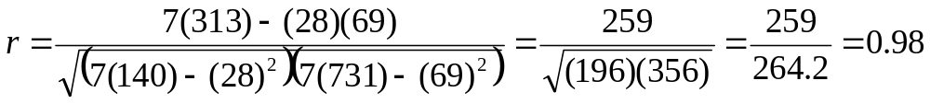
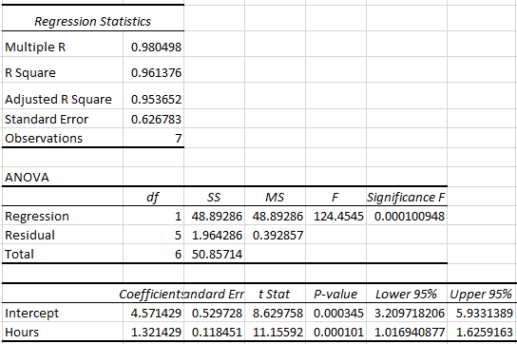
∑X = 28
∑Y = 69
∑XY = 313
∑X² = 140
∑Y² = 731
Calculate the correlation coefficient, r:
[slope will be positive]

Slide 26
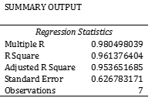
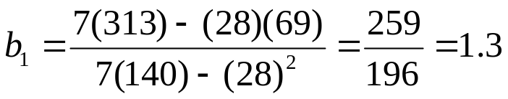

Example: Hours Studied & Grades
Calculate the coefficient of determination, R²:
R² = (0.98)² = .9604
Calculate the regression coefficient b₁ (the slope):
Calculate the regression coefficient b₀ (the Y-intercept, or constant): b0 = 4.57

Slide 27
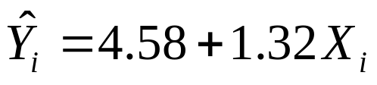
Example: Hours Studied & Grades
The regression equation:
Q: Explain the meaning of the regression coefficients.
Q: If someone studies 3.5 hours, what would we predict his/her quiz score to be?
    Try these yourself before advancing the slide.

Slide 28
Example: Hours Studied & Grades
Answers to … ?
Q: Explain the meaning of the regression coefficients.
Q: If someone studies 3.5 hours, what would we predict his/her quiz score to be?
4.58 + 1.32 (3.5) = 9.2

Slide 29
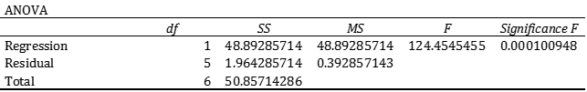
More About Excel Output
Before using MS Excel, you should know the following:
    df is degrees of freedom
    SS is sum of squares
    MS is mean square (SS divided by its degrees of freedom)
SST = SSR + SSE
Sum of Squares Total (SST) = Sum of Squares Regression (SSR) + Sum of Squares Error (SSE)
Total variation in Y = Explained Variation (Explained by the X-variable) + Unexplained Variation
SSE is the sum of the squared residuals.
    Note that some textbooks use the term Residuals and others use Error.
    They are the same thing and deal with the unexplained variation, i.e., the deviations.
    This is the number that is minimized by the least squares (regression) line.
SSR/SST is the proportion of the variation in the Y-variable explained by the X-variable. This is the R-Square, r², the coefficient of determination.
ANOVA
 | df | SS | MS | F | Significance F
Regression | 1 | SSR | MSR | MSR/MSE
Residual (Error) | n-2 | SSE | MSE
Total | n-1 | SST

Slide 30
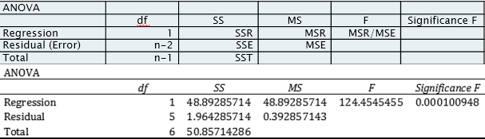
In simple regression, the degrees of freedom of the SS Regression is 1 (the number of independent variables).
The number of degrees of freedom for the SS Residual is (n – 2).
Please note that SS Residual is the SSE.
If X is not related to Y, you should get an F-ratio of around 1.
In fact, if the explained (regression) variation is 0, then the F-ratio is 0.
F-ratios between 0 and 1 will not be statistically significant.
On the other hand, if all the points are on a line, then the unexplained variation (residual variation) is 0. This results in an F-ratio of infinity.
An F-value of, say, 30 means that the explained variation is 30 times greater than the unexplained variation.
This is not likely to be by chance and the F-value will be significant.

Slide 31
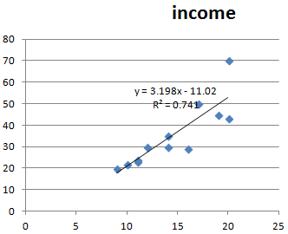
MS Excel Example: Education & Income
Education (X) | 9 | 10 | 11 | 11 | 12 | 14 | 14 | 16 | 17 | 19 | 20 | 20
Income (‘000s) (Y) | 20 | 22 | 24 | 23 | 30 | 35 | 30 | 29 | 50 | 45 | 43 | 70
A researcher is interested in determining whether there is a relationship between years of education and income.
SUMMARY OUTPUT
Regression Statistics
Multiple R | 0.860811139
R Square | 0.740995817
Adjusted R Square | 0.715095399
Standard Error | 7.816452413
Observations | 12
ANOVA
 | df | SS | MS | F | Significance F
Regression | 1 | 1747.947383 | 1747.947383 | 28.60941509 | 0.000324168
Residual | 10 | 610.9692833 | 61.09692833
Total | 11 | 2358.916667
 | Coefficients | Standard Error | t Stat | P-value | Lower 95% | Upper 95%
Intercept | -11.02047782 | 8.909954058 | -1.236872575 | 0.244393811 | -30.87309606 | 8.832140427
X Variable 1 | 3.197952218 | 0.597884757 | 5.348776972 | 0.000324168 | 1.865781732 | 4.530122704

Slide 32
SUMMARY OUTPUT
Regression Statistics
Multiple R | 0.860811139
R Square | 0.740995817
Adjusted R Square | 0.715095399
Standard Error | 7.816452413
Observations | 12
ANOVA
 | df | SS | MS | F | Significance F
Regression | 1 | 1747.947383 | 1747.947383 | 28.60941509 | 0.000324168
Residual | 10 | 610.9692833 | 61.09692833
Total | 11 | 2358.916667
 | Coefficients | Standard Error | t Stat | P-value | Lower 95% | Upper 95%
Intercept | -11.02047782 | 8.909954058 | -1.236872575 | 0.244393811 | -30.87309606 | 8.832140427
X Variable 1 | 3.197952218 | 0.597884757 | 5.348776972 | 0.000324168 | 1.865781732 | 4.530122704
This regression is very significant; the F-value is 28.61.
If the X-variable explains very little of the Y-variable, you should get an F-value that is 1 or less.
In this case, the explained variation (due to regression = explained by the X-variable) is 28.61 times greater than the unexplained (residual) variation.
The probability of getting the sample evidence or even a stronger relationship if the X and Y are unrelated (Ho is that X does not predict Y) is .000324168.
In other words, it is almost impossible to get this kind of data as a result of chance.
The regression equation is:
Income = -11.02 + 3.20 (years of education).

Slide 33
SUMMARY OUTPUT
Regression Statistics
Multiple R | 0.860811139
R Square | 0.740995817
Adjusted R Square | 0.715095399
Standard Error | 7.816452413
Observations | 12
ANOVA
 | df | SS | MS | F | Significance F
Regression | 1 | 1747.947383 | 1747.947383 | 28.60941509 | 0.000324168
Residual | 10 | 610.9692833 | 61.09692833
Total | 11 | 2358.916667
 | Coefficients | Standard Error | t Stat | P-value | Lower 95% | Upper 95%
Intercept | -11.02047782 | 8.909954058 | -1.236872575 | 0.244393811 | -30.87309606 | 8.832140427
X Variable 1 | 3.197952218 | 0.597884757 | 5.348776972 | 0.000324168 | 1.865781732 | 4.530122704
In theory, an individual with 0 years of education would make a negative income of $11,020 (i.e., public assistance). Every year of education will increase income by $3,200.
The correlation coefficient is .86 which is quite strong.
The coefficient of determination, r², is 74%.
This indicates that the unexplained variation is 26%.
One way to calculate r² is to take the ratio of the sum of squares regression/ sum of squares total.
SSREG/SST = 1747.947383/ 2358.916667 = .741
The Mean Square Error (or using Excel terminology, MS Residual) is 61.0969.
The square root of this number 7.816 45 is the standard error of estimate and is used for confidence intervals.
The mean square (MS) is the sum of squares (SS) divided by its degrees of freedom.

Slide 34
SUMMARY OUTPUT
Regression Statistics
Multiple R | 0.860811139
R Square | 0.740995817
Adjusted R Square | 0.715095399
Standard Error | 7.816452413
Observations | 12
ANOVA
 | df | SS | MS | F | Significance F
Regression | 1 | 1747.947383 | 1747.947383 | 28.60941509 | 0.000324168
Residual | 10 | 610.9692833 | 61.09692833
Total | 11 | 2358.916667
 | Coefficients | Standard Error | t Stat | P-value | Lower 95% | Upper 95%
Intercept | -11.02047782 | 8.909954058 | -1.236872575 | 0.244393811 | -30.87309606 | 8.832140427
X Variable 1 | 3.197952218 | 0.597884757 | 5.348776972 | 0.000324168 | 1.865781732 | 4.530122704
Another way to test the regression for significance is to test the b₁ term (slope term which shows the effect of X on Y).
This is done via a t-test. The t-value is 5.35 and this is very, very significant. The probability of getting a b₁ of this magnitude if Ho is true (the null hypothesis for this test is that beta₁ = 0, i.e., the X variable has no effect on Y), or one indicating an even stronger relationship, is 0.000324168.
Note that this is the same sig. level we got before for the F-test.
Indeed, the two tests give exactly the same results. Testing the b₁ term in simple regression is equivalent to testing the entire regression.
After all, there is only one X variable in simple regression. In multiple regression we will see tests for the individual bi terms and an F-test for the overall regression.

Slide 35
MS Excel Example: Education & Income
Prediction: According to the regression equation, how much income would you predict for an individual with 18 years of education?
Income = -11.02 + 3.20 (18)
Answer = 46.58 in thousands which is $46,580.
    Please note that there is sampling error so the answer has a margin of error.
    This is beyond the scope of this course so we will not learn it.

Slide 36
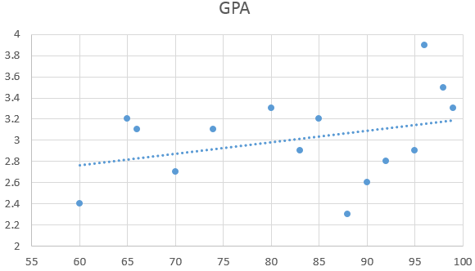
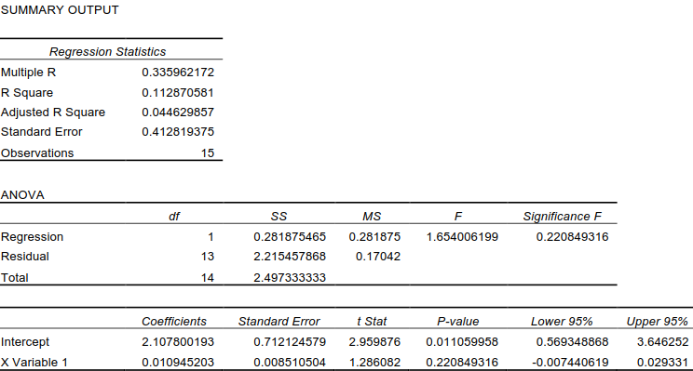
Example: A researcher is interested in determining whether there is a relationship between the high school average and GPA in Partytime College.
This regression is not significant; the F-value is 1.654. If the X-variable explains very little of the Y-variable, you should get an F-value that is 1 or less. The probability of getting the sample evidence (or data indicating an even stronger relationship) if the X and Y are unrelated (Ho is that X does not predict Y, i.e., the regression is not significant) is .2208. We do not have any evidence to reject the null hypothesis.
The correlation coefficient is a weak .336 and is not statistically significant. It may be 0 (in the population) and we are simply looking at sampling error.
If the regression is not significant, we do not look at the regression equation. There is nothing to look at as it all may reflect sampling error.

Slide 37
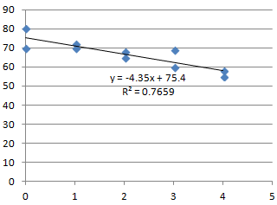
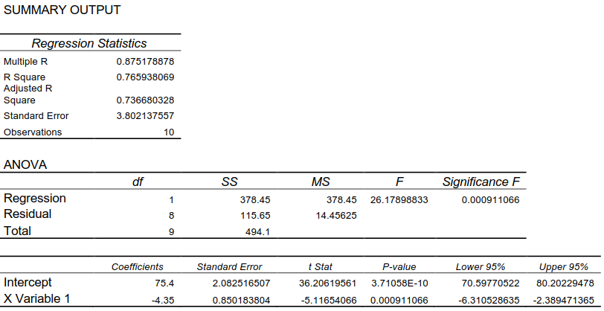
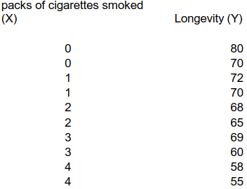
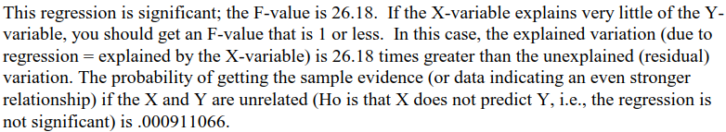

Slide 38

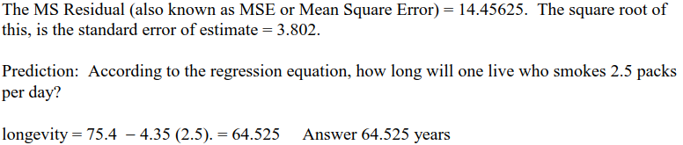

Slide 39
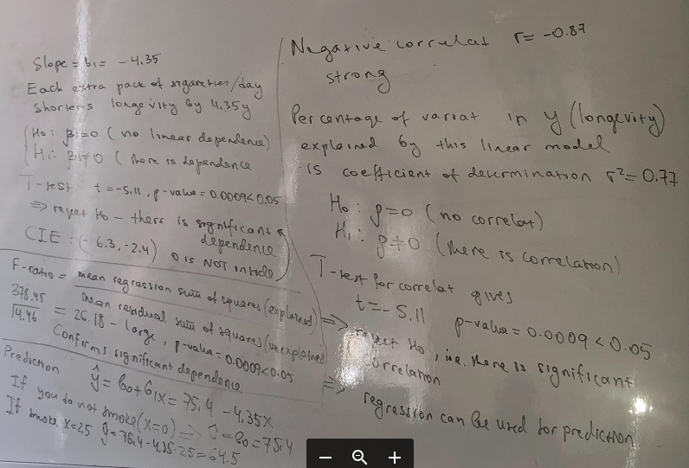

Slide 40
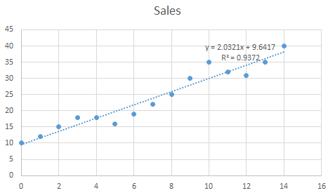
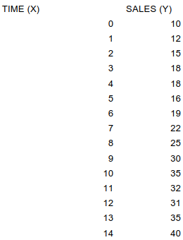
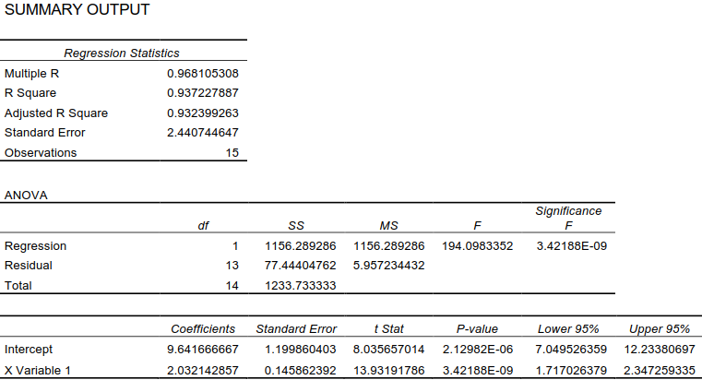
This (time series) regression is significant; the F-value is 194.098. p-value is .00000000342.
The regression equation is: Sales (in millions) = 9.641667 + 2.032143 (Time).
According to the trend line, sales increase by $2,032,143 per year.
Prediction: What are expected sales for 2016? Note 2016 is 19.
Sales (in millions) = 9.641667 + 2.032143 (19). Answer $48,252,384

Slide 41






Slide 42

(4) (a) r2 (coefficient of determination) = 79.40% (b) r, the correlation coefficient = - .891 (it is negative since the slope is negative) (c) The sample size consisted of 15 people. (d) The (computed) F-statistic is 50.117. It is very, very, very, very significant. This is not chance that we are looking at. (e) Amount spent on clothing = $13,296.30 - 99.44 (IQ); Note that the slope term is negative. This indicates an inverse relationship (g) An increase of one point of IQ results in a decrease in amount spent on clothing of $99.44. (h) An individual with a zero IQ will spend about $13,296.30 on clothing per year. (i) The standard error of estimate is 950.357399. I would round it to 950.36. (j) An individual with a 100 IQ should spend about $3352.30 on clothing.

