Slide 1
Earth 001
Earth History
Dr. Emily Haddad
June 14th, 2018

Slide 2
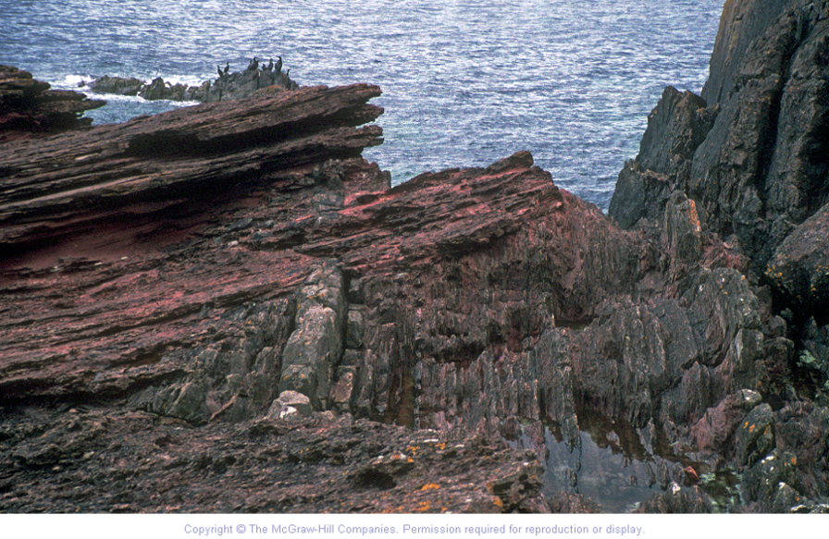
Observe the orientation of rocks at Siccar Point, Scotland
Red layers
Unconformity
Vertical, gray layers
09.00.a1
Notes:
INSTRUCTIONS TO STUDENTS
Observe the orientation of rocks at Siccar Point, Scotland
EXPLANATION
James Hutton realized that rock layers at Siccar Point required Earth to have a long history
Gray sandstone and shale layers are nearly vertical
Reddish sandstone and conglomerate are gently dipping
Contact between layers suggests rocks have very different geologic histories
Hutton used modern processes to interpret events that happened in Earth’s past; this is known as uniformitarianism

Slide 3
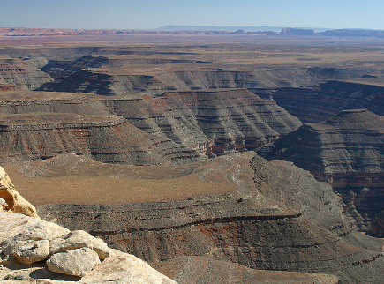
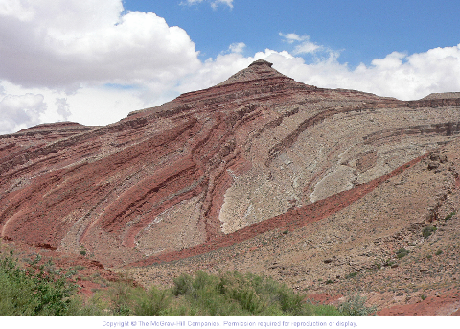
Observe the layers in these two photographs, which show the same sequence of rocks. What is different and what do you think happened?
Most sediment is deposited in horizontal layers
If layers are not horizontal, something has happened (deformation)
09.01.a
Notes:
MEDIA
0901a1_goosenecks_raplee.kml
INSTRUCTIONS TO STUDENTS
Observe the layers in these two photographs, which show the same sequence of rocks. What is different and what do you think happened?
OBSERVATION
Flat and more gray-green in left photo
Folded and more red in right photo
EXPLANATION
Left photograph: rocks deposited horizontally and remained nearly horizontal for 300 million years (Goosenecks, southern Utah)
Right photograph: no longer horizontal, but same rocks (San Juan River, Utah)

Slide 4

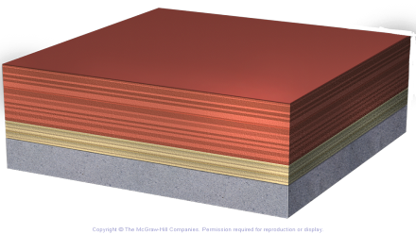
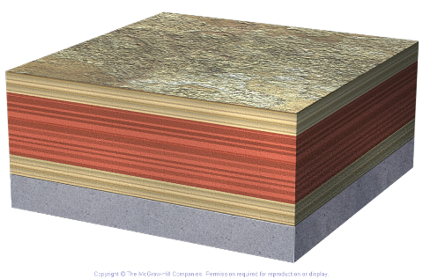
Younger Units Deposited on Older Units
Red layers deposited over tan
Tan sediment deposited over older rock
Third layer is youngest and is on top
09.01.a
Notes:
NOTES
Can use analogies, like yesterday’s mail is below today's in a stack of mail on your desk

Slide 5
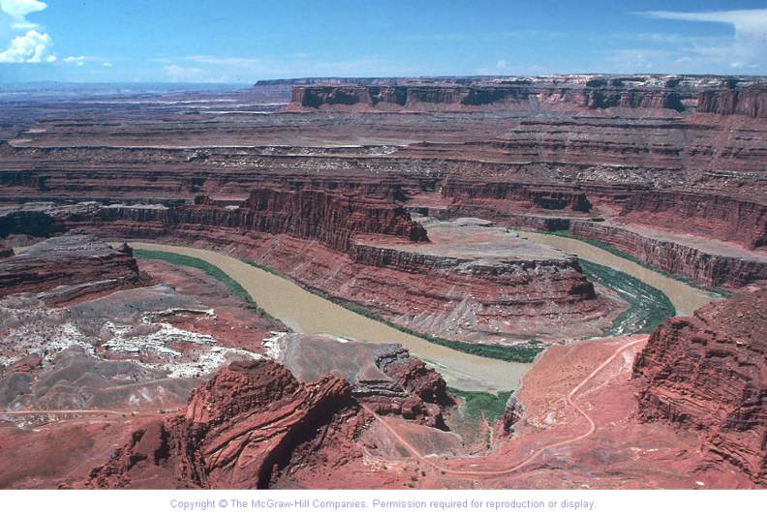
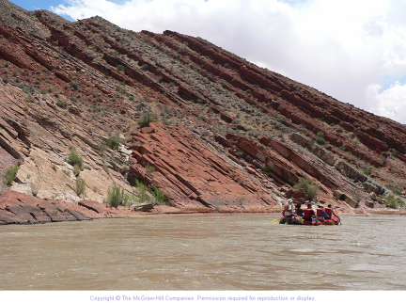
Highest layers are youngest layers in sequence
River deposits are youngest (not part of the layered sequence)
In the tilted layers below?
Lowest rock layers are oldest
Upper layers are youngest
09.01.a
Observe these layers. Which is oldest and which is youngest?
Notes:
MEDIA
0901a6_dead_horse_point.kml
INSTRUCTIONS TO STUDENTS
Observe these layers. Which is oldest and which is youngest?
Observe the second photograph. Which is oldest and which is youngest?
NOTES
Top: Colorado River from Dead Horse Point, Canyonlands, Utah
Bottom: Part of same rock sequence, Lime Ridge, Utah

Slide 6
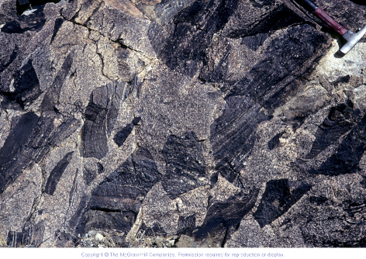
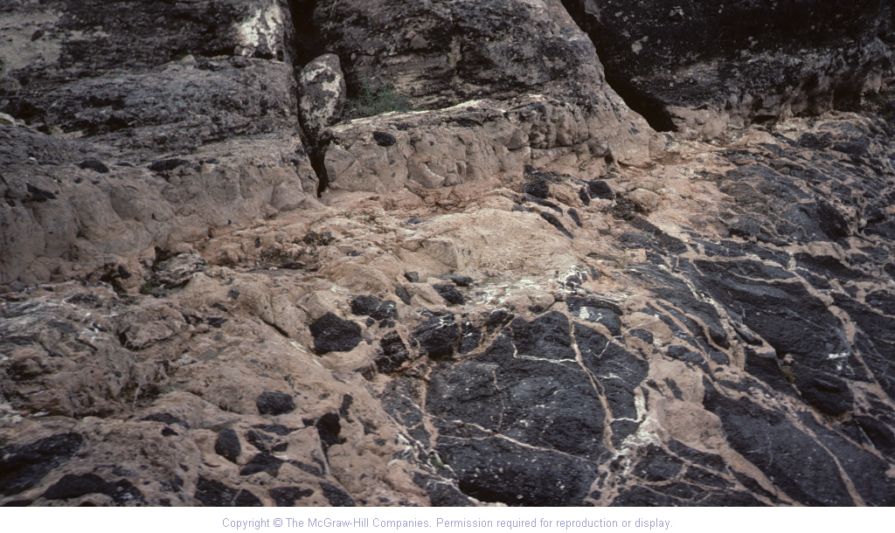
Younger Sediment or Rock Can Contain Pieces of Older Rock
Determine which part of the rock is older in each image
Gray granite
Conglomerate
Dark metamorphic rocks
Dark basalt
09.01.a
Notes:
INSTRUCTIONS TO STUDENTS
Determine which part of the rock is younger in each image
EXPLANATION
First photograph: light-colored granite contains dark-colored pieces of older metamorphic rocks that fell into granitic magma (Harcuvar Mountains, Arizona)
Second photograph: lower dark basalt contributed clasts to overlying tan, volcanic-ash-rich conglomerate (Lake Pleasant, Arizona)

Slide 7
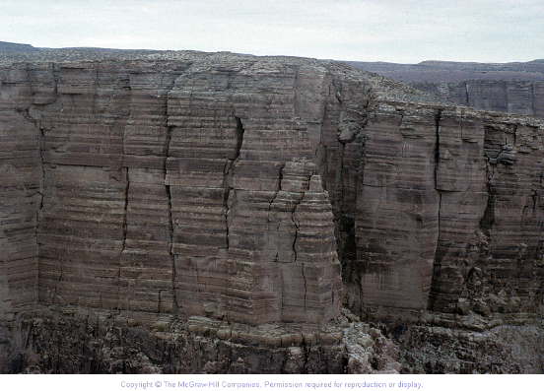
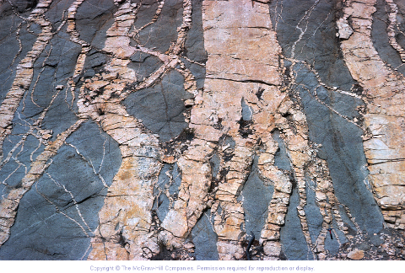
Younger Rock or Feature Can Crosscut an Older Rock or Feature
Determine which rock or feature is younger in each image
Limestone
Tan dikes
Fractures
Dark igneous rock
09.01.a
Notes:
INSTRUCTIONS TO STUDENTS
Determine which rock or feature is younger in each image
EXPLANATION
First photograph: fractures cut across (crosscut) the limestone layers (Little Colorado River, Arizona)
Second photograph: light-colored dikes of granite cross cut darker igneous rocks (Santa Catalina Mountains, Arizona)

Slide 8
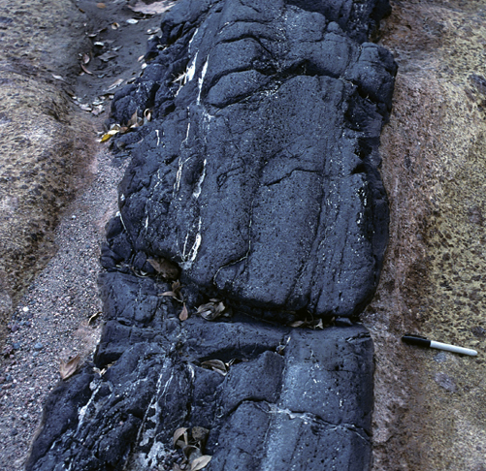
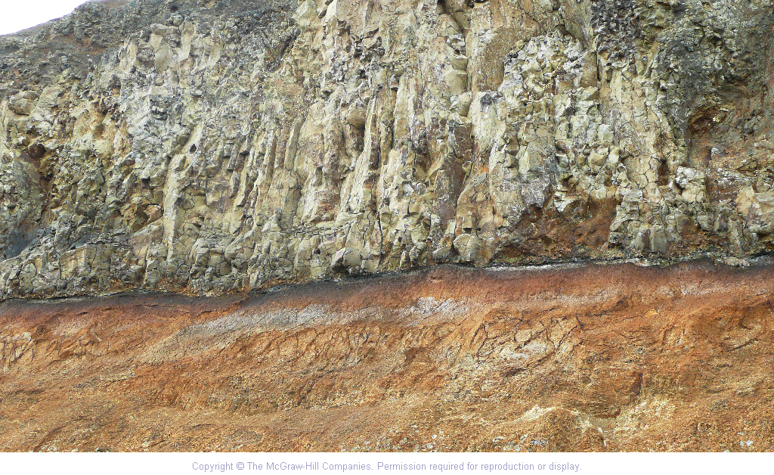
Younger Rocks and Features Can Cause Changes Along Contacts with Older Rocks
Observe the boundaries between different rock types
Gray conglom-erate
Lava flow
Dark dike
Older rock
Baking along contacts
Baking along base of lava flow (but not on top)
Sill can bake rocks below and above
09.01.a
Notes:
INSTRUCTIONS TO STUDENTS
Observe the boundaries between different rock types
EXPLANATION
First photograph: heat and fluids from magma affect an older conglomerate, forming baked zone along dike (Bloody Basin, Arizona)
Second photograph: collapse of volcanic dome sent hot ash downhill; heat baked and reddened older underlying rocks (Lewiston, Washington)

Slide 9
Steno’s Laws
Law of Original Horizontality
Law of Superposition
Law of Cross-cutting Relationships
  Younger sediment or rock can contain pieces of an older rock
  Younger rock or feature can cut across any older rock or feature
  Younger rocks and features can cause changes along their contacts with older rocks
Law of Faunal Succession

Slide 10
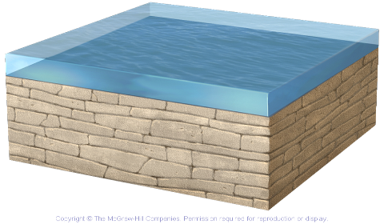
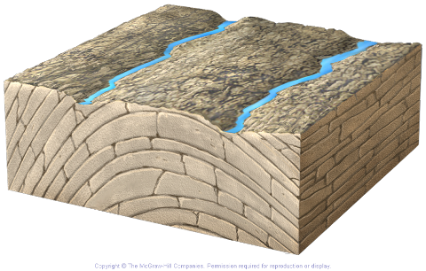
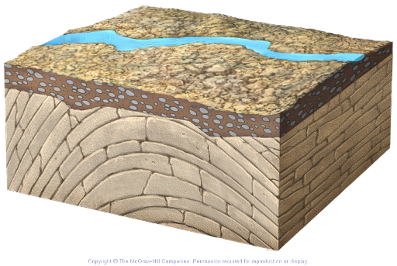
What Does an Unconformity Represent?
Limestone folded and later eroded by rivers
Deposit layers, like gray limestone
Sediment
deposited on
top of eroded
surface forming an
angular unconformity
Unconformity
09.03.a
Notes:
EXPLANATION
Unconformities represent intervals of time missing (no deposition) from a rock sequence
Limestone deposited under water
Sea withdraws and limestone beds are folded and beveled by erosion
New layer deposited on top, forming an unconformity (angular unconformity)

Slide 11
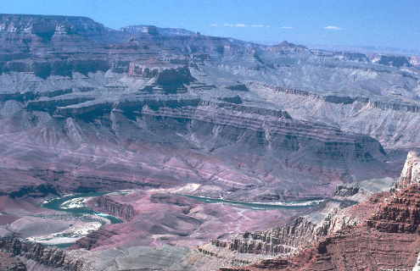
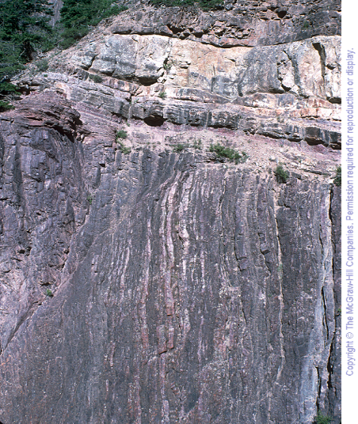
Identify the angular unconformity in each photograph
Rocks above unconformity
Unconformity
Rocks above unconformity
Rocks below unconformity
Unconformity
09.03.a
Rocks below unconformity
Notes:
INSTRUCTIONS TO STUDENTS
Identify the angular unconformity in each photograph
NOTES
Left: Grand Canyon, Arizona
Right: Box Canyon Falls, Ouray, Colorado

Slide 12
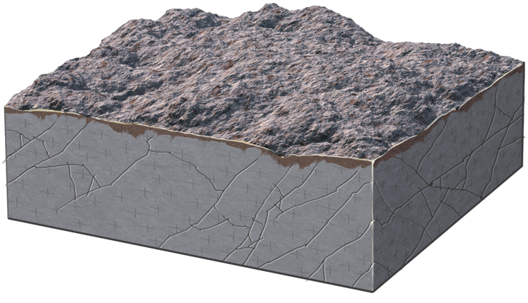
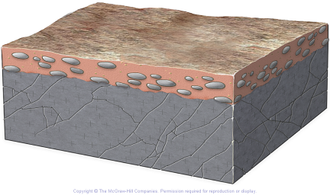
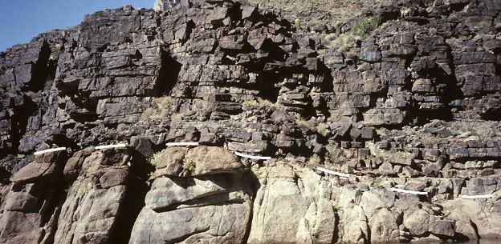
How Does a Nonconformity Form?
Nonconformity
Nonlayered
rock uplifted and eroded
Erosion
surface buried by sediment
Observe the nonconformity drawn on this photograph
Sandstone
Granite
09.03.b
Notes:
INSTRUCTIONS TO STUDENTS
Observe the nonconformity drawn on this photograph
NOTES
Photograph: Grand Canyon, Arizona
EXERCISE
Think about what the difference is between an angular unconformity and a nonconformity

Slide 13
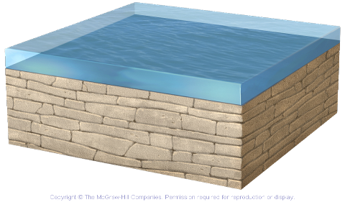
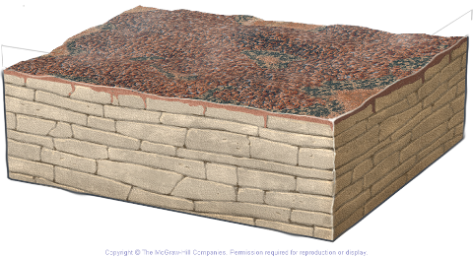
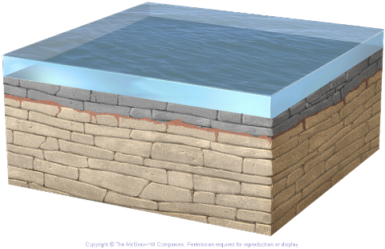
How Does a Disconformity Form?
Weathering erodes surface
Deposition of horizontal layers
Disconformity
Eroded surface
covered by later sediment
09.03.c
Notes:
EXPLANATION
If lower rock layers are not tilted before deposition above the unconformity, then the contact is a disconformity
Layers of limestone (in this case) deposited by sea
Rock exposed at surface; weathering and erosion affect surface
Sedimentation resumes, in this case a return of the sea
NOTES
The following slide is a photograph of two disconformities

Slide 14
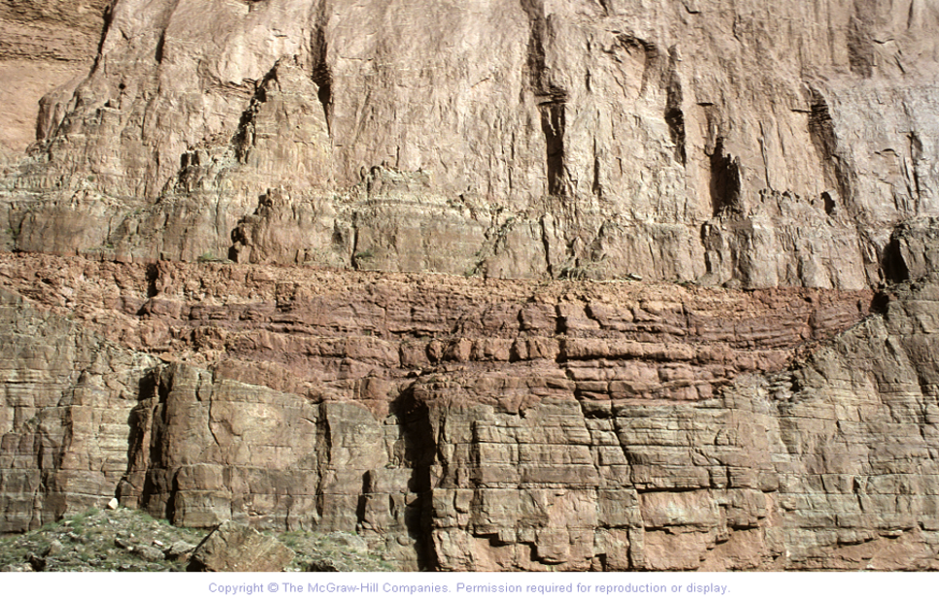
Observe two disconformities in this photograph
09.03.c4
Mississippian Limestone
Disconformity 2
Devonian Formation
Cambrian Limestone
Disconformity 1
Notes:
INSTRUCTIONS TO STUDENTS
Observe this photograph and identify two disconformities
NOTES
Photograph: Grand Canyon, Arizona

Slide 15
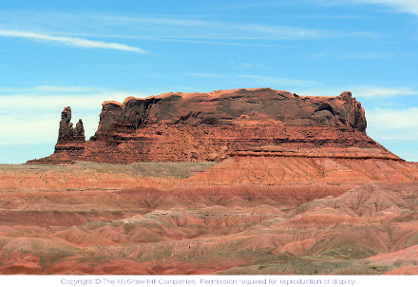
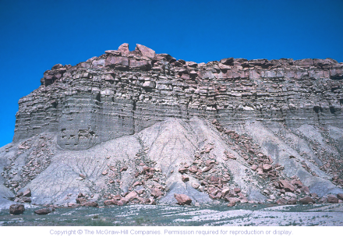
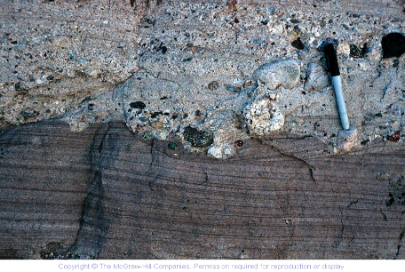
*Thickness of layers may indicate RATE of sedimentation
Thick layers
Thin layers
Gradational boundaries
Sharp boundaries
07.07.a
Notes:
INSTRUCTIONS TO STUDENTS
Observe characteristics of layers in sedimentary rocks
NOTES
Thick layers: Round Rock, Arizona
Thin layers: Green River Formation, Utah
Gradational: Shiprock, New Mexico
Sharp: Punchbowl, southern California

Slide 16
Reconstructing the history of an environment is complicated!
Unconformities mean we’re missing pages of the history book
Varying rates of deposition means thickness of layers =/= age
If deposition isn’t constant, how can we figure out how old the rocks are?

Slide 17
Absolute Dating Vs. Relative Dating

Slide 18
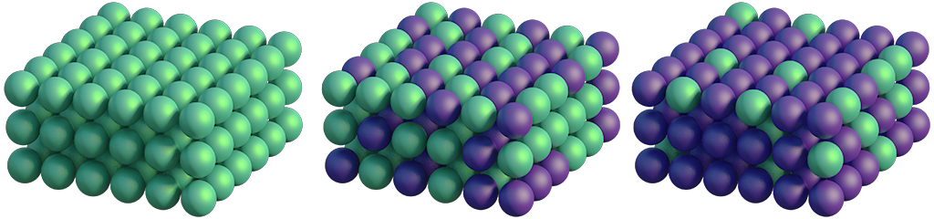
How Does Radioactive Decay Occur?
Before decay, unstable parent atoms
Half the parent atoms decayed to daughter atoms (time = half life)
After a second half life, only ¼ parent atoms remain
 | Before Any Decay | After One Half-Life | After Two Half-Lives
Atoms of Parent | 1,000 | 500 | 250
Atoms of Daughter | 0 | 500 | 750
Example for 1000 atoms
09.04.a
Notes:
EXPLANATION
Starting atoms are called parent atoms or parent isotopes; parent isotope will decay into different isotopes called the daughter product
At a later time, half the parent atoms (green) have decayed to daughter product (purple)
Amount of time it takes for half the parent atoms to decay is called a half life
After a time equal to another half life, half the remaining parent atoms have decayed to daughter product
NOTES
You may ask students to calculate how the numbers of parent and daughter atoms will change after even more half lives
If a large enough class, have all students stand up and flip a coin; heads stays up, tails sit down; count number of students remaining and then keep repeating process; demonstrates half life, randomness of decay, and exponential nature of radioactive decay

Slide 19
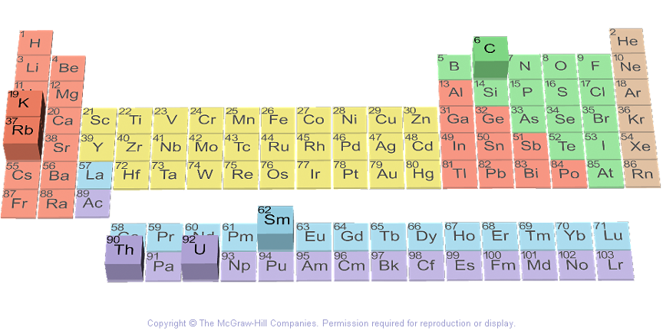
Common Radioactive Decay Series
Potassium (K) decays to argon (Ar)
Carbon-14 (C) decays to nitrogen (N)
Rubidium (Rb) decays to strontium (Sr)
Dating a rock by several methods
09.04.b,c
Thorium (Th) and uranium (U) decay to isotopes of lead (Pb)
Notes:
EXPLANATION
K-Ar and related Ar-Ar: used to date volcanic rocks and cooling of deep rocks
Rb-Sr: used to date old granites and metamorphic rocks and investigate seawater changes over time (last part not in book)
Carbon-14: used to date wood, charcoal, bones, etc; best suited for dating materials that are only hundreds to thousands of years old
Thorium and uranium: used mostly to date old rocks and to investigate sources of magma
Use several methods on a rock to determine when it formed and how fast it cooled (can date uplift of pluton)

Slide 20
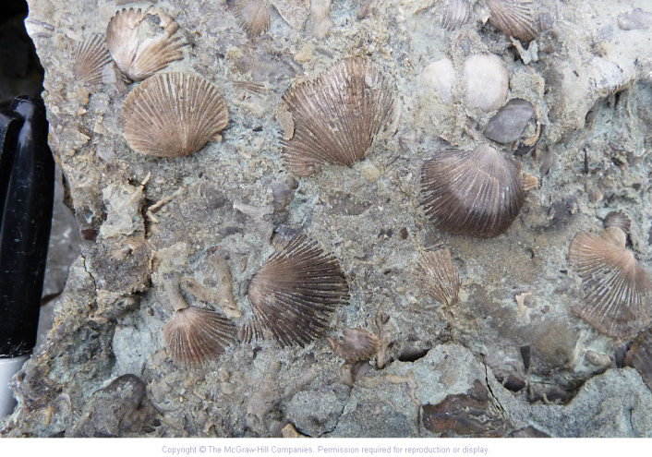
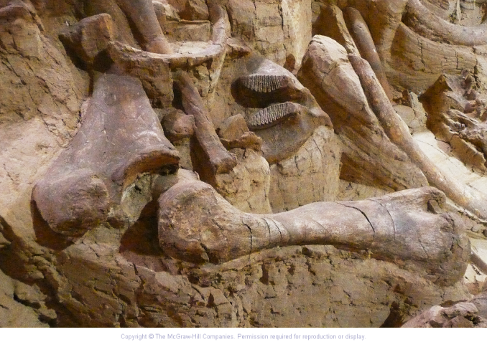
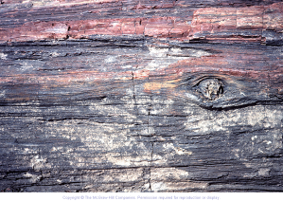
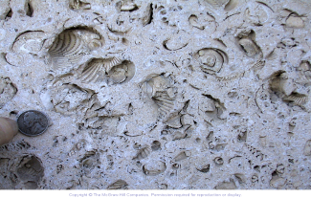
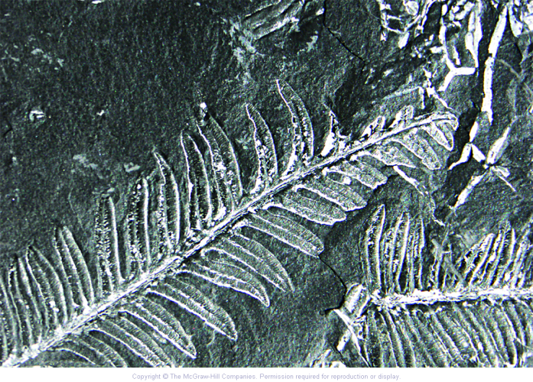
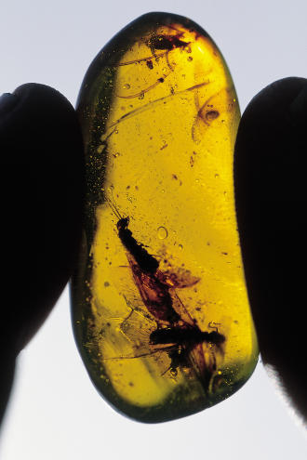
How Are Fossils Preserved?
Shells/hard parts
Bones
Replacement
Thin film of material
Cast or mold
Impressions
Amber
Constructed feature
https://www.youtube.com/watch?v=4-dTz416rYg
09.05.a
Notes:
EXPLANATION
Hard parts are easiest thing to preserve: stems of crinoids (Caesar Creek State Park, Ohio)
Bones are hard parts: most bones are found as fragments rather than complete skeletons (Hot Springs, South Dakota)
Replacement: fossil preservation when silica, pyrite, or some other material replaces original material (petrified wood) (Petrified Forest National Park, Arizona)
Cast or mold: Animal leaves a cavity in the rock that mimics its shape; if cavity is unfilled it is a mold (wall of geology building, UTEP, El Paso, Texas)
Thin carbon film: when buried, carbon-rich plants become thin films of carbon (300-million-year-old fern)
Impressions: fish and other soft creatures preserved as impressions, especially in quiet water
Amber: tree sap can trap insects
Constructed feature: some fossils do not preserve the actual organism, but do preserve something the organism constructed, like this stromatolite (Franklin Mountains near El Paso, Texas)

Slide 21
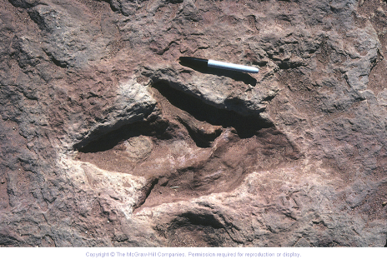
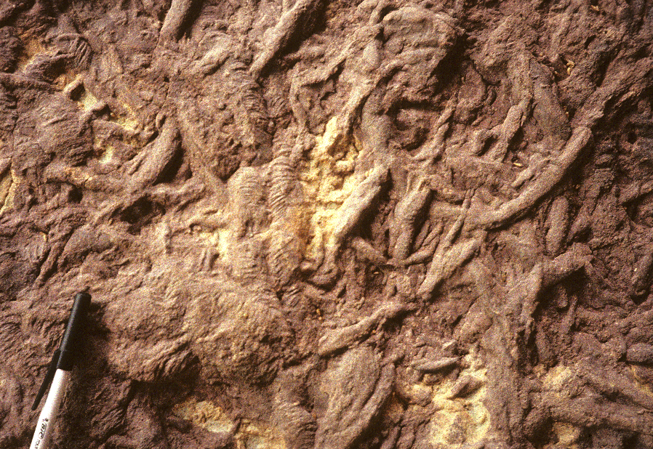
Traces of Creatures in Rock Record
Footprints
Burrows of worms, etc.
What are some aspects of a creature you could infer from a sequence of footprints?
How would you try to figure out what kind of creature made a particular kind of burrow?
09.05.b
Notes:
INSTRUCTIONS TO STUDENTS
Think about what you could infer about a creature from a sequence of footprints (Moenave, Arizona)
Think about how you would try to figure out what kind of creature make a particular kind of burrow (Grand Canyon, Arizona)

Slide 22
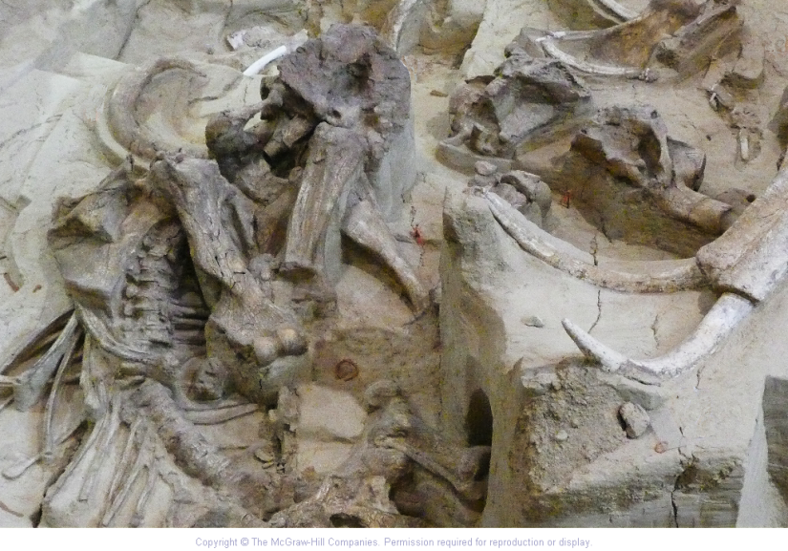
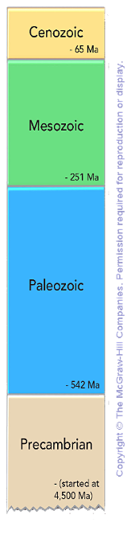
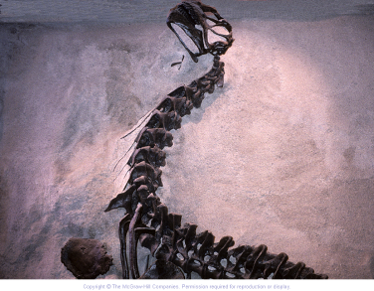
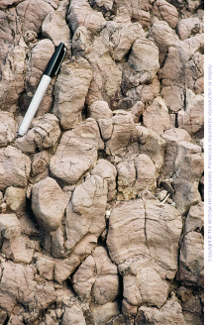
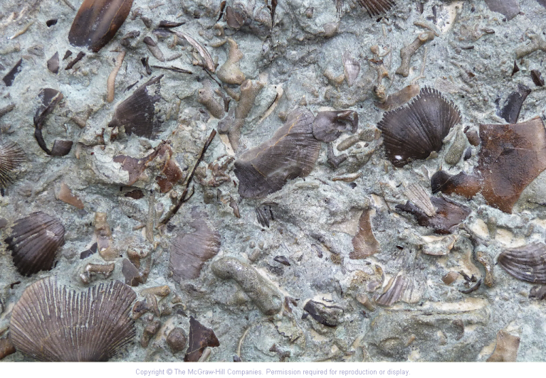
How Fossils Vary with Age
Dinosaurs and flowering plants
Mammals and grasses
Crinoids, coral, clams, certain fish, plants, insects, and amphibians
Simple creatures
and fossils,
such as stromatolites
09.06.a
Notes:
EXPLANATION
Cenozoic (recent life): mammals (such as this mammoth) became dominant type of life (Hot Springs, South Dakota)
Mesozoic (middle life): dinosaurs rose to dominance during this era (Dinosaur National Monument, Utah)
Paleozoic (ancient life): rise of major groups of marine animals, such as coral (Caesar Creek State Park, Ohio)
Precambrian (before the Cambrian): covers 90% of geologic time, but only simple life forms existed, such as bacteria and algae (Grand Canyon National Park, Arizona)

Slide 23
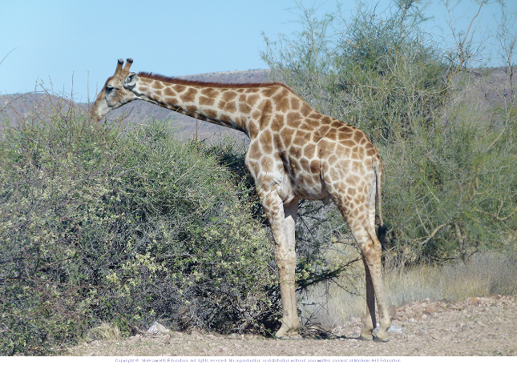
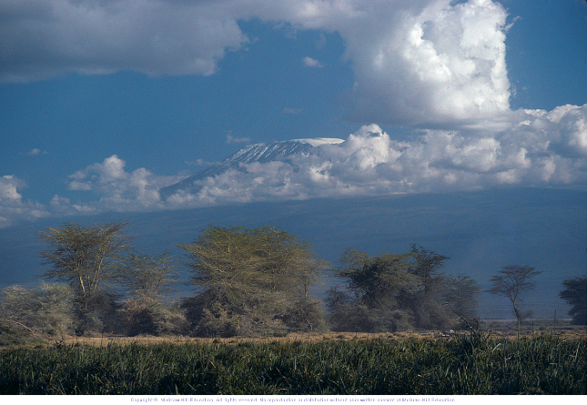
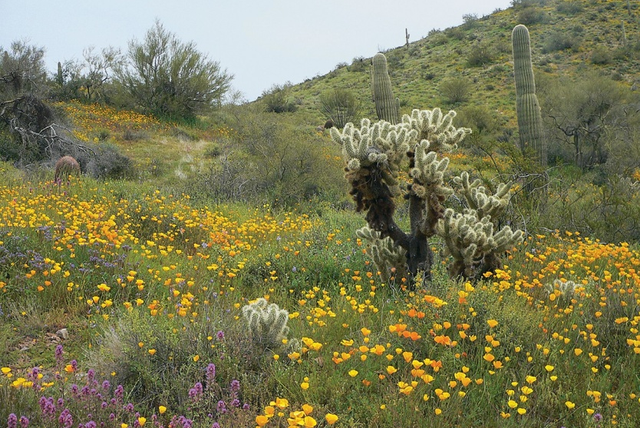
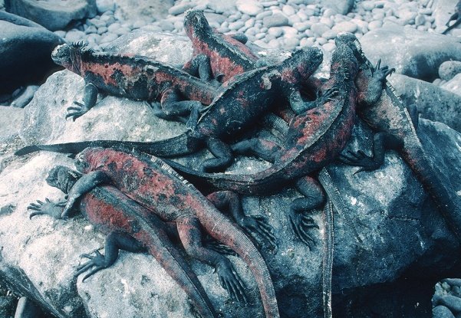
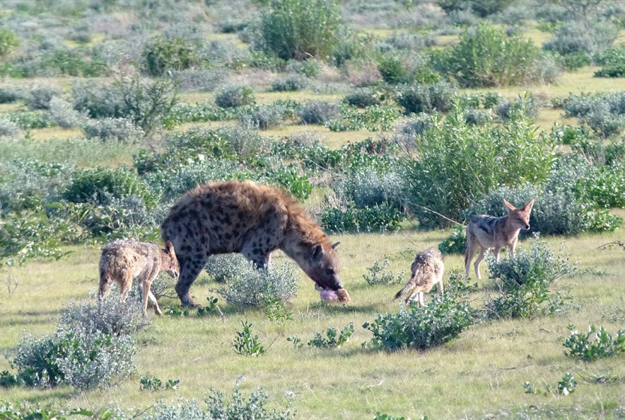
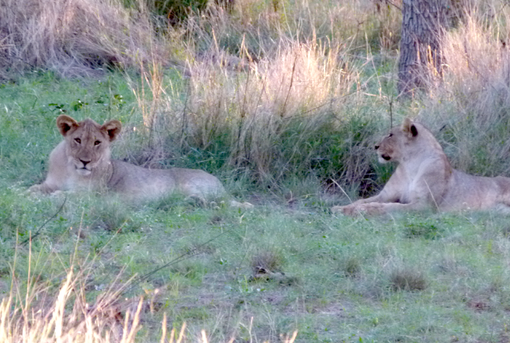
Factors that Influence Species Extinction
Environmental Setting
Overall Climate and Climate Change
Reproductive Strategy
Adaptability
Competition
Predators/Prey
04.05.b
Notes:
EXPLANATION
Environmental setting: living organisms have certain ways they live and certain survival needs
Climate: changes in climate can threaten a population of animals
Reproduction: involves the production of offspring of the same species
Adaptability: the more adaptable a species the more likely to survive changes to environment
Competition: can occur both within species and across species
Predation: usually occurs across species

Slide 24
Geologic Timescale
Boundary based on mass extinction (dinos and others)
Boundary based on major mass extinction called the Great Dying
Boundary based on widespread appearance of hard-shelled organisms
09.08.a1
Notes:
EXPLANATION
Timescale used to correlate rock units across countries and continents and to have standard vocabulary for describing time
Eras and Periods shown on this figure
Cenozoic now subdivided into Neogene and Paleogene

Slide 25
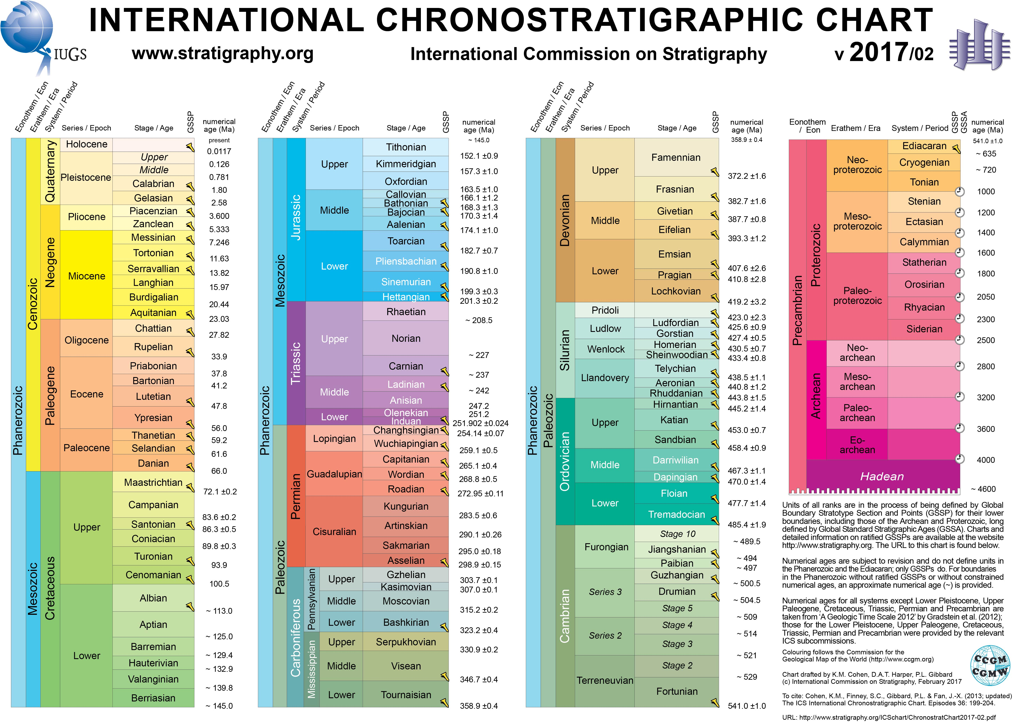

Slide 26
Assigning Numeric Ages to Timescale
Date a volcanic layer
Date clasts or a dike
Fossil-bearing layer
09.08.b
Notes:
EXPLANATION
A numeric age obtained for the volcanic layer can help constrain the ages of the sedimentary layers on either side of the volcanic unit
A fossil-bearing layer that is crosscut by a dike must be older than the dike
Obtaining numeric ages for the volcanic units above and below the fossil-bearing bed can bracket its age

Slide 27
Using Timescale to Assign Numeric Ages
Bracket using ages of fossils from geologic timescale
Use fossils and timescale to assign numeric age (like for this unconformity)
09.08.c
Notes:
EXPLANATION
Fossils can be assigned to a time period, and then the age for that period provides an estimate for the age of the fossil-bearing layer
Unconformity can be bracketed using fossils and the timescale to assign ages to rocks above and below the unconformity. For example the underlying rocks could have
Jurassic dinosaur fossils (160 Ma), whereas the overlying layer has Early Cenozoic mammal fossils (60 Ma), so unconformity is between 160 and 60 Ma.
Unconformity can be bracketed by assigning a numeric age to the granite, along with an age assigned to the fossils based on their position on the timescale.
Granite could be numerically dated at 80 Ma, whereas overlying fossil beds are Early Cenozoic (60 Ma), so unconformity formed sometime between 80 and 60 Ma.

Slide 28




Evidence that Earth’s History is Not Short
Seasonal layers in tree rings
Seasonal layers in varves (lake sediment)
Measured rates of modern plate movement are consistent with long-term rates
Seasonal layers in ice cores
09.09.b
Notes:
EXPLANATION
Tree rings record annual growth cycles; thickness patterns in bristlecone pine rings can be correlated from living trees to dead one to form
a continuous record back 9,000 years
Varves are alternating light- and dark-sediment that occur due to seasonal variations; the Green River Formation in Wyoming and Utah includes
million of varves, so the formation spans at least several million years
Current rates of plate motion indicate that the Atlantic Ocean took 100 million years to form as Africa and the Americas moved apart

Slide 29



Where Age of Earth Comes From
Age of meteorites
Dated Moon rocks
Oldest dates on Earth rocks
4.55 billion
4.5 billion
3.9 to > 4.0 b.y. (rock) to 4.3 b.y. (grains)
Data from astronomy on age of Solar System and Universe
09.09.t
Notes:
EXPLANATION
Meteorites analyses support formation of the solar system and earth between 4.53 and 4.58 billion years ago (Allende meteorite dated at 4.56 billion years old)
NOTE
Only the meteorite photograph and gneiss photograph are in section 9.9.

Slide 30
Important events in earth’s history

Slide 31




Early Events in Earth’s History
Impact Events
Greenstone Belts
Iron Formations
https://www.youtube.com/watch?v=UlUFPNKLukk
https://www.youtube.com/watch?v=JVboHupB8l0
Increase in Oxygen Over Times
04.08.b,c
Notes:
EXPLANATION
Impact events: material from space debris collided with Earth; collision rate decreased over time (Vredefort, South Africa)
Greenstone belts: metamorphosed lava flows common in the Archean (Noranda, Quebec, Canada)
Iron formations: changes in Earth’s atmosphere and oceans allowed iron to precipitate out of seawater (Sherman, Ontario, Canada)
Increase in oxygen: free oxygen first appeared about 2.3 to 2.4 billion years ago (Great Oxygenation Event); Second Oxygenation Event
occurred late in the Proterozoic, bringing oxygen levels to near modern-day levels

Slide 32



Precambrian Life
09.10.a,b
Stromatolites
Bacteria
Cambrian Explosion
Trilobites
Brachiopods
Notes:
EXPLANATION
Precambrian life
Stromatolites: earliest non-microscopic fossils identified on Earth, but created by microscopic creatures
Bacteria: about 2 billion years ago, bacteria had produced enough oxygen through photosynthesis to increase the amount of oxygen
in the atmosphere, thus providing a protective ozone layer
Cambrian explosion
Trilobites: had external skeletons and were extremely diverse in appearance
Brachiopods: Cambrian seas produced representatives of many marine groups

Slide 33



Life in the Paleozoic
Early Paleozoic
Middle Paleozoic
Late Paleozoic
09.10.c
Notes:
EXPLANATION
Early Paleozoic: corals, crinoids, mollusks, trilobites, snails, shelled creatures with tentacles
Middle Paleozoic: fish became diverse, insects appeared, plants included ferns and seedless trees
Late Paleozoic: amphibians and early reptiles evolve
NOTES
Paintings by Karen Carr

Slide 34




Life in the Mesozoic
Early Mesozoic: Triassic
Middle Mesozoic: Jurassic
Late Mesozoic: Cretaceous
09.11.a
Notes:
EXPLANATION
Early Mesozoic (Triassic): small dinosaur-like creatures, early mammals, seed-bearing conifers
Middle Mesozoic (Jurassic): dinosaurs diversified, seas flourished with ammonites, star fish, large marine reptiles
Late Mesozoic (Cretaceous): flying reptiles, flowering plants (angiosperms), turtles, plankton
NOTES
Paintings by Karen Carr

Slide 35


Life in the Cenozoic
Early Cenozoic
Late Cenozoic
09.11.c
Notes:
EXPLANATION
Early Cenozoic: bats, rodents, primates, sloths, whales, hoofed animals, marsupials, small horses
Late Cenozoic: first humans and familiar creatures
NOTES
Paintings by Karen Carr

Slide 36
Landscape Evolution

Slide 37






How a Typical Landscape Forms
Preexisting rock covered by sea
Sea deposits layer of sediment
Environment changes, depositing more rock
Deposition stops
Area eroded by rivers, etc.
Continued erosion
09.02.a
Notes:
EXPLANATION
Preexisting rock (metamorphic and igneous rocks) covered by sea
Layer of sediment deposited horizontally after retreat of sea
Environmental changes deposit a series of different layers
Deposition ceases; weathering and erosion begins
Erosion by rivers, streams, glaciers, etc.; in this case a small canyon formed by river erosion
River cuts downward, carving a deeper, wider canyon

Slide 38

Observe this photograph and consider the sequence of events that likely occurred
09.02.a6
Highest layers are youngest layers in sequence
Laccoliths in Henry Mtns. baked and domed the layers
Middle layers deposited next
Lowest rock layers are oldest
Erosion of canyon and deposition along river are youngest events
Notes:
MEDIA
0902a6_grand_view_point.kml
INSTRUCTIONS TO STUDENTS
Observe this photograph and consider the sequence of events that likely occurred
EXPLANATION
Older layers exposed in bottom of canyon deposited first
Younger layers above that with highest and youngest layers (on horizon) deposited last
All layers deposited and became hard rock; the layers were continuous across the entire area prior to erosion of canyon
Intrusions in Henry Mountains domed the rock layers and baked the nearby ones
Erosion of the canyon and deposition of river sediments the most recent event
River cut the canyon
NOTES
Canyonlands, Utah

Slide 39


Determining Ages of Landscapes
RECALL: Law of Superposition
Landscape surface younger than rocks on which it is carved
Landscape surface older than rocks deposited on top
09.02.b
Notes:
INSTRUCTIONS TO STUDENTS
What can you say about the age of the tilted layers relative to the upper horizontal layers?
What can you say about the age of the landscape relative to the age of the basalt?
EXPLANATION
Landscape surface is younger than tilted layers
Landscape surface is older than the basalt layer deposited on top of surface

Slide 40


Other Indications of Landscape Age
Most river
terraces formed
before erosion
down to present level
RECALL: Law of Cross-cutting Relationships
A surface with well-developed soil is older than one with a less developed soil
09.02.b
Notes:
EXPLANATION
Sometimes we must use features to infer ages, such as an older river terrace forming before river eroded down to present level
Well-developed soil indicates area older than area with little or no soil development; note that the soil is developed on a terrace

Slide 41

On this figure, geologic features are numbered in the order they occurred. Identify reasons why the units and
features are interpreted to have
formed in this relative order.
09.12.c1
Notes:
INSTRUCTIONS TO STUDENTS
Identify reasons why the units and features are interpreted to have formed in this relative order, with 1 being the oldest and 11 being the youngest
NOTES
You may have students do this exercise as an in-class assignment

