Slide 1
The Explosion
By PHILIP LARKIN

Slide 2
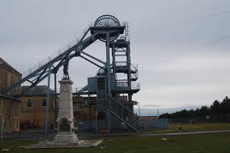
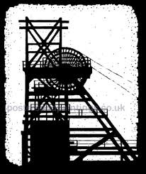
“Shadows pointed towards the pithead:”
Pithead: entrance to a coal mine.

Slide 3
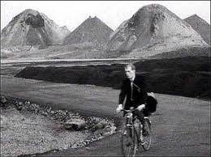
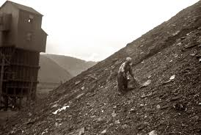
“In the sun the slagheap slept.”
Slagheap: Pile of debris. pile of waste matter from coal mining etc

Slide 4
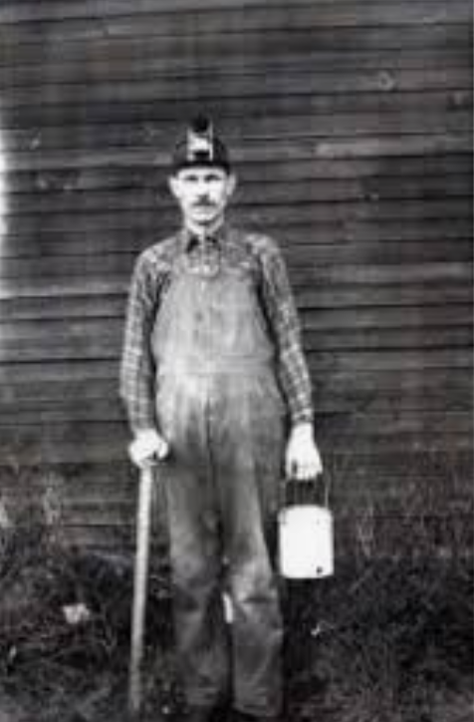
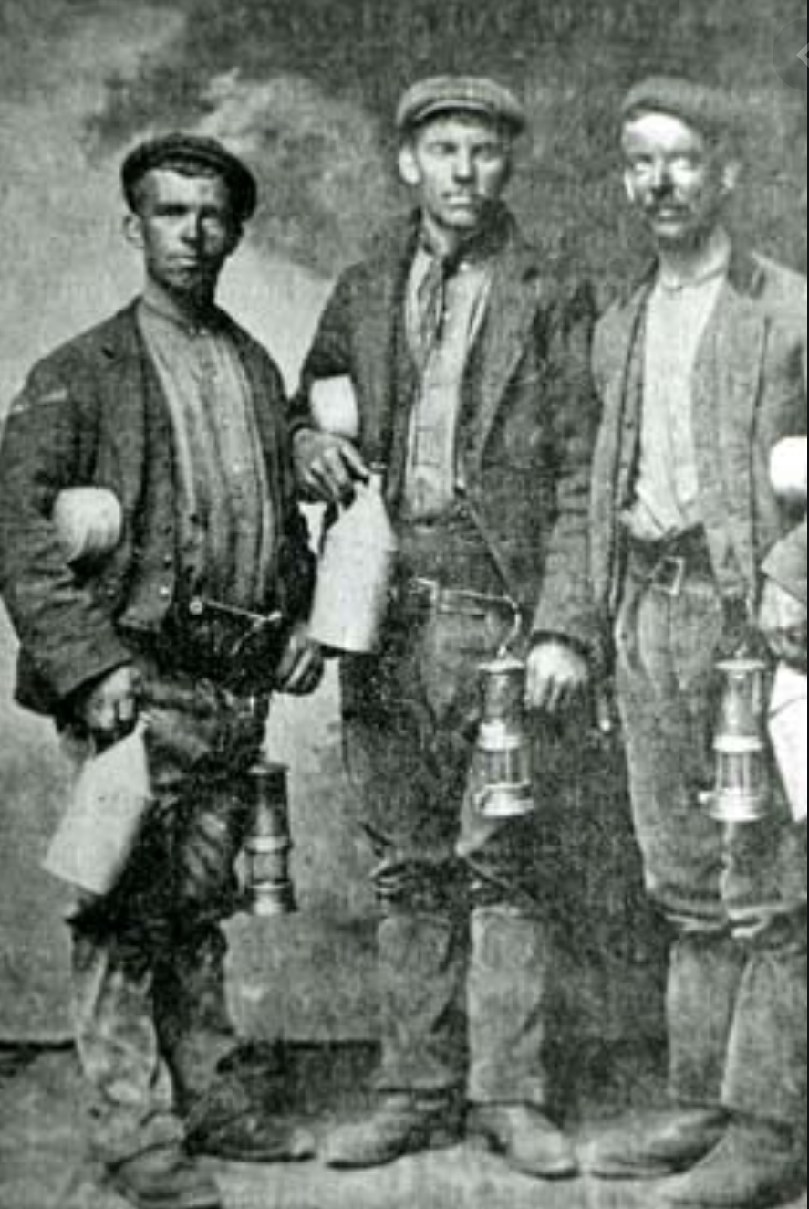
“So they passed in beards and moleskins,”
moleskins: work trousers made of hard-wearing heavy cotton fabric.
Clothes made of heavy, durable cotton fabric.

Slide 5
“At noon, there came a tremor; cows
Stopped chewing for a second; sun
Scarfed as in a heat-haze, dimmed.”
The momentousness of an earthquake and a solar eclipse recalls events reported at Christ’s crucifixion.
“sun/Scarfed”—could possibly mean solar eclipse…

Slide 6
Plot Summary
Stanza 1, 2, 3, 4 : poem opens on an ominous note “day of the explosion.” The unsuspecting
coal miners are walking (coughing, laughing, talking) toward the mines (where
they will die) and towards the slagheap (some kind of sleeping monster). One coal
miner finds some bird’s eggs and he throws them into the grass, breaking the
eggs. They move on thru the tall gates and into the mine.
Stanza 5: Explosion occurs at noon—with tremor and solar eclipse (“scarfed sun dimmed”)
Stanza 6: The poem shifts to the funeral of the miners at the chapel (church). We hear the
sermon predicting the resurrection of the miners in heaven and the reunion the
wives will have with the miners in heaven.
Stanza 7, 8: The wives have a VISION (without irony, literally—”plain as lettering on the
chapel”): they see the miners ALIVE AGAIN or reunited with them.
Stanza 9 (one line stanza): Reaffirms that the VISION is a real transcendent moment (did
happen/or will happen literally) because they see the coal miner with unbroken
eggs—they wouldn’t have known about that incident in the morning, about that
detail about broken eggs. [broken eggs plays double duty.]

Slide 7
Theme 1: Dread of extinction(death) COUNTERED BY epiphanic recognitions of transcendent and spiritual values
It is through the link with others (our humanity exists in our loving and compassionate relationship with others)
And therefore our existence can survive (death).

Slide 8
Theme 2: Celebrating family, community—a reprieve from the hopelessness of isolating, individualism
The poem celebrates family, marriage, camaraderie among men that transcends even DEATH.
The poem rejects “isolating individualism” that removes us from our connection to and place in the community.

Slide 9
Theme 3: VISION of IMMORTALITY—
Extraordinary vision that promises:
the grieving wives reunion with their husbands

