Slide 1
Ambulances
Philip Larkin

Slide 2
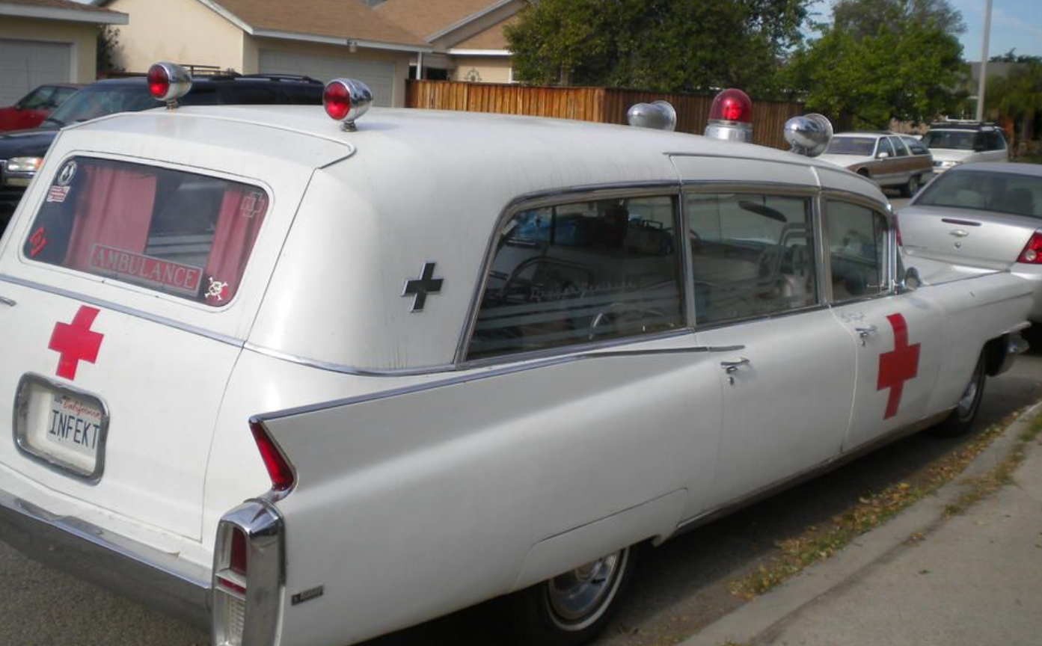
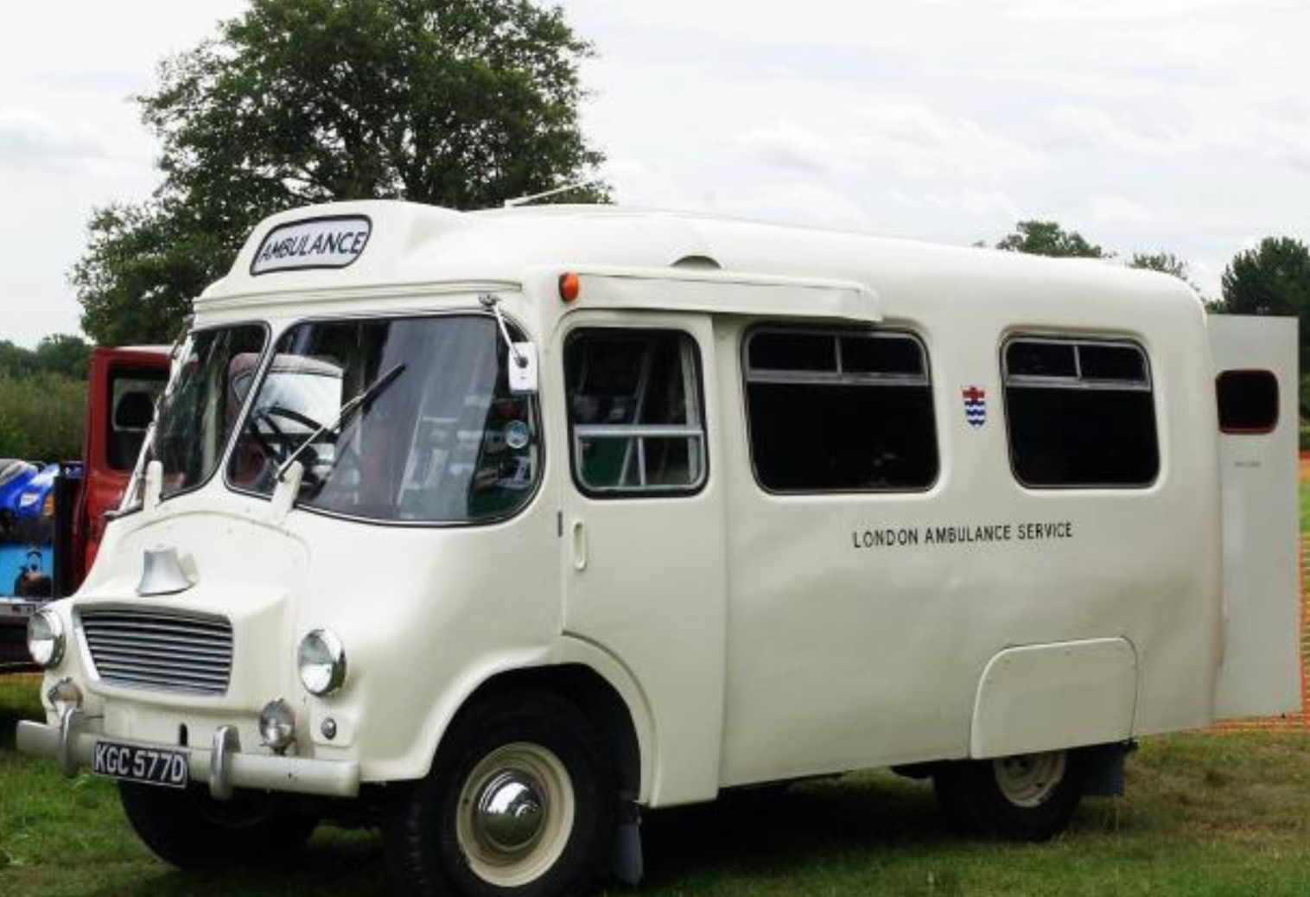
Ambulances from 1960s
London 1966
Ambulance

Slide 3
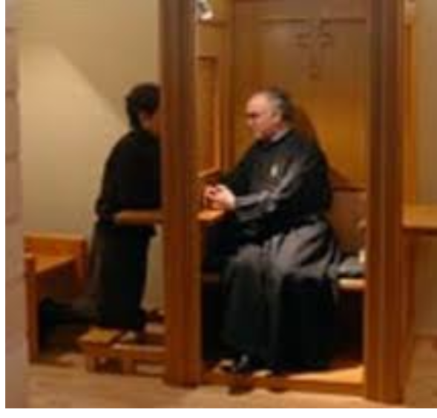
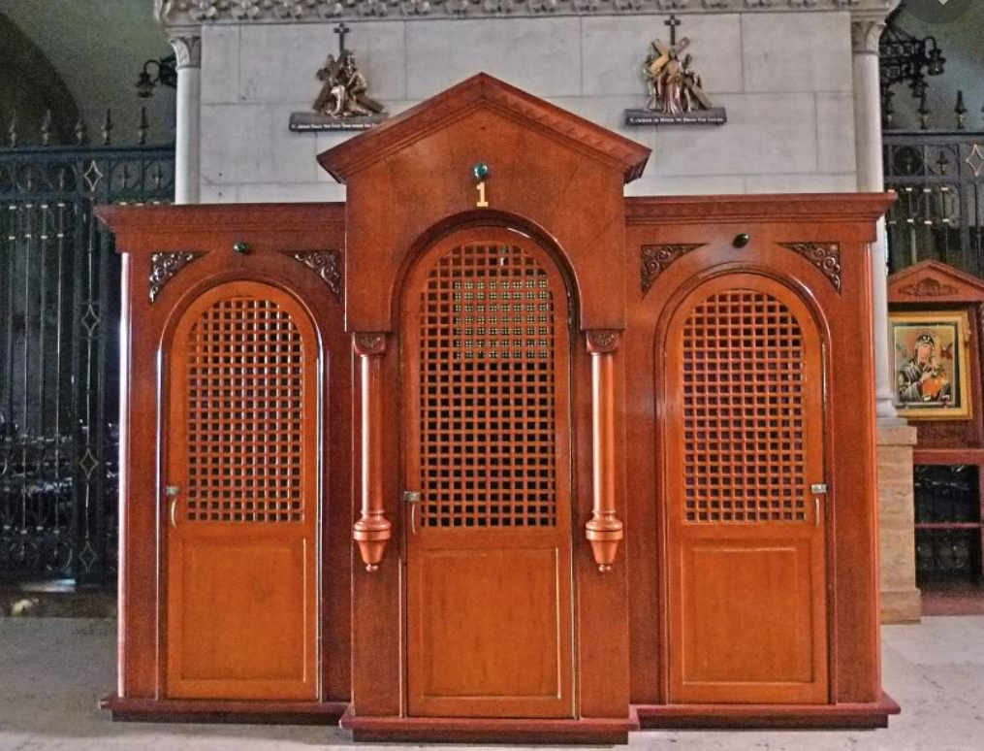
“Closed like confessionals, they thread”

Slide 4
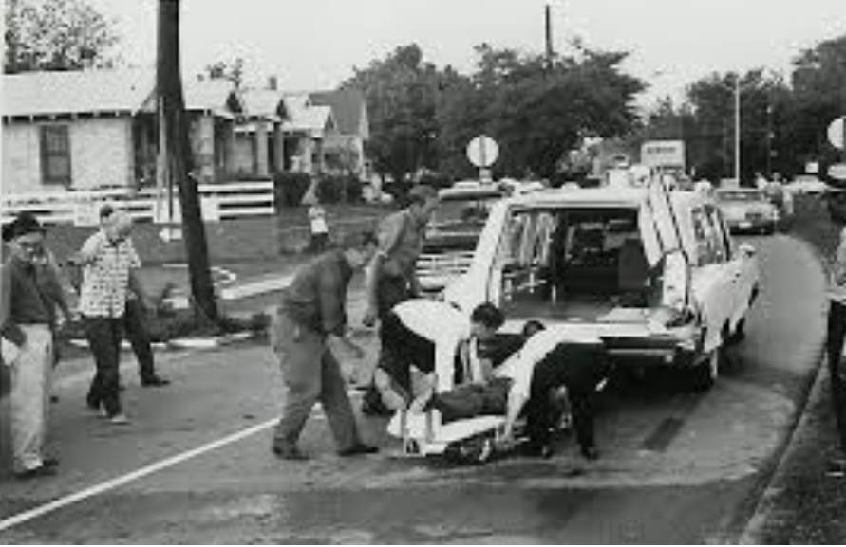
A wild white face that overtops/
Red stretcher-blankets momently/ as it is carried in and stowed,

Slide 5
Plot Summary: from unity with the community to isolation/dissolution that death brings.
Stanza 1: Ambulances compared to confessionals. Both don’t reveal their secrets.
Death in the midst of bustling life in the cities. No one can escape death.
Stanza 2: in the city, in the front of children and women and social gatherings like
dinners, the event of death takes place. The dying person experiences the
terror firsthand.
Stanza 3: Finality of death. Function of ambulances: to take the reality/horror of death
away(“fastened doors recede”) from the families and community.
Stanza 4: Event of death transforms us back into individuals separate from community/family
loosening, severing our ties (that we built over time) to our families, cutting us off.
Stanza 5: Isolated individual then transitions from being to non-being.

Slide 6
Theme 1: A poem on death in the secular age
The poem gives us a “secular” (non-religious) view of death and its impact on us.
Despite the word “confessionals” and the phrase “Poor soul” religion plays no role in the explication of death in the poem. There is no “soul”, no afterlife here in the poem. Only total extinction.
Finality of death is confirmed—death is: “emptiness”, “permanent”, “blank” “true”: death really is death and nothing else. And worse thing about it, it is unavoidable: “All streets in time are visited.”
What awaits us/present in our day to day lives is the “solving emptiness”: solving, perhaps, as in confirming utter destruction, dissolution of the “self” (person).

Slide 7
Theme 2: Death: separates the “self” that had cohered in the network of love, family and community
For it is only in the families and community that the “self” can experience
the “exchange of love”

Slide 8
Theme 3: Death reveals the truth about our existence: truth of “all we are”/ “all we do”
And sense the solving emptiness
That lies just under all we do.
all we do: everyday, ordinary reality of our lives
Brings closer what is left to come,
And dulls to distance all we are.
all we are: NATURE OF OUR EXISTENCE: what defines our existence
  our existence only has a semblance of meaning when we are part of community/family where “exchange of love” is possible.

