Slide 1
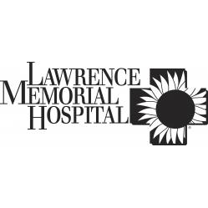
Lawrence Memorial Hospital in Lawrence, KS.

Slide 2
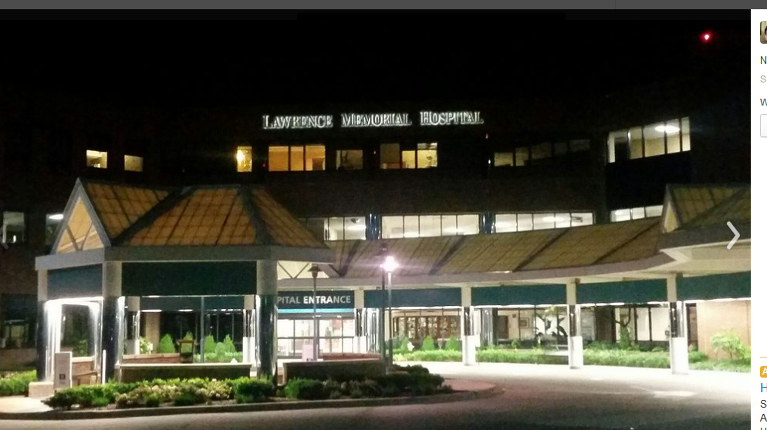
Lawrence Memorial Hospital’s Location
Lawrence Memorial Hospital in Lawrence, Kan. is a general medical and surgical facility

Slide 3
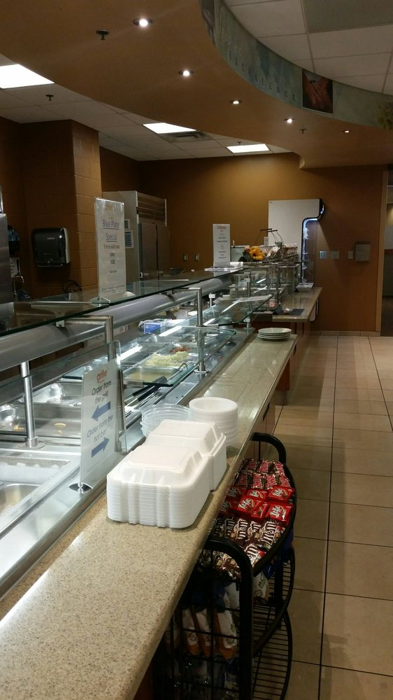

Slide 4
The main entrance parking lot in itself although spacious, it tends to be full all the time
The handicap parking is sparse. they could stand to create more for people who have difficulties in walking or are wheelchair bound
This hospital is clean and the layout is actually pretty simple and easy to move around
There are only 4 floors in this hospital, 1 cafeteria, 1 coffee bar, 1 gift shop and one cancer treatment wing

Slide 5
LMH’s Competitive Market
LMH is recognized as a top 100 hospital in the United States because it:
Has a lower mortality index considering patient severity
Has fewer patient complications
Avoids adverse patient safety events
Follows accepted care protocol
Has lower mortality and 30-day readmission rates
Keeps expenses low
Sends patients home sooner
Scores better on patient satisfaction surveys

Slide 6
LMH received an overall composite score in the 93.5 percentile, which means it’s continuously improving – and improving at a faster rate than 93.5 percent of all medium-sized community hospitals in the U.S
The medium-sized community hospital category is the largest of the five categories in the 100 top hospitals study, which makes it the most competitive: after being compared to roughly 1,000 similar hospitals
LMH emerged in the category’s top 20 hospitals

Slide 7
LMH’s Service Lines
Lawrence Memorial cardiology specialists are expertly working everyday in diagnosing and treating heart conditions
From heart disease prevention and risk assessments to life-saving procedures and cardiac rehabilitation, LMH is dedicated to helping you and your loved ones prevent and fight heart disease
LMH has a cardiac rehabilitation program that's nationally certified by the American Association of Cardiovascular and Pulmonary Rehabilitation
LMH also provide emergency heart care with our board-certified cardiologists
They have performed thousands of life-saving procedures with excellent outcomes for heart attack and heart failure patients

Slide 8
LMH’s business segment
Lawrence Memorial Hospital operates as a community hospital that provides health and wellness services for the people of Lawrence and the extended community in Kansas
It offers services in the areas of cardiology, endocrinology, vein disorders treatment, neurology, oncology, orthopedics, primary care, pulmonology, surgery, therapy, wound healing center, and women's health services
The company also offers educational programs, such as fitness programs, health screenings, healthy living programs, parenting programs, pregnancy and childbirth programs, safety classes and programs, special events, support groups, and wellness classes for the community, businesses, and patients

