Slide 1
Types of Luminaires
Student’s Name
Institutional Affiliation

Slide 2
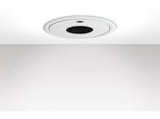
A recessed luminaire
A recessed luminaire is mounted into a hollow opening in a ceiling.
It has the appearance of a practically continuous surface consisting of one or more translucent panels behind which light source are placed.
When installed it look as if it has light shining from a hole in the ceiling, concentrating the light in a downward direction as a broad floodlights or narrow spotlights.
The recessed luminaires offer the opportunity to transform general lighting into something special, a solution that combines efficient performance with ultra-smooth styling
Generally, they enhance the look and feel of the space and help to create a positive corporate image by their outstanding aesthetics as well.

Slide 3
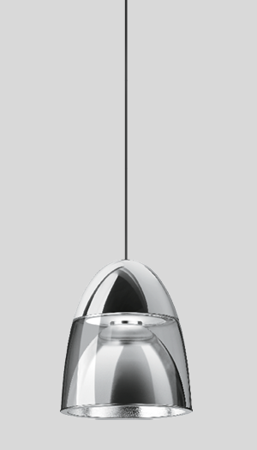
Pendent luminaire
Pendent luminaire hangs from the ceiling normally suspended by a chain, a metal rod or a cord.
They provide economical ambient lighting with high visual comfort and are seen as succinct architectural details.
In most cases, pendent luminaires have a drawbar which makes the luminaire height adjustable.
They are often used to highlight particular areas or focal points in a room but also in situations where the luminaire itself assumes the role of an architectural element.
They provide uniform light distribution, drive performance and improve productivity in the workspace.

Slide 4
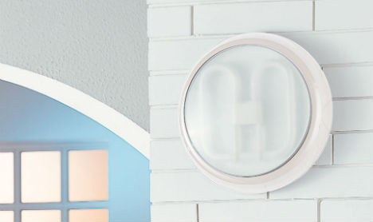
Wall mounted luminaires
The wall mounted luminaires are usually defined by their types of installation and not by their light characteristics.
Different light distributions are possible like the wide-beamed, narrow-beamed, symmetrical or asymmetrical in various directions.
The wall mounted luminaires can perform many different tasks.
For instance, the ceiling wash lights provide an illumination of the ceiling with a high degree of uniformity.
Up lights are designed for optimum efficiency and light distribution. As such, they are perfect for economical indirect lighting .
Floor wash lights are designed to provide safe illumination of traffic routes.

Slide 5

Ceiling mounted luminaire
The ceiling mounted luminaire are designed to emit both accent and general lighting while obscuring the body of the device thus allowing only the light to be exposed.
This design can be used to change the backgrounds by adding subtle or dramatic contrasting effects.
They use less energy as compared to the fluorescent lights.
They also easy to install, last longer and are maintenance free.

Slide 6
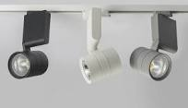
Track luminaires
Track luminaires are mounted anywhere on a continuous track device which has electrical conductors.
They allow the user to direct light in any shape or form
They can be fixed to the ceilings or walls, lengthwise down beams, or crosswise across beams or rafters.
They can as well be suspended using rods from high places like vaulted ceilings.
The track may have more than one live conductor so that many switched circuits can be used to control different fittings on the same track.
When this is the case, the installers will have to place the tab of the connector on the fixture to one side or the other when fixing it to the track.

Slide 7
References
http://www.waclighting.com/sites/waclighting.com/files/product/specsheet/WTK-4023_SP_122717_0.pdf
https://www.bygmax.dk/media/files/134612/56614.6.db.en.pdf
https://www.assets.lighting.philips.com/is/content/PhilipsLighting/fp912401483183-pss-en_gb
file:///C:/Users/DELL/Desktop/Ceiling-Mount-Luminaire.pdf
https://products.currentbyge.com/sites/products.currentbyge.com/files/documents/document_file/IND302-Lumination-LAL-Series-Spec-Sheet.pdf

