Slide 1
Protective Gear

Slide 2
Analysis
Skateboard Helmets
Mouth Guard
Safety Pads

Slide 3
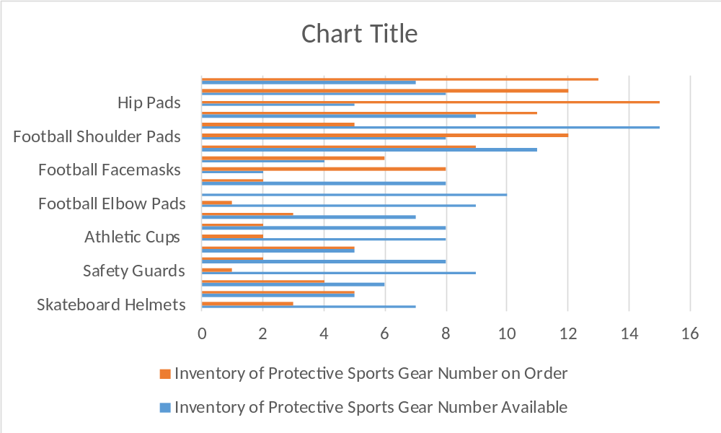
Linked Excel Chart
.
Shaped
object

Slide 4
Protection
FIRST!

