Slide 1
Lecture 09

Slide 2
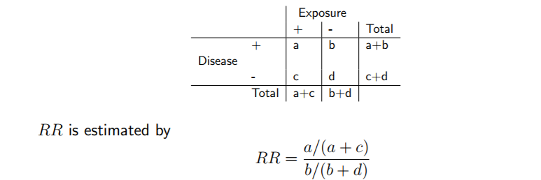
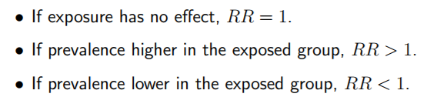
Relative Risk
In a prospective study we gain information about the prevalence of the disease in the two groups.
The ratio of the probability of a disease in two groups, often denoted ‘exposed’ and ‘unexposed’ is the relative risk.

Slide 3
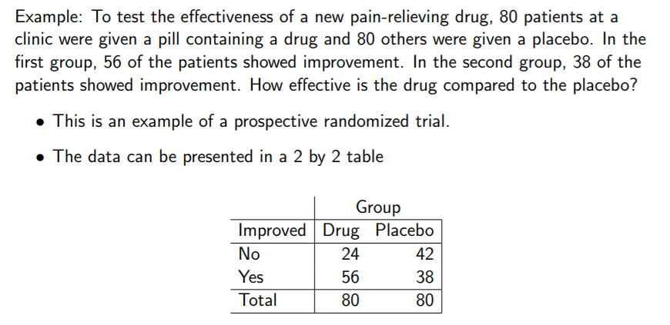

Relative Risk

Slide 4
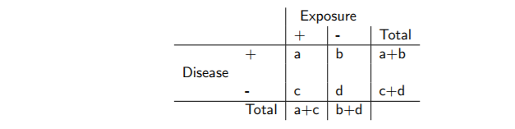
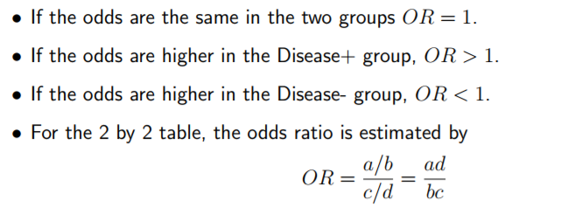
Odds Ratio
In retrospective studies, samples are taken for those affected and unaffected by a disease, and their exposure to a factor recorded.
Once again, the data can be arranged in a 2 by 2 table

Slide 5
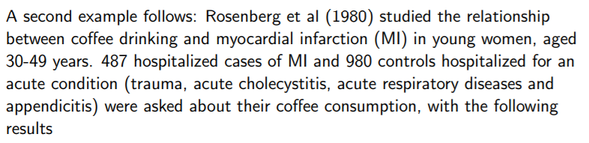
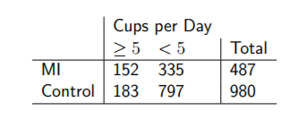

Slide 6
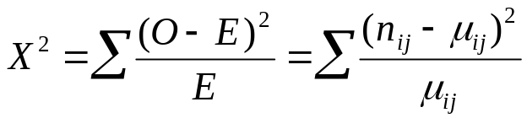
TESTS OF INDEPENDENCE:
Pearson Chi-Square test
Y
X
Level 1
Level 2
Level 1
Level 2
n₁₁
n₂₁
n₁₂
n₂₂
n₁₊
n₂₊
n₊₁
n₊₂
n
Frequency
Pearson Chi-squared Statistic
Under H0:
μ₁₁=(n₊₁n₁₊)/n
μ₁₂ =(n₁₊n₊₂)/n
μ₂₁ =(n₊₁n₂₊)/n
μ₂₂ =(n₊₂n₂₊)/n
With large sample size, it has a Chi-square distribution with df =(I-1)(J-1)

Slide 7
Chi-square Degrees of freedom
df = (r-1) (c-1)
    Where r = # of rows, c = # of columns
    Thus, in any 2x2 contingency table, the degrees of freedom = 1.
    As the degrees of freedom increase, the distribution shifts to the right and the critical values of chi-square become larger.

Slide 8
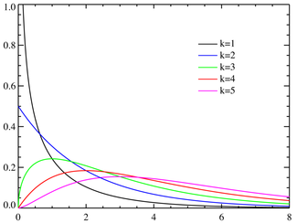

Chi-Square Test of Independence

Slide 9
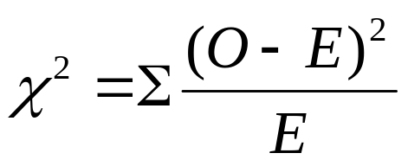
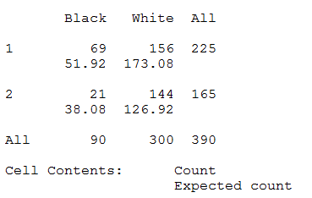
Example:
Approval for a new bill by Race
 | Black | White | Total
Approve | 69 | 156 | 225
Disapprove | 21 | 144 | 165
Total | 90 | 300 | 390
O is what we observe from our sample, the observed frequency. NOTE that χ² works with frequencies in each cell.
E is the expected frequency, the number of people who would show up in each cell IF the null hypothesis were true.

Slide 10

Step 1. Hypothesis:
H₀: The Decision and the race are independent
H₁: H₀ is false.
Step 2. The Distribution:.
Since we are interested in the effect of one nominal variable on another nominal variable the χ² distribution is appropriate -- we are doing a row by column [2X2] analysis.
Step 3. Level of Significance:
Set alpha at .05 for 95% confidence. Or any other alpha value.
Step 4. Determine Critical Value of χ²:
The chi square distribution changes shape by degrees of freedom, just as does the t distribution. Degrees of freedom change as a function of the number of comparisons made.
Look up our critical value of α = 0.05 in Chi Square table at 1 df. Find that the value is 3.84 or from R

Slide 11
Chi square test by hand?
Step 5. Decision: Let's fill in the table:
 | Black | White | Total
Approve | 69 | 156 | 225
Disapprove | 21 | 144 | 165
Total | 90 | 300 | 390
 | O | E | (O-E) | (O-E)² | (O-E)²/E
n₁₁ | 69 | 51.92308 | 17.07692 | 291.6213 | 5.61641
n₁₂ | 156 | 173.0769 | -17.0769 | 291.6213 | 1.684923
n₂₁ | 21 | 38.07692 | -17.0769 | 291.6213 | 7.658741
n₂₂ | 144 | 126.9231 | 17.07692 | 291.6213 | 2.297622
 |  |  |  | Sum = | 17.2577
 |  |  |  | df = | 1

Slide 12
Chi square test by R?
> race <- matrix(c(69, 156, 21, 144), 2, byrow = T)
> race
[,1] [,2]
[1,] 69 156
[2,] 21 144
> chisq.test(race)
Pearson's Chi-squared test with Yates' continuity correction
data: race
X-squared = 16.2619, df = 1, p-value = 5.516e-05
> chisq.test(race, correct = F)
Pearson's Chi-squared test
data: race
X-squared = 17.2577, df = 1, p-value = 3.264e-05

Slide 13
Step 6. Interpret:
The Chi Square value of 17.26 is way beyond the critical value of 3.84.
Therefore reject the null hypothesis of independence.

Slide 14
Fisher’s Exact Test
Fisher’s Exact Test is a test for independence in a 2 X 2 table. It is most useful when the total sample size and the expected values are small. The test holds the marginal totals fixed and computes the hypergeometric probability that n₁₁ is at least as large as the observed value
Useful when E(cell counts) < 5.

Slide 15
Fisher’s Exact Test
> fisher <- matrix(c(9, 4, 3, 9), 2)
> fisher
[,1] [,2]
[1,] 9 3
[2,] 4 9
> fisher.test(fisher)
Fisher's Exact Test for Count Data
data: fisher
p-value = 0.04718

