Slide 1
Lecture 11
Introduction to Multiple regression

Slide 2
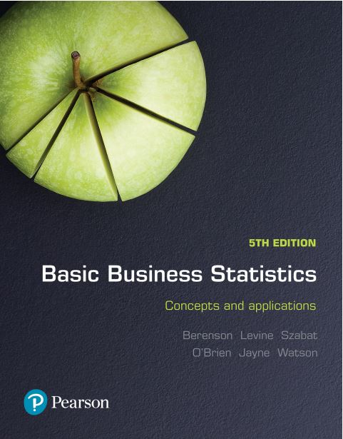
Basic Business Statistics
Concepts and Applications, 5th edition
Chapter 13
Introduction to multiple regression
Copyright © 2019 Pearson Australia (a division of Pearson Australia Group Pty Ltd)
9781488617249 / Berenson / Basic Business Statistics, 5e

Slide 3
Learning Objectives
After studying this Chapter you should have a better understanding of:
How to develop a multiple regression model.
How to interpret the regression coefficients.
How to use categorical variables in a regression model.

Slide 4
The Multiple Regression Model
Idea: Examine the linear relationship between
1 dependent (Y) & 2 or more independent variables (X_{i}).
Multiple Regression Model with k Independent Variables:
Y-intercept
Population slopes
Random Error

Slide 5
Multiple Regression Equation
The coefficients of the multiple regression model are estimated using sample data.
Multiple regression equation with k independent variables:
Estimated (or predicted)
value of Y
Estimated
intercept
Estimated
slope coefficients
$${\hat{Y}}_{i}=\hat{β}\text{0}+\hat{β}\text{1}X_{\text{1}\text{i}}+\hat{β}\text{2}X_{\text{2}\text{i}}+…+\hat{β}\text{k}X_{\text{ki}}$$
In this chapter we will always use Excel to obtain the regression slope coefficients and other regression summary measures.

Slide 6
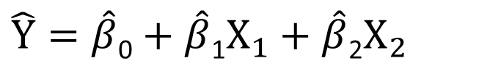
Multiple Regression Equation
Two variable model
Y
$$\hat{Y}=\hat{β}\text{0}+\hat{β}\text{1}X_{1}+\hat{β}\text{2}X_{2}$$
Slope for variable X₁
X₂
Slope for variable X₂
X₁

Slide 7
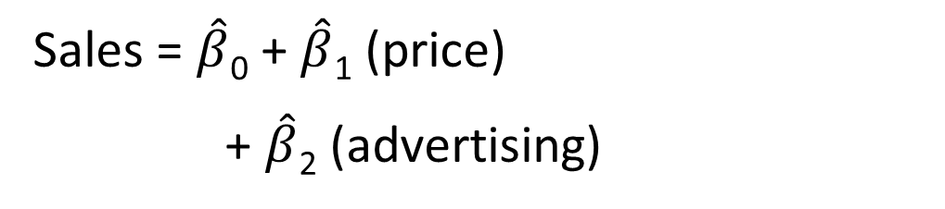
Pie Sales Example
Week | Pie Sales | Price ($) | Advertising ($100s)
1 | 350 | 5.50 | 3.3
2 | 460 | 7.50 | 3.3
3 | 350 | 8.00 | 3.0
4 | 430 | 8.00 | 4.5
5 | 350 | 6.80 | 3.0
6 | 380 | 7.50 | 4.0
7 | 430 | 4.50 | 3.0
8 | 470 | 6.40 | 3.7
9 | 450 | 7.00 | 3.5
10 | 490 | 5.00 | 4.0
11 | 340 | 7.20 | 3.5
12 | 300 | 7.90 | 3.2
13 | 440 | 5.90 | 4.0
14 | 450 | 5.00 | 3.5
15 | 300 | 7.00 | 2.7
A distributor of frozen dessert pies wants to evaluate factors thought to influence demand.
Dependent variable: pie sales (units per week)
Independent variables:
advertising ($100s), price (in $).
Data are collected for 15 weeks.
Multiple regression equation
Sales = $\hat{β}$₀ + $\hat{β}$₁ (price)
+ $\hat{β}$₂ (advertising)

Slide 8
Multiple Regression Output
Regression Statistics
Multiple R |  | 0.72213
R Square |  | 0.52148
Adjusted R Square |  | 0.44172
Standard Error |  | 47.46341
Observations |  | 15
ANOVA |  | df | SS | MS | F | Significance F
Regression |  | 2 | 29460.027 | 14730.01 | 6.53861 | 0.01201
Residual |  | 12 | 27033.306 | 2252.776
Total |  | 14 | 56493.333
 | Coefficients |  | Standard Error | t Stat | P-value | Lower 95% | Upper 95%
Intercept |  | 306.52619 | 114.25389 | 2.68285 | 0.01993 | 57.58835 | 555.46404
Price |  | -24.97509 | 10.83213 | -2.30565 | 0.03979 | -48.57626 | -1.37392
Advertising |  | 74.13096 | 25.96732 | 2.85478 | 0.01449 | 17.55303 | 130.70888

Slide 9
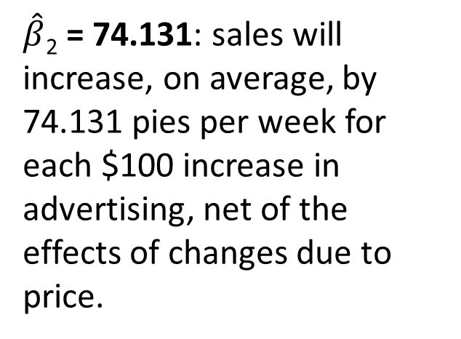
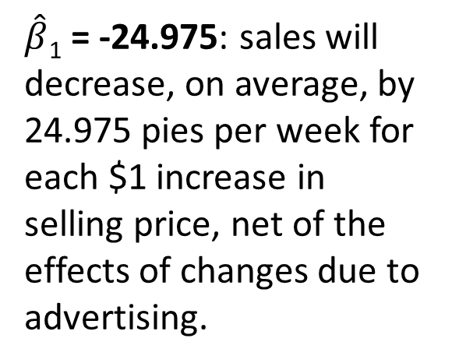
The Multiple Regression Equation
Where:
Sales is in number of pies per week.
Price is in $.
Advertising is in $100s.
$\hat{β}$₁ = -24.975: sales will decrease, on average, by 24.975 pies per week for each $1 increase in selling price, net of the effects of changes due to advertising.
$\hat{β}$₂ = 74.131: sales will increase, on average, by 74.131 pies per week for each $100 increase in advertising, net of the effects of changes due to price.

Slide 10
Are Individual Variables Significant?
Shows if there is a linear relationship between the variable X_{j} and Y.
Hypotheses
Use t tests of individual variable slopes
  (between X_{j} and Y).
  H₀: β_{j} = 0 (no linear relationship)
  H₁: β_{j} ≠ 0 (linear relationship does exist)

Slide 11
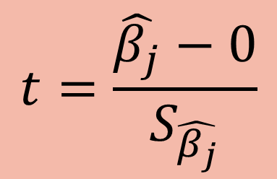
Are Individual Variables Significant?
  H₀: β_{j} = 0 (no linear relationship)
  H₁: β_{j} ≠ 0 (linear relationship does exist
  between x_{j} and y)
  Test Statistic:
$$t=\frac{\hat{β_{j}}−0}{S_{\hat{β_{j}}}}$$
(df = n – k – 1)

Slide 12
Are Individual Variables Significant?
Regression Statistics
Multiple R | 0.72213
R Square | 0.52148
Adjusted R Square | 0.44172
Standard Error | 47.46341
Observations | 15
ANOVA | df | SS | MS | F | Significance F
Regression | 2 | 29460.027 | 14730.01 | 6.53861 | 0.01201
Residual | 12 | 27033.306 | 2252.776
Total | 14 | 56493.333
 | Coefficients | Standard Error | t Stat | P-value | Lower 95% | Upper 95%
Intercept | 306.52619 | 114.25389 | 2.68285 | 0.01993 | 57.58835 | 555.46404
Price | -24.97509 | 10.83213 | -2.30565 | 0.03979 | -48.57626 | -1.37392
Advertising | 74.13096 | 25.96732 | 2.85478 | 0.01449 | 17.55303 | 130.70888
t-value for price is t = -2.306, with p-value 0.0398
t-value for advertising is t = 2.855, with p-value 0.0145

Slide 13


Are Individual Variables Significant?
From Excel output:
H₀: β_{i} = 0
H₁: β_{i} ≠ 0
 | Coefficients | Standard Error | t Stat | P-value
Price | -24.97509 | 10.83213 | -2.30565 | 0.03979
Advertising | 74.13096 | 25.96732 | 2.85478 | 0.01449
Decision:
Conclusion:
d.f. = 15-2-1 = 12
= .05 t_{α/2} = 2.1788
The test statistic for each variable falls in the rejection region (p-values < .05)
$α$/2=0.025
$α$/2=0.025
Do not reject H₀
Reject H₀ for each variable.
There is evidence that both price and advertising affect pie sales at α = 0.05.
Reject H₀
-t_{α/2}
t_{α/2}
Reject H₀
0
-2.1788
2.1788

Slide 14
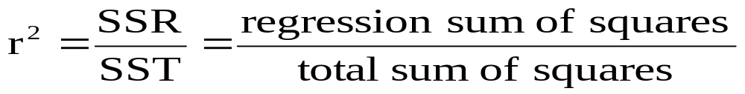
Coefficient of Multiple Determination
Reports the proportion of total variation in Y explained by all X variables taken together.

Slide 15
Coefficient of Multiple Determination
Regression Statistics
Multiple R |  | 0.72213
R Square |  | 0.52148
Adjusted R Square |  | 0.44172
Standard Error |  | 47.46341
Observations |  | 15
ANOVA |  | df | SS | MS | F | Significance F
Regression |  | 2 | 29460.027 | 14730.01 | 6.53861 | 0.01201
Residual |  | 12 | 27033.306 | 2252.776
Total |  | 14 | 56493.333
 | Coefficients |  | Standard Error | t Stat | P-value | Lower 95% | Upper 95%
Intercept |  | 306.52619 | 114.25389 | 2.68285 | 0.01993 | 57.58835 | 555.46404
Price |  | -24.97509 | 10.83213 | -2.30565 | 0.03979 | -48.57626 | -1.37392
Advertising |  | 74.13096 | 25.96732 | 2.85478 | 0.01449 | 17.55303 | 130.70888
52.1% of the variation in pie sales is explained by the variation in price and advertising.

Slide 16
Is the Model Significant?
F Test for Overall Significance of the Model:
Shows if there is a linear relationship between all of the X variables considered together and Y.
Hypotheses:
H₀: β₁ = β₂ = … = β_{k} = 0 (no linear relationship)
H₁: at least one β_{i} ≠ 0 (at least one independent variable affects Y)

Slide 17
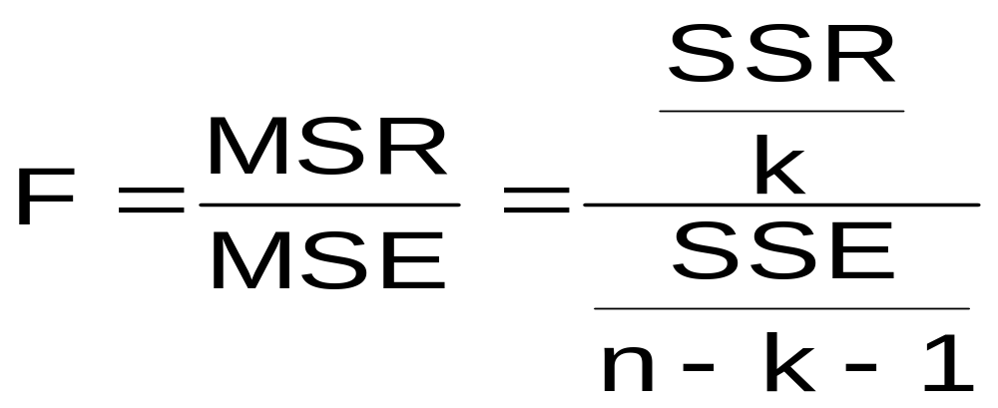
F Test for Overall Significance
Test statistic:
Where F has (numerator) = k and
(denominator) = (n – k - 1) degrees of freedom

Slide 18
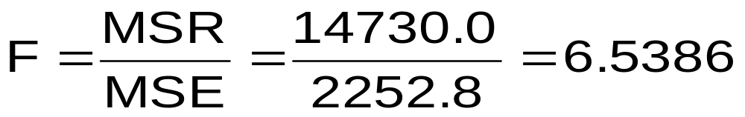
F Test for Overall Significance
Regression Statistics
Multiple R | 0.72213
R Square | 0.52148
Adjusted R Square | 0.44172
Standard Error | 47.46341
Observations | 15
ANOVA | df | SS | MS | F | Significance F
Regression | 2 | 29460.027 | 14730.01 | 6.53861 | 0.01201
Residual | 12 | 27033.306 | 2252.776
Total | 14 | 56493.333
 | Coefficients | Standard Error | t Stat | P-value | Lower 95% | Upper 95%
Intercept | 306.52619 | 114.25389 | 2.68285 | 0.01993 | 57.58835 | 555.46404
Price | -24.97509 | 10.83213 | -2.30565 | 0.03979 | -48.57626 | -1.37392
Advertising | 74.13096 | 25.96732 | 2.85478 | 0.01449 | 17.55303 | 130.70888
With 2 and 12 degrees of freedom
p-value for the F Test

Slide 19
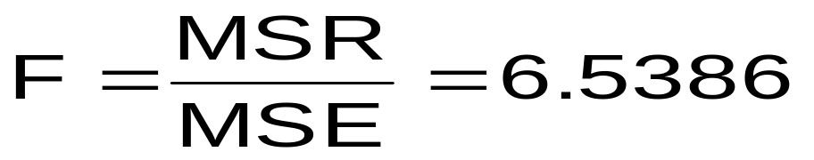
F Test for Overall Significance
Test Statistic:
Decision:
H₀: β₁ = β₂ = 0
H₁: β₁ and β₂ not both zero
α = .05
df₁= 2 df₂ = 12
Since F test statistic is in the rejection region (p-value < .05), reject H₀
Do not
reject H₀
α = 0.05
Conclusion:
There is evidence that at least one independent variable affects Y.
0
F
Reject H₀
Critical Value: F_{α} = 3.885

Slide 20
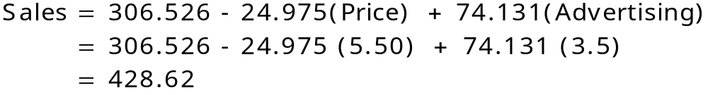
Using The Equation to Make Predictions
Predict sales for a week in which the selling price is $5.50 and advertising is $350:
Predicted sales is 428.62 pies.
Note that advertising is in $100s, so $350 means that X₂ = 3.5

Slide 21
Using Dummy Variables
A dummy variable is a categorical explanatory variable with two levels:
yes or no, on or off, male or female
coded as 0 or 1
Regression intercepts are different if the variable is significant.
Assumes equal slopes for other variables.
If more than two levels, the number of dummy variables needed is number of levels minus 1.

Slide 22
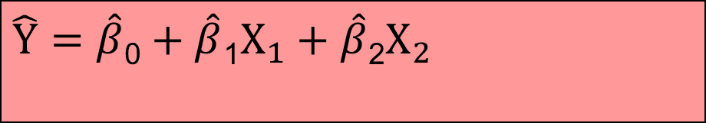
Dummy-Variable Example (with Two Levels)
$$\hat{Y}=\hat{β}\text{0}+\hat{β}\text{1}X_{1}+\hat{β}\text{2}X_{2}$$
Let: Y = pie sales
X₁ = price
X₂ = holiday (dummy variable)
(X₂ = 1 if a holiday occurred during the week)
(X₂ = 0 if there was no holiday that week)

Slide 23


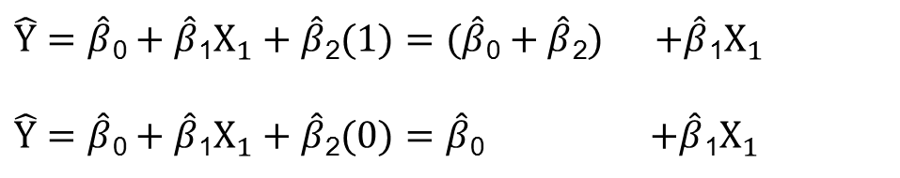
Dummy-Variable Example (with Two Levels)
$\hat{Y}=\hat{β}\text{0}+\hat{β}\text{1}X_{1}+\hat{β}\text{2}(1)=(\hat{β}\text{0}+\hat{β}\text{2})$ $+\hat{β}\text{1}X_{1}$
$\hat{Y}=\hat{β}\text{0}+\hat{β}\text{1}X_{1}+\hat{β}\text{2}(0)=\hat{β}\text{0}$ $+\hat{β}\text{1}X_{1}$
Holiday
No holiday
Different intercept
Same slope
Y (sales)
If H₀: β₂ = 0 is rejected, then
‘Holiday’ has a significant effect on pie sales.
$\hat{β}$₀ + $\hat{β}$₂
$\hat{β}$₀
Holiday (X₂ = 1)
No holiday (X₂ = 0)
X₁ (Price)

Slide 24

Interpreting the Dummy Variable Coefficient (with Two Levels)
Sales: number of pies sold per week
Price: pie price in $
1 If a holiday occurred during the week
Holiday:
0 If no holiday occurred
b₂ = 15: on average, sales were 15 pies greater in weeks with a holiday than in weeks without a holiday, given the same price

