Slide 1
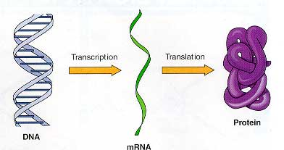
DNA RNA Protein
The Secret of Life
Lecture 17
Dr. Chandra Emani

Slide 2
What are we going to learn today ?
What is the structure of DNA?
How does DNA encode information ?
How do Mutations occur ?
Can we make DNA in a lab and manipulate it ?
What is RNA?
How are proteins made from DNA and RNA ?

Slide 3
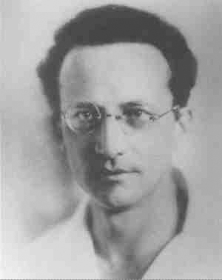
Gene – An Information Molecule ?
In his book, WHAT IS LIFE ? Schrodinger hypothesized –
Gene may be an aperiodic crystal – an information molecule with codes, just like a Morse code of dots and dashes
There maybe molecules inside the cell where the entire instructions for making the cell are in a digital format
The language of the instructions will be in chemical format
Erwin Schrodinger
Austrian Physicist
Nobel, 1933

Slide 4
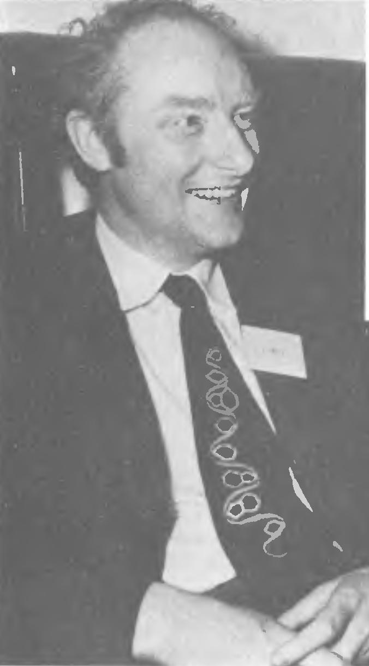
Features of an Information Molecule
In his book, “What Mad Pursuit?” Crick summed up –
An information molecule should have simple and finite chemical instructions
There should be a process for the exact replication of this information
The copies produced by replication should again replicate themselves into further copies
Mistakes made during replication should also be faithfully copied
Francis Crick
English Molecular Biologist
Nobel, 1962

Slide 5
Genes are made of DNA
Known since the late 1800s:
    Heritable information is carried in discrete units called genes
    Genes are parts of structures called chromosomes
    Chromosomes are made of Deoxyribo Nucleic Acid (DNA) and protein

Slide 6
First Clues to DNA Structure
DNA is made of chains of small subunits called nucleotides
There are four nucleotides in DNA – “Tetranucleotide hypothesis”
    Adenine
    Guanine
    Cytosine
    Thymine
Chargaff’s rule: A = T ; G = C
Purines
“AGs are pure”
Pyrimidines

Slide 7
Nucleotides
Each nucleotide has three components:
    Phosphate group
    Deoxyribose sugar
    One of four nitrogen-containing bases – A, G, C, T

Slide 8
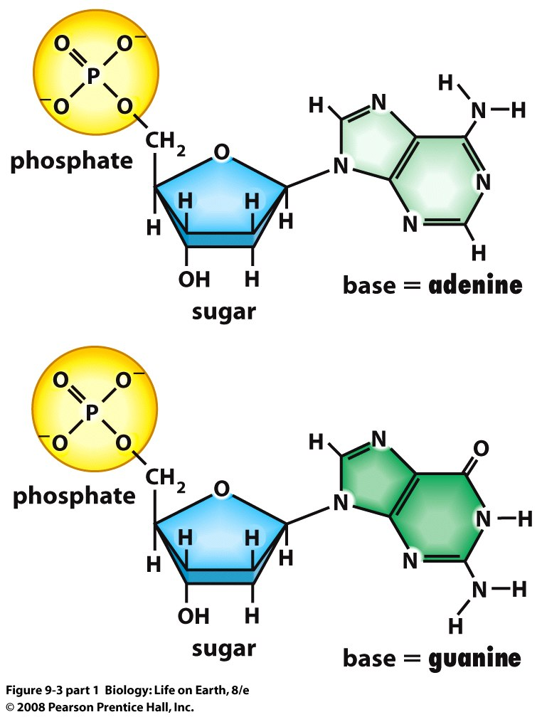
Purines
Notes:
FIGURE 9-3 (part 1) DNA nucleotides

Slide 9
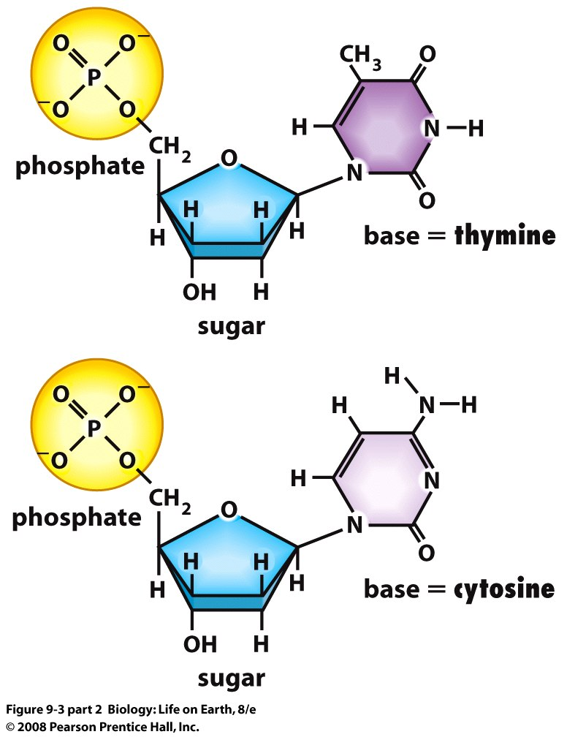
Pyrimidines
Notes:
FIGURE 9-3 (part 2) DNA nucleotides

Slide 10
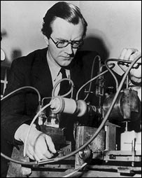
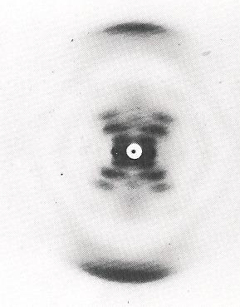
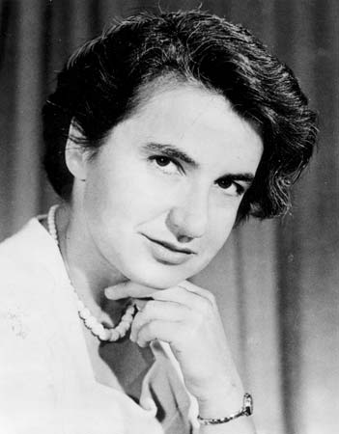
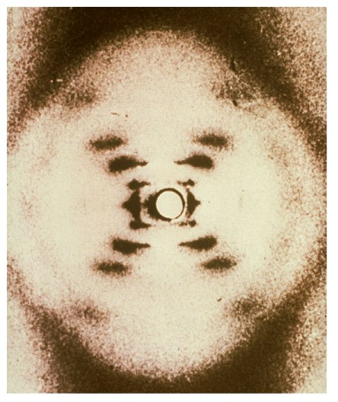
DNA is a Helix – Wilkins and Franklin
From X-ray diffraction patterns they deduced that DNA
  Is long and thin
  Has a uniform diameter of 2 nanometers
  Is helical, and is twisted like a corkscrew
  Consists of repeating subunits

Slide 11
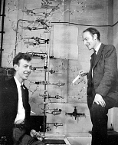
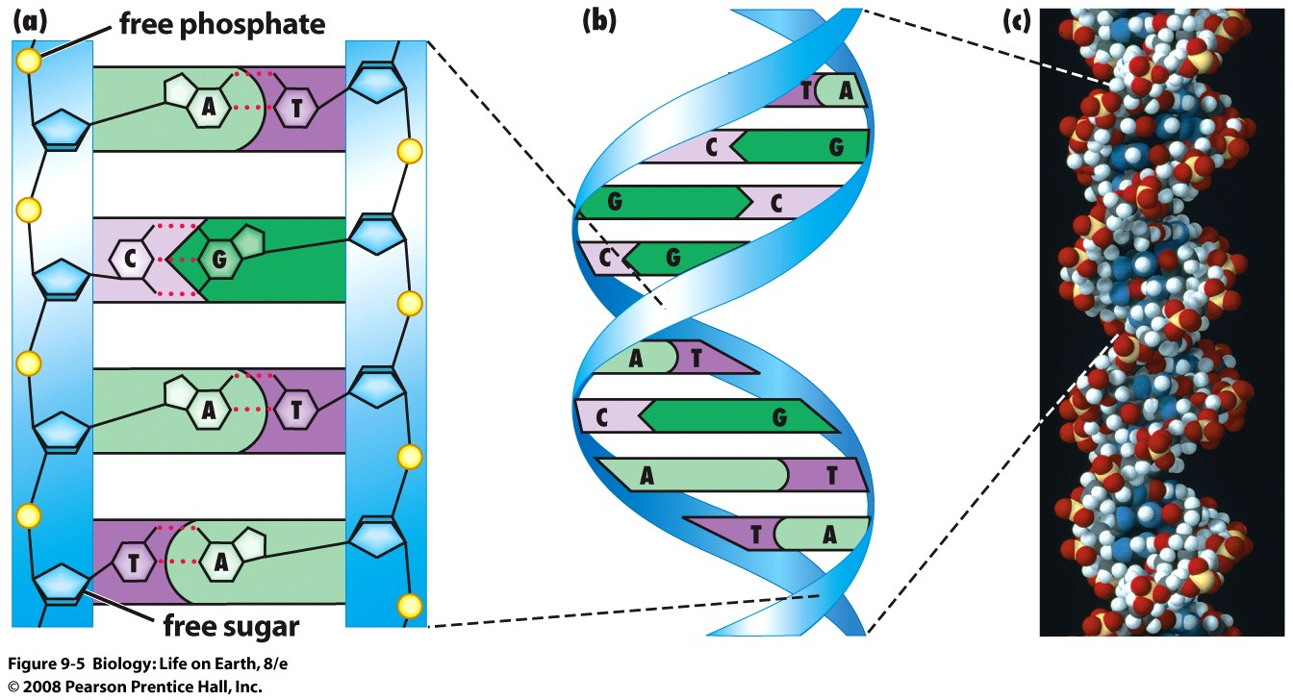
DNA Is a Double Helix – Watson & Crick
Watson -Crick Model combined the X-ray data with bonding theory
  DNA is a ladder made of two strands of nucleotides
  The deoxyribose and phosphate portions make up the sugar-phosphate backbone
  A, G, C, T protrude inward and are joined by hydrogen bonding
  The nucleotide strands form an anti-parallel two chain spiral helix

Slide 12
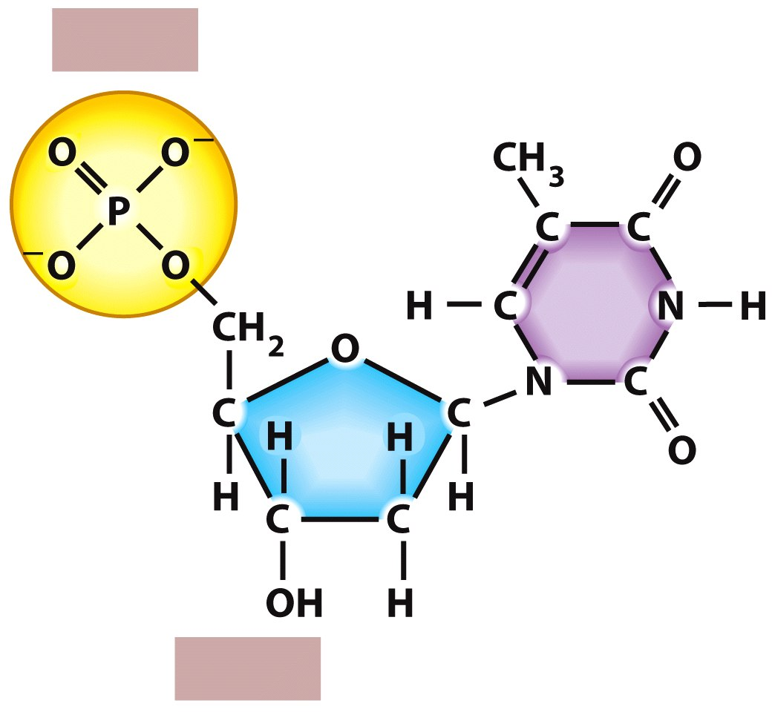
DNA Is a Double Helix – Watson & Crick
5′ end
5
4
6
3
5′
1
2
1′
4′
3′
2′
3′ end
Notes:
FIGURE E9-4 Numbering of carbon atoms in a nucleotide

Slide 13
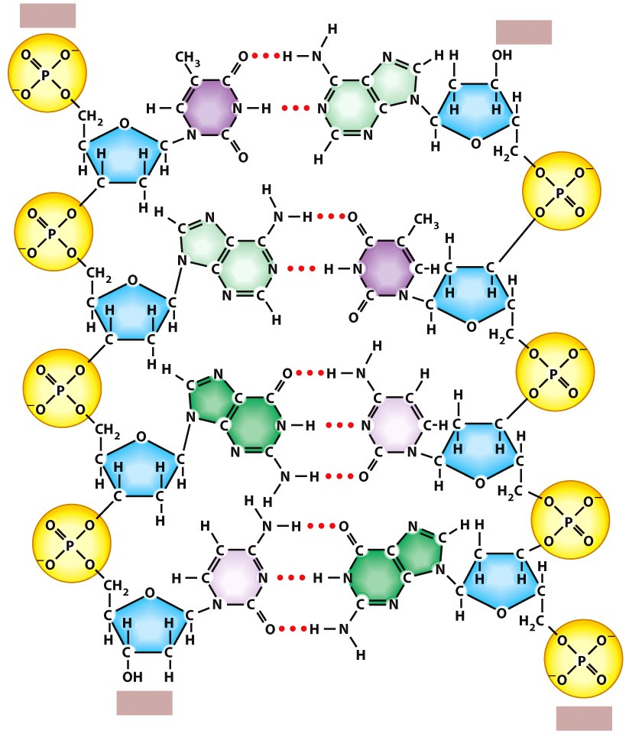
DNA Is a Double Helix – Watson & Crick
  The two nucleotide strands always run anti-parallel
  The orientation of the Watson strand is always 5-prime to 3-prime complementary to an anti-parallel Crick strand that runs 3-prime to 5-prime
  A-T are joined by two hydrogen bonds and C-G are joined by three hydrogen bonds
5′ end
3′ end
3′ end
5′ end

Slide 14
DNA is the Information Molecule
How can a molecule with only 4 simple parts be the carrier of genetic information?
DNA language is written in the chemical alphabets of A, G, C, T
The key lies in the sequence, not number, of subunits

Slide 15
DNA information – Genetic Code
Within a DNA strand, the four types of bases can be arranged in any linear order, and this sequence is what encodes genetic information
The genetic code is analogous to languages, where small sets of letters combine in various ways to make up many different words
  English has 26 letters
  Hawaiian has 2 letters
  The binary language of computers uses only two “letters” (0 and 1, or “on” and “off”)
  DNA uses A, G, C, T

Slide 16
DNA information – Genetic Code
The sequence of only four nucleotides can produce many different combinations
  A 10 nucleotide sequence can code for greater than 1 million different combinations
  AGGCCTGCAT can result in a million different combinations

Slide 17
DNA copying or “Replication”
DNA Replication ensures Genetic Constancy during Cell Division
  Replication of DNA Is a Critical Event in a Cell’s Life
  Replicated DNA Is Half New and Half Old since cells reproduce by dividing in half

Slide 18
DNA Replication
Each of two daughter cells gets an exact copy of parent cell’s genetic information
Duplication of the parent cell DNA is called replication

Slide 19
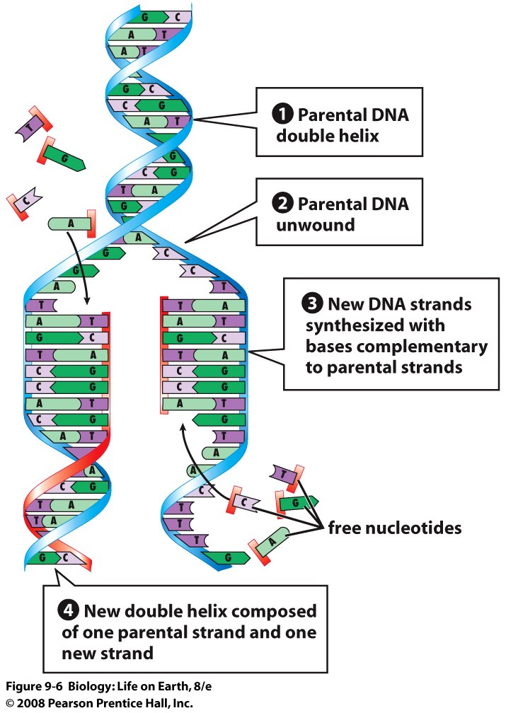
DNA Replication
DNA replication begins when DNA helicases separate the two strands
  Hydrogen bonds between bases are broken
  A second strand of new DNA is synthesized along each separated strand by DNA polymerases, which position free nucleotides across from complementary nucleotides

Slide 20
DNA Replication
Base pairing is the foundation of DNA replication
  An adenine on one strand pairs with a thymine on the other strand; a cytosine pairs with guanine
  If one strand reads ATG, the other reads TAC

Slide 21
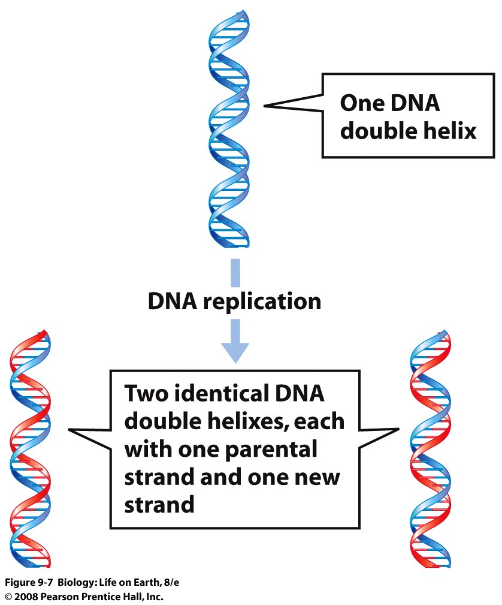
DNA Replication
Notes:
FIGURE 9-7 Semiconservative replication of DNA

Slide 22
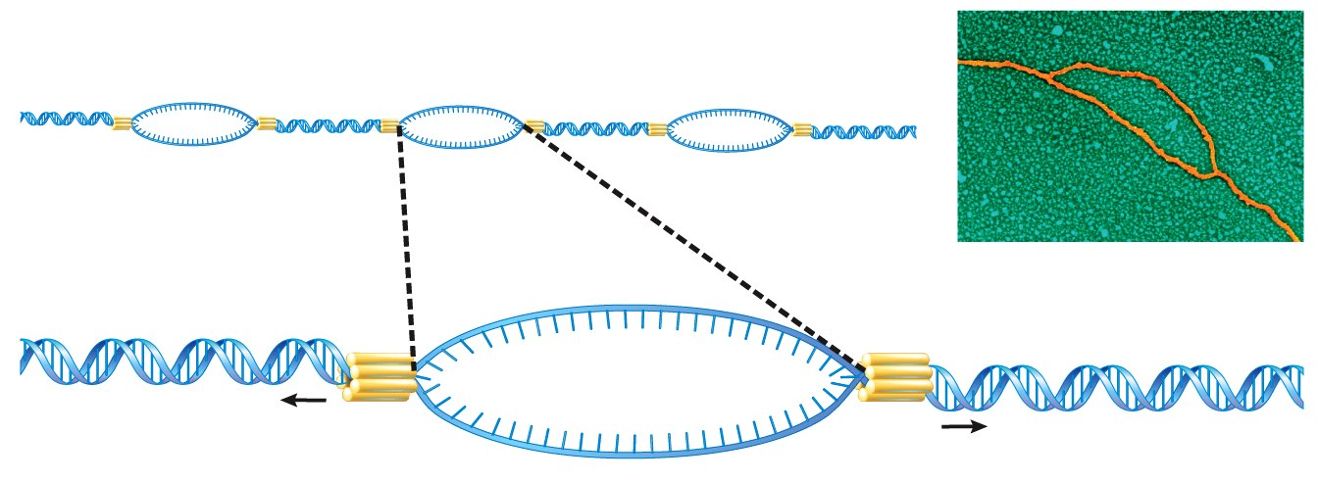
DNA Replication
replication bubbles
DNA
DNA helicase
replication forks
Notes:
FIGURE E9-7ab DNA replication
(a) DNA helicase enzymes separate the parental strands of a chromosome to form replication bubbles. (b) Each replication bubble consists of two replication forks, with "unwound" DNA strands between the forks.

Slide 23
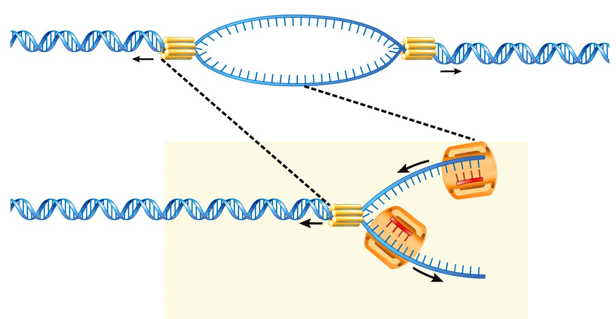
DNA Replication
DNA helicase
replication forks
DNA
polymerase #1
3′
5′
continuous
synthesis
3′
discontinuous
synthesis
DNA
polymerase #2
5′
Notes:
FIGURE E9-7bc DNA replication
(b) Each replication bubble consists of two replication forks, with "unwound" DNA strands between the forks. (c) DNA polymerase synthesizes new pieces of DNA.

Slide 24
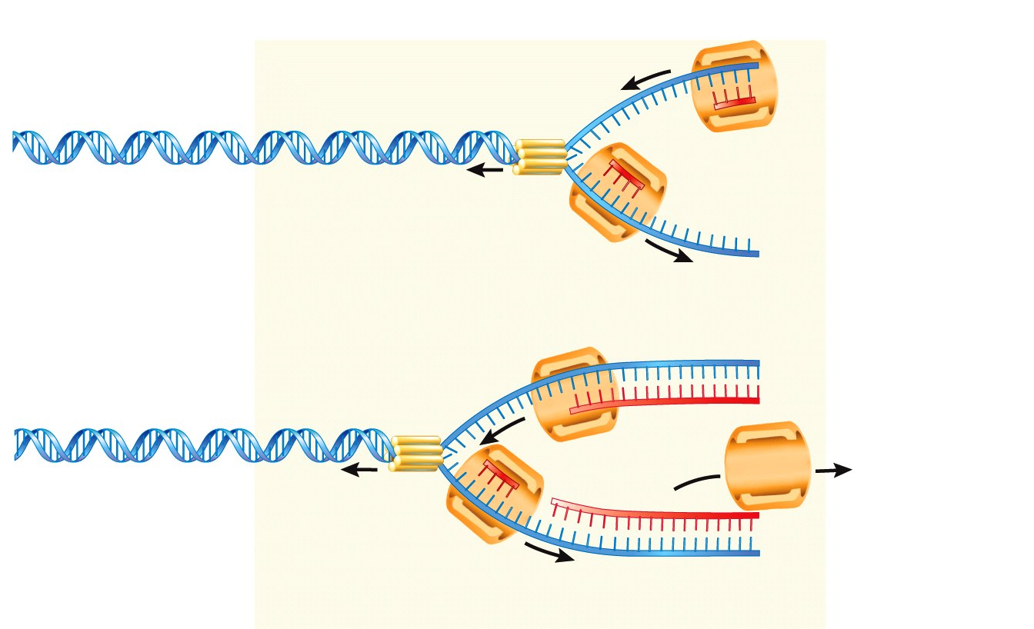
DNA
polymerase #1
DNA Replication
3′
5′
continuous
synthesis
3′
discontinuous
synthesis
DNA
polymerase #2
5′
DNA polymerase #1
continues along
parental DNA strand
3′
5′
DNA
polymerase #2
leaves
5′
continuous synthesis
3′
discontinuous synthesis
3′
DNA
polymerase #3
5′
DNA Replication always occurs in 5’ 3’ direction
Notes:
FIGURE E9-7cd DNA replication
(c) DNA polymerase synthesizes new pieces of DNA. (d) DNA helicase and DNA polymerase move along a replication bubble.

Slide 25
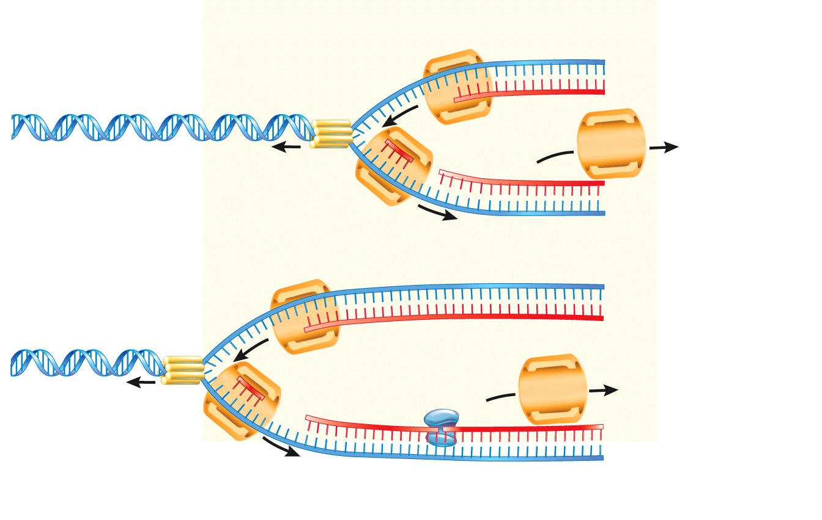
DNA Replication
DNA polymerase #1
continues along
parental DNA strand
3′
5′
DNA
polymerase #2
leaves
5′
continuous synthesis
Okazaki
fragments
3′
discontinuous synthesis
3′
DNA
polymerase #3
5′
3′
5′
5′
3′
DNA
polymerase #3
leaves
3′
5′
3′
DNA
polymerase #4
5′
DNA ligase joins
daughter DNA strands
together.
Notes:
FIGURE E9-7de DNA replication
(d) DNA helicase and DNA polymerase move along a replication bubble. (e) DNA ligase joins the small DNA segments into a single daughter strand.

Slide 26
Mutations
How Do Mutations Occur?
  Accurate Replication and Proofreading Produce Almost Error-Free DNA
  Mistakes (Mutations) Do Happen
  Mutations Range from Changes in Single Nucleotides to Movements of Large Pieces of Chromosomes
  Mutations May Have Varying Effects on Function

Slide 27
Replication And Proofreading
During replication, DNA polymerase mismatches nucleotides once every 10,000 base pairs
DNA repair enzymes “proofread” each new daughter strand, replacing mismatched nucleotides
However…

Slide 28
Mistakes Do Happen !!!!
DNA is damaged in a number of ways
Spontaneous chemical breakdown at body temperature
Certain chemicals (some components of cigarette smoke) damage DNA
Notes:
Figure: 19-2 part a
Title:
Viral structure and replication part a
Caption:
(a) A cross section of the virus that causes AIDS. Inside, genetic material is surrounded by a protein coat and molecules of reverse transcriptase, an enzyme that catalyzes the transcription of DNA from the viral RNA template after the virus enters the host cell. This virus is among those that also have an outer envelope that is formed from the host cell's plasma membrane. Spikes made of glycoprotein (protein and carbohydrate) project from the envelope and help the virus attach to its host cell.

Slide 29
Mistakes Do Happen !!!!
UV light from the sun causes DNA damage
  DNA damage leads to uncontrollable cell division (a tumor) and skin cancer
Notes:
Figure: 19-2 part a
Title:
Viral structure and replication part a
Caption:
(a) A cross section of the virus that causes AIDS. Inside, genetic material is surrounded by a protein coat and molecules of reverse transcriptase, an enzyme that catalyzes the transcription of DNA from the viral RNA template after the virus enters the host cell. This virus is among those that also have an outer envelope that is formed from the host cell's plasma membrane. Spikes made of glycoprotein (protein and carbohydrate) project from the envelope and help the virus attach to its host cell.

Slide 30
Types of Mutations
Point mutation - individual nucleotide in the DNA sequence is changed
Insertion mutation - one or more nucleotide pairs are inserted into the DNA double helix
Deletion mutation - one or more nucleotide pairs are removed from the double helix
Notes:
Figure: 19-2 part a
Title:
Viral structure and replication part a
Caption:
(a) A cross section of the virus that causes AIDS. Inside, genetic material is surrounded by a protein coat and molecules of reverse transcriptase, an enzyme that catalyzes the transcription of DNA from the viral RNA template after the virus enters the host cell. This virus is among those that also have an outer envelope that is formed from the host cell's plasma membrane. Spikes made of glycoprotein (protein and carbohydrate) project from the envelope and help the virus attach to its host cell.

Slide 31
Types of Mutations
Inversion - piece of DNA is cut out of a chromosome, turned around, and re-inserted into the gap
Translocation - chunk of DNA (often very large) is removed from one chromosome and attached to another
Notes:
Figure: 19-2 part a
Title:
Viral structure and replication part a
Caption:
(a) A cross section of the virus that causes AIDS. Inside, genetic material is surrounded by a protein coat and molecules of reverse transcriptase, an enzyme that catalyzes the transcription of DNA from the viral RNA template after the virus enters the host cell. This virus is among those that also have an outer envelope that is formed from the host cell's plasma membrane. Spikes made of glycoprotein (protein and carbohydrate) project from the envelope and help the virus attach to its host cell.

Slide 32
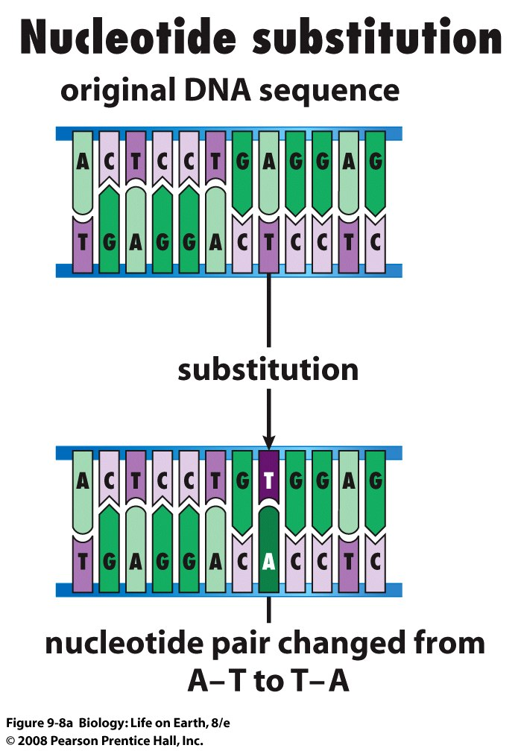
Types of Mutations
Point mutation - individual nucleotide in the DNA sequence is changed
Also known as nucleotide substitutions
Notes:
FIGURE 9-8a Mutations
(a) Nucleotide substitution. In parts (a) through (d), the original DNA bases are in pale colors with black letters; mutations are in deep colors with white letters.

Slide 33
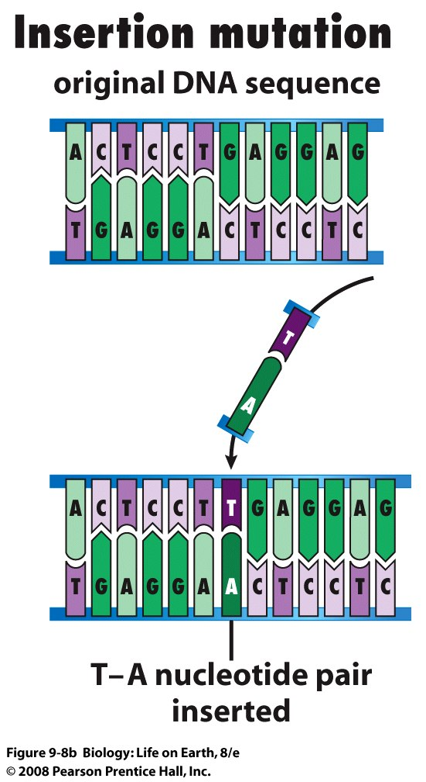
Types of Mutations
Insertion mutation - one or more nucleotide pairs are inserted into the DNA double helix
Notes:
FIGURE 9-8b Mutations
(b) Insertion mutation. In parts (a) through (d), the original DNA bases are in pale colors with black letters; mutations are in deep colors with white letters.

Slide 34
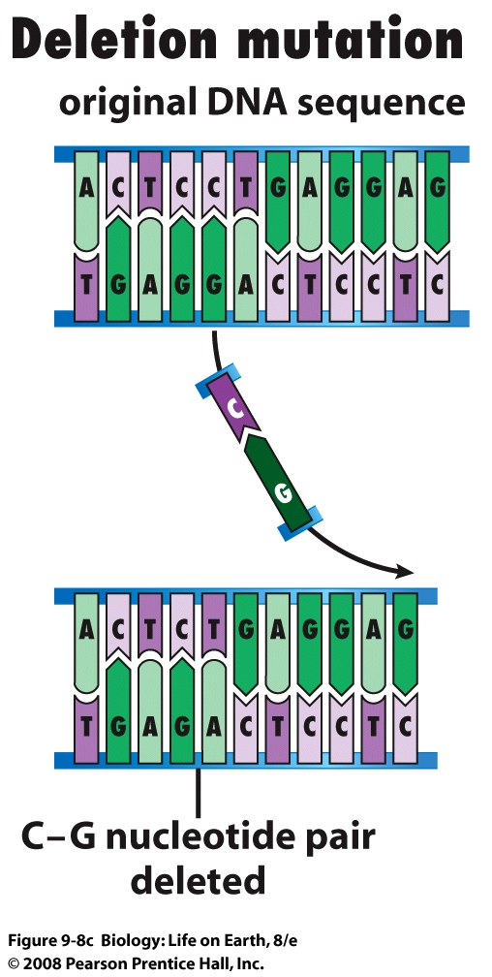
Types of Mutations
Deletion mutation - one or more nucleotide pairs are removed from the double helix
Notes:
FIGURE 9-8c Mutations
(c) Deletion mutation. In parts (a) through (d), the original DNA bases are in pale colors with black letters; mutations are in deep colors with white letters.

Slide 35
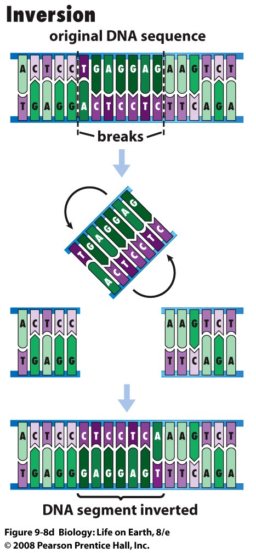
Types of Mutations
Inversion - piece of DNA is cut out of a chromosome, turned around, and re-inserted into the gap
Notes:
FIGURE 9-8d Mutations
(d) Inversion mutation. In parts (a) through (d), the original DNA bases are in pale colors with black letters; mutations are in deep colors with white letters.

Slide 36
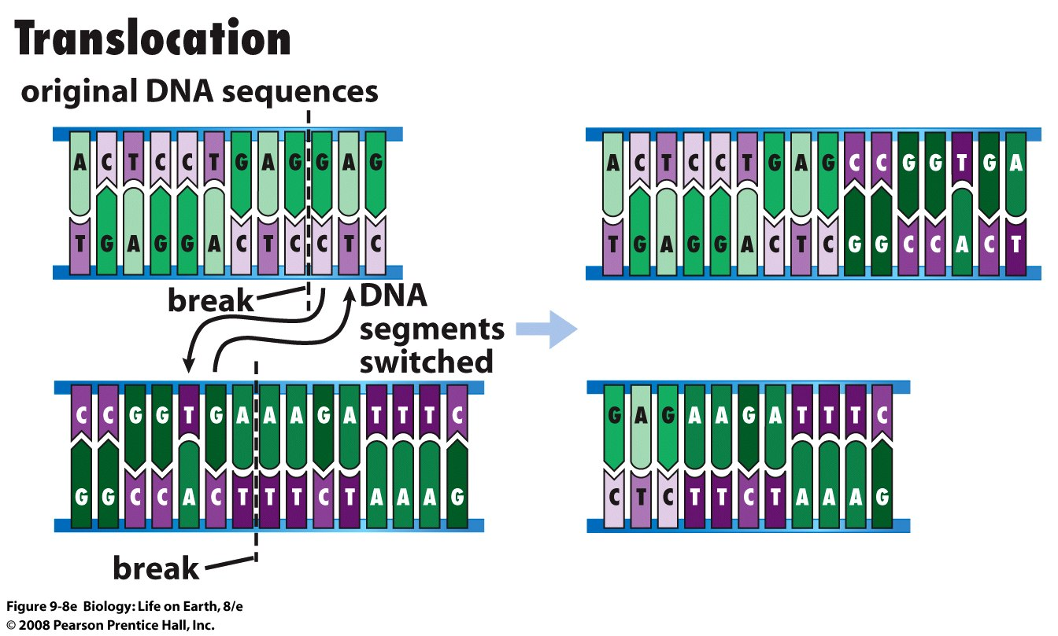
Types of Mutations
Translocation - chunk of DNA (often very large) is removed from one chromosome and attached to another
Notes:
FIGURE 9-8e Mutations
(e) Translocation.

Slide 37
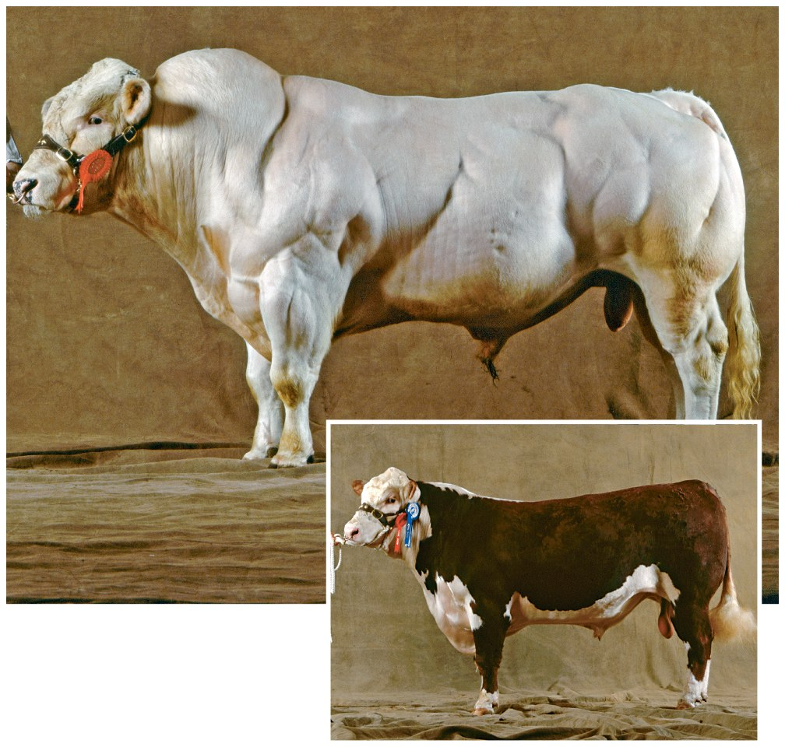
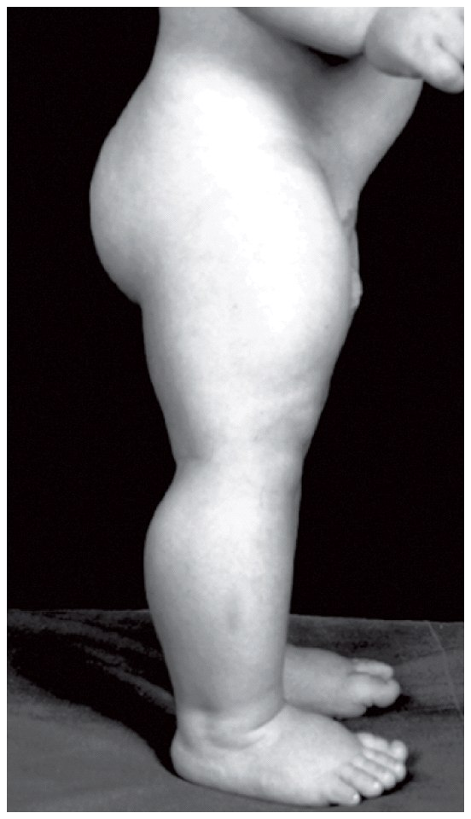
Mutation in “Myostatin”
Notes:
Chapter 9 Opener
Ordinary bull or incredible hulk? A tiny change in DNA makes all the difference.

Slide 38
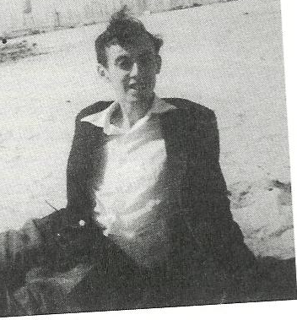

Jim’s scribbling on the Wall……………….
In 1953, Jim Watson first came up with a tentative hypothesis that DNA may have the information to make protein
DNA RNA Protein
Francis Crick called it the CENTRAL DOGMA OF LIFE

Slide 39
RNA Intermediaries
DNA in eukaryotes is kept in the nucleus
Protein synthesis occurs at ribosomes in the cytoplasm
DNA information must be carried by an intermediary (RNA) from nucleus to cytoplasm

Slide 40
RNA
RNA differs structurally from DNA
  RNA is single stranded
  RNA uses the sugar ribose
  RNA uses the nitrogenous base uracil (U) instead of thymine (T)

Slide 41
RNA Intermediaries
There are three types of RNA involved in protein synthesis
  Messenger RNA (mRNA) carries DNA gene information to the ribosome
  Transfer RNA (tRNA) brings amino acids to the ribosome
  Ribosomal RNA (rRNA) is part of the structure of ribosomes

Slide 42
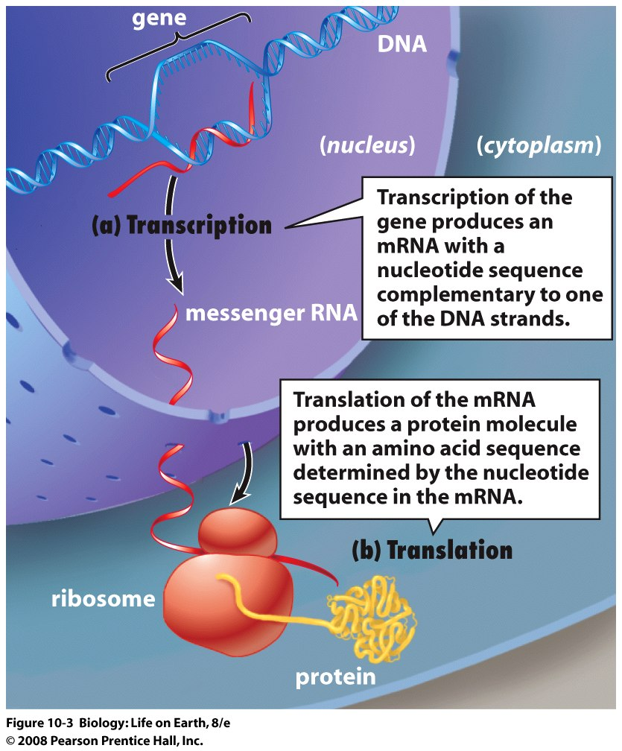
Notes:
FIGURE 10-3 Genetic information flows from DNA to RNA to protein
(a) During transcription, the nucleotide sequence in a gene specifies the nucleotide sequence in a complementary RNA molecule. For protein-encoding genes, the product is an mRNA molecule that exits from the nucleus and enters the cytoplasm. (b) During translation, the sequence in an mRNA molecule specifies the amino acid sequence in a protein.

Slide 43
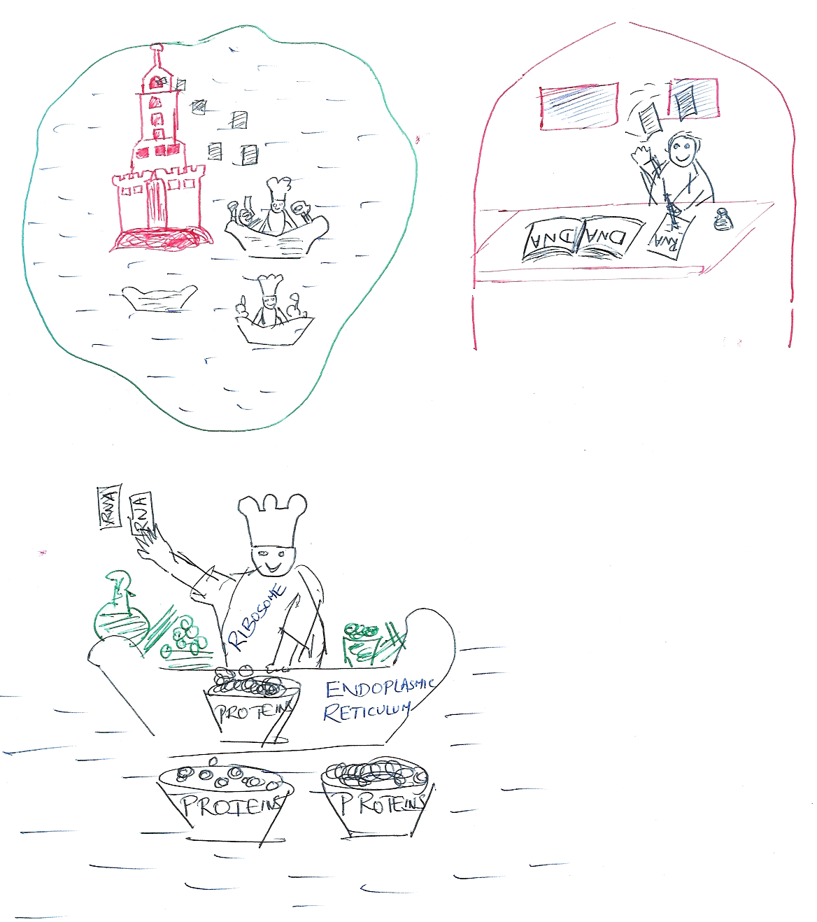
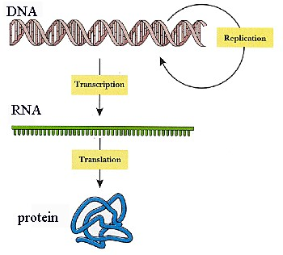
DNA RNA Protein
RNA
CYTOPLASM
RIBOSOMES
NUCLEUS
ENDOPLASMIC
RETICULUM

Slide 44
DNA RNA Protein

Slide 45
The Genetic Code
The base sequence in a DNA gene dictates the sequence and type of amino acids in translation
Bases in mRNA are read by the ribosome in triplets called codons
For e.g. AUG would read for Methionine, UUU for phenylalanine, CCG for proline and so on.

Slide 46
The Genetic Code
Each codon specifies a unique amino acid in the genetic code
Each mRNA also has a start and a stop codon
AUG for methionine is a start codon – it signals the start of protein synthesis or starting point of a gene
UAA, UGA and UAG are stop codons – they signal the end of protein synthesis or the end of a gene

Slide 47
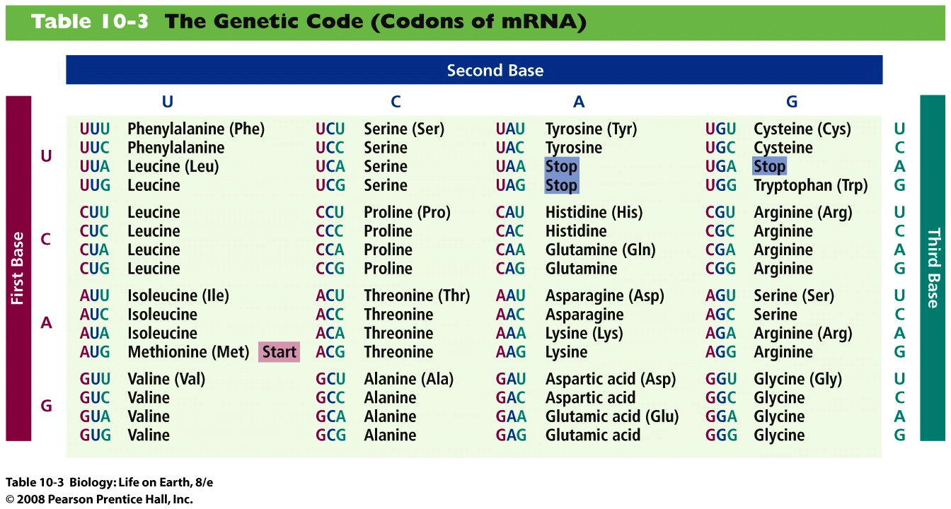
Notes:
Table 10-3 The Genetic Code (Codons of mRNA)

Slide 48
Transcription
Transcription of a DNA gene into RNA has three stages
  Initiation
  Elongation
  Termination

Slide 49
Initiation
Initiation phase of transcription
  DNA molecule is unwound and strands are separated at the beginning of the gene sequence
  2. RNA polymerase binds to promoter region at beginning of a gene on template strand

Slide 50
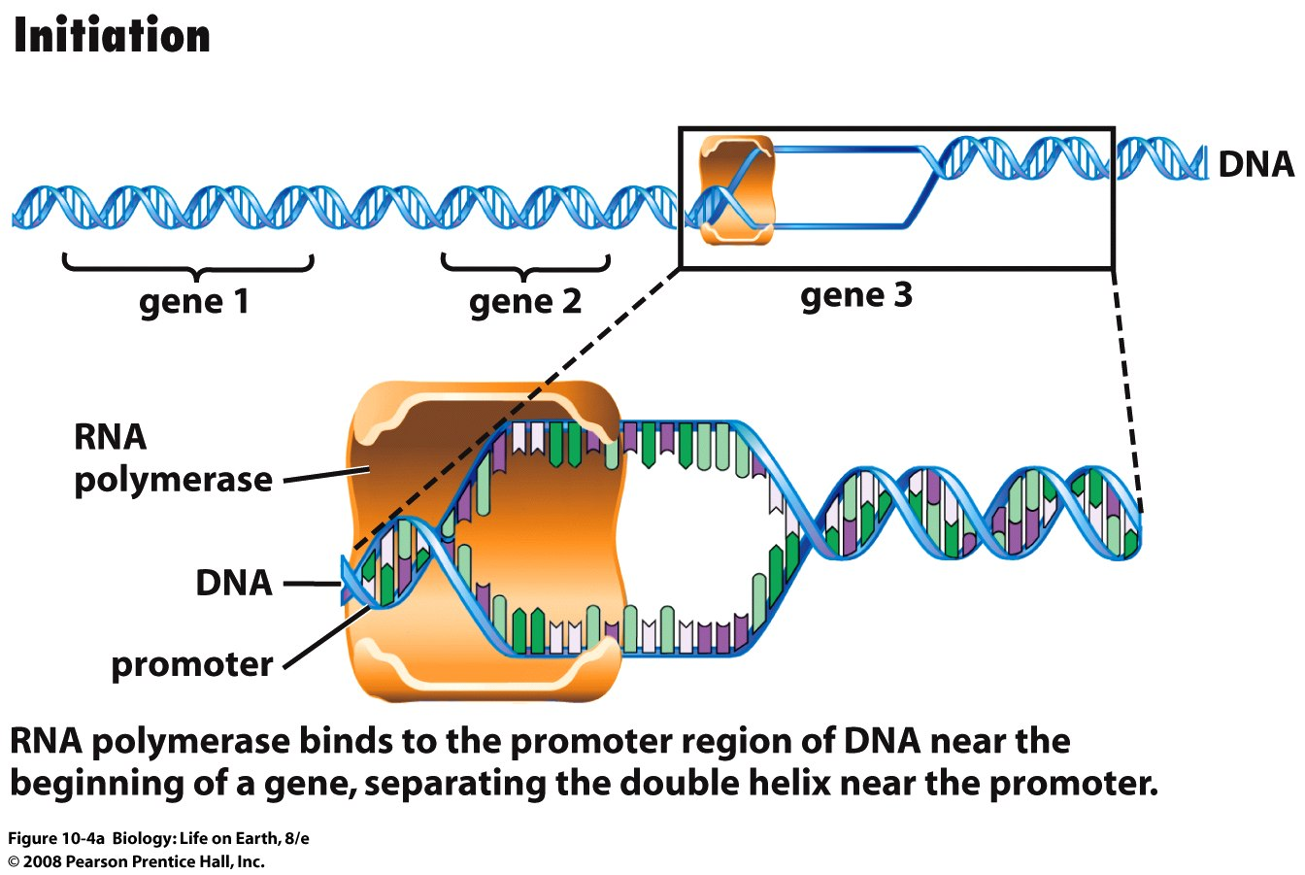
Notes:
FIGURE 10-4a Transcription is the synthesis of RNA from instructions in DNA
A gene is a segment of a chromosome's DNA. One of the DNA strands will serve as the template for the synthesis of an RNA molecule with bases complementary to the bases in the DNA strand.

Slide 51
Elongation
Elongation phase of transcription
  RNA polymerase synthesizes a sequence of RNA nucleotides along DNA template strand
  Bases in newly synthesized RNA strand are complementary to the DNA template strand
  RNA strand peels away from DNA template strand as DNA strands repair and wind up

Slide 52
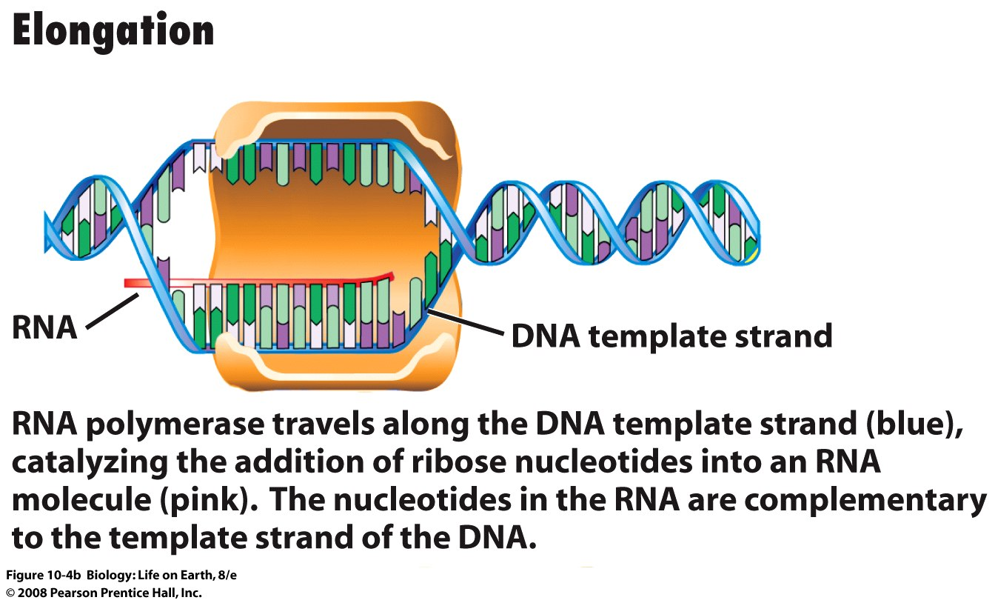
Notes:
FIGURE 10-4b Transcription is the synthesis of RNA from instructions in DNA
A gene is a segment of a chromosome's DNA. One of the DNA strands will serve as the template for the synthesis of an RNA molecule with bases complementary to the bases in the DNA strand.

Slide 53
Termination
Termination phase of transcription
  RNA polymerase reaches a termination sequence and releases completed RNA strand

Slide 54
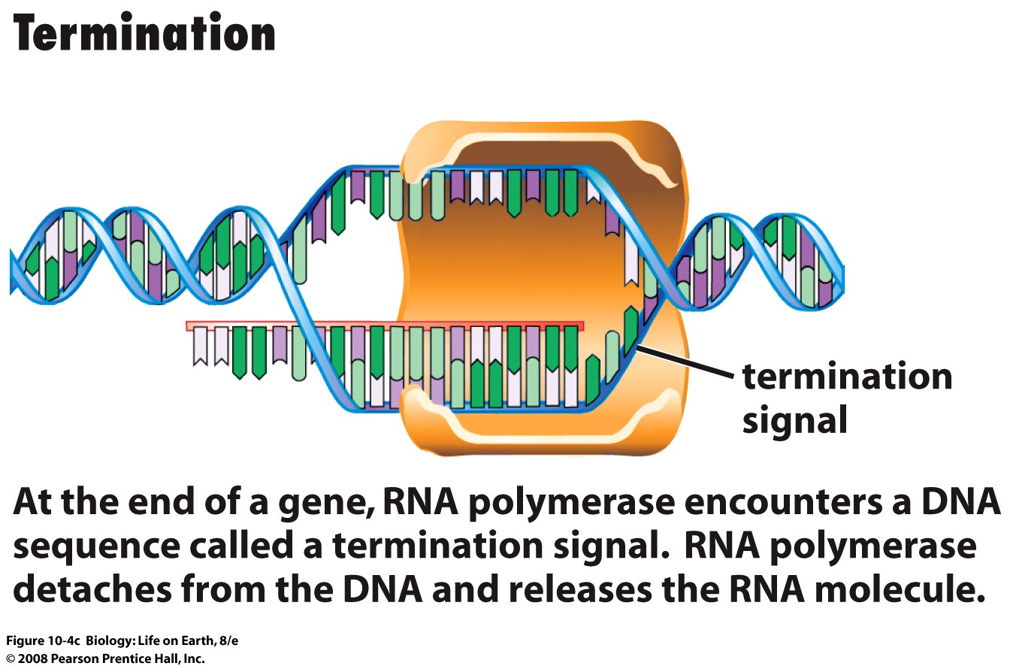
Notes:
FIGURE 10-4c Transcription is the synthesis of RNA from instructions in DNA
A gene is a segment of a chromosome's DNA. One of the DNA strands will serve as the template for the synthesis of an RNA molecule with bases complementary to the bases in the DNA strand.

Slide 55
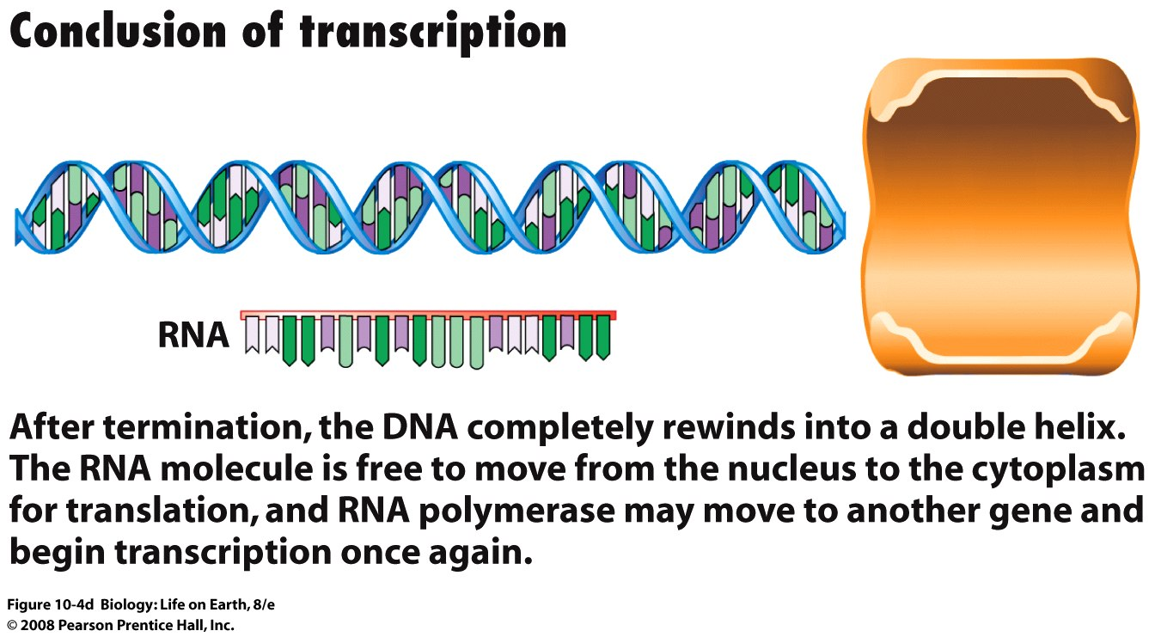
Notes:
FIGURE 10-4d Transcription is the synthesis of RNA from instructions in DNA
A gene is a segment of a chromosome's DNA. One of the DNA strands will serve as the template for the synthesis of an RNA molecule with bases complementary to the bases in the DNA strand.

Slide 56
mRNA to Protein
  Messenger RNA (mRNA) Carries Information for Protein Synthesis from the DNA to Ribosomes
  Ribosomes Consist of Two Subunits, Each Composed of Ribosomal RNA (rRNA) and Protein
  Transfer RNA (tRNA) Molecules Decode the Sequence of Bases in mRNA into the Amino Acid Sequence of a Protein
  During Translation, mRNA, tRNA, and Ribosomes Cooperate in Protein Synthesis

Slide 57
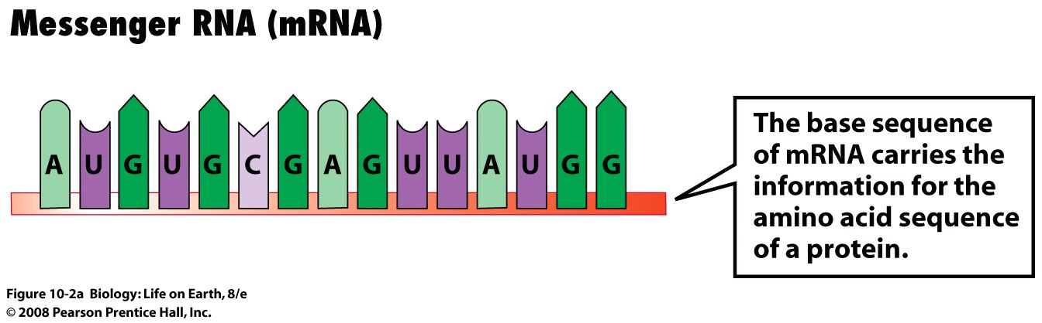
Messenger RNA
Notes:
FIGURE 10-2a Cells synthesize three major types of RNA

Slide 58
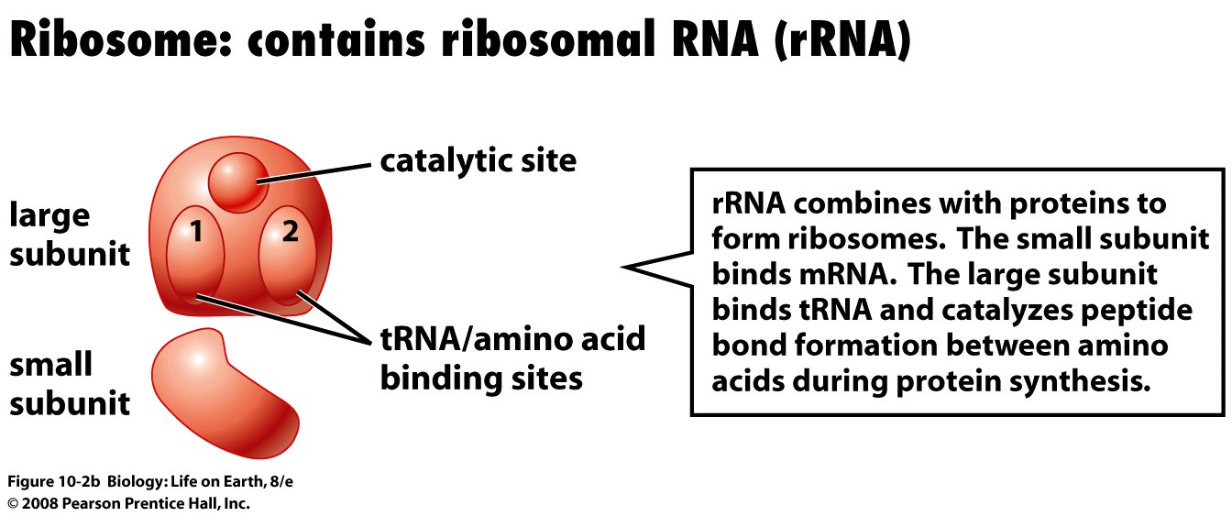
Ribosomal RNA
Notes:
FIGURE 10-2b Cells synthesize three major types of RNA

Slide 59
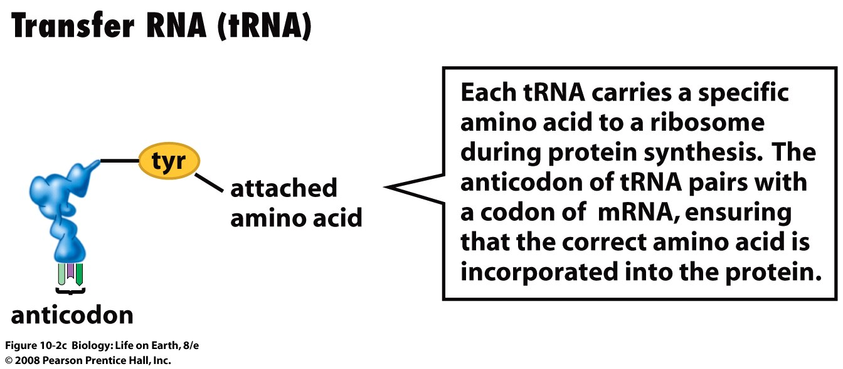
Transfer RNA
Notes:
FIGURE 10-2c Cells synthesize three major types of RNA

Slide 60
Protein synthesis in prokaryotes
  In prokaryotes
    The chromosomes are not contained within a nucleus
    All of the nucleotides in a gene encode for the amino acids of a protein
    Genes for a related function are adjacent and are transcribed together
    Transcription and translation occur simultaneously within the same compartment

Slide 61
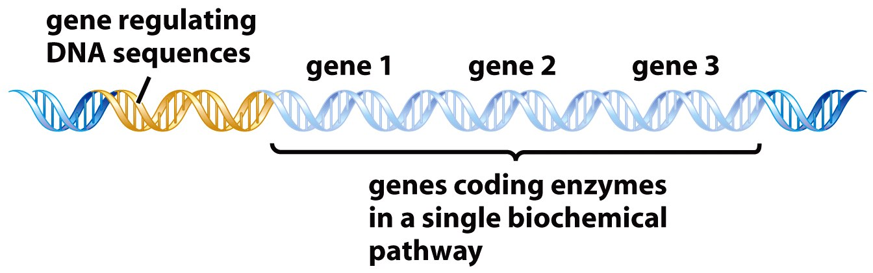
Protein synthesis in prokaryotes
    Genes for a related function are adjacent and are transcribed together
Notes:
FIGURE 10-6a Messenger RNA synthesis in prokaryotic cells
(a) In prokaryotes, many or all of the genes for a complete metabolic pathway lie side by side on the chromosome.

Slide 62
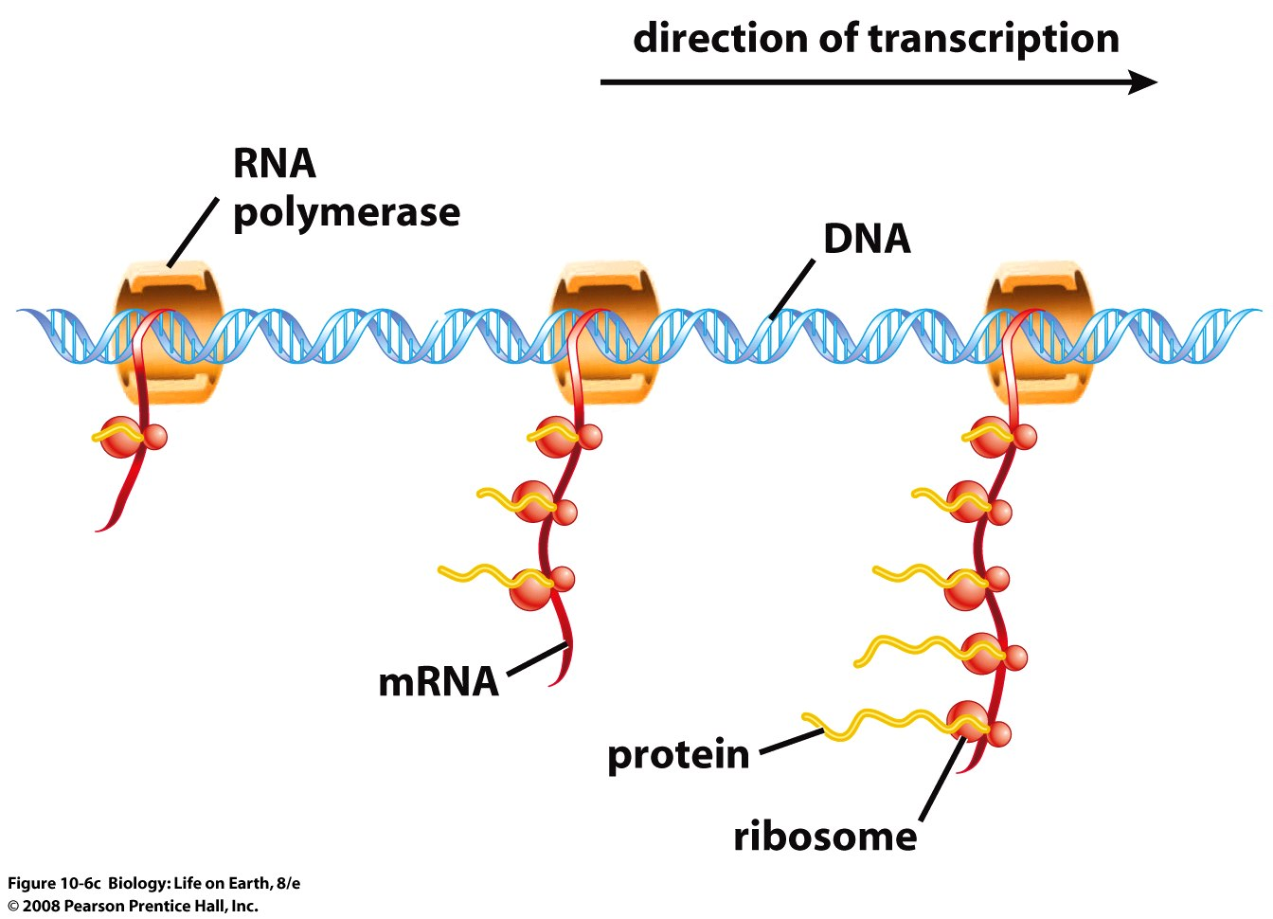
Protein synthesis in prokaryotes
    Transcription and translation occur simultaneously within the same compartment
Notes:
FIGURE 10-6c Messenger RNA synthesis in prokaryotic cells
The diagram below the micrograph shows all of the key molecules involved.

Slide 63
Protein synthesis in eukaryotes
  In eukaryotes
  The DNA is in the nucleus and the ribosomes are in the cytoplasm
  The genes that encode the proteins for a biochemical pathway are not clustered together on the same chromosome

Slide 64
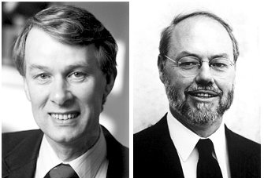
Split Genes
  In eukaryotes
    Each gene consists of multiple segments of DNA that encode for protein, called exons
    Exons are interrupted by other segments that are not translated, called introns
Richard Roberts
English Biochemist
Nobel 1993
Philip Sharp
American Biochemist
Nobel 1993

Slide 65
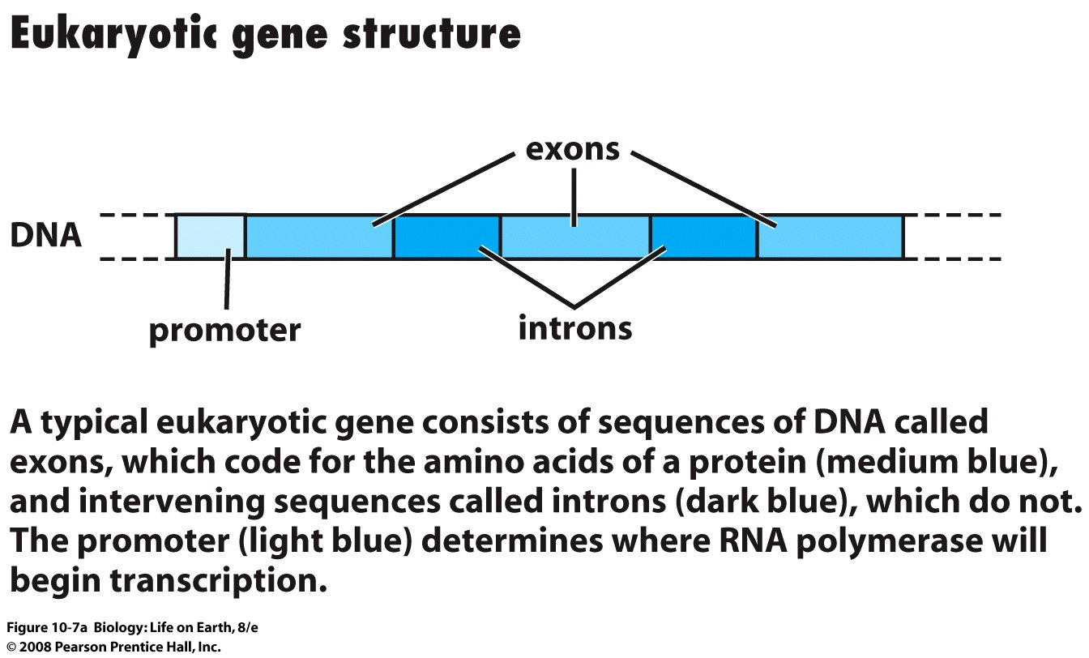
Split Genes
Notes:
FIGURE 10-7a Messenger RNA synthesis in eukaryotic cells

Slide 66
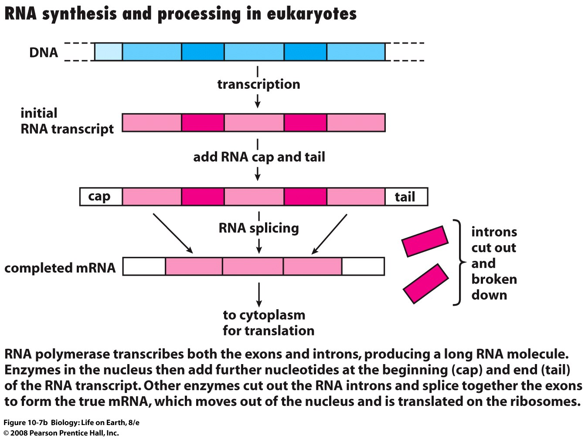
RNA Splicing
Notes:
FIGURE 10-7b Messenger RNA synthesis in eukaryotic cells

Slide 67
Protein synthesis in eukaryotes
  Transcription of a gene produces a very long RNA strand that contains introns and exons
  Enzymes in the nucleus cut out the introns and splice together the exons to make true mRNA
  mRNA exits the nucleus through a membrane pore and associates with a ribosome

Slide 68
Why split genes ?
Why are eukaryotic genes split up into exons and introns?
  Through “alternate” splicing, a cell can make multiple proteins from a single gene

Slide 69
Ribosomes
Ribosomes are large complexes of proteins and rRNA

Slide 70
Transfer RNAs
Transfer RNAs hook up to and bring amino acids to the ribosome
There is at least one type of tRNA assigned to carry each of the twenty different amino acids

Slide 71
Translation or Protein Synthesis
Ribosomes, tRNA, and mRNA cooperate in protein synthesis, which begins with initiation:
  The mRNA binds to the small ribosomal subunit
  2. The mRNA slides through the subunit until the first AUG (start codon) is exposed in the first tRNA binding site…
Notes:
Figure: 19-2 part a
Title:
Viral structure and replication part a
Caption:
(a) A cross section of the virus that causes AIDS. Inside, genetic material is surrounded by a protein coat and molecules of reverse transcriptase, an enzyme that catalyzes the transcription of DNA from the viral RNA template after the virus enters the host cell. This virus is among those that also have an outer envelope that is formed from the host cell's plasma membrane. Spikes made of glycoprotein (protein and carbohydrate) project from the envelope and help the virus attach to its host cell.

Slide 72
Translation or Protein Synthesis
  3. The first tRNA carrying methionine (and anticodon UAC) binds to the mRNA start codon completing the initiation complex
  4. The large ribosomal subunit joins the complex
Notes:
Figure: 19-2 part a
Title:
Viral structure and replication part a
Caption:
(a) A cross section of the virus that causes AIDS. Inside, genetic material is surrounded by a protein coat and molecules of reverse transcriptase, an enzyme that catalyzes the transcription of DNA from the viral RNA template after the virus enters the host cell. This virus is among those that also have an outer envelope that is formed from the host cell's plasma membrane. Spikes made of glycoprotein (protein and carbohydrate) project from the envelope and help the virus attach to its host cell.

Slide 73
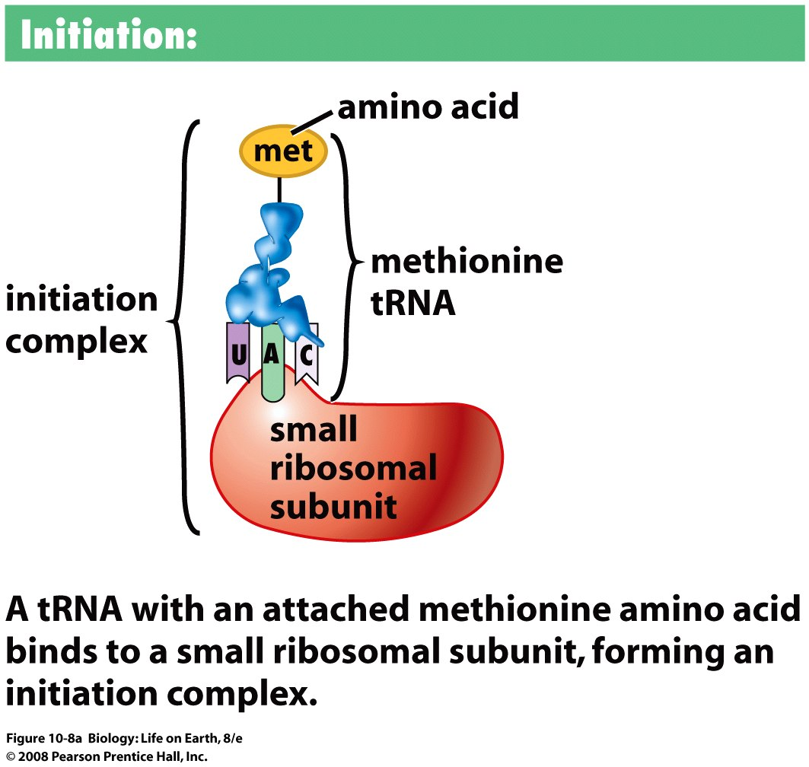
Protein Synthesis
Notes:
FIGURE 10-8a Translation is the process of protein synthesis
Protein synthesis, or translation, decodes the base sequence of an mRNA into the amino acid sequence of a protein.

Slide 74
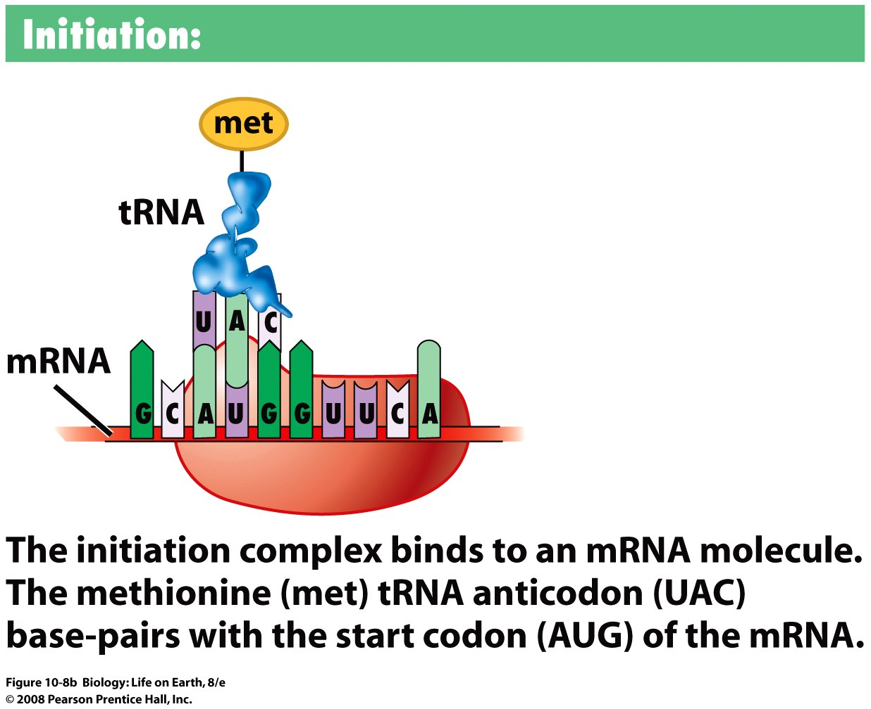
Protein Synthesis
Notes:
FIGURE 10-8b Translation is the process of protein synthesis
Protein synthesis, or translation, decodes the base sequence of an mRNA into the amino acid sequence of a protein.

Slide 75
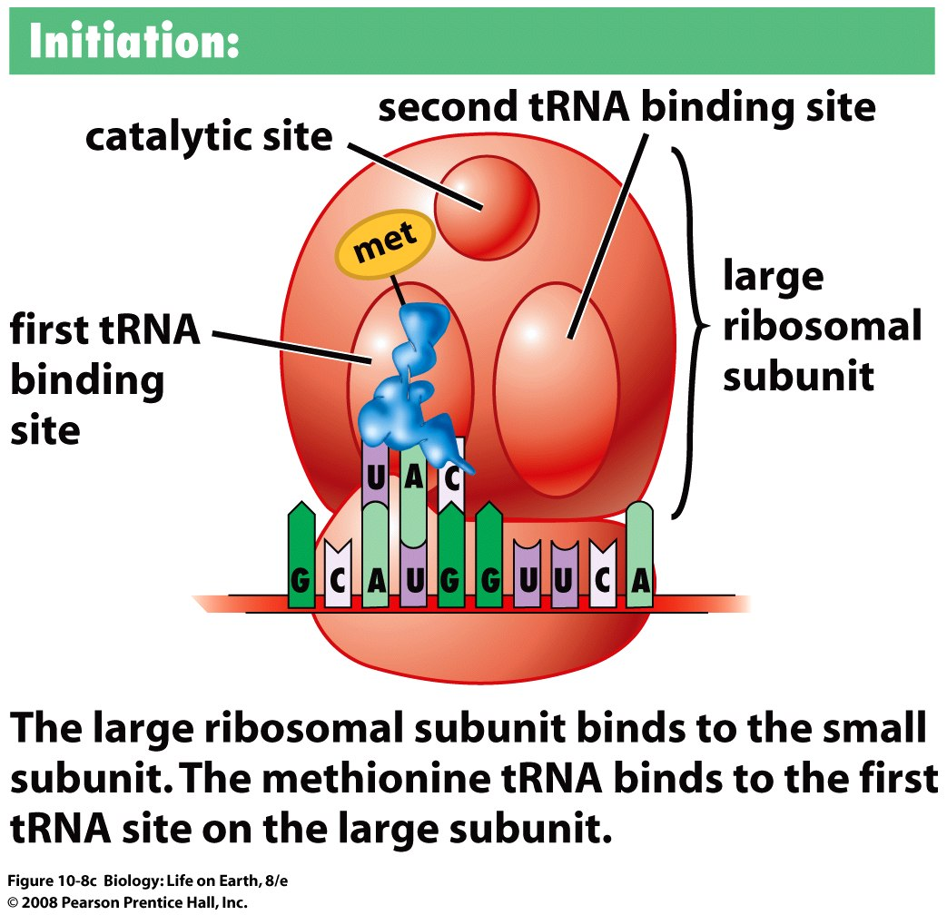
Protein Synthesis
Notes:
FIGURE 10-8c Translation is the process of protein synthesis
Protein synthesis, or translation, decodes the base sequence of an mRNA into the amino acid sequence of a protein.

Slide 76
Protein Synthesis
Middle phase of protein synthesis: Elongation
  A second tRNA binds to the second tRNA binding site adjacent to the first tRNA
  2. The anticodon of the second tRNA is complementary to the mRNA codon exposed in the second tRNA binding site…

Slide 77
Protein Synthesis
Middle phase of protein synthesis: Elongation
  A peptide bond forms between the methionine and second amino acid through the action of the ribosome catalytic site
  The first amino acid is released from the tRNA in the first tRNA binding site…

Slide 78
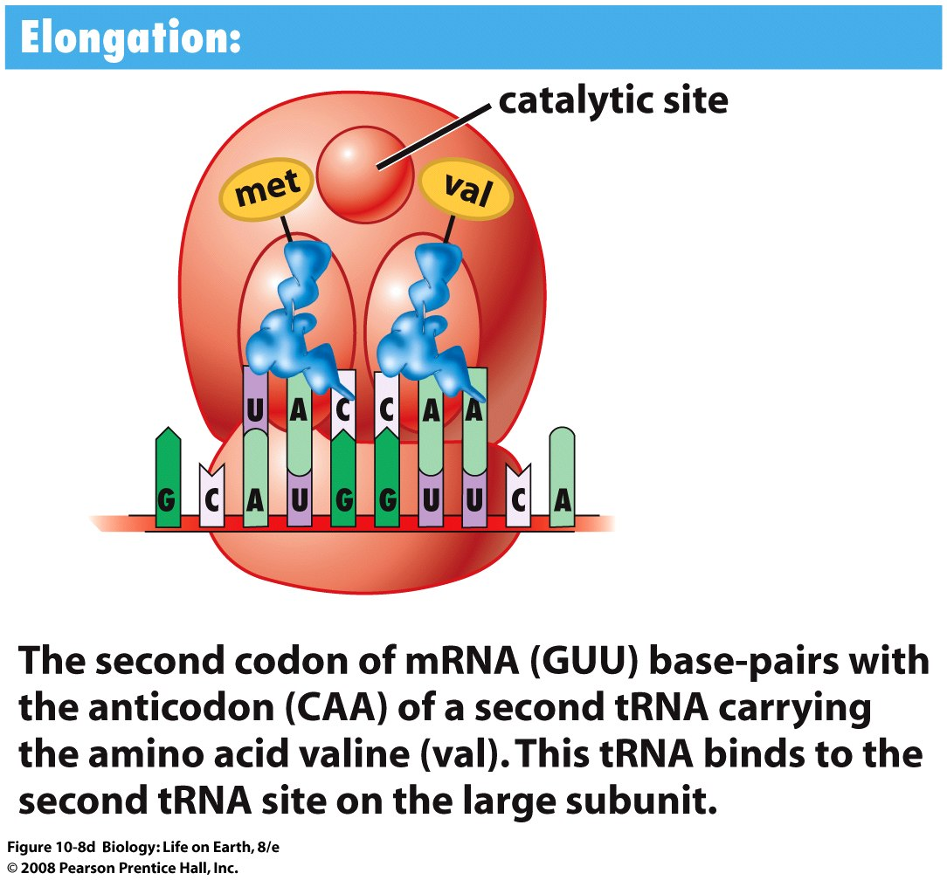
Protein Synthesis
Notes:
FIGURE 10-8d Translation is the process of protein synthesis
Protein synthesis, or translation, decodes the base sequence of an mRNA into the amino acid sequence of a protein.

Slide 79
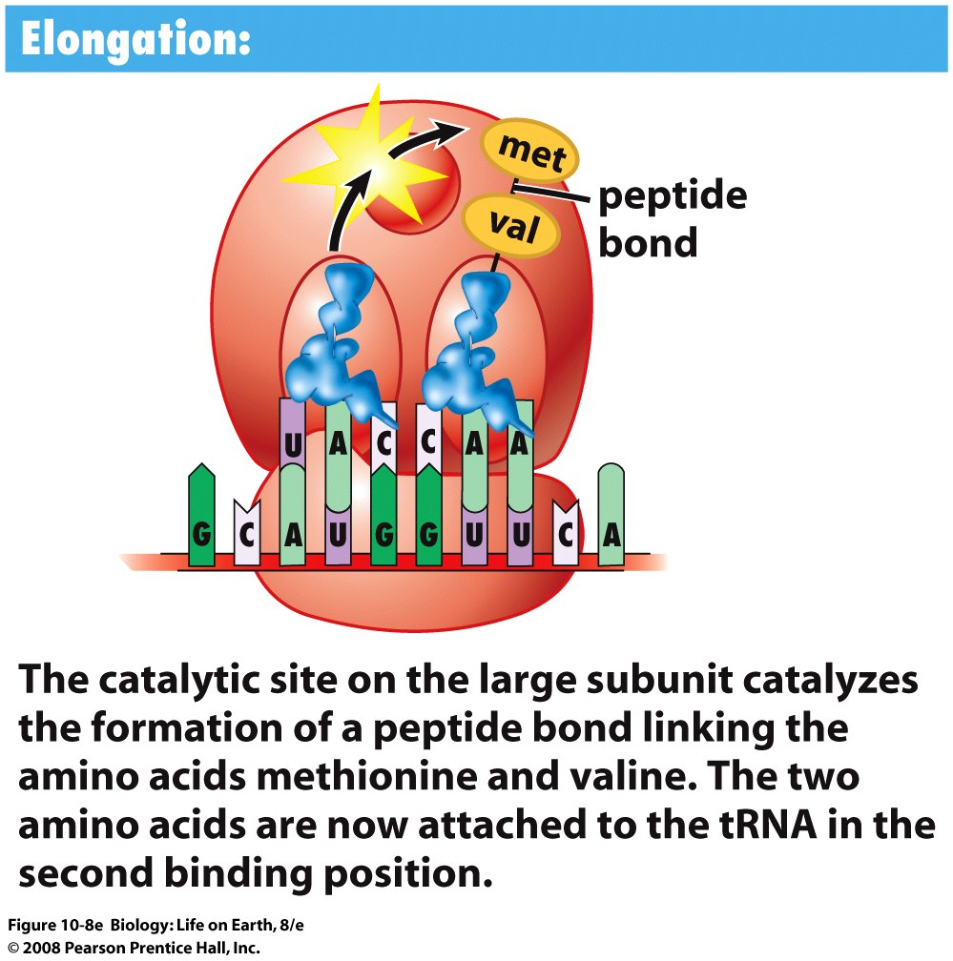
Protein Synthesis
Notes:
FIGURE 10-8e Translation is the process of protein synthesis
Protein synthesis, or translation, decodes the base sequence of an mRNA into the amino acid sequence of a protein.

Slide 80
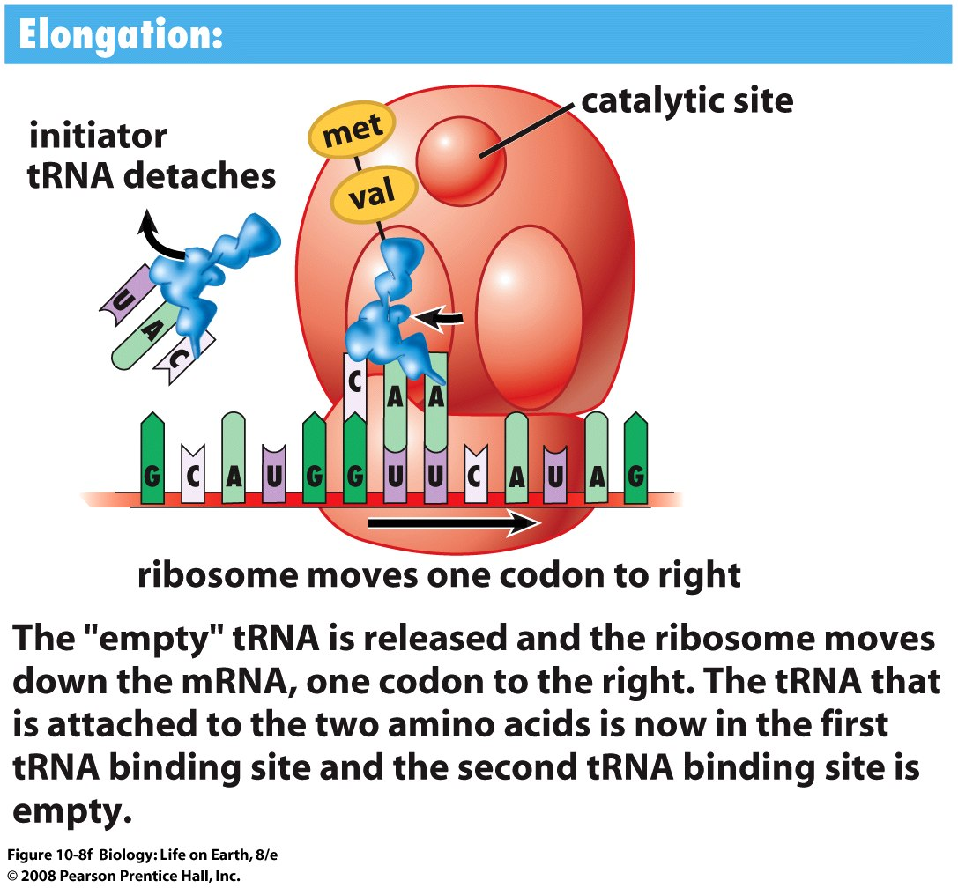
Protein Synthesis
Notes:
FIGURE 10-8f Translation is the process of protein synthesis
Protein synthesis, or translation, decodes the base sequence of an mRNA into the amino acid sequence of a protein.

Slide 81
Protein Synthesis
Middle phase of protein synthesis: Elongation
  The “empty” tRNA in the first binding site leaves the ribosome
  The ribosome moves down the mRNA by one codon, transferring the tRNA holding the amino acid chain to the first tRNA binding site…

Slide 82
Protein Synthesis
Middle phase of protein synthesis: Elongation
  A new tRNA with anticodon complementary to the newly exposed codon in the second tRNA binding site approaches and the whole elongation cycle repeats
  Empty tRNAs are reloaded with their appropriate amino acids by enzymes in the cytoplasm

Slide 83
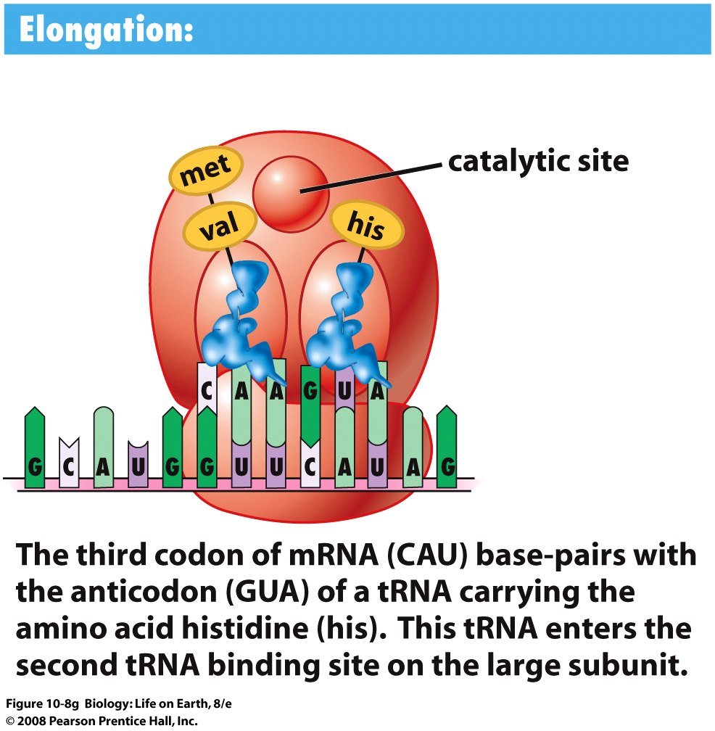
Protein Synthesis
Notes:
FIGURE 10-8g Translation is the process of protein synthesis
Protein synthesis, or translation, decodes the base sequence of an mRNA into the amino acid sequence of a protein.

Slide 84

Protein Synthesis
Notes:
FIGURE 10-8h Translation is the process of protein synthesis
Protein synthesis, or translation, decodes the base sequence of an mRNA into the amino acid sequence of a protein.

Slide 85
Protein Synthesis
End phase of protein synthesis: Termination
  A stop codon on the mRNA slides into the second tRNA binding site
  A special protein binds to the stop codon
  The ribosome breaks into separate subunits…

Slide 86
Protein Synthesis
End phase of protein synthesis: Termination
  The finished protein chain is released
  The mRNA is released and can be used to make another protein

Slide 87

Protein Synthesis
Notes:
FIGURE 10-8i Translation is the process of protein synthesis
Protein synthesis, or translation, decodes the base sequence of an mRNA into the amino acid sequence of a protein.

Slide 88

Protein Synthesis
Notes:
FIGURE 10-9 Complementary base pairing is critical to decode genetic information
(a) DNA contains two strands: the template strand is used by RNA polymerase to synthesize an RNA molecule. (b) Bases in the template strand of DNA are transcribed into a complementary mRNA. Codons are sequences of three bases that specify an amino acid or a stop during protein synthesis. (c) Unless it is a stop codon, each mRNA codon forms base pairs with the anticodon of a tRNA molecule that carries a specific amino acid. (d) The amino acids borne by the tRNAs are joined together to form a protein.

Slide 89

Mutations are the raw material for Evolution
0
Uncle Charles and “sports”
  Darwin never knew about genes and DNA
  He referred to the sudden changes in life forms as “sports”
    Solving DNA structure now reveals that changes are due to mutations
    A mutation codes for a new protein and thus a new structure and new function.
Notes:
In Asia, a significant percentage of men are related to Genghis Khan. In Ireland, a significant percentage of men are related to a fifth-century warlord.
The Lemba people in southern Africa are connected with the ancient Jews.
Teaching Tips
1. Like the Y chromosome, mitochondrial DNA (mtDNA) can be used to trace maternal ancestry (because mitochondria are characteristically inherited from the egg). For a fee, several commercial groups offer to provide information about a person’s ancestry based upon genetic samples. Such groups can be found by searching the Internet using the keywords “genetic ancestry.”

Slide 90

“We have discovered THE SECRET OF LIFE!”
- The words of Francis Crick
  DNA structure specifies
    STRUCTURE
    FUNCTION
    INFORMATION
Notes:
FIGURE 9-5 The Watson-Crick model of DNA structure
(a) Hydrogen bonding between complementary base pairs holds the two strands of DNA together. Three hydrogen bonds (red dotted lines) hold guanine to cytosine, and two hydrogen bonds hold adenine to thymine. Note that each strand has a free phosphate (yellow ball) on one end and a free sugar (blue pentagon) on the opposite end. Further, the two strands run in opposite directions. (b) Strands of DNA wind about each other in a double helix, like a twisted ladder, with the sugar-phosphate backbone forming the uprights and the complementary base pairs forming the rungs. (c) A space-filling model of DNA structure.

Slide 91
Next Lecture
Gene Expression

