Slide 1
Lecture 8
Hypothesis Testing: Population Mean: Part I

Slide 2
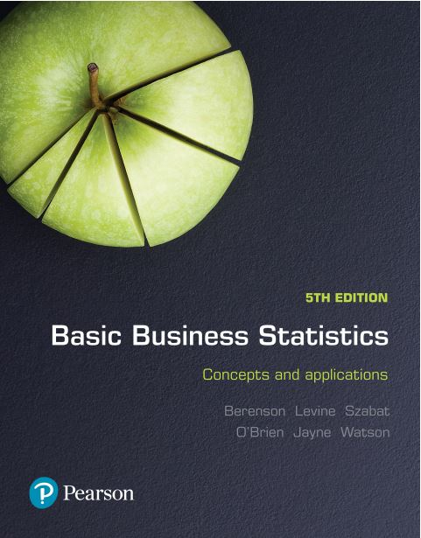
Basic Business Statistics
Concepts and Applications, 5th edition
Chapter 9
Fundamentals of hypothesis testing: One-sample tests
Copyright © 2019 Pearson Australia (a division of Pearson Australia Group Pty Ltd)
9781488617249 / Berenson / Basic Business Statistics, 5e

Slide 3
Basic Business Statistics
Concepts and Applications, 5th edition
Chapter 10
Hypothesis testing: Two-sample tests
Copyright © 2019 Pearson Australia (a division of Pearson Australia Group Pty Ltd)
9781488617249 / Berenson / Basic Business Statistics, 5e

Slide 4
Learning Objectives
After studying this chapter you should be able to:
Identify the basic principles of hypothesis testing
The mechanics of How to test a two tail hypothesis about the mean
Understand the Intuition underlying a hypothesis test
Briefly relate hypothesis testing to our earlier discussion of confidence intervals.
Testing difference in population means

Slide 5
What is a Hypothesis?
A hypothesis is a statement (assumption) about a population parameter, e.g. the population mean.
NOT the sample mean
The Null Hypothesis, H₀
States the belief or assumption in the current situation (status quo). For example the mean monthly mobile phone bill in Melbourne/Singapore H₀ is μ = $72.
Reject or not reject H₀
The Alternative Hypothesis, H₁
Is the opposite of the null hypothesis e.g. The mean monthly mobile phone bill for Melbourne/Singapore is not equal to $72 ( H₁: μ ≠ 72 )

Slide 6
Hypothesis Testing Process
Assumption: the
Mean monthly
Population
Mobile phone bill is $72.
(Null Hypothesis:
H₀: μ = 72 )
Now select a random sample
If not likely,
Suppose
the sample mean
bill is $69. Is that
likely if μ = 72 ?
Sample
REJECT
Null Hypothesis

Slide 7

Reason for Rejecting the Null Hypothesis- Recall the Empirical rule and the notion of distance
Sampling Distribution of $\overline{X}$ assuming
H₀ is true
X
69
μ = 72
If H₀ is true
...then we reject the null hypothesis that μ = 72
If it is unlikely that we would get a sample mean of this value…

Slide 8
The Level of Significance, α
α Defines rejection region of the sampling distribution
Typical values are 0.01, 0.05, or 0.10
Linked to 99%, 95% and 90% confidence levels
Level of significance =
α
Represents
critical value
H₀: μ = 72 H₁: μ ≠ 72
α
α
/2
/2
Rejection region is shaded
Two-tail test
0

Slide 9
Errors in Making Decisions
Type I error
Reject a true null hypothesis
Type II error
Fail to reject a false null hypothesis
The probability of Type I error is α
The level of significance of the test; i.e. 0.01, 0.05, 0.10
The probability of Type II error is β

Slide 10
Outcomes and Probabilities
Possible Hypothesis Test Outcomes
Actual Situation
Decision
H₀ True
H₀ False
Do Not
No error
(1- )
Type II Error
( β )
Reject
α
H
0
Reject
Type I Error
( )
No Error
( 1 - β )
H
α
0

Slide 11
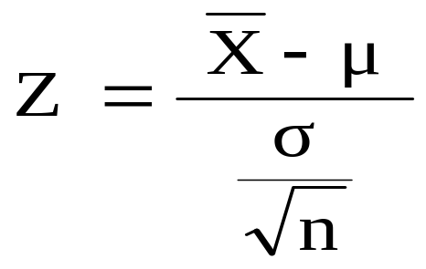

Z Test of Hypothesis for the Mean (σ Known)
Hypothesis
Tests for μ
σ Known
σ Known
σ Unknown
(Z test)
(t test)
The test statistic is:
Convert sample statistic to a Z test statistic

Slide 12
6 Steps in Hypothesis Testing
State the null hypothesis, H₀ and the alternative hypothesis, H₁
Choose the level of significance, α, and the sample size, n
Determine the appropriate test statistic and sampling distribution
Determine the critical values that divide the rejection and non-rejection regions
Collect data and calculate the value of the test statistic
Make the statistical decision and state the managerial conclusion
    if the test statistic falls into the non-rejection region, do not reject the null hypothesis H₀; if the test statistic falls into the rejection region, reject the null hypothesis
    express the managerial/analyst conclusion in the context of the real-world problem

Slide 13
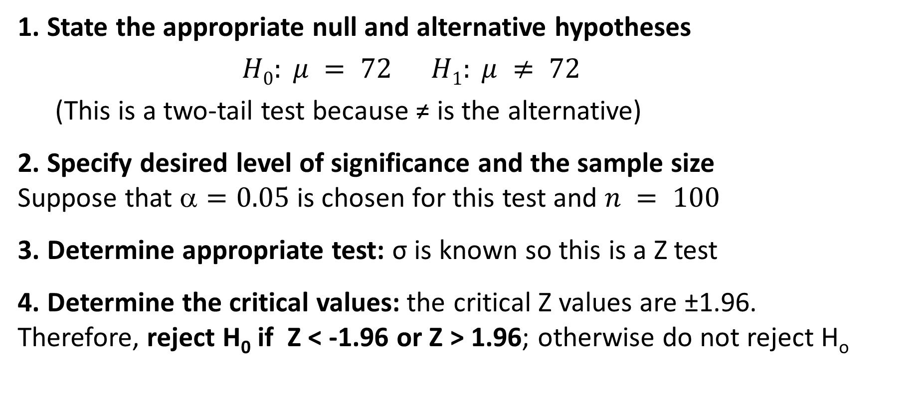
Hypothesis Test Example:
Test the assumption or status quo that the true mean mobile phone bill is equal to 72. Assume σ = 10
1. State the appropriate null and alternative hypotheses
$H0: μ = 72 H1: μ ≠ 72$
  (This is a two-tail test because ≠ is the alternative)
2. Specify desired level of significance and the sample size
Suppose that $=0.05$ is chosen for this test and $n = 100$
3. Determine appropriate test: σ is known so this is a Z test
4. Determine the critical values: the critical Z values are ±1.96.
Therefore, reject H₀ if Z < -1.96 or Z > 1.96; otherwise do not reject H_{o}

Slide 14

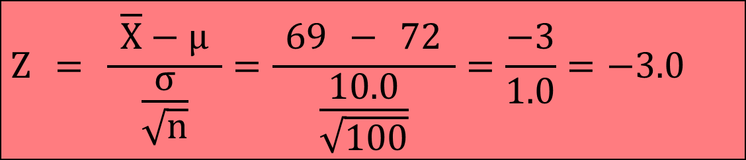
Hypothesis Test Example (continued)
5. Collect the data and calculate the test statistic
Suppose the sample results are:
  n = 100, = 69 (σ = 10.0 is assumed known)
  So the test statistic is:
$$Z = \frac{ \overline{X}−μ }{\frac{σ}{\sqrt{n}}}=\frac{ \text{69} − 72 }{\frac{\text{10.0}}{\sqrt{\text{100}}}}=\frac{−\text{3}}{\text{1.0}}=−\text{3}\text{.0 }$$

Slide 15
Hypothesis Test Example (continued)
6. Is the test statistic (Z=-3.0) in the rejection region?
α / 2 = 0.025
Do not reject H₀
α / 2 = 0.025
Reject H₀
Reject H₀
-Z= -1.96
0
+Z= +1.96
Here, Z = -3.0 < -1.96, so the test statistic is in the rejection region. Therefore, we reject the null hypothesis at the 5% level and conclude that there is sufficient evidence that the mean Melbourne/Singaporean phone bill is not equal to $72.

Slide 16
Alternative to critical value method of carrying out a hypothesis test is the P value approach
p-value: is the probability of obtaining a test statistic more extreme ( ≤ or ≥) than the observed sample value, given H₀ is true
Also called observed level of significance
It is the smallest value of α for which H₀ can be rejected
Obtain the p-value from Table E.2
If p-value < α , reject H₀
If p-value ≥ α , do not reject H₀
The KEY difference between the approaches is with the critical value method we choose the level of significance e.g. 5% and determine whether to reject H0 or not. With the p-value approach it tells us the precise level of significance at which we can reject

Slide 17

P-value example:
How likely is it to see a sample mean of 69 (or something further from the mean, in either direction) if the true mean is μ = 72?
$\overline{X}$= 69 is translated to a Z score of Z = -3.0
$$P(Z<−\text{3}\text{.0})=\text{0.0}\text{013} \\ P(Z>\text{3}\text{.0})=\text{0.0}\text{013}$$
p-value = 0.0013 + 0.0013 = 0.0026
Since 0.0026 < 0.05, we reject the null hypothesis
α/2 = 0.025
α/2 = 0.025
0.0013
0.0013
-1.96
0
1.96
Z
-3.0
3.0

Slide 18
Connection of a hypothesis test to
Confidence Intervals
For $\overline{X}$ = 69, σ = 10 and n = 100, derive the 95% confidence interval:
$\text{69 –(1.96)∗(10/}$√100) to $\text{69 }\text{+}\text{(1.96)∗(10/}$√100)
= 67.04 ≤ µ ≤ 70.96
This interval does not contain the hypothesized mean (72), so we reject the null hypothesis at α = 0.05

Slide 19
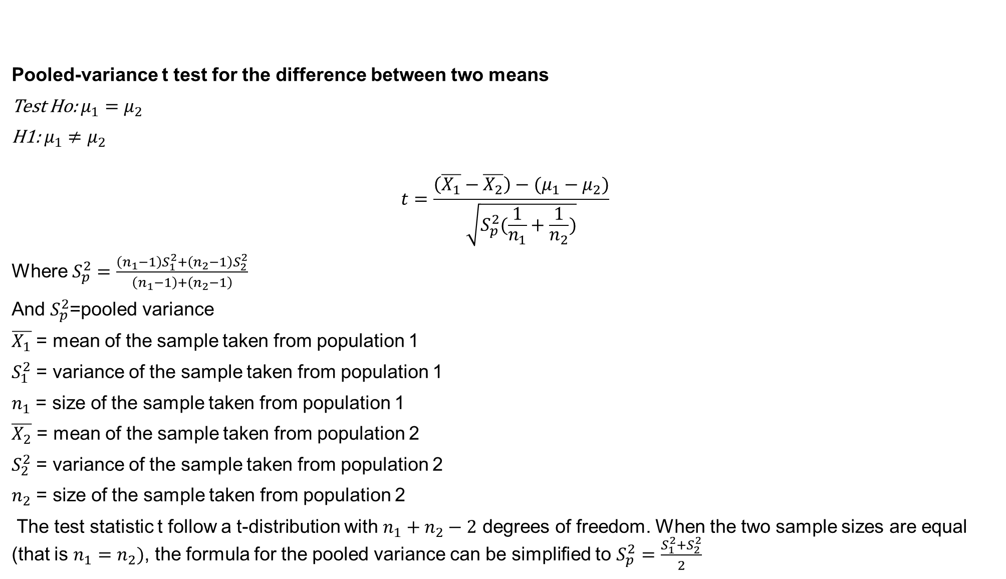
Pooled-variance t test for the difference between two means
Test Ho: $μ_{1}=μ_{2}$
H1: $μ_{1}≠μ_{2}$
$$t=\frac{\left(\overline{X_{1}}−\overline{X_{2}}\right)−(μ_{1}−μ_{2})}{\sqrt{S_{p}^{2}(\frac{1}{n_{1}}+\frac{1}{n_{2}})}}$$
Where $S_{p}^{2}=\frac{\left(n_{1}−1\right)S_{1}^{2}+\left(n_{2}−1\right)S_{2}^{2}}{\left(n_{1}−1\right)+\left(n_{2}−1\right)}$
And $S_{p}^{2}$=pooled variance
$\overline{X_{1}}$ = mean of the sample taken from population 1
$S_{1}^{2}$ = variance of the sample taken from population 1
$n_{1}$ = size of the sample taken from population 1
$\overline{X_{2}}$ = mean of the sample taken from population 2
$S_{2}^{2}$ = variance of the sample taken from population 2
$n_{2}$ = size of the sample taken from population 2
The test statistic t follow a t-distribution with $n_{1}+n_{2}−2$ degrees of freedom. When the two sample sizes are equal (that is $n_{1}=n_{2})$, the formula for the pooled variance can be simplified to $S_{p}^{2}=\frac{S_{1}^{2}+S_{2}^{2}}{2}$

Slide 20

Consider data on the number of hours spent studying per week as reported by students in a class survey. Students who say they usually sit in the front are compared to students who say they usually sit in the back. Consider the following summary statistics for the sample:
Consider groups 1 and 2 are front sitters and back sitters, respectively.

Slide 21
