Slide 1
HR 173 Power in Organizations WORKSHOP 5 PART A
Dr Stephanos Avakian

Slide 2
Introduction
Introduce the study of power and its relevance to organizations
Understand how power emerges in the organizational setting
Appreciate the role as well as pitfalls of power use

Slide 3
Power
The art of exerting and maintaining control and influence over an individual or a group

Slide 4
Definition
“Power the capacity of individuals to overcome resistance on the part of others, to exert their will, and to produce results consistent with their own interests and objectives.”
Buchanan, David A., and Andrzej A. Huczynski. Organizational Behaviour, Pearson Education, Limited, 2015. p.760

Slide 5
Influence
Influence on behaviour
If behaviour does not change then power is not exerted or not exerted effectively.
Duration of change on behaviour

Slide 6
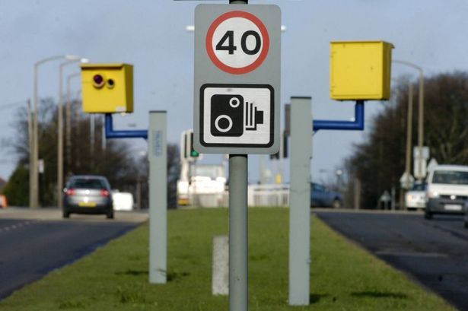
Does someone change their driving behaviour after receiving a speed ticket?

Slide 7
COGNITIVE
Thoughts
EMOTIONAL
Feelings
POWER

Slide 8

If you do not behave yourself you will not………
CONDITION
OUTCOME

Slide 9
Informal authority
The role of Language!
The generation of key impressions onto another person with intention of leaving a lasting impression.
You are influenced to buy something without being fully aware that you made that decision!

Slide 10
John French and Bertram Raven (1958) identified five bases of power
Reward
Coercive
Referent
Legitimate
Expert

Slide 11
Reward power
The ability to exert influence based on the other’s belief that the influencer has access to valued rewards which will be dispensed in return for compliance.

Slide 12
Coercive power
The ability to exert influence based on the other’s belief that the influencer can administer unwelcome penalties or sanctions

Slide 13
Referent power
The ability to exert influence based on the other’s belief that the influencer has desirable abilities and personality traits that can and should be copied.

Slide 14
Legitimate power
The ability to exert influence based on the other’s belief that the influencer has authority to issue orders which they in turn have an obligation to accept

Slide 15
Expert power
The ability to exert influence based on the other’s belief that the influencer has superior knowledge relevant to the situation and the task.

Slide 16
Task: Read chapter 10 pages 764-765
“Stephen Lukes (2005) argues that power may be visible and self-evident, or subtle and covert, or institutionalized, as we have seen, in organizational structures. Power, for Lukes, thus has three faces:
1. Visible power that is exercised to secure a decision in situations where there is observable conflict or disagreement.
2. Covert power that is exercised to keep issues off the decision-making agenda, so that potential conflicts or disagreements are avoided, and are therefore unobservable.
3. Institutional power, which defines reality and what is ‘normal’ for others, – if norms and meanings become internalized by an organization’s members, they will then act in accordance with those norms, even if these work against their interests.”

Slide 17
Activity
Create a situation where the occurrence of a particular event illustrates each of the following types of power in some detail.
1. Visible power
2. Covert power
3. Institutional power

Slide 18
Power and duration
The internalisation of power concerns the extent to which the person interprets and accepts the condition and outcome
The importance of interpretation and power

Slide 19
The role of media
The reinforcement of key ideas that sustain key relationships between ‘causes’ and ‘outcomes’
The lack of self-interpretation and critical thinking. Taking this at face value.

Slide 20
Power in Society
If we do not have a strong leader to negotiate against the European partners then we will not get a good deal!
If the UK exists from the EU then…………………

