Slide 1
HR 173 Power in Organizations WORKSHOP 5 PART B

Slide 2
Political Tactics Read Buchanan, and Huczynski. 2015p.754
Image building We all know people who didn’t get the job because they didn’t look the part – appearance is a credibility issue; support for the right causes, adherence to group norms, self-confident manner
Information games Withholding information, bending the truth, white lies, timed release of information, overwhelming others with complex technical details
Structure games Creating new roles, teams, and departments, abolishing old ones, in order to promote supporters and sideline adversaries, and to signal new priorities
Scapegoating Ensuring that someone else is blamed, that this is the fault of another department, or external factors, or my predecessor, or trading conditions, or a particular individual; avoiding personal blame

Slide 3
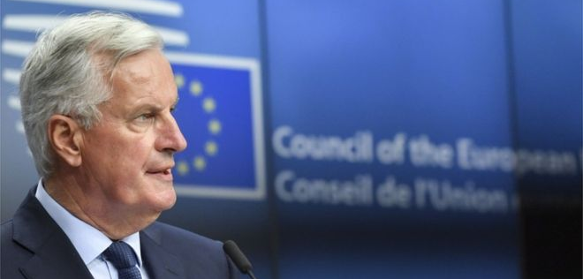

Slide 4
BBC 20 July 2018
Michel Barnier questions Theresa May's Brexit White Paper
"We are not going to negotiate on the basis of the White Paper because that's the British paper but we could use many elements of the White Paper," said Mr Barnier.
"There's not an awful lot of justification for the EU running the risk of weakening the single market.
"That is our main asset. There's no justification for us to create additional burdens on business just because the UK wants to leave."

Slide 5
Alliances Doing secret deals with influential others to form a critical mass, a coalition, to win support for and to progress your proposals
Networking Friends in high places, ‘wine and dine’ them to get your initiatives onto the senior management agenda, improve your visibility, gather information
Compromise Give in, all right, you win this time, I won’t put up a fight and embarrass you in public – if you will back me next time

Slide 6
Rule games Refuse requests because they have not followed correct procedures or are contrary to company policy; accept similar requests from allies on the grounds of ‘special circumstances’
Positioning Choose and move to roles that make you visible and appear successful; withdraw from failing projects; locate yourself appropriately in the building, sit in the ‘right’ place at meetings
Issue selling Package, present, and promote your plans and ideas in ways that make them more appealing to your target audiences
Dirty tricks Keep dirt files for blackmail, spy on others, discredit and undermine competitors, spreading false rumours, corridor whispers

Slide 7
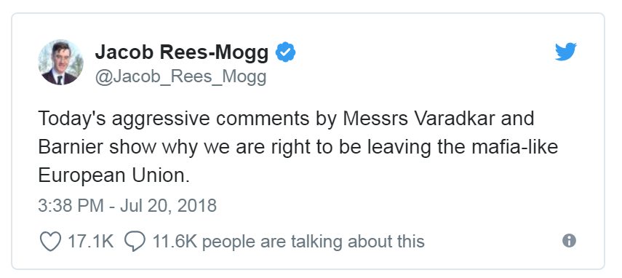

Slide 8
Different levels of power
Individual
Concentration on the individual’s thinking and behaviour
Group
Interests held between members
Organization
Power exerted across different groups

Slide 9
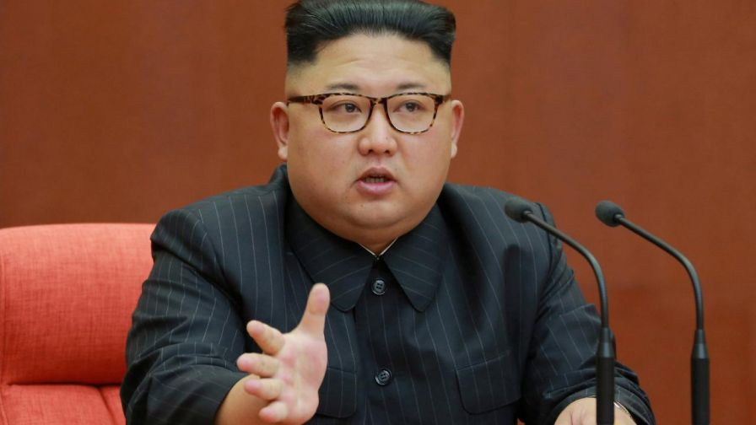
Power and Fear

Slide 10
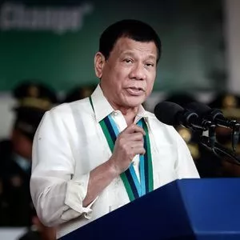
How to deal with drug dealers
https://www.youtube.com/watch?v=IoVKjhu7mfk

Slide 11
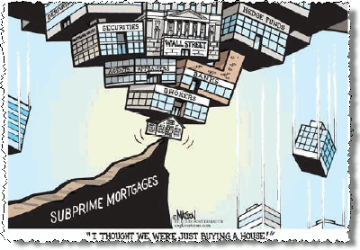
Global Financial Meltdown
https://www.youtube.com/watch?v=VQzEWeGJLP0&t=4175s

Slide 12
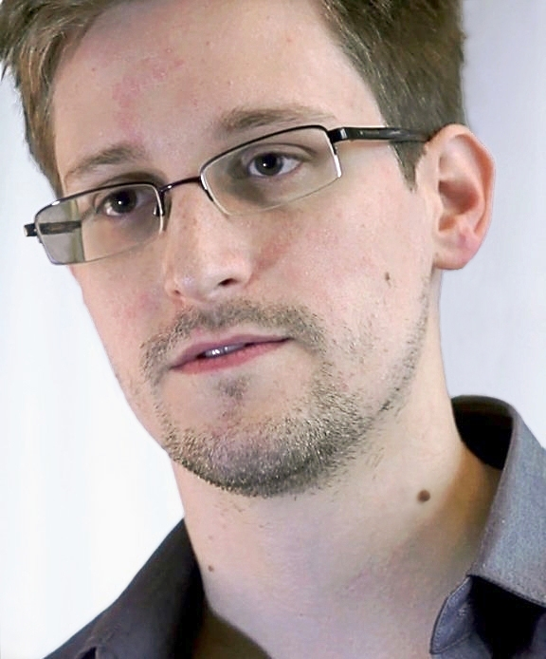
Power and Interests
Edward Snowden
What is ethical?
What power does government have to determine what is what is ‘ethical’ or ‘unethical’?
https://www.youtube.com/watch?v=0hLjuVyIIrs

Slide 13
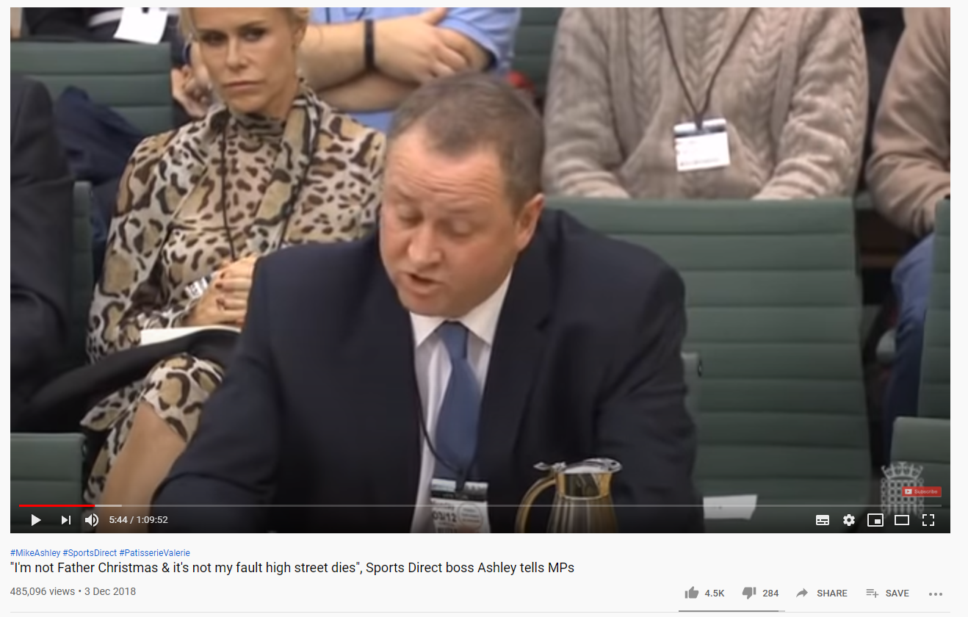
3 Questions for discussion
Having watched the first 15 minutes of the video discuss what seems to be the prominent issue between Mike Ashley and the Members of Parliament? How is power exerted in the relationship between the members of Parliament and Mike Ashley, Mike Ashley and employees and employees How can we describe the categories of power shown in the video and covered in the content of this session?

Slide 14
Summary
Effective leadership always depends on language for negotiating interests.
Language is not about articulating about what something happens but how we want something to be presented.
Change and leadership are never straightforward processes but are constantly challenged and re-defined according to the interests of the involved parties.

