Slide 1
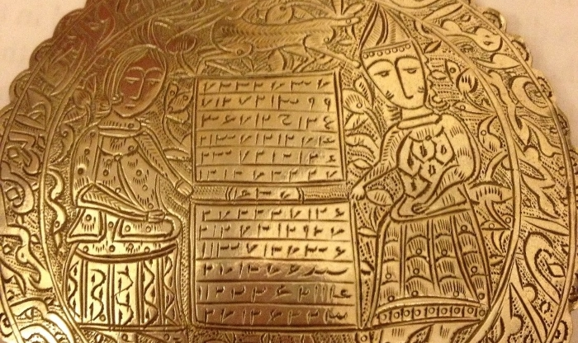
Linguistics
The History of Arabic Language

Slide 2
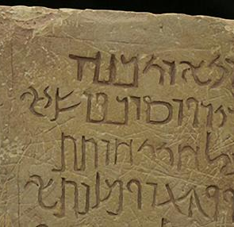
Why the history of Arabic Language?
One of the most spoken languages in the world
Since its introduction, it has greatly developed as a language
The various aspects that have influenced its development
The interaction of the Arabic language with other languages.
Notes:
The Arabic language is one of the most spoken languages around the world, more so by the Arabic countries (Belinkov et al., 2018). Additionally, it is ranked globally as number six of the most common languages spoken by over 200 million people. Since it was introduced to the world, it has evolved to become the language used today. Besides, it is also associated with many aspects for example religion. Due to the fact that over the years it has interacted with many other languages, its structure and originality was influenced before its standardization.

Slide 3
History of Arabic Language
The Arabic language originated from Afro-Asiatic languages
The spread of the language was facilitated by the death of Prophet Muhammad
It was mostly associated with the Islamic religion
The interaction between Arabic speakers and other communities resulted to a variety of dialects all under the Arabic language.
Notes:
The Arabic language was a descendant of the Afro-Asiatic languages including the Hebrew language. However, the language came from a more specific language group known as the South-west Semitic language group, which was from the Semitic languages group, one of the Afro-Asiatic languages (Belinkov et al., 2018). The Arabic language was greatly associated with the Islamic religion; therefore, it became worldly known after the death of Prophet Muhammad. Additionally, since the Arabs were well known traders, this led to the interaction of the Arabic language and other languages which resulted to the development of different dialects.

Slide 4
Development of the Arabic Language
Arabic language pre-Islam and post-Islam religion
The Arabic language existed before the Islamic religion in the 4th century
It become globally known after the death of Prophet Muhammad
The believers of Prophet Muhammad, Muslims, started migrating spreading both the language and the Islamic religion.
It led to the writing of the Quran, the Muslim holy book.
Notes:
The existence of the Arabic language dates back in the 4th century due to poems and scrolls evident found in the Syria Desert where some Arabs lived. However, after the death of Prophet Muhammad, it become worldly known (Siddiqui, Monem & Shaalan, 2016). Due to the migration of Muslims, the spread of the Islamic religion and the Arabic language was initiated. During this period, the writing of the Quran was initiated in the middle of the growing number of dialects of the Arabic language.

Slide 5
The dialects of the Arabic language
Resulted from the continued interactions between Arabic speakers and other communities.
Factors such as religion and culture led to the development of different dialects
The teaching of the Arabic language in the West also contributed to the different dialects
The Arabic language still maintained its originality among the Semitic languages
Notes:
After the death of Prophet Muhammad, the interactions between the Arabs and other languages began. In their mission to spread the Islamic language, they interacted with other communities who learnt the language and developed the different dialects (Versteegh, 2014). More so, since the Arabic speakers were known for their trading skills, their endeavors also contributed to the spread and development of the different dialects. However, amid all these influences, the Arabic language still maintained its originality.

Slide 6
The standardization of the Arabic language
Resulted from the need to maintain the originality of the Arabic language
The language used for the standardization was vetted based on various conditions for example the language used was from a prestigious community, Mecca.
The scholars who carried out the standardization felt the need to preserve the beauty of the language.
The Quran was used as the reference of the original Arabic language
Notes:
During the time of the standardization of the Arabic language, many dialects were emerging from all areas due to the increased interaction of the Arabs and other communities (Alanazi, 2019). Therefore, scholars felt the need to preserve the language and its beauty. As a result, one language was identified to be used to correct the other dialects. The scholar used the dialect that was used in the writing of the Quran, which belonged to Prophet Muhammad’s community found in Mecca.

Slide 7
Diglossia aspect of the Arabic Language
Defined as the existence of two dialects of the same language used for different scenarios by the speakers
The development of the different dialects resulted to diaglossia of the Arabic language, that is classical Arabic, standard Arabic, and colloquial Arabic
Classical Arabic is referred to as the formal language since it was used in the writing of the Quran
Standard Arabic is mainly used for speaking and writing
Colloquial Arabic is mainly used for speech like a slang.
Notes:
Diaglossia, according to Al-Sobh, Abu-Melhim, & Bani-Hani (2015), is defined as the existence of two distinct languages under the same language used for different scenarios. In this case, there are three distinct dialects under the Arabic language. Classical Arabic is one of the three dialects, and it is considered to be formal in the context that it was used in the writing of the Quran. The standard Arabic is also under the Arabic language; however, it is used for speech and the writing of articles and books. Lastly, there is the colloquial Arabic which is mainly used for speech.

Slide 8
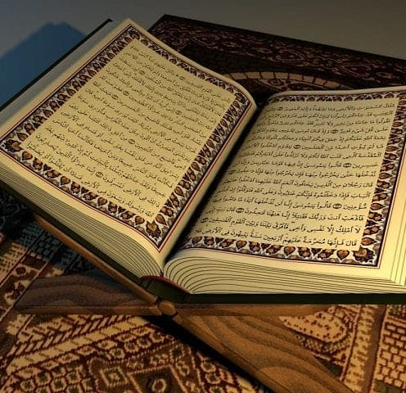
Position of the classical Arabic
It is important to the Islamic religion
It is taught to all Muslim believers as they learn the Quran
It holds the originality of the Arabic language
It also holds the cultural aspect of Arabs
Notes:
The classical Arabic language was used in the writing of Quran, the holy book in the Islamic religion. Therefore, it is considered important to the Islamic religion (Al-Huri, 2015). Thus, every Muslim is taught the classical Arabic for that is what is used in reading the holy book. Additionally, it is considered to be the original Arabic language, therefore, it holds the originality of the language. Due to its considered beauty, it helps preserve the Arabic culture.

Slide 9
Position of the Standard Arabic
Mainly used for speech and writing
In some cases, it is used together with colloquial Arabic for speech
Most common for it has over 250 million speakers
It is learnt in schools by those who used it as a second language
Notes:
Standard Arabic is mainly used for speech and writing, especially in schools where people learn it as a second language (Al-Sobh, Abu-Melhim, & Bani-Hani, 2015). It is mostly used together with colloquial Arabic in speech. Additionally, it is most common all over the world with over 250 million speakers especially in various countries, where it is used as a first language. Example of these countries includes Qatar, Tunisia, and Syria among others.

Slide 10
Importance of the Arabic language
It connects all Muslims around the world
It preserves the Arabic language
It also describes the culture of the Arabs
It is used in matters related to the Islamic religion
Notes:
Since inception of the Arabic language, it is perceived to be important to both the Islamic religion and the Arabs themselves (Al-Huri, 2015). One of the major reasons why it is considered important is because it is used in the Islamic religion which connects all Muslims around the world. Additionally, it also helps preserve the Arabic culture through the poetry written in Arabic language.

Slide 11
Challenges of the Arabic language
The emergence of new dialects
The inability of the Arabic language to incorporate learning of scientific lessons
The adoption of the English language
The Arabic language is mainly associated with criminal activities
Notes:
The Arabic language has faced many challenges over time despite the fact that it is important (Al-Qahtani & Al Zumor, 2016). One of the major challenges is the continued emergence of new dialects which pose a threat to the language. Additionally, since the Arabic language was originally used in teaching and learning in the education system in most Arabic countries, it failed to incorporate some of the sciences lessons. As a result, this led to the integration of English in the learning system, which affected the existence of the Arabic language. Additionally, the Arabic language is associated with criminal activities such as bombing and terrorists’ attacks.

Slide 12
References
Alanazi, M. S. (2019). THE USE OF COMPUTER-ASSISTED TRANSLATION TOOLS FOR ARABIC TRANSLATION: USER EVALUATION, ISSUES, AND IMPROVEMENTS (Doctoral dissertation, Kent State University).
Al-Huri, I. (2015). Arabic language: Historic and sociolinguistic characteristics. English Literature and Language Review, 1(4), 28-36.
Al-Sobh, M. A., Abu-Melhim, A. R. H., & Bani-Hani, N. A. (2015). Diglossia as a result of language variation in Arabic: Possible solutions in light of language planning. Journal of Language Teaching and Research, 6(2), 274-279.

Slide 13
References Cont…
Al-Qahtani, Z., & Al Zumor, A. W. (2016). Saudi parents’ attitudes towards using English as a medium of instruction in private primary schools. International Journal of Applied Linguistics and English Literature, 5(1), 18-32
Belinkov, Y., Magidow, A., Barrón-Cedeño, A., Shmidman, A., & Romanov, M. (2018). Studying the History of the Arabic Language: Language Technology and a Large-Scale Historical Corpus. arXiv preprint arXiv:1809.03891.
Siddiqui, S., Monem, A. A., & Shaalan, K. (2016, June). Sentiment analysis in Arabic. In International Conference on Applications of Natural Language to Information Systems (pp. 409-414). Springer, Cham.
Versteegh, K. (2014). Arabic language. Edinburgh University Press.

